Slide 1
Generative Enrichment Analysis
Ali Rahjouei. Dr. rer. nat.

Slide 2
Data
Factual information (such as measurements or statistics) used as a basis for reasoning, discussion, or calculation

Slide 3
Information
knowledge obtained from investigation, study, instruction, intelligence, news, facts or data

Slide 4
Wisdom
ability to discern inner qualities and relationships : INSIGHT
good sense : JUDGMENT
accumulated philosophical or scientific learning : KNOWLEDGE

Slide 5






Data → Information → Wisdom

Slide 6
High throughput methods in modern research

Slide 7


Transforming Gene Lists into Valuable Information
They are not updated.
They are not precise.
Type of correlation is not clear.
Different conditions
List of hits or candidates
Gene enrichment analysis
Pathway enrichment analysis
Finding interactors from databases
============================
Searching literatures
Data from genome wide screening or any high throughput methods
Analysis
Time consuming
Error prone
Dependent on domain expertise
Hard to perform on a long list

Slide 8
Idea: embedding latest information into data to turn it to wisdom
Today we accumulated a lot information about biological system and the molecular mechanism behind the chemical reactions that makes life possible in its complex form. This information are exponentially growing and database responsible for gathering these data in many different forms can not catch up with increase of information. Additionally, in many cases relationships demonstrated in these databases are lacking directionality in term of cause and effects plus in term of positive or negative effects. Furthermore, they are lacking the context that these interaction happens. All together, these weaknesses make it very difficult to use these databases for the interpretation of data that coming from high throughput studies.

Slide 9


Idea: embedding latest information into data to turn it to wisdom
To overcome this challenges, I developed a platform that is able to gather updated information from Pubmed and Arxiv and embedding this information with the hit list from high throughput experiments and turning it to wisdom that can be used for many different purposes or even discovering new pathways.
Pubmed
Arxiv
API

Slide 10
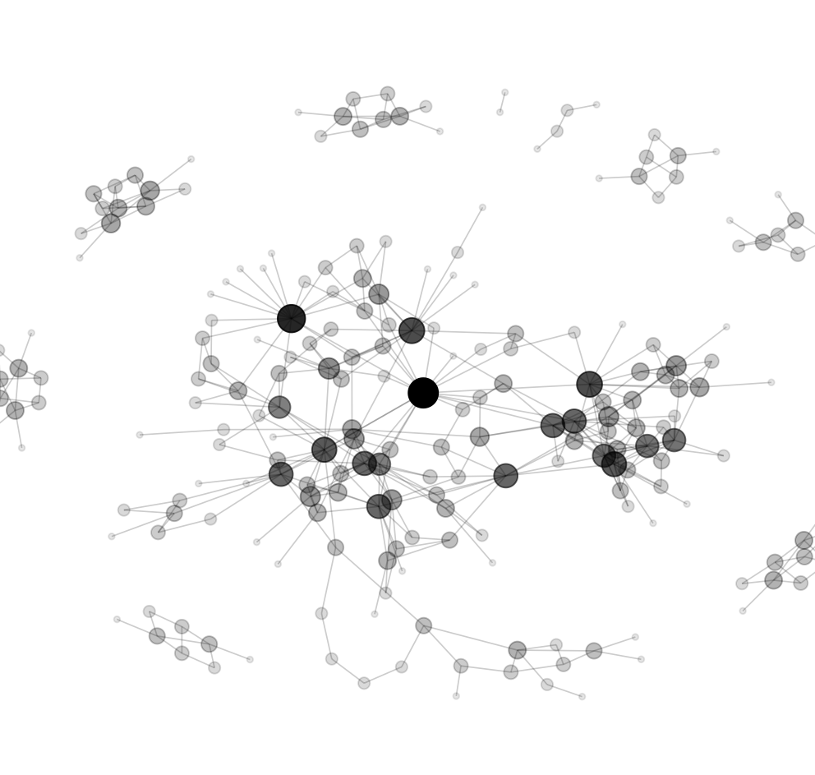
Different conditions
Correlation network
Based on correlation
Storing them in list
Cas9 genome wide screening with Cas9
library
Analysis
Pairing genes

Slide 11



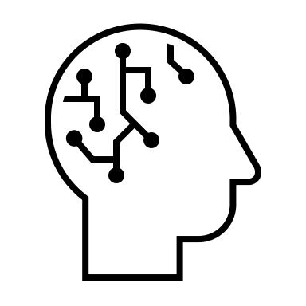
Load Data
Take gene and connect to Pubmed with API
Parsing extracted Data
Sending Data to local database
SQLite database
ID ----------
Gene ----------
Title ----------
Abstract ----------
Authors ----------
Keywords ----------
Year ----------
LLM sum. ----------
Cleaned sum. ----------
Pre-prompt
Abstract to correlational summary
Marcoroni-7B-v3-GGUF
Q5 quantization
Take abstract, send it to LLM
Take the summary and clean up the summary from LLM
Take back the response

Slide 12
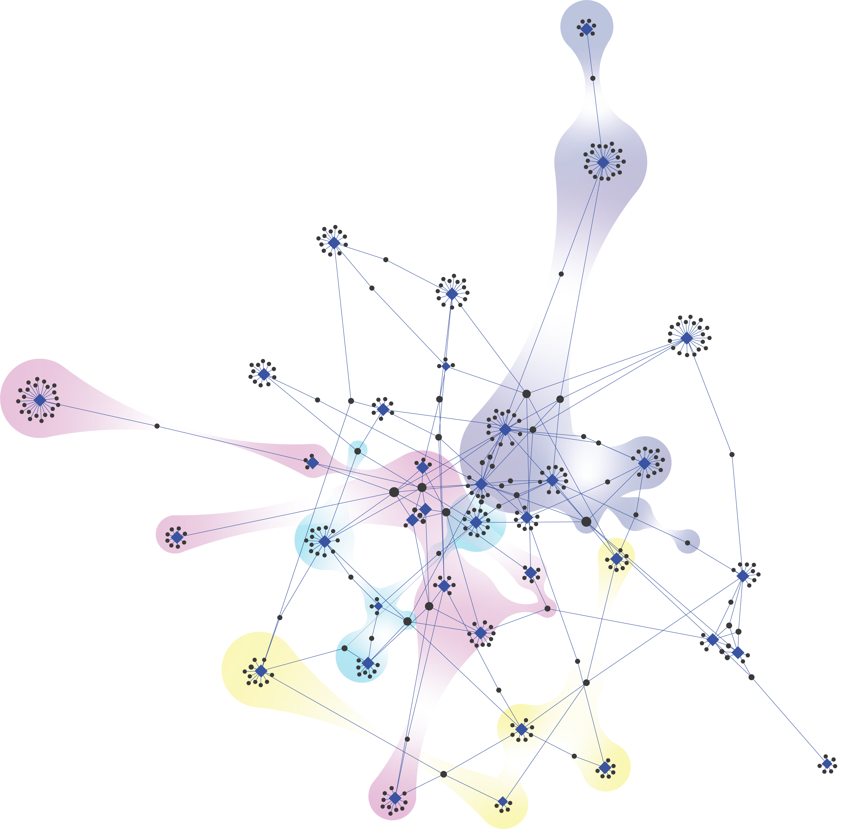

SQLite database
ID ----------
Gene ----------
Title ----------
Abstract ----------
Authors ----------
Keywords ----------
Year ----------
LLM sum. ----------
Cleaned sum. ----------
Identifying gene function or mechanism of action
Analysis
Constructing knowledge graph
Knowledge graph

