Slide 1

GeoData Collection Process
By Atikur Rahman

Slide 2
Introduction
KoboToolbox is a free & open source suite of tools for field data collection for use in challenging environments.
Powerful and intuitive data collection tools to make an impact.
High quality data collection for everyone

Slide 3


















Global reach, local impact
20 million + 241 14,000+
Surveys collected per month Countries & territories Organizations

Slide 4

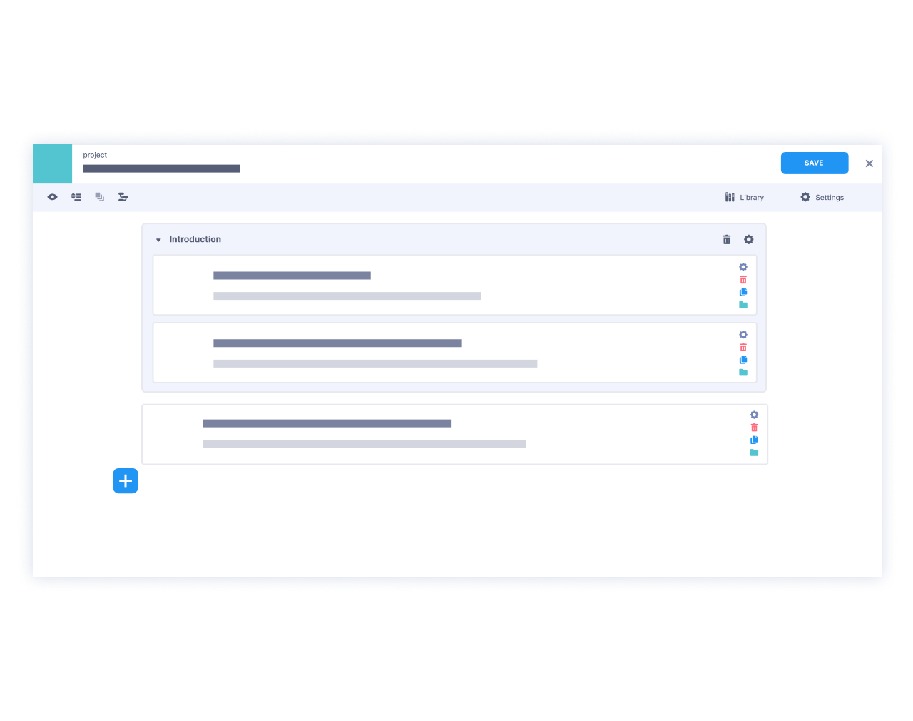
What KoboToolbox can do
Powerful form development
Quickly build questionnaires with our intuitive tools
Choose from 25 quantitative and qualitative question types
Edit forms in Excel for complex needs with the XLSForm standard
Use skip logic and validation for high data quality
Translate forms into multiple languages
Create custom form templates or use questions from our library

Slide 5
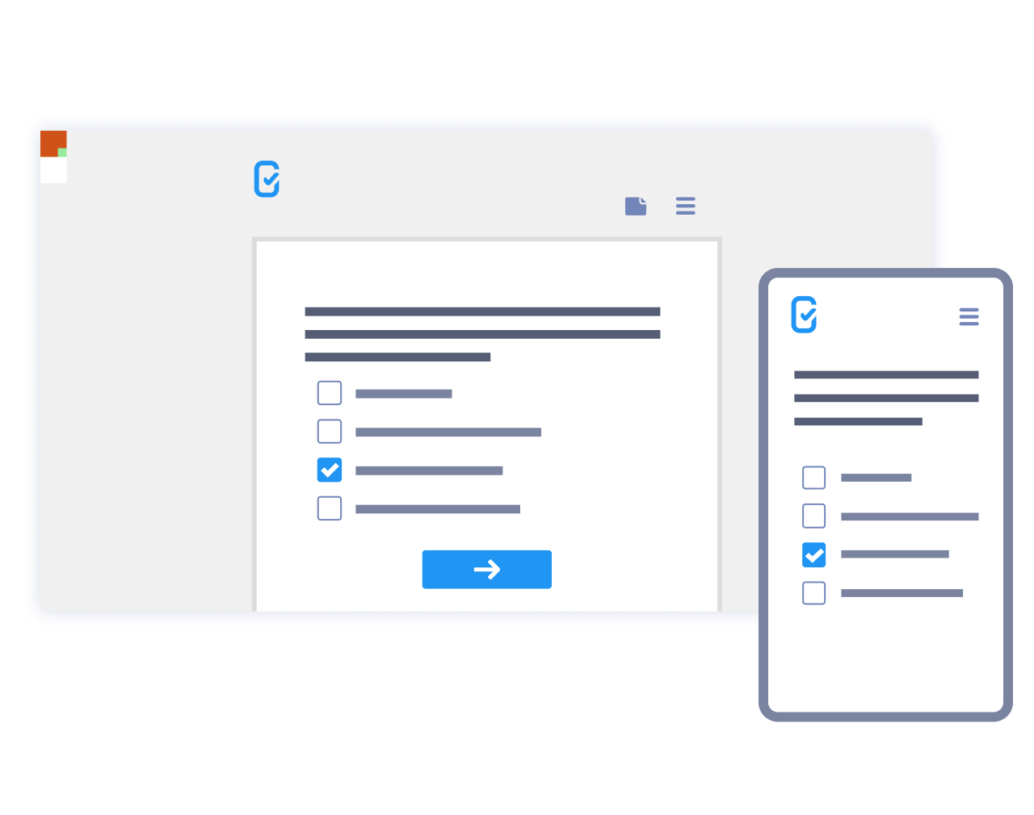

Data collection & analysis
Collect data offline or online, on any device
Collect data using our Android app or a web browser
Review and validate data in real time
Visualize data with custom maps and reports
Easily scale projects, for dozens or millions of respondents
Download data in XLS, CSV, KML, ZIP, or GeoJSON

Slide 6

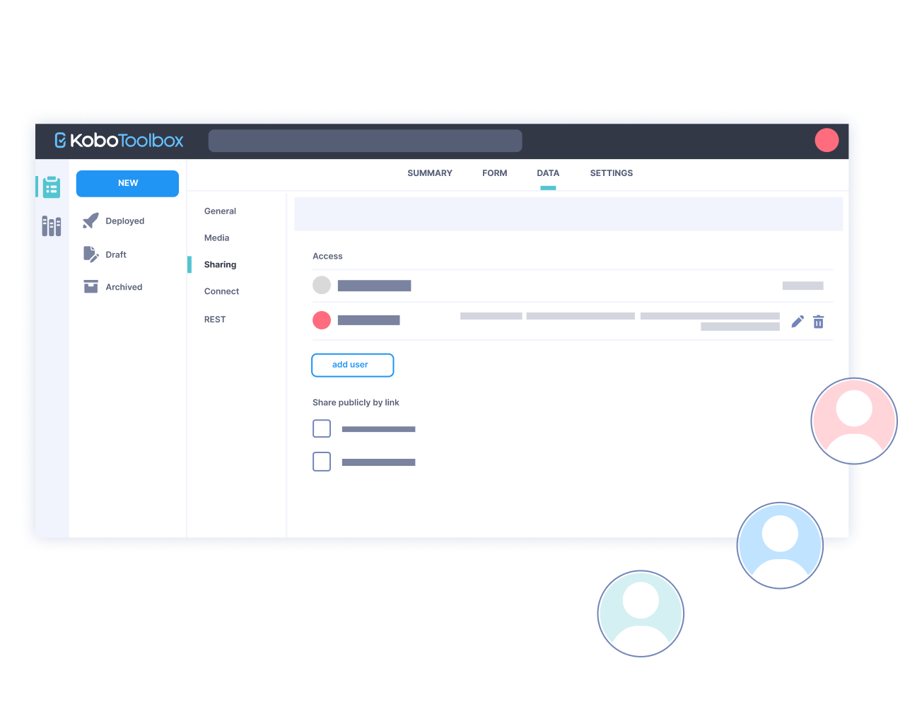
Project & team management
Share projects and data using fine-grained permission options
Dynamically connect data collected from multiple projects
Integrate with other tools via our powerful API
Add an unlimited number of data collectors and project collaborators
Create an unlimited number of projects

Slide 7

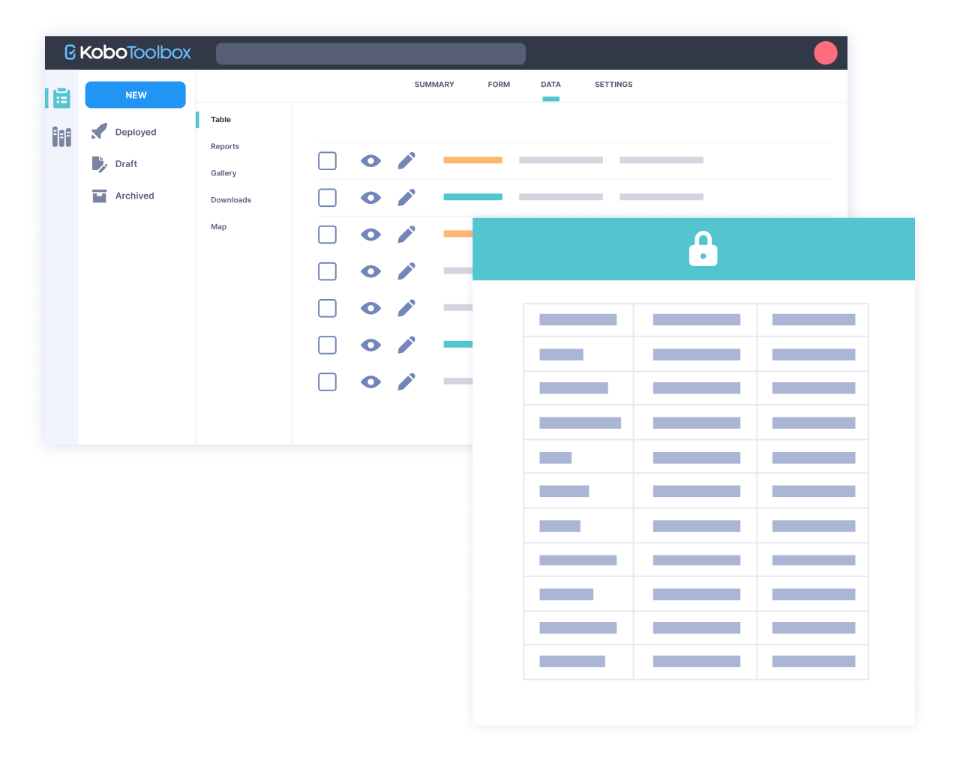
Secure and flexible
Intuitive user interface, available in multiple languages
User-owned data, with full control of access to data
Free Data Processing Agreements (DPA) available on request for full GDPR compliance
Custom features, secure standalone servers, and support available on demand
High data security standards by design.

Slide 8
OSM Data Field Data Collection by KoboToolbox
https://wiki.openstreetmap.org/wiki/Map_features
https://www.kobotoolbox.org/

Slide 9

Thank You…
arahmandc.github.io
mapbd.github.io

