Slide 1
INTRO to DATA SCIENCE Lecture 5: Probability & naive bayesian classification

Slide 2
last time: - Linear regression - regularization questions?
Recap

Slide 3
I. Review of regularization II. Probability iII. Logistic regression
agenda
Notes:
Keep the spam filter idea in mind as we go on

Slide 4
Regularization
These regularization problems can also be expressed as:
OLS: min(||y – xβ||²)
L1 regularization: min(||y – xβ||² + λ||x||)
L2 regularization: min(||y – xβ||² + λ||x||²)
We are no longer just minimizing error but also an additional term.

Slide 5
Regularization
These regularization problems can also be expressed as:
L1 regularization: min(||y – xβ||² + λ||x||)
When do we use L1?

Slide 6
Regularization
These regularization problems can also be expressed as:
L1 regularization: min(||y – xβ||² + λ||x||)
Common case: Text Classification
X = [animal = 1, …, carnival = 0, …, xylophone =0, …zebra = 0]
Y = Topic or Y = Important/Not Important or Y = Positive/Negative

Slide 7
I. intro to probability
INTRO TO DATA SCIENCE
Notes:
This is a light intro to a huge field.
NOTE: lots of whiteboard for this part

Slide 8
Intro to probability
Q: What is a probability?
Notes:
Q: any ideas?

Slide 9
Intro to probability
Q: What is a probability?
A: A number between 0 and 1 that characterizes the likelihood that
some event will occur.

Slide 10
Intro to probability
Q: What is a probability?
A: A number between 0 and 1 that characterizes the likelihood that
some event will occur.
The probability of event A is denoted P(A).

Slide 11
Intro to probability
Q: What is the set of all possible events called?

Slide 12
Intro to probability
Q: What is the set of all possible events called?
A: This set is called the sample space Ω. Event A is a member of the sample space, as is every other event.

Slide 13
Intro to probability
Q: What is the set of all possible events called?
A: This set is called the sample space Ω. Event A is a member of the sample space, as is every other event.
The probability of the sample space P(Ω) is 1.
Notes:
Q: can you see why?

Slide 14
Intro to probability
Q: What is a probability distribution?
A: A function that assigns probability to each event in the sample space.
Notes:
Q: can you see why?

Slide 15
Intro to probability
Q: What is a probability distribution?
A: A function that assigns probability to each event in the sample space.
A distribution can be discrete or continuous
Ex:
Discrete – Uniform distribution
X ~ {1, … , N} - P( X = x ) = 1/N
Notes:
Q: can you see why?

Slide 16
Intro to probability
Q: What is a probability distribution?
A: A function that assigns probability to each event in the sample space.
A distribution can be discrete or continuous
Ex:
Continuous – Normal distribution – N(u, o)
X ~ N(0, 1) - P( X = x ) = 0
Notes:
Q: can you see why?

Slide 17
Intro to probability
Q: What is expected value?
A: It is the average value of a random variable – one that represents the most common value
Notes:
Q: can you see why?

Slide 18
Intro to probability
Q: What is expected value?
A: It is the average value of a random variable – one that represents the most common value
For discrete distributions
E(X) = Σ x * p(x)
For continuous distributions
E(X) = integral ( x * p(x) )
Notes:
Q: can you see why?

Slide 19
Intro to probability
Linda is 31 years old, single, outspoken and very bright. She majored in philosophy. As a student, she was deeply concerned with issues of discrimination and social justice, and also participated in anti-nuclear demonstrations.
Which is more probable?
Linda is a bank teller.
Linda is a bank teller and active in the feminist movement.
Notes:
Foreshadowing…

Slide 20
Intro to probability
Q: Consider two events A & B. How can we characterize the
intersection of these events?
Notes:
Whiteboard: events A & B (A = female, B = brown hair)

Slide 21
Intro to probability
Q: Consider two events A & B. How can we characterize the
intersection of these events?
A: With the joint probability of A and B, written P(AB).

Slide 22
Intro to probability
Q: Suppose event B has occurred. What quantity represents the
probability of A given this information about B?
Notes:
Whiteboard: diagram w/ B filled in

Slide 23
Intro to probability
Q: Suppose event B has occurred. What quantity represents the
probability of A given this information about B?
A: The intersection of A & B divided by region B.
Notes:
Whiteboard: diagram w/ B filled in

Slide 24
Intro to probability
Q: Suppose event B has occurred. What quantity represents the
probability of A given this information about B?
A: The intersection of A & B divided by region B.
Notes:
Whiteboard: diagram w/ B filled in

Slide 25
Intro to probability
Q: Suppose event B has occurred. What quantity represents the
probability of A given this information about B?
A: The intersection of A & B divided by region B.
This is called the conditional probability
of A given B, written P(A|B) = P(AB) / P(B).
Notes:
Whiteboard: diagram w/ B filled in

Slide 26
Intro to probability
Q: Suppose event B has occurred. What quantity represents the
probability of A given this information about B?
A: The intersection of A & B divided by region B.
This is called the conditional probability
of A given B, written P(A|B) = P(AB) / P(B).
Notice, with this we can also write P(AB) = P(A|B) * P(B).
Notes:
Foreshadowing…

Slide 27
Intro to probability
Linda is 31 years old, single, outspoken and very bright. She majored in philosophy. As a student, she was deeply concerned with issues of discrimination and social justice, and also participated in anti-nuclear demonstrations.
Which is more probable?
Linda is a bank teller.
Linda is a bank teller and active in the feminist movement.
Notes:
Foreshadowing…

Slide 28
Intro to probability
Q: What does it mean for two events to be independent?
Notes:
Whiteboard: events A & B (A = female, B = brown hair)

Slide 29
Intro to probability
Q: What does it mean for two events to be independent?
A: Information about one does not affect the probability of the other.
Notes:
Whiteboard: events A & B (A = female, B = brown hair)

Slide 30
Intro to probability
Q: What does it mean for two events to be independent?
A: Information about one does not affect the probability of the other.
This can be written as P(A|B) = P(A).
Notes:
See why this is true?

Slide 31
Intro to probability
Q: What does it mean for two events to be independent?
A: Information about one does not affect the probability of the other.
This can be written as P(A|B) = P(A).
Using the definition of the conditional probability, we can also write:
P(A|B) = P(AB) / P(B) = P(A) → P(AB) = P(A) * P(B)
Notes:
Note: this is sometimes used as the definition of independent events. We will use this later on.

Slide 32
Bayes’ theorem
This result is called Bayes’ theorem. Here it is again:
P(A|B) = P(B|A) * P(A) / P(B)
Notes:
Gives you a way to translate one conditional prob into another.

Slide 33
Bayes’ theorem
This result is called Bayes’ theorem. Here it is again:
P(A|B) = P(B|A) * P(A) / P(B)
Some facts:
- This is a simple algebraic relationship using elementary definitions.
Notes:
Nb: We derived it from scratch in a handful of slides.

Slide 34
Bayes’ theorem
This result is called Bayes’ theorem. Here it is again:
P(A|B) = P(B|A) * P(A) / P(B)
Some facts:
- This is a simple algebraic relationship using elementary definitions.
- It’s interesting because it’s kind of a “wormhole” between two different “interpretations” of probability.
Notes:
We will talk a bit about that in a second

Slide 35
Bayes’ theorem
This result is called Bayes’ theorem. Here it is again:
P(A|B) = P(B|A) * P(A) / P(B)
Some facts:
- This is a simple algebraic relationship using elementary definitions.
- It’s interesting because it’s kind of a “wormhole” between two different “interpretations” of probability.
- It’s a very powerful computational tool.
Notes:
This is really what we care about.

Slide 36
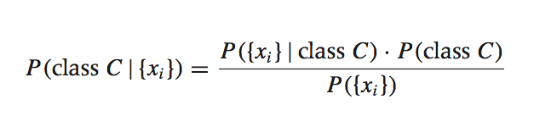
Some terminology
Each term in this relationship has a name, and each plays a distinct role in any probability calculation (including ours).
Notes:
{xi} denotes attribute values

Slide 37
The likelihood function
This term is the likelihood function. It represents the joint probability of observing features {x_{i}} given that that record belongs to class C.
Notes:
Joint because {xi} is a vector
Also called “class-conditional probability”

Slide 38
The likelihood function
This term is the likelihood function. It represents the joint probability of observing features {x_{i}} given that that record belongs to class C.
We can observe the value of the likelihood function from the training data.
Notes:
{xi} denotes attribute values

Slide 39
The prior
This term is the prior probability of C. It represents the probability of a record belonging to class C before the data is taken into account.

Slide 40
The prior
This term is the prior probability of C. It represents the probability of a record belonging to class C before the data is taken into account.
The value of the prior is also observed from the data.
Notes:
This represents our “prior beliefs” about C.

Slide 41
The normalization constant
This term is the normalization constant. It doesn’t depend on C, and is generally ignored until the end of the computation.

Slide 42
Maximum likelihood estimator
Maximum likelihood estimator (MLE):
What parameters maximize the likelihood function?
Notes:
Joint because {xi} is a vector
Also called “class-conditional probability”

Slide 43
Maximum a posteriori estimate
Maximum a posteriori estimate (MAP):
What parameters maximize the likelihood function AND prior?
Notes:
Joint because {xi} is a vector
Also called “class-conditional probability”

Slide 44
II. LOGISTIC REGRESSION
INTRO TO DATA SCIENCE
Notes:
Bayesian inference is another huge field (also very interesting, effective, and fashionable).
This is a lightning tour.

Slide 45

Logistic regression
continuous categorical
supervised regression classification
unsupervised dimension reduction clustering

Slide 46
Logistic regression
Q: What is logistic regression?

Slide 47
Logistic regression
Q: What is logistic regression?
A: A generalization of the linear regression model to classification problems.
Notes:
Popularized in clinical studies due to ease of use, interpretation.

Slide 48
Logistic regression
In linear regression, we used a set of covariates to predict the value of a (continuous) outcome variable.

Slide 49
Logistic regression
In linear regression, we used a set of covariates to predict the value of a (continuous) outcome variable.
In logistic regression, we use a set of covariates to predict probabilities of (binary) class membership.

Slide 50
Logistic regression
In linear regression, we used a set of covariates to predict the value of a (continuous) outcome variable.
In logistic regression, we use a set of covariates to predict probabilities of (binary) class membership.
These probabilities are then mapped to class labels, thus solving the classification problem.
Notes:
Eg, by threshholding at 50%

Slide 51
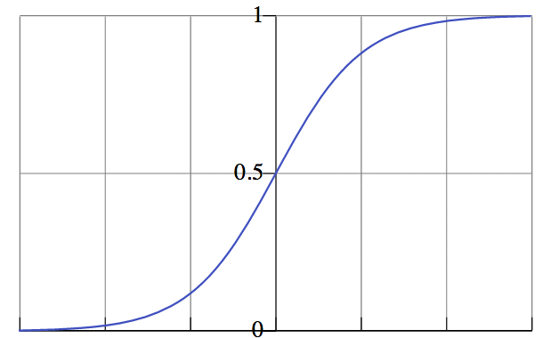

probabilities
probability of
belonging to
class
NOTE
Probability predictions look like this.
value of independent variable
Notes:
smoothly varying, between 0 and 1 (y-axis: probability of belonging to class 1)
→ looks like a cdf

Slide 52
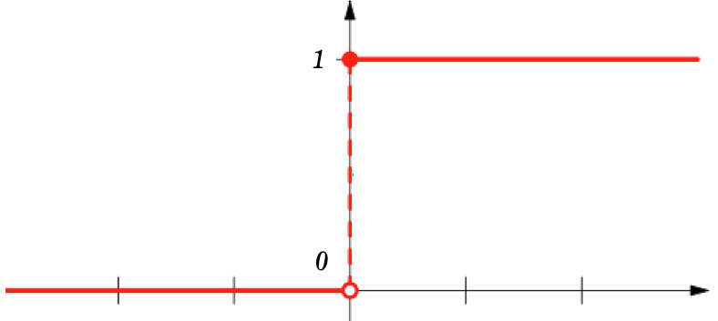
Class labels
class label
NOTE
Probabilities are “snapped” to class labels (eg by threshholding at 50%).
value of independent variable
Notes:
Sharply varying, w/ step at threshhold level
→ looks like a heaviside function

Slide 53
Logistic regression
The logistic regression model is an extension of the linear regression model, with a couple of important differences.

Slide 54
Logistic regression
The logistic regression model is an extension of the linear regression model, with a couple of important differences.
The first difference is in the outcome variable.

Slide 55
Logistic regression
The logistic regression model is an extension of the linear regression model, with a couple of important differences.
The main difference is in the outcome variable.
Notes:
We’ll do the outcome var first

Slide 56

Outcome variables
The key variable in any regression problem is the response type of the outcome variable y given the value of the covariate x:
Notes:
this is what we’re estimating

Slide 57

Outcome variables
The key variable in any regression problem is the conditional mean of the outcome variable y given the value of the covariate x:
In linear regression, we assume that this conditional mean is a linear function taking values in (-∞, +∞):
Notes:
Linear in x or some function of x; eg, linear in beta

Slide 58
Outcome variables
In logistic regression, we’ve seen that the conditional mean of the outcome variable takes values only in the unit interval [0, 1].
Notes:
Remember the ‘S’ curve

Slide 59
Outcome variables
In logistic regression, we’ve seen that the conditional mean of the outcome variable takes values only in the unit interval [0, 1].
The first step in extending the linear regression model to logistic regression is to map the outcome variable E(y|x) into the unit interval.

Slide 60
Outcome variables
In logistic regression, we’ve seen that the conditional mean of the outcome variable takes values only in the unit interval [0, 1].
The first step in extending the linear regression model to logistic regression is to map the outcome variable E(y|x) into the unit interval.
Q: How do we do this?

Slide 61

The logistic function
A: By using a transformation called the logistic function:

Slide 62
The logistic function
A: By using a transformation called the logistic function:
We’ve already seen what this looks like:
Notes:
This function was first studied in the mid-19th century in the context of modeling population growth (note the saturation effect).

Slide 63
The logistic function
A: By using a transformation called the logistic function:
We’ve already seen what this looks like:
NOTE
For any value of x, y is in the interval [0, 1]
This is a nonlinear transformation!
Notes:
Another alternative would be to use the normal cdf…this leads to the probit model (and gives similar prediction results)

Slide 64

The logistic function
The logit function is an important transformation of the logistic function. Notice that it returns the linear model!

Slide 65
The logistic function
The logit function is an important transformation of the logistic function. Notice that it returns the linear model!
The logit function is also called the log-odds function.

Slide 66
The logistic function
The logit function is an important transformation of the logistic function. Notice that it returns the linear model!
The logit function is also called the log-odds function.
NOTE
This name hints at its usefulness in interpreting our results.
We will see why shortly.

