Slide 1
PROOF OF CONCEPT — LIVE SYSTEM OUTPUT
Real Results, Not Just a Concept
Every screenshot and number on the following slides comes from our actual working system — built, run, and verified end-to-end.
AI-Powered Criminal Network Analysis System

Slide 2
The Experiment
We deliberately hid one person from every written report, to test if the system could still find him
1
2
3
Set Up the Test
Run the Pipeline
Check the Result
5 synthetic people. One of them, Sanjay Gupta, never appears in any police report — only in phone, financial, and social media data.
NER extraction, entity resolution, relationship extraction, graph construction, and centrality analysis — fully automated.
Did the system flag Sanjay Gupta as important, despite him being invisible in every written report?
AI Criminal Network Analysis — Proof of Concept
2

Slide 3
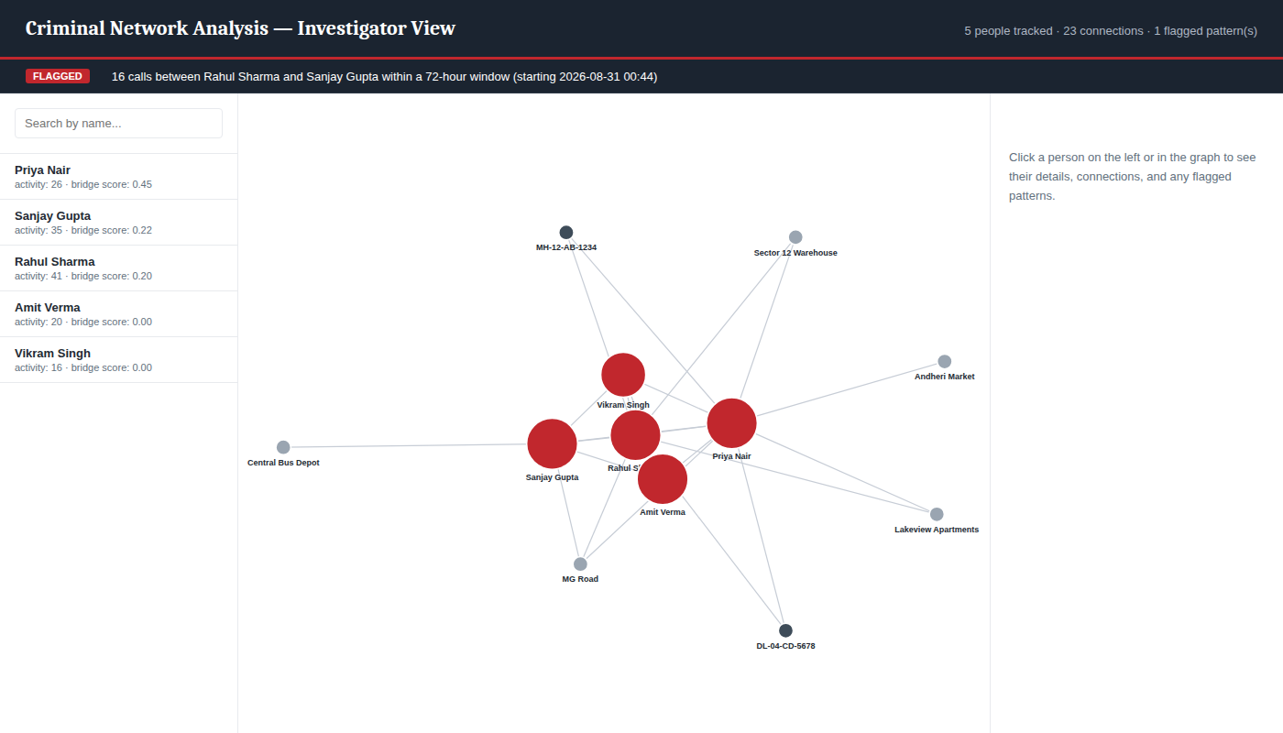
The Actual Dashboard
Live screenshot — not a mockup
AI Criminal Network Analysis — Proof of Concept
3

Slide 4
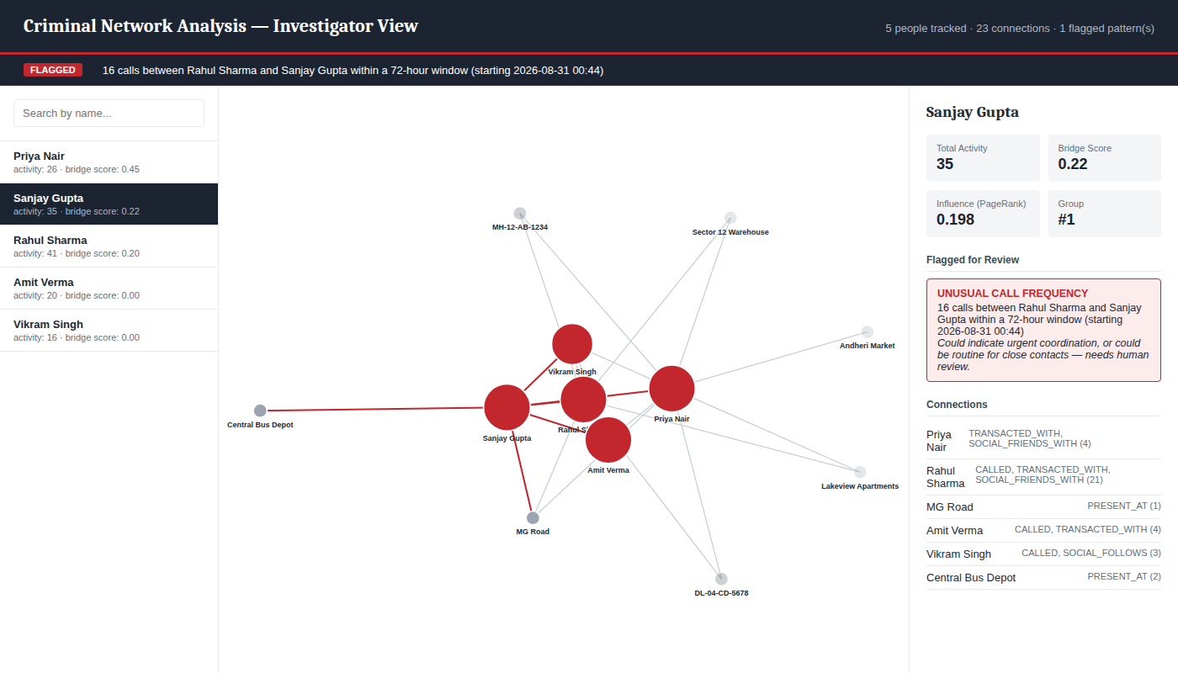
The Reveal: Clicking on the Hidden Person
Sanjay Gupta — zero mentions in any police report
AI Criminal Network Analysis — Proof of Concept
4

Slide 5
The Numbers Behind the Reveal
Adding a third data source (social media) is what actually surfaced Sanjay Gupta
BEFORE — Phone + Financial Records Only
AFTER — + Social Media Data Added
Person | Bridge Score
Priya Nair | 0.4286
Rahul Sharma | 0.25
Sanjay Gupta | 0.00
Amit Verma | 0.00
Vikram Singh | 0.00
Person | Bridge Score
Priya Nair | 0.4545
Sanjay Gupta | 0.2182
Rahul Sharma | 0.20
Amit Verma | 0.00
Vikram Singh | 0.00
Sanjay Gupta jumped from an untracked 0.00 to the #2 highest bridge score in the network — found only once phone, financial, and social data were fused together.
AI Criminal Network Analysis — Proof of Concept
5

Slide 6
No Single Record Tells
the Whole Story.
Connecting them does. This system is built, tested, and ready to demo.
AI Criminal Network Analysis — Proof of Concept
6

