Slide 1
MID-TERM 2 > Medical Search Engine : I-MedWiki Web Health Informatics Supervised By:- Dr. Vijay Mago
Submitted by:-
Ankit Raj
Jasmeet Singh Grewal
Ramanpreet Kaur Deol

Slide 2
Objective
To build a medical search engine which is capable of generating categorical search results based on the string entered by the user.

Slide 3
Key Features Implemented
Non-redundancy: There would be no duplicate data fetched through this application.
Non-Clumsiness: The links or data fetched would be well categorized on the basis of different diseases that have the same symptoms.
Single Objective Search engine: Since the search engine would basically serve as a medical dictionary, thus, there would be no results for any term outside the medical scope

Slide 4
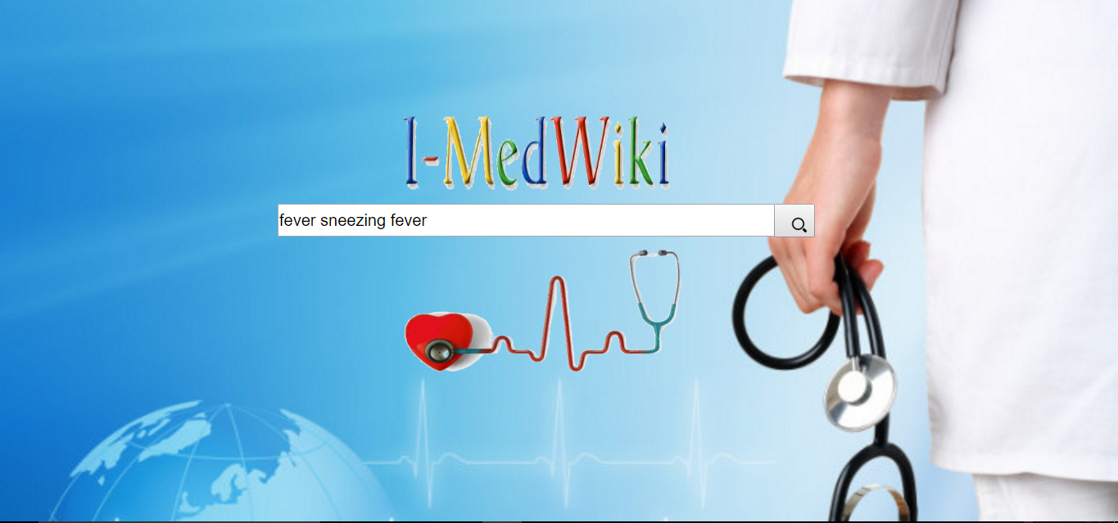
Non-Redundancy

Slide 5
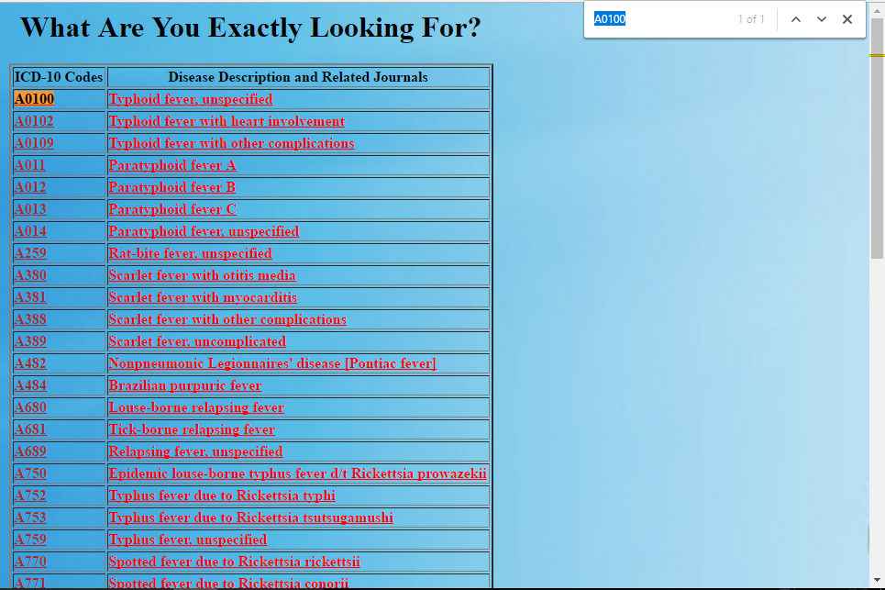
Non-Redundancy (…..continued)
For the same symptom ,it won’t fetch the duplicate data. As you can see in screenshot mentioned below , for “fever” it returns different diseases having some unique codes.

Slide 6
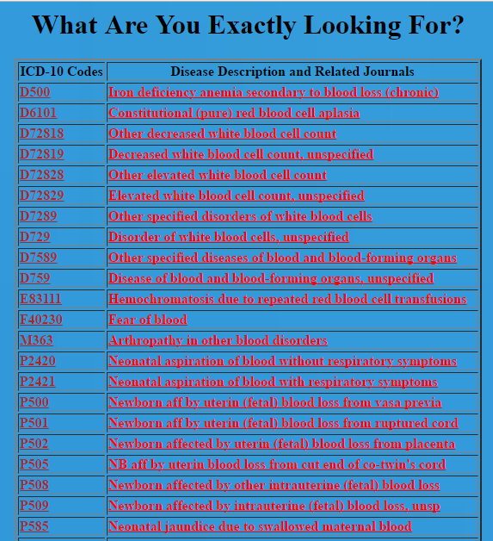
Non Clumsiness
The result fetched, (currently from database) is well categorized on the basis of their unique ICD code.

Slide 7
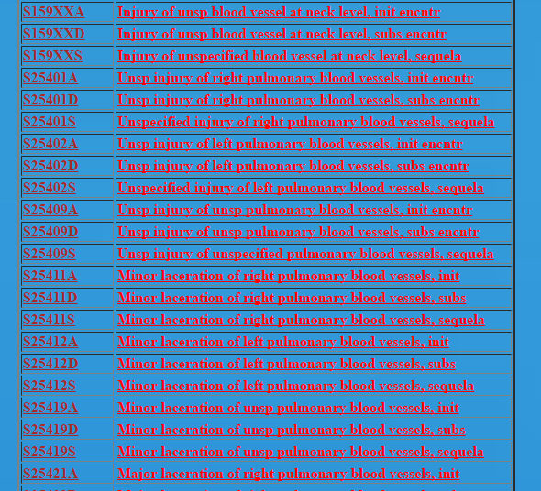
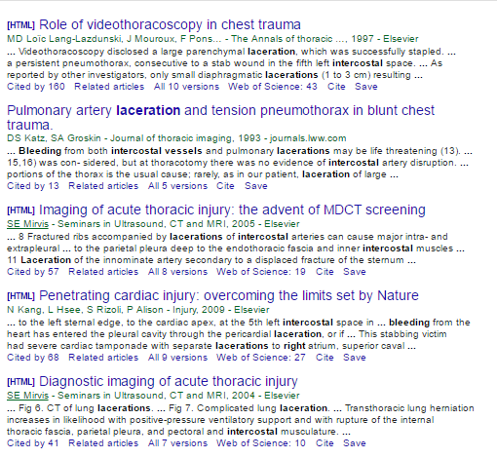
Single Objective Search Engine
The result fetched, (currently from database) from the query is always within the medical scope.

Slide 8
Technologies Used
Front-End
Java
HTML5 - CSS
JSP
Apache-Tomcat server
Back-End
MySQL
MVC Architecture followed
Used the concept of “getters-setters” where the query is made from one form and result are fetched in different form.
Note:- Soon will be able to use UI tools to fetch results directly from websites .

Slide 9
Updated Prototype (Invision)
Check the link Below:
https://projects.invisionapp.com/share/BFA6L4CW9

Slide 10
Pre-requisites
Java 7 or higher Version
MySQL
Apache Tomcat Server
NetBeans/eclipse (optional: for easy editing of codes)

Slide 11
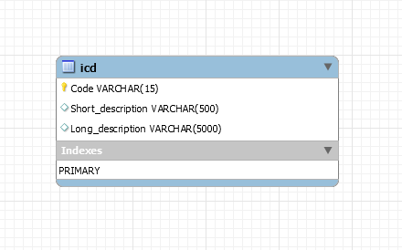
Setup Instructions
Setting Up database:
Create a database and name it web_info (update the root password as per your database).
Import the data to your database in a table named "icd" from ICD-10 data recorded in icd.csv file.
MySQL-J-Connector Setting Up:
Download mysql-connector-java-5.1.41-bin and copy it in \web\WEB-INF folder of java

Slide 12
Setup Instructions (….continued)
Servlet setup:
Copy DatabaseConn.java file in \src\java of java
Copy web.xml in \web\WEB-INF folder of java
Setting up front-end:
Copy find.jsp and test connection.jsp along with all images specified in repository (with updated root password) in \web folder of java.
Finally, you are all set to use this application

Slide 13
Progress Report
All the details related to the progress made are given on the GitHub page.
Follow the link below:
https://github.com/araj4/medical-search-engine

Slide 14
Live Demo…..

Slide 15
References
For downloading the icd 10 data
https://www.cob.cms.hhs.gov/Section111/help/icd10.dx.codes.htm
and
http://icd10codelink.com/

Slide 16
Future Scope
To make this search engine efficient for generating high quality content
Presently, it is not collecting live data from the website. In future, it would be self- efficient to collect online data and update it regularly.
It would search the symptoms based on the disease that encounters with them.
No such results would be fetched that does not have any medical background such as research journal or scholar papers related to the topic (symptom) being searched.

Slide 17
Thankyou ☺

