Slide 1
FINAL PRESENTATION> Medical Search Engine : I-MedWiki Web Health Informatics Supervised By:- Dr. Vijay Mago
Submitted by:-
Ankit Raj
Jasmeet Singh Grewal
Ramanpreet Kaur Deol

Slide 2
Objective
To build a medical search engine which is capable of generating categorical search results based on the string entered by the user.

Slide 3
Comments added in our previous presentation:
Increase the visibility of result page. (DONE)
Fetch the hierarchical codes to guide the page to proper ICD link. (DONE)
Try to fetch dynamic entity directly from website and search according to that. (Error occurred while trying various UI tools as browsers were not compatible causing several web-security issues. Tried with : Selenium, Webload and Apache Jmeter but no luck.)

Slide 4
Key Features Implemented
Non-redundancy: There would be no duplicate data fetched through this application.
Non-Clumsiness: The links or data fetched would be well categorized on the basis of different diseases that have the same symptoms.
Single Objective Search engine: Since the search engine would basically serve as a medical dictionary, thus, there would be no results for any term outside the medical scope
To make this search engine efficient for generating high quality content
However, we were not able to fetch the web contents directly, we got all the points of our project covered.

Slide 5
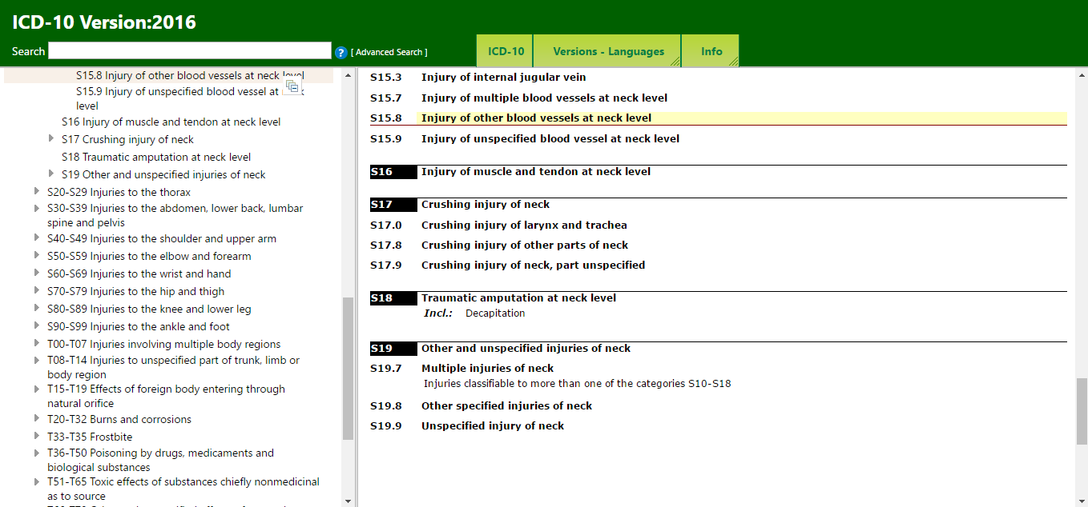
ICD proper page fetched …

Slide 6
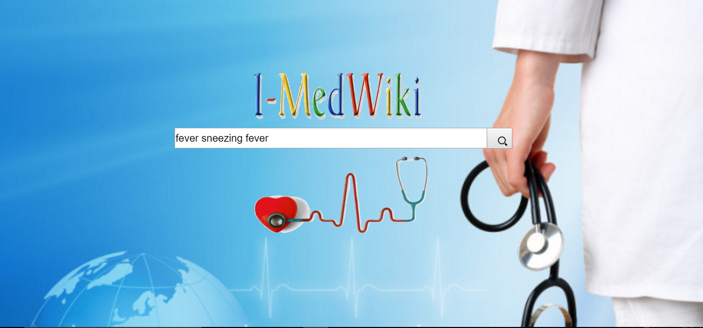
Non-Redundancy

Slide 7
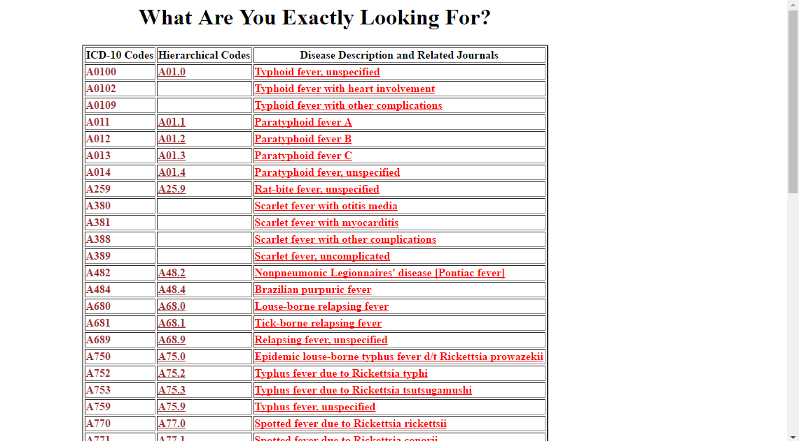
Non-Redundancy (…..continued)
For the same symptom ,it won’t fetch the duplicate data. As you can see in screenshot mentioned below , for “fever” it returns different diseases having some unique codes.

Slide 8
Non Clumsiness
The result fetched, (currently from database) is well categorized on the basis of their unique ICD code.

Slide 9
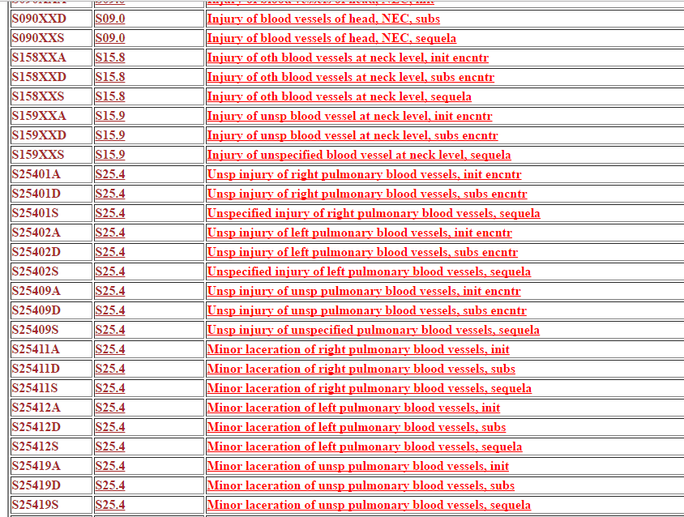
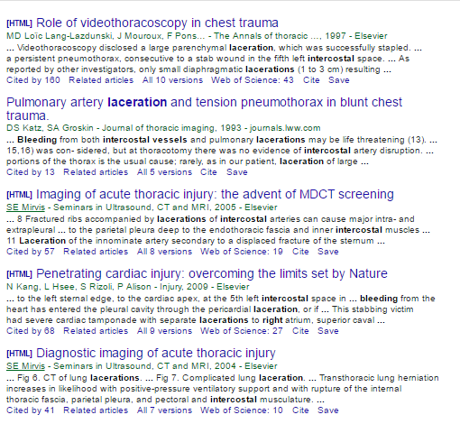
Single Objective Search Engine
The result fetched, (currently from database) from the query is always within the medical scope.

Slide 10
Technologies Used
Front-End
Java
HTML5 - CSS
JSP
Apache-Tomcat server
Back-End
MySQL
MVC Architecture followed
Used the concept of “getters-setters” where the query is made from one form and result are fetched in different form.
Note:- Soon will be able to use UI tools to fetch results directly from websites .

Slide 11
Updated Prototype (Invision)
Check the link Below:
https://projects.invisionapp.com/share/BFA6L4CW9

Slide 12
Pre-requisites
Java 7 or higher Version
MySQL
Apache Tomcat Server
NetBeans/eclipse (optional: for easy editing of codes)

Slide 13
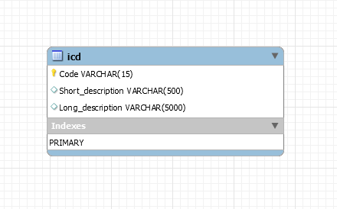
Setup Instructions
Setting Up database:
Create a database and name it web_info (update the root password as per your database).
Import the data to your database in a table named "icd" from ICD-10 data recorded in icd.csv file.
MySQL-J-Connector Setting Up:
Download mysql-connector-java-5.1.41-bin and copy it in \web\WEB-INF folder of java

Slide 14
Setup Instructions (….continued)
Servlet setup:
Copy DatabaseConn.java file in \src\java of java
Copy web.xml in \web\WEB-INF folder of java
Setting up front-end:
Copy find.jsp and test connection.jsp along with all images specified in repository (with updated root password) in \web folder of java.
Finally, you are all set to use this application

Slide 15
Progress Report
All the details related to the progress made are given on the GitHub page.
Follow the link below:
https://github.com/araj4/medical-search-engine

Slide 16
Live Demo…..

Slide 17
References
For downloading the icd 10 data
https://www.cob.cms.hhs.gov/Section111/help/icd10.dx.codes.htm
and
http://icd10codelink.com/

Slide 18
Scope for better version … .
Presently, it is not collecting live data from the website. In future, it would be self- efficient to collect online data and update it regularly.
It would search the symptoms based on the disease that encounters with them.

Slide 19
Thankyou ☺

