Slide 1
Development of the Program to Create a PDF File Including a LaTeX Document
Miyazaki Shun
Araki Tsuyohito

Slide 2
ABSTRACT
Basically, We cannot directly change the Portable Document Format(PDF) file when changing the contents of the PDF file.
We believe that if you can modify the content of a PDF file with one PDF file, it will improve the ease of modification of PDF files and contribute to improving the mutual editability of PDF.

Slide 3
APPROACH
Incorporate a source document as a metadata stream into a PDF file and extract from the PDF file.
Only for editing in Latef.

Slide 4
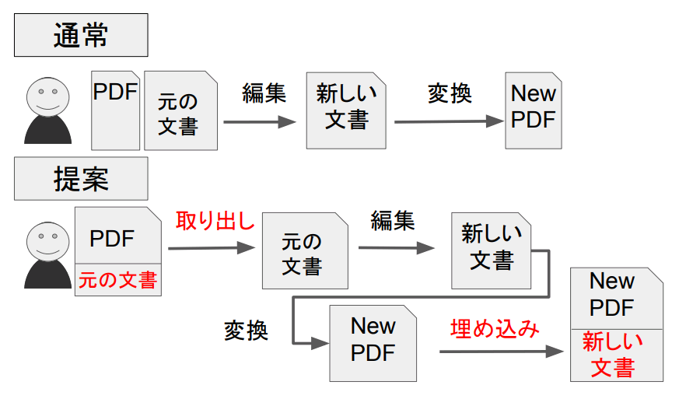
APPROACH

Slide 5
METHODS
Convert the LATEX le into the PDF file
Incorporate the source document into the PDF
Extracting a source document

Slide 6
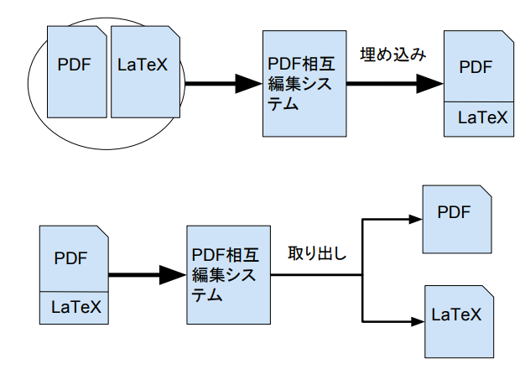
METHODS

Slide 7
RESULT
With our PDF mutual editing system, we were able to embed source code in PDF file, retrieve it, and automate typesetting.
The PDF mutual editing system is effective for improving the mutual editability of PDF.

Slide 8
FUTURE WORK
Automate
Typeset
- font-style
Coresspond to other than LaTeX

Slide 9
REFERENCES
[1] Rosenthol, Leonard. Developing with PDF. O'Reilly Media,Inc, 2013, 218p.,ISBN978-1-449-32791-0
[2] Steward, Sid.; 千住治郎 訳 . PDF Hacks. オライリー・ジャパン, 2005, 368p.,ISBN4-87311-222-2
[3] Whitington, John.; 村上雅章 訳. PDF 構造解説. オライリー・ジャパン,2012, 248p.,ISBN978-4-87311-549-8
[4]小林徳滋. PDF インフラストラクチャ 解説.アンテナハウスCAS 電子出版,2016, 268p.,ISBN4900552186
[5] Adobe Systems Incorporated. "Document management - Portable document forma- Part 1: PDF 1.7.“ PDF Reference and Adobe Extensions to the PDF Speci cation. http://wwwimages.adobe.com/content/dam/Adobe/en/devnet/pdf/pdfs/PDF32000_2008.pdf,(accessed 2016-07-02).
[6] Adobe Systems Incorporated."XMP SPECIFICATION PART1 DATA MODEL, SERIALIZATION, AND CORE PROPERTIES." Adobe - XMP DeveloperCenter.http://wwwimages.adobe.com/content/dam/Adobe/en/devnet/xmp/pdfs/XMPSpecificationPart1.pdf,(accessed 2016-07-02).
[7] Adobe Systems Incorporated."XMP SPECIFICATION PART2 ADDITIONAL PROPERTIES." Adobe - XMP Developer Center. http://wwwimages.adobe.com/content/dam/Adobe/en/devnet/xmp/pdfs/XMPSpecificationPart2.pdf, (accessed 2016-07-02).
[8] Adobe Systems Incorporated."XMP SPECIFICATION PART 3 STORAGE IN FILES." Adobe - XMP Developer Center.http://wwwimages.adobe.com/content/dam/Adobe/en/devnet/xmp/pdfs/XMPSpecificationPart3.pdf,(accessed 2016-07-02).
[9] Adobe Systems Software IrelandLtd. \Adobe - XMP Developer Center."Adobe.http://www.adobe.com/jp/devnet/xmp.html,(accessed 2016-07-04).

