Slide 1
Elixir Modules
Aamer F Rakla
67-495 – Advanced Topics in Information Systems/Innovation in Information Systems

Slide 2
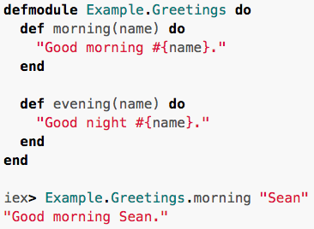
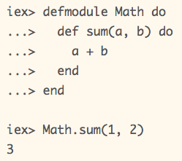
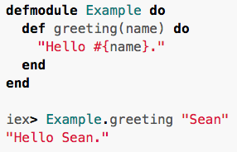
What is A Module?
Simply, it is a group of functions; It is similar to a class in an OOP Language
Modules are used without even realizing it, such as the String module
The defmodule macro is used to created modules
Elixir also allows for nested modules

Slide 3
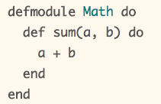

Compilation
Modules are normally written into files
This way they can be compiled and reused
It can be compiled using elixirc math.ex resulting in a BEAM file in bytecode for Eralang VM
Running iex in the same directory as the BEAM file will make it available

Slide 4
Compilation
Elixir projects are usually organized into three directories:
ebin - contains the compiled bytecode (usually .beam files)
lib - contains elixir code (usually .ex files)
test - contains tests (usually .exs files)
For actual projects, a build tool called mix handles compiling

Slide 5
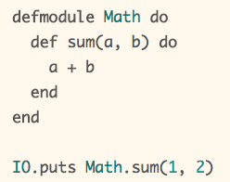
Scripted Mode
Scripted mode is used primarily for learning purposes as well as testing
Elixir scripts are files ending in .exs
Elixir treats .ex and .exs exactly the same, except .exs isn’t compiled

Slide 6
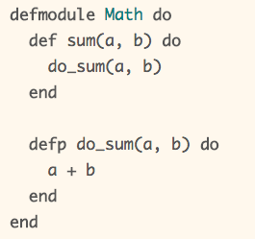

Named Functions
Functions can be defined inside of a module using def or defp for private
Public functions can be called from other modules and private ones only from within the module

Slide 7
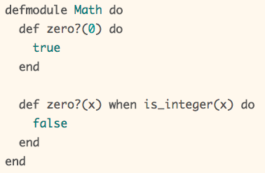
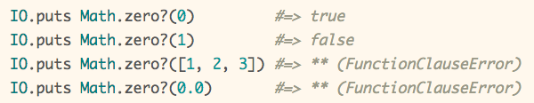
Named Functions
Like in Java and other languages, Elixir supports function overloading
In other words, having functions with the same name but different arrities
Elixir also supports guards for functions

Slide 8
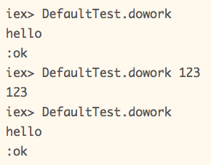
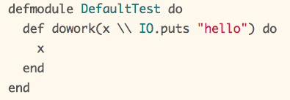
Default Arguments
Functions support default arguments
Expressions can be used as default arguments
They are only evaluated when called, not during definition

Slide 9
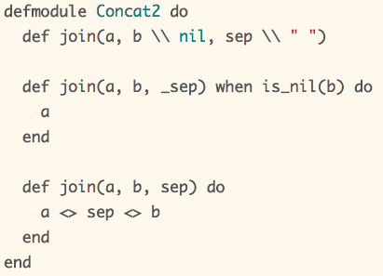

Default Arguments
When overloading a function (when it has multiple clauses), a function without a body (a function head), is needed to define default values

Slide 10
Default Arguments
When overloading a function (when it has multiple clauses), the order they are listed makes a difference
Elixir/Erlang will use the first matching function
The compiler will give a warning when this happens

Slide 11
Module Attributes
Module attributes originate from Erlang
Module attributes in Elixir serve three purposes:
They serve to annotate the module, often with information to be used by the user or the VM.
They work as constants.
They work as a temporary module storage to be used during compilation.

Slide 12
Annotations
Annotations are used for many purposes, such as tracking the version of a module
Erlang VM uses annotations to track the version of a module
If there is no version, the MD5 checksum of the module is used
Elixir has a number of reserved attributes, inlcuding:
@moduledoc - provides documentation for the current module.
@doc - provides documentation for the function or macro that follows the attribute.
@behaviour - (notice the British spelling) used for specifying an OTP or user-defined behaviour.
@before_compile - provides a hook that will be invoked before the module is compiled. This makes it possible to inject functions inside the module exactly before compilation.

Slide 13
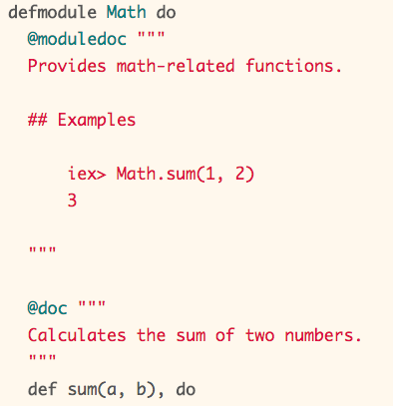
Annotations
@moduledoc and @doc are the most used attributes and Elixir expects everyone to use them
Elixir treats documentation as first-class and provides many functions to access it
Elixir promotes useing markdown with heredocs to write readable documentation
Heredocs are multiline strings, starting and ending with “””

Slide 14
Annotations
There is a tool called ExDoc for generating HTML pages from the documentation
Attributes can also be used by developers or extended by libraries to support custom behavior

Slide 15
Sources
These slides were made using information and examples from the official Elixir Language website and Elixir School
http://elixir-lang.org/getting-started/modules.html
http://elixir-lang.org/getting-started/module-attributes.html
https://elixirschool.com/lessons/basics/modules/

