Slide 1
MLPC – Team Toothpaste
Aral Cimcim, Sandro Müller, Linus Madlener, Kevin Eberl

Slide 2
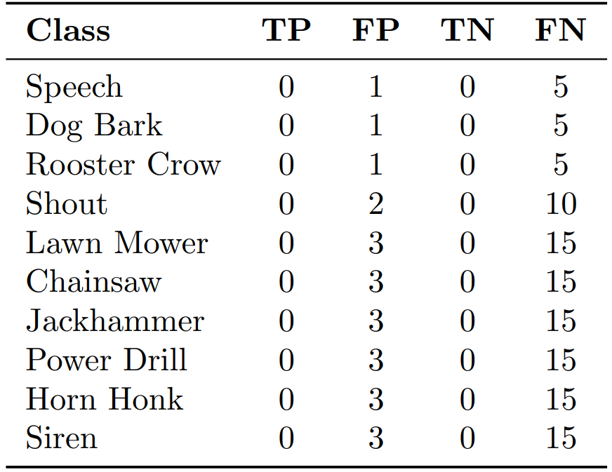
Outline
Problem
Better accuracy isn’t everything
Missing event (false negative) penalized more than False alarm (false positive)
Our Goal
Design cost-aware system
3 Hypotheses
“Dumb” threshold is costly
Raw predictions are noisy
Deeper isn’t always better
Results & Conclusion
Table 1: Cost Matrix for Evaluation

Slide 3
Architecture
Multi-stage pipeline
Input: Frame-level audio embeddings (120ms)
Core Model: Bidirectional GRU classifier for temporal patterns
Post-Processing:
Smooths probabilities
Applies tuned thresholds
Filters out noise
Output: Final predictions for 1.2s segments

Slide 4
Hypothesis 1: “Dumb” Threshold is Expensive
Class | Threshold
Speech | 0.36
Shout | 0.39
Chainsaw | 0.33
Jackhammer | 0.55
Lawn Mower | 0.50
Power Drill | 0.54
Dog Bark | 0.29
Rooster Crow | 0.49
Horn Honk | 0.59
Siren | 0.43
Hypothesis
Single fixed threshold (e.g., 0.5) performs poorly
Ignores unique cost penalties
Method
Tuned one threshold for each of the 10 classes
Iterated through all possible thresholds
Selected the one with lowest cost for that class
Single most impactful improvement
Table 2: Optimal threshold for each class based on cost

Slide 5
Hypothesis 2: Raw Predictions are Noisy
Hypothesis
Model output contains short, spurious detections -> expensive
Need to clean these predictions
Method
Two-step “cleaning” process on frame-level predictions:
Median Filtering: Applied to raw probabilities to smooth out single frame “blips” and fill small gaps
Duration Filtering: After thresholding, remove any detected event shorter than 3 frames (360ms)
Effectively removed noise -> lowering final cost

Slide 6
Hypothesis 3: Deeper Isn’t Always Better
Hypothesis:
More complex model might overfit -> higher cost
Method
Trained models with varying complexity:
Layers: [1, 2, 4]
Hidden Dimensions: [256, 512, 1024]
Compared validation/total cost after full pipeline
Outcome
1 layer & 256 hidden dimensions achieved lowest cost

Slide 7
Results & Conclusion
Key Strategies:
Cost-sensitive loss function
Class-specific probability thresholds
Median and duration filtering
Performance
System | Total Cost on Test Set
Baseline (Most Frequent) | 101.47
Logistic Regression | 53.69
Default RNN | 38.22
Regular RNN (tuned parameters) | 37.92
Tuned RNN | 35.95
Table 3: Final performance of each classifier

