Slide 1
MLPC – Team Toothpaste
Aral Cimcim, Sandro Müller, Linus Madlener, Kevin Eberl

Slide 2
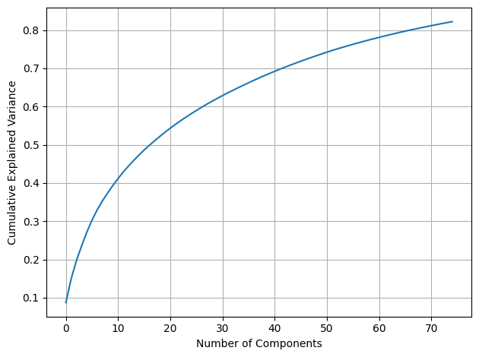
Feature Selection Which audio features matter?
Raw input: 768-dimensional frame wise embeddings
Preprocessing:
Stack all frames across files StandardScaler
PCA → 50 principal components
Result: first 50 PCs explain > 80 % of variance, so we reduce 768 → 80
Figure 1: Cumulative Explained Variance as a Function of the Number of Principal Components

Slide 3

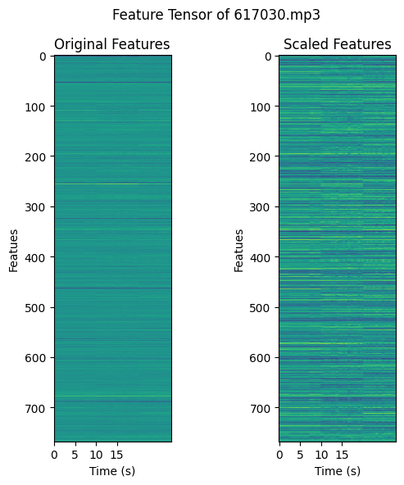
Fixed Length Embeddings From variable to fixed length vectors
Figure 2: Scaled Features

Slide 4
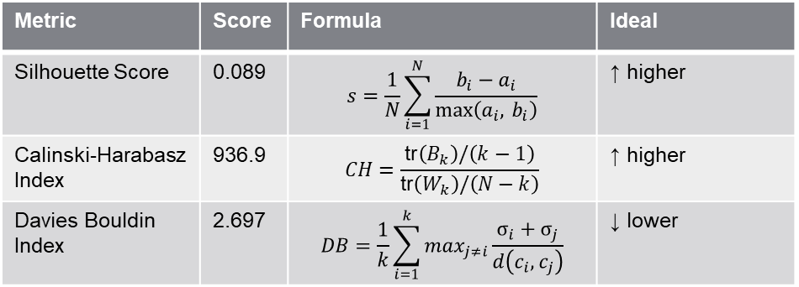
Clustering Audio Regions Do regions group into meaningful clusters?
Clustering
Alogrithm: K-Means
Number of Clusters (k): 25
random_state = 42 , n_init = 10
768 D → 50 D → KMeans(25)
Used less PCs to reduce noise and 25 clusters seemed to work the best by iterating over 10 possibilities
Table 1: Cluster Quality Metrics and Formulas
Metric | Score | Formula | Ideal
Silhouette Score | 0.089 | $$s=\frac{1}{N}\sum_{i=1}^{N}{\frac{ b_{i}−a_{i} }{\max\left(a_{i}, b_{i}\right)}}$$ | ↑ higher
Calinski-Harabasz Index | 936.9 | $$CH=\frac{\text{tr}\left(B_{k}\right)/\left(k−1\right)}{\text{tr}\left(W_{k}\right)/\left(N−k\right)}$$ | ↑ higher
Davies Bouldin Index | 2.697 | $$DB=\frac{1}{k}\sum_{i=1}^{k}{max_{j≠i}\frac{σ_{i}+σ_{j}}{d\left(c_{i},c_{j}\right)}}$$ | ↓ lower

Slide 5
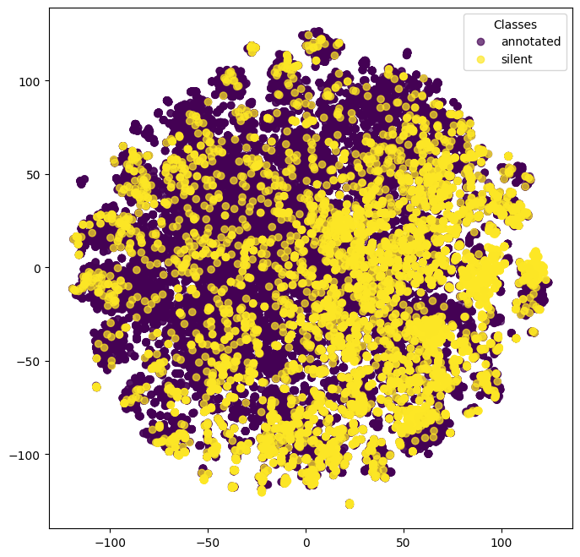
Silent Regions: One Big Cluster? Where do the silence land?
Build fixed_vectors and segment_labels (“annotated” vs. “silent”)
Embed everything via TSNE(n_components = 2, perplexity = 30)
Colour points by label
Figure t-SNE annotated vs silent, what does silence forms a tight cluster or not?
Figure 3: t-SNE Visualization of Annotated vs Silent Samples

