Slide 1
MLPC – Team Toothpaste
Aral Cimcim, Sandro Müller, Linus Madlener, Kevin Eberl

Slide 2
Data Split Best split to avoid data leakage?
Data Splitting
80% for training to generalize
10% for validation, reducing overfitting
10% for testing, test unbiased performance
Data Leakage
When similar frames are in training & test set
Potential solution: split by files first
Another issue: Annotation too similar for certain classes and text embeddings

Slide 3
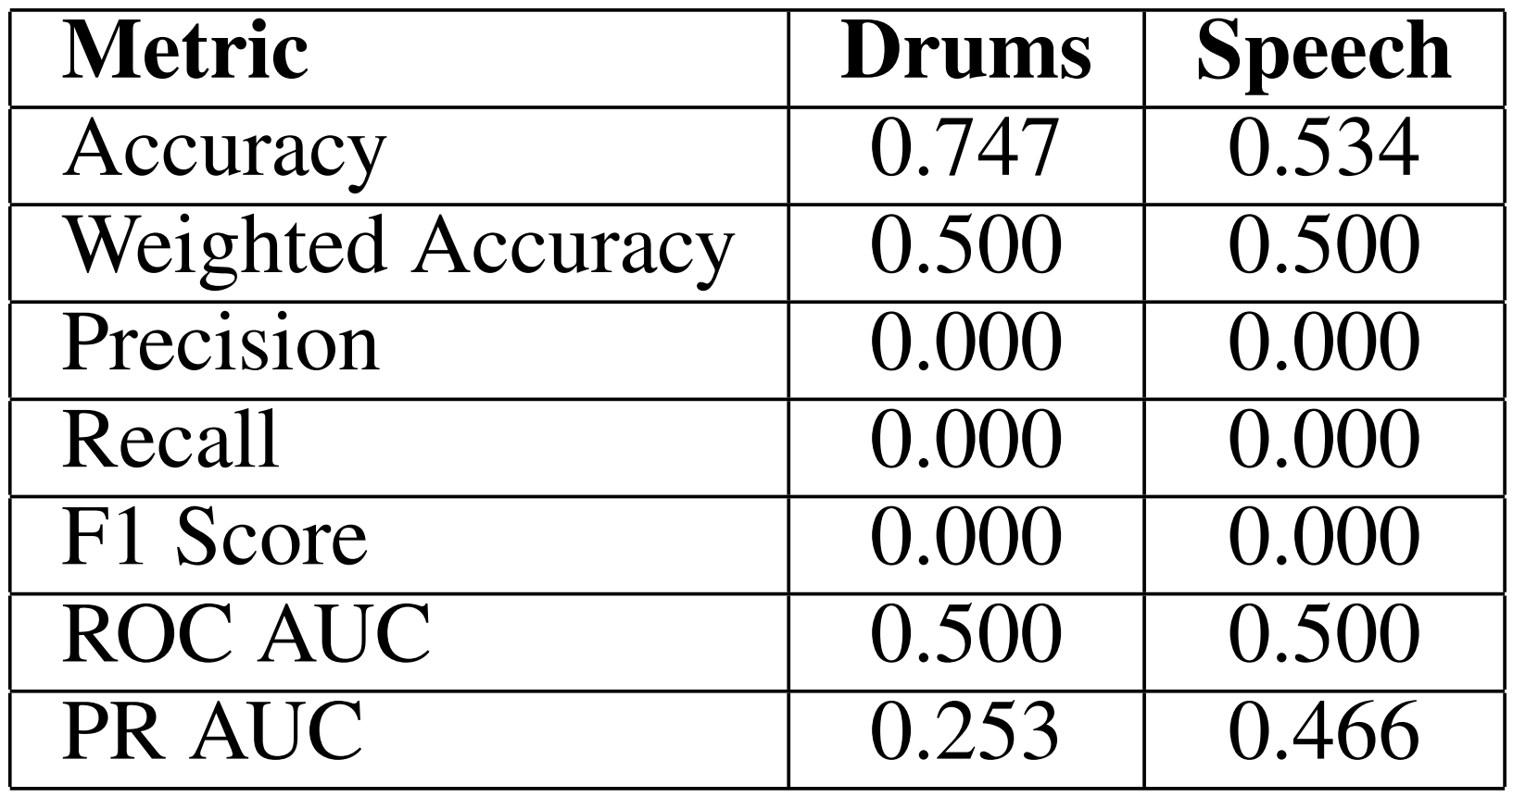

Evaluation Which evaluation criterion?
Balanced Accuracy Score
Imbalanced data: classes not equally distributed -> no favoring majority class
Equal weight to TPR & TNR
$Balanced Accuracy=\frac{1}{2}(\frac{TP}{TP+FN}+\frac{TN}{TN+FP})$
Worst vs. best performance
Baseline classifier predicting majority class -> 75% (drums)
Table 1: Performance Metrics for labels "Drums" and "Speech"

