Slide 1
Android Studio with JAVA
Notes:
2018.11.17 박한별

Slide 2
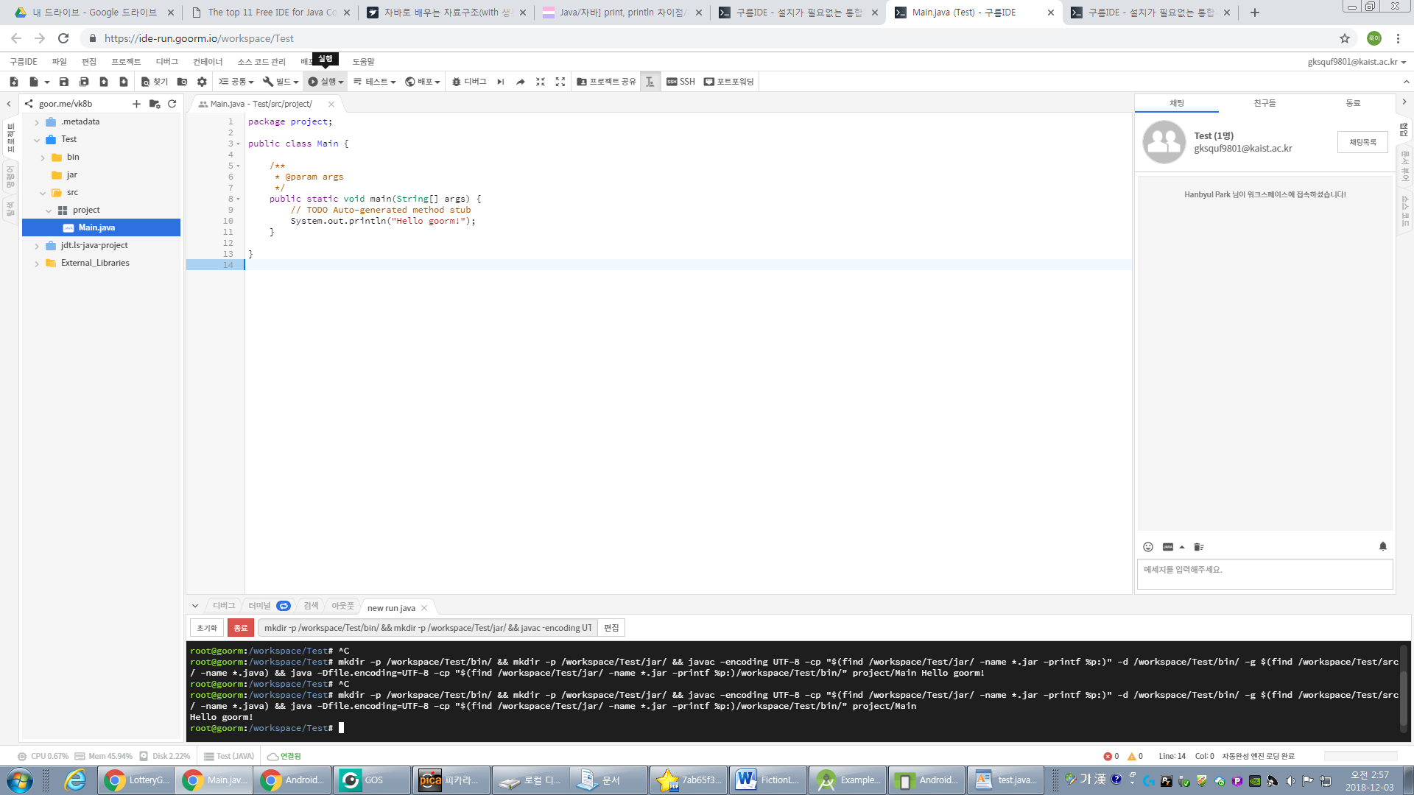
Goorm IDE

Slide 3
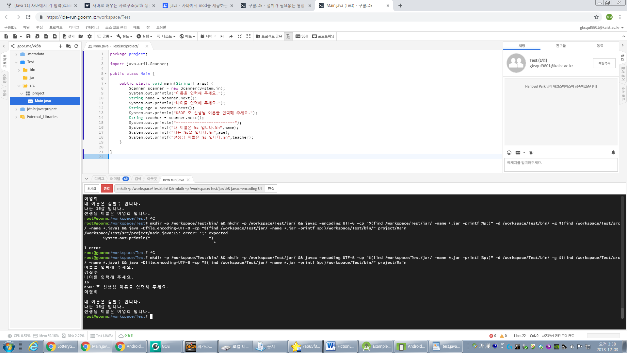
Goorm IDE

Slide 4
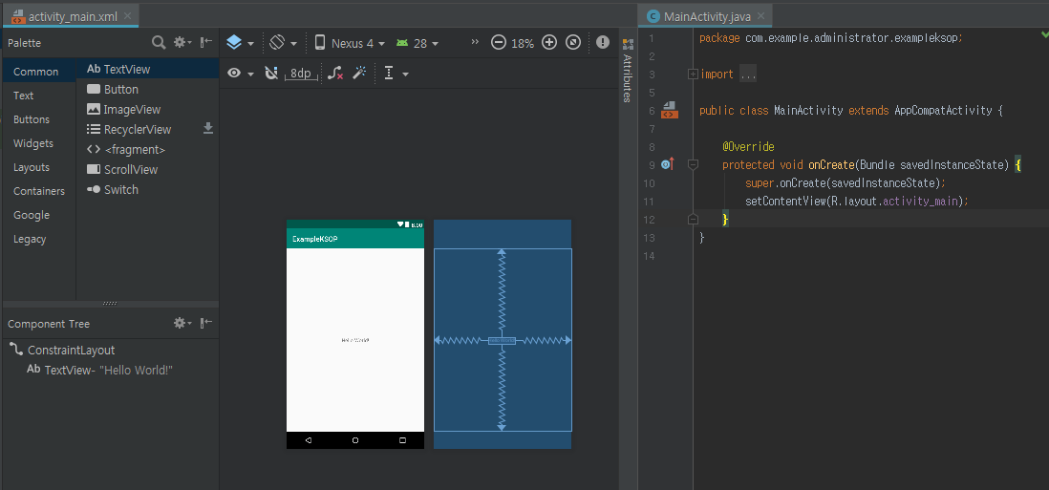
ANDROID STUDIO

Slide 5
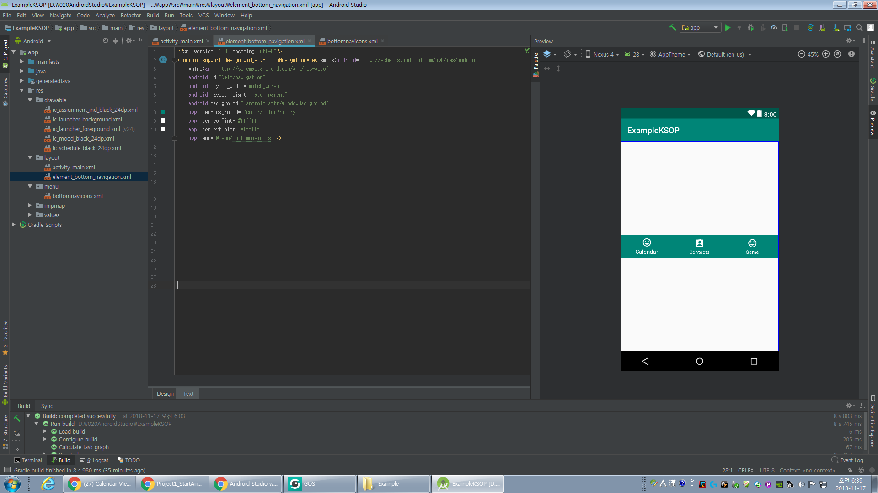
ANDROID STUDIO

Slide 6
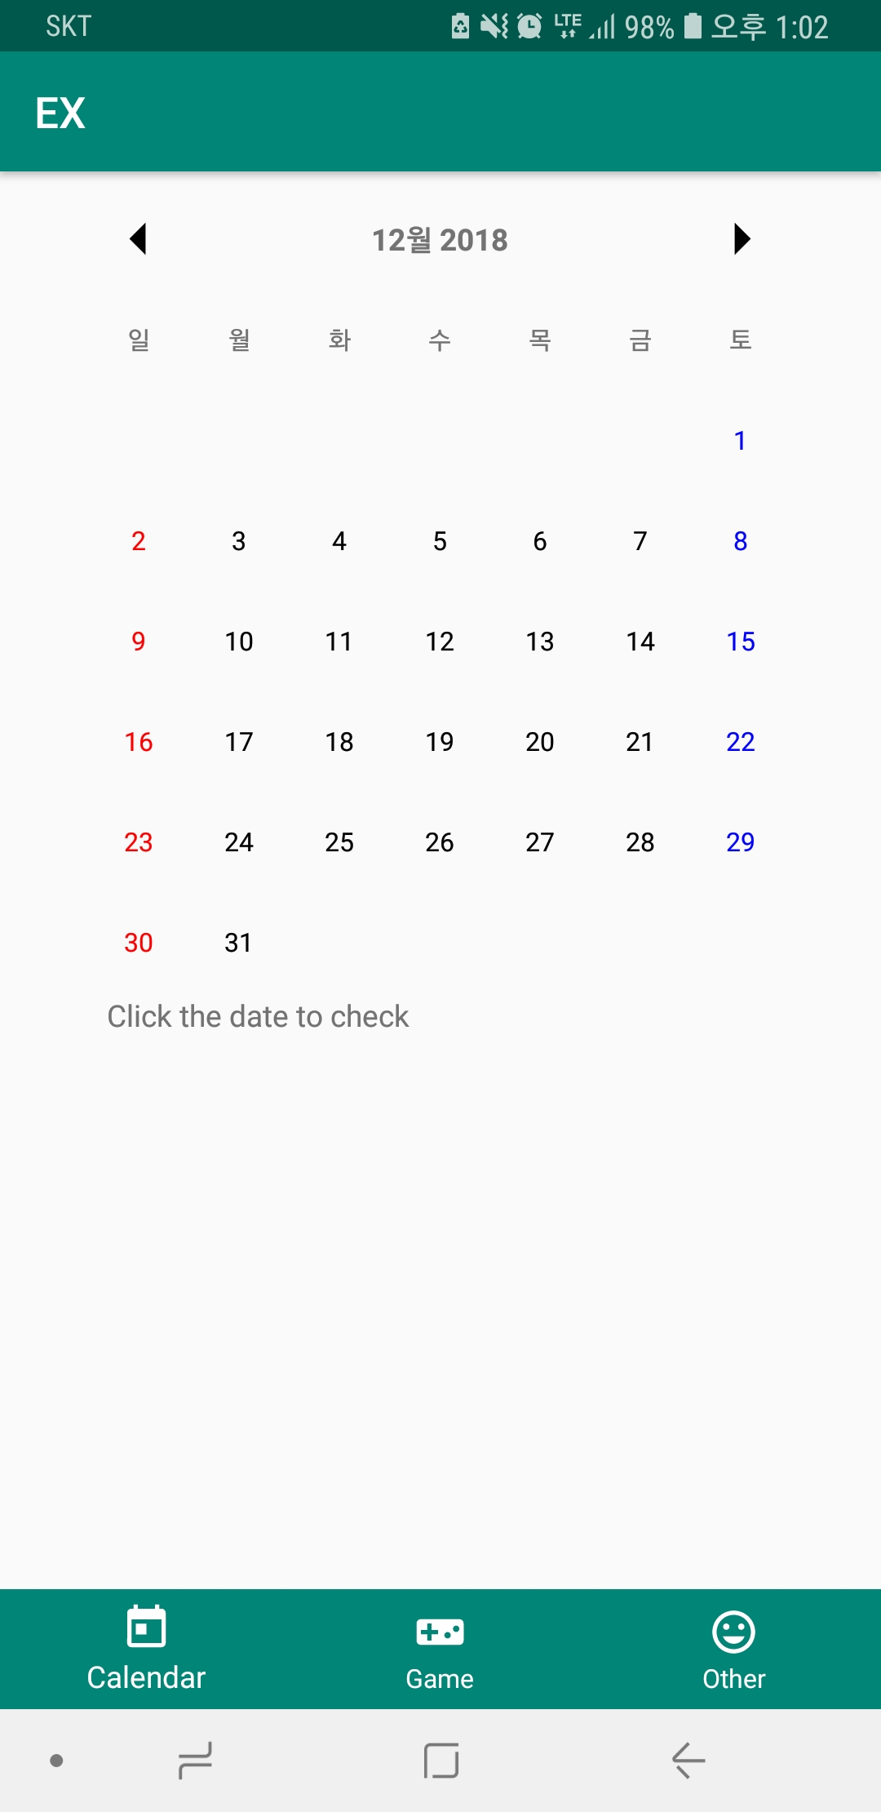
ANDROID STUDIO

Slide 7
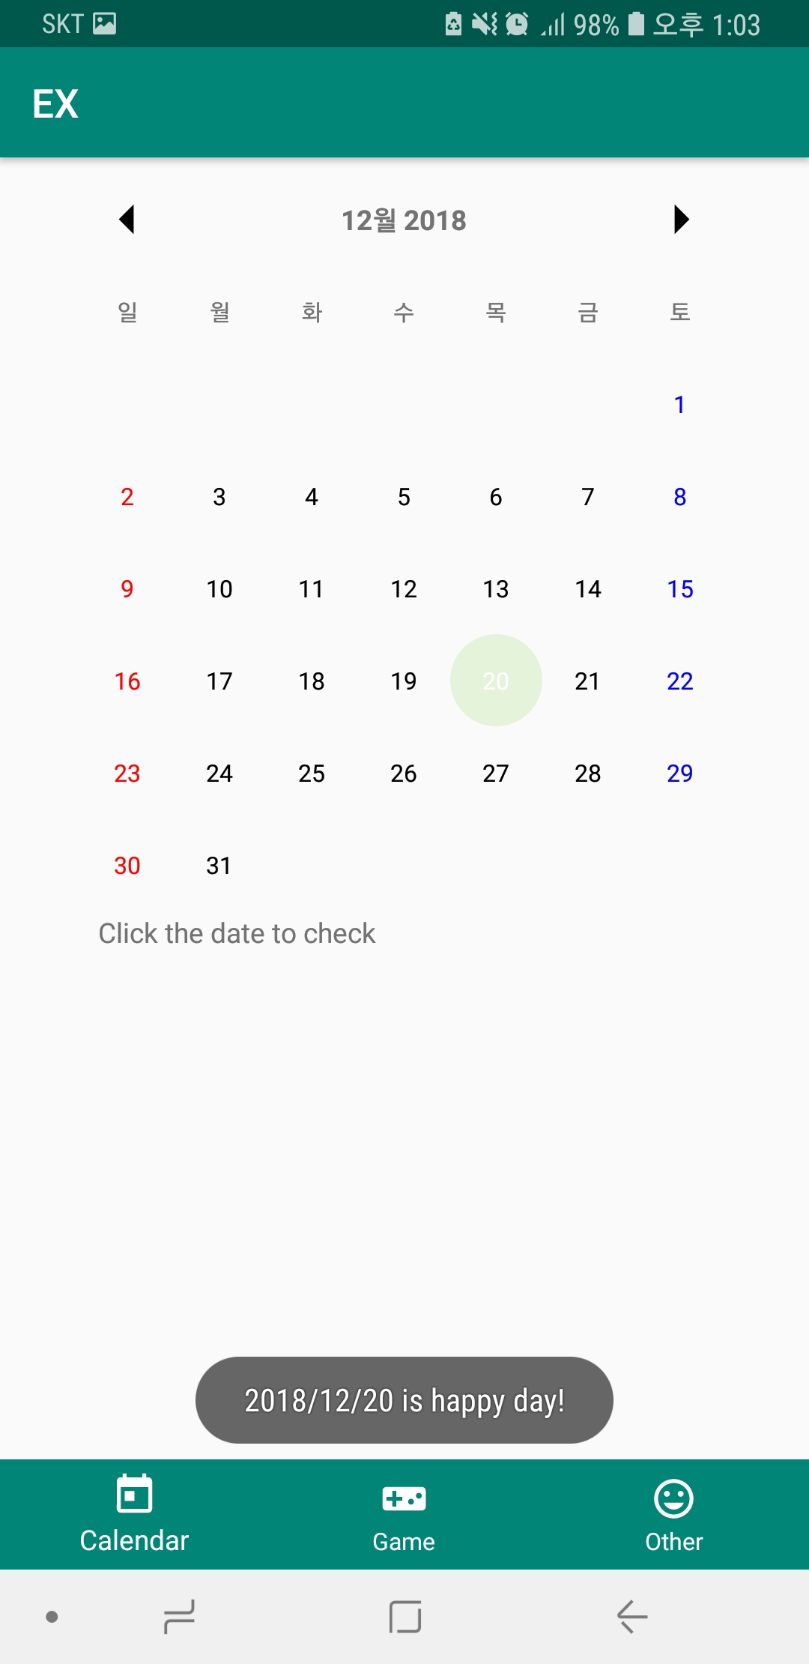
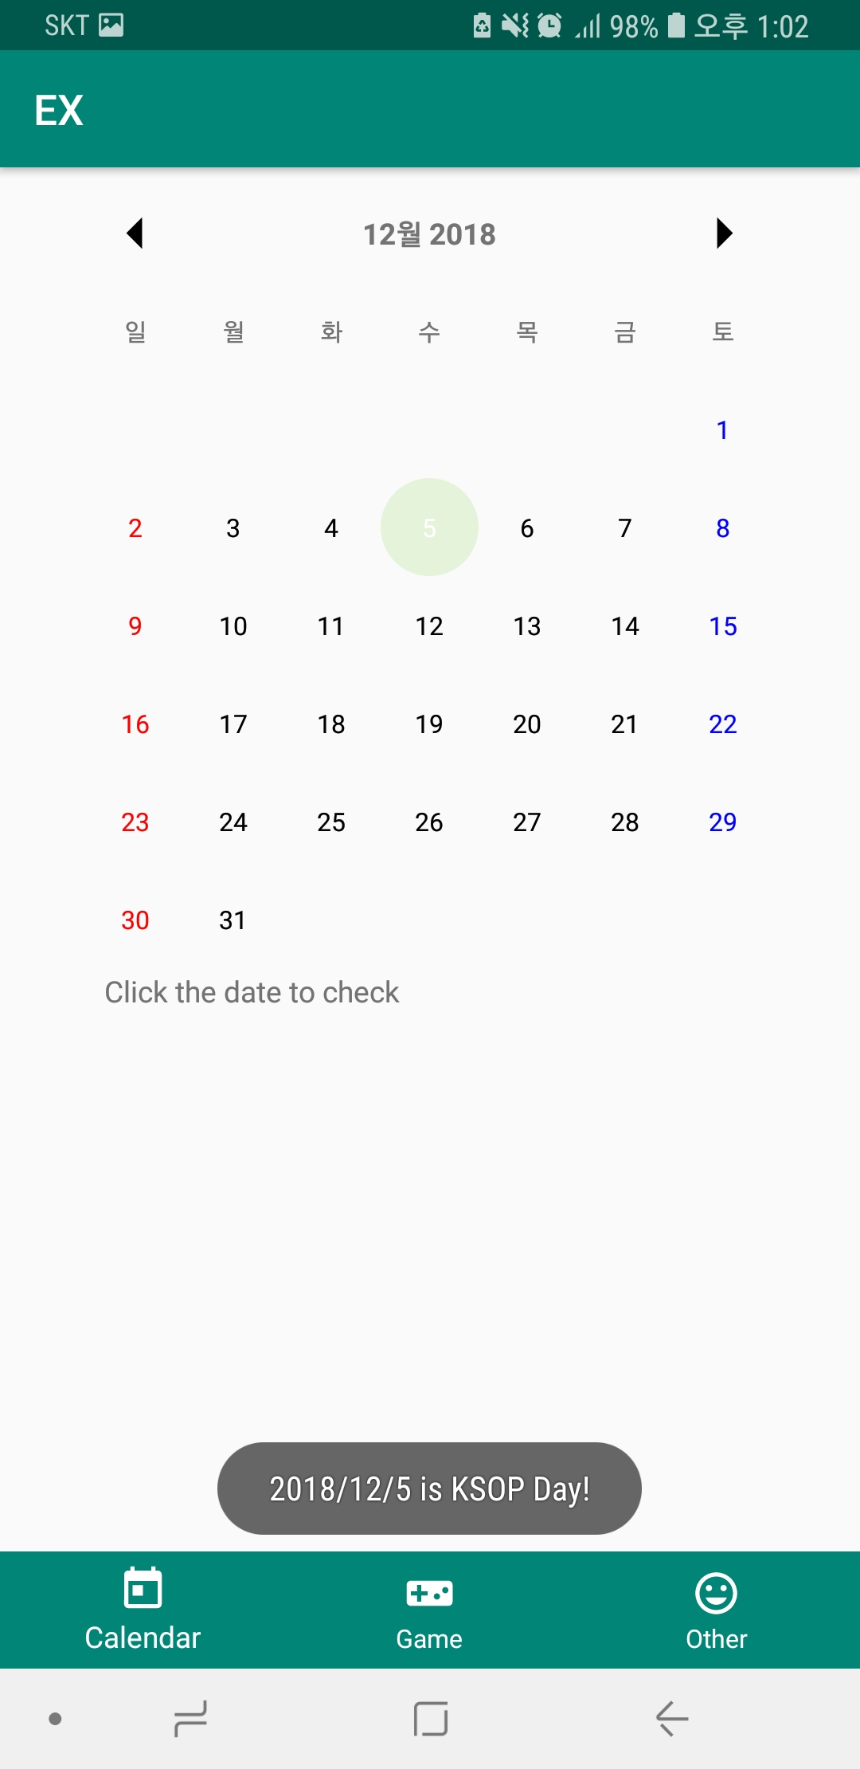
ANDROID STUDIO

Slide 8
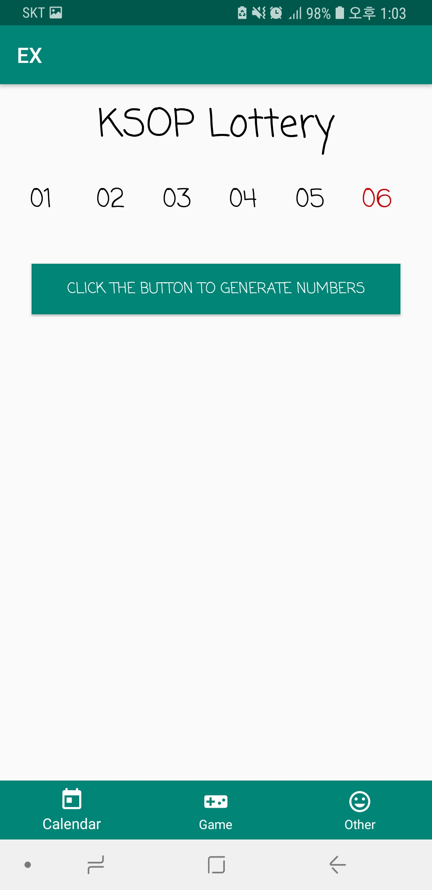
ANDROID STUDIO

Slide 9
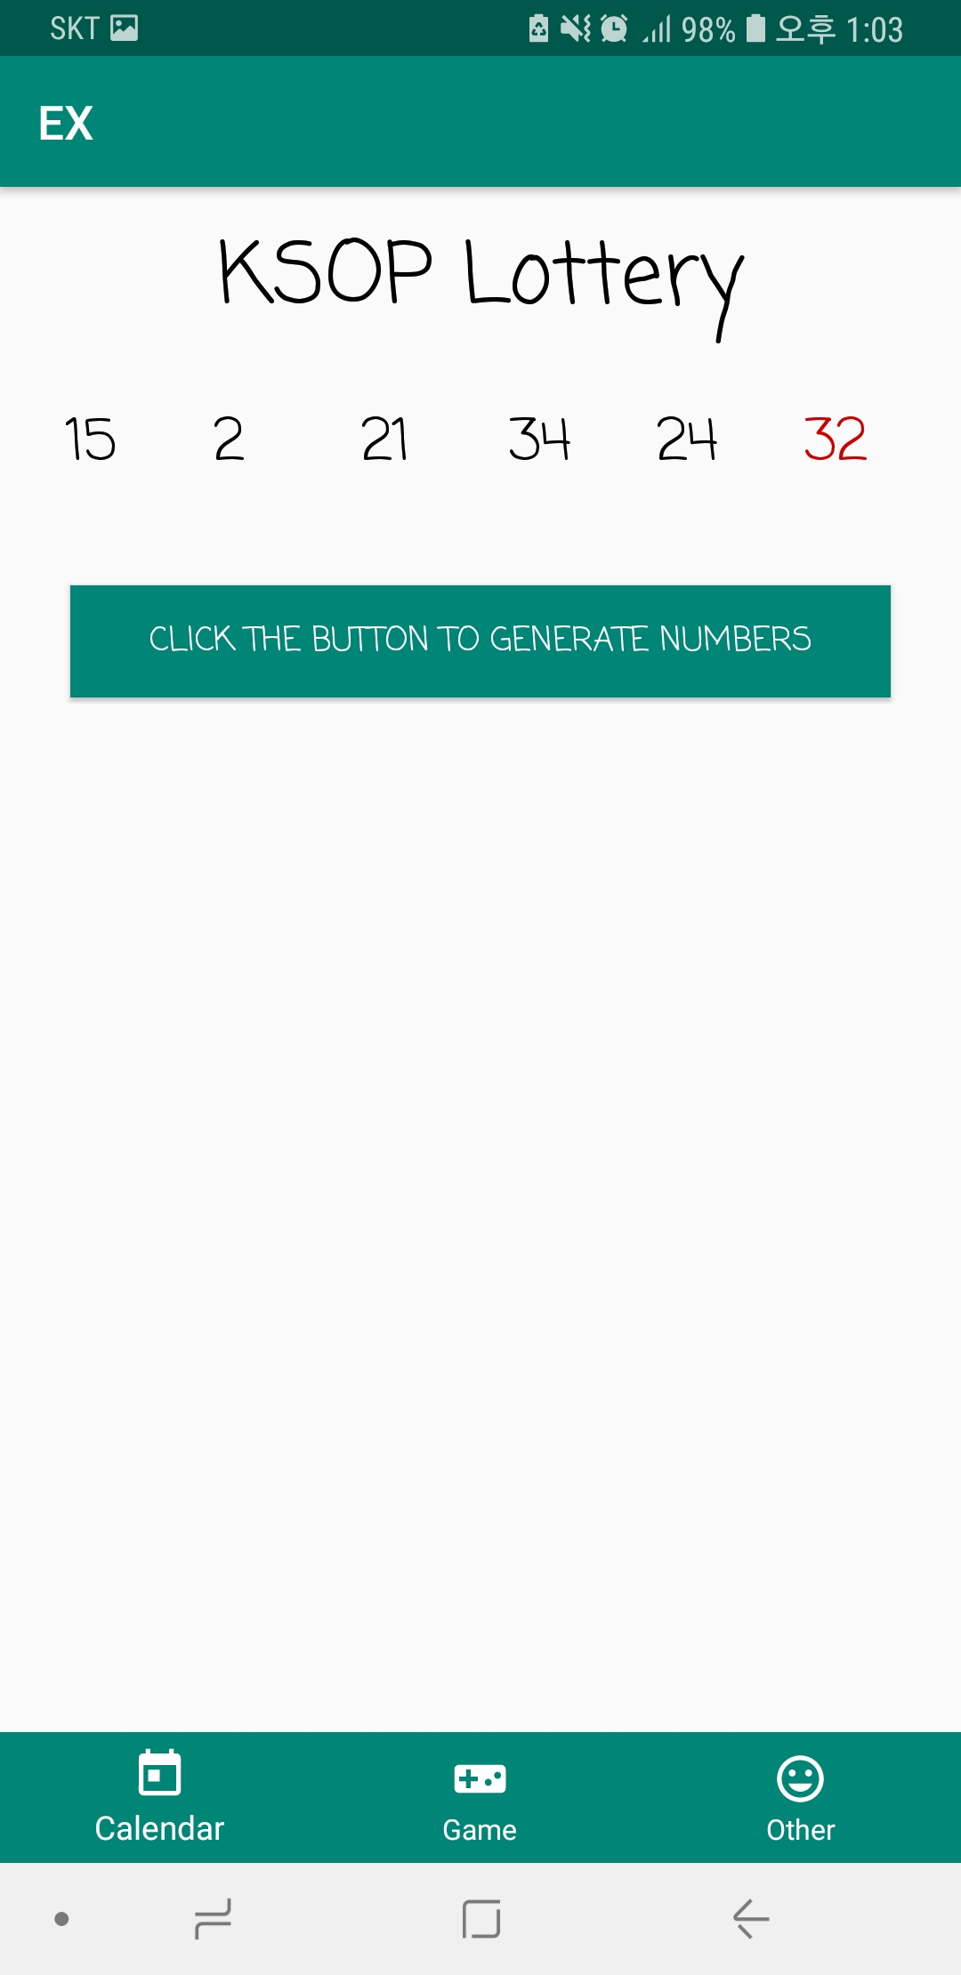
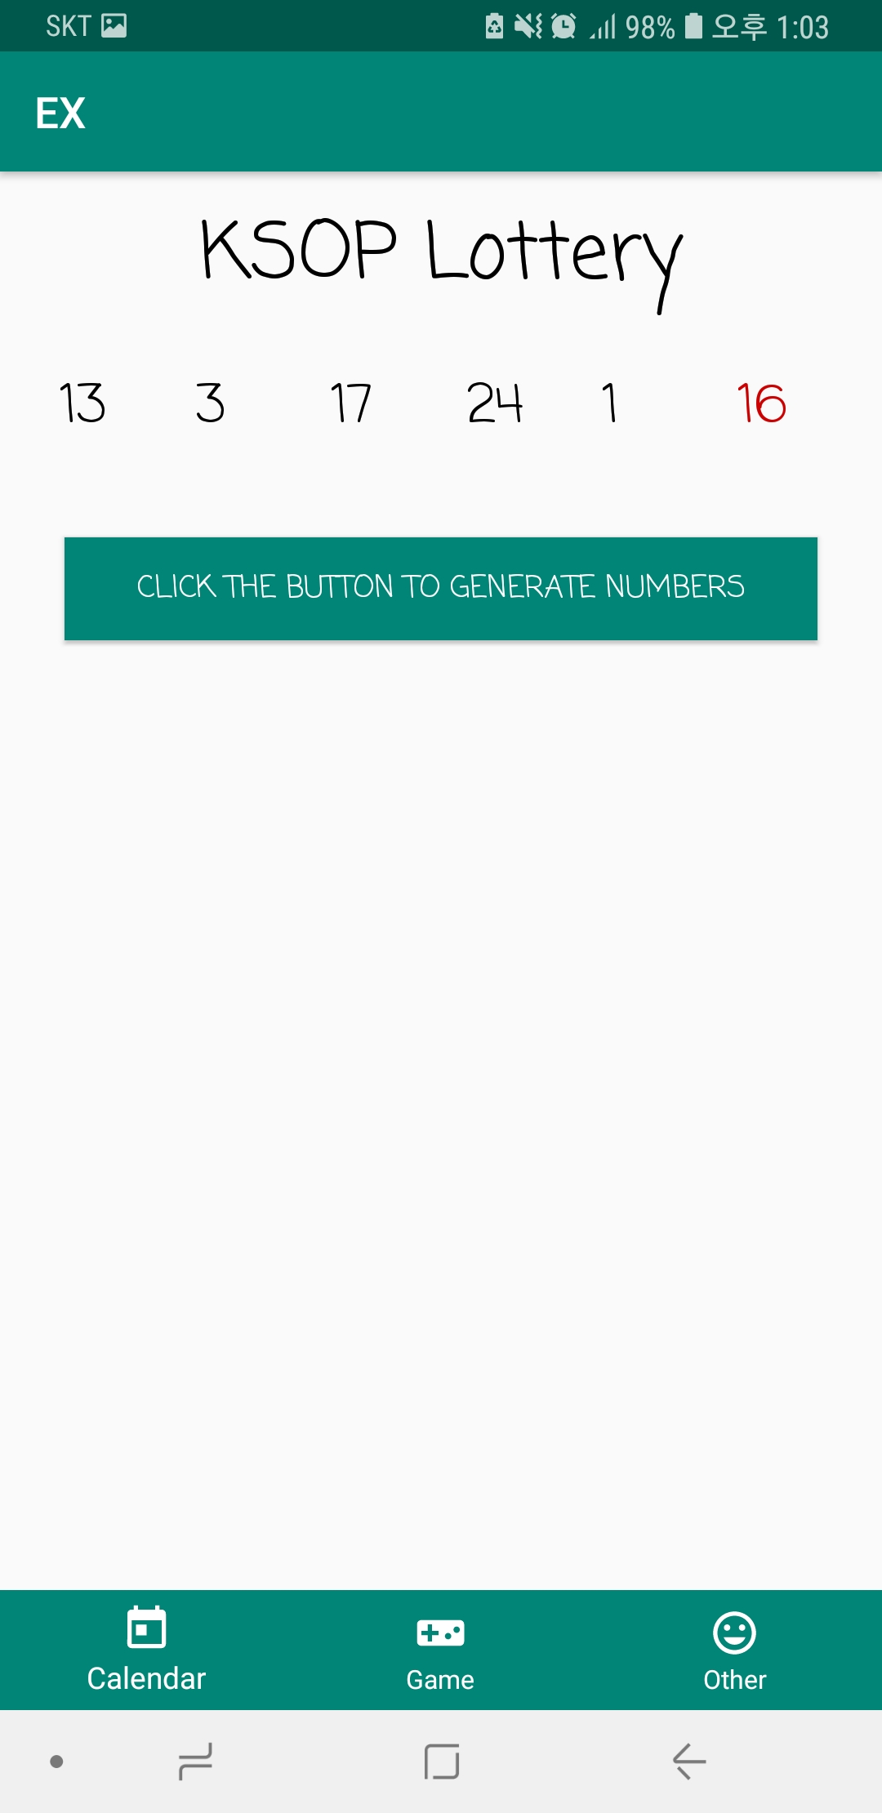
ANDROID STUDIO

