Slide 1
WELCOME

Slide 2
PRESENTED BY
MD Abdul Alim
Sajal Kundu
Solaiman Ahmed
Nazmul Haque
Khandaker Mihir-uj-Jaman

Slide 3
SUPERVISED BY
Md. Mahmudul Hasan
Lecturer,
Department of Computer Science & Engineering
Dhaka International University, Bangladesh

Slide 4
OVERVIEW
Introduction
Objectives
Design Requirements
Development of Project
User Specifications
Testing
Advantage
Problems
Future Development

Slide 5
INTRODUCTION
"Pharmacy Management System", is a medical application system is a client/server based application.
The project was developed on the basis of "stock managing" and its "billing process" being presently used in medical stores.
Its an interactive application for stock and billing which helps in maintaining the records of medicine and keep accounting information of all registered seller of the system.

Slide 6
OBJECTIVES
#The main objective of the application is to automate the existing system of manually maintained.
Records of the counter sales,
Purchases,
Reorder levels,
Supplier and
Customer monetary positions and
Other related transactions made by the seller.

Slide 7
DESIGN REQUIREMENTS
#Hardware Requirements-
Processor: Intel Core Duo 2.0 GHz or higher.
RAM: Minimum 512MB or Greater.
Hard disk: 20 GB (Free Space).
Monitor: Plug and play monitor.
Mouse: Microsoft PS/2 mouse.
Keyboard: Standard 101/102 key.

Slide 8
#Software Requirements-
Software: XAMPP/ WAMMP
Operation System: Windows 7 or higher, MAC, UNIX.
Browser: PHP (7.24)
Back End: MYSQL
Server: APACHE

Slide 9
DEVELOPMENT OF PROJECT
#Programming And Markup Language
HTML5
Json
JQuery
Database
PHP7
Laravel 5.4
Ajax
CSS3
Bootstrap
JavaScript

Slide 10
USER SPECIFICATION
#This system has three kinds of users-
Admin (Top Level User)
Sellers (Mid level User)
Front-end Users (General User)

Slide 11
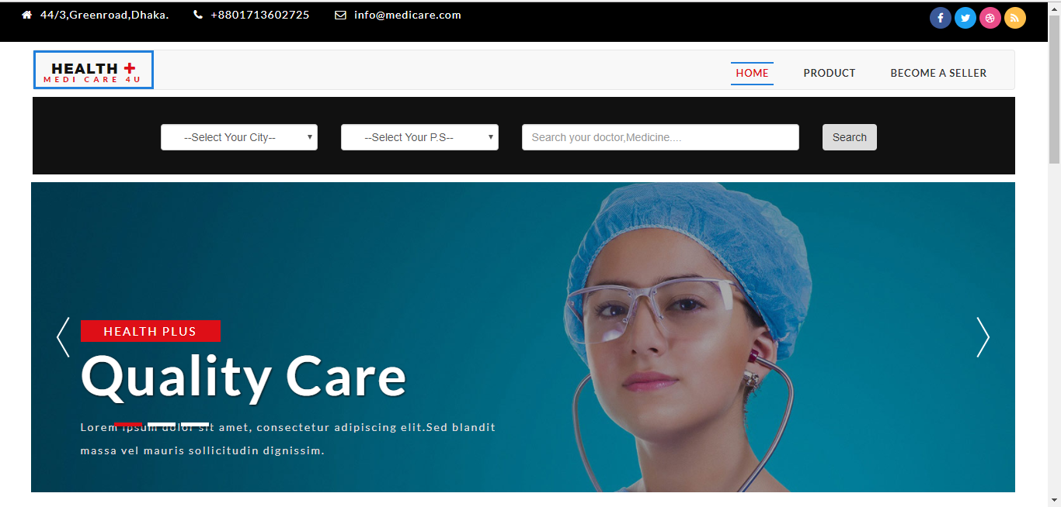
HOMEPAGE

Slide 12
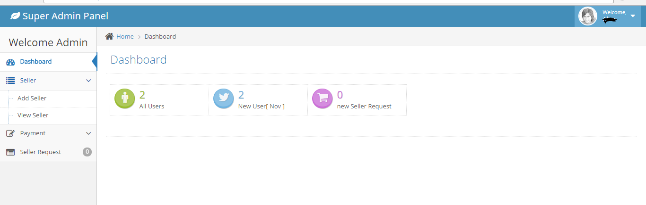
SUPER ADMIN PANEL

Slide 13
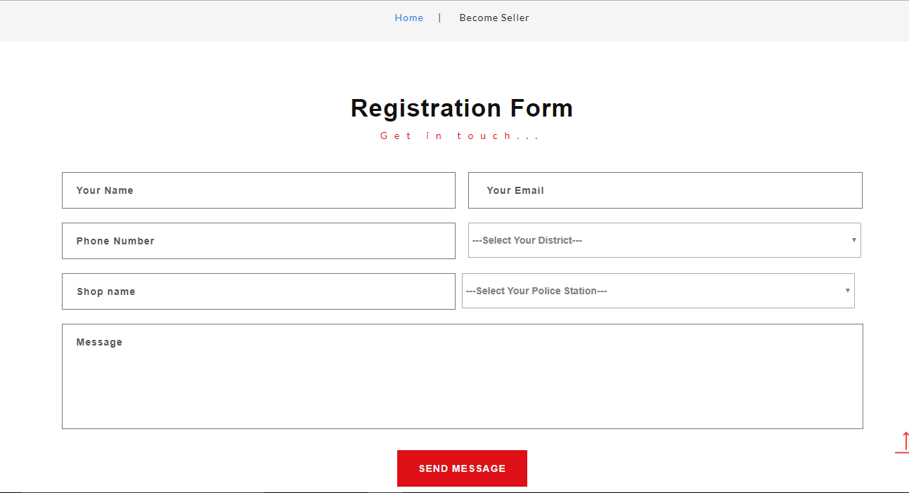
BECOME A SELLER

Slide 14
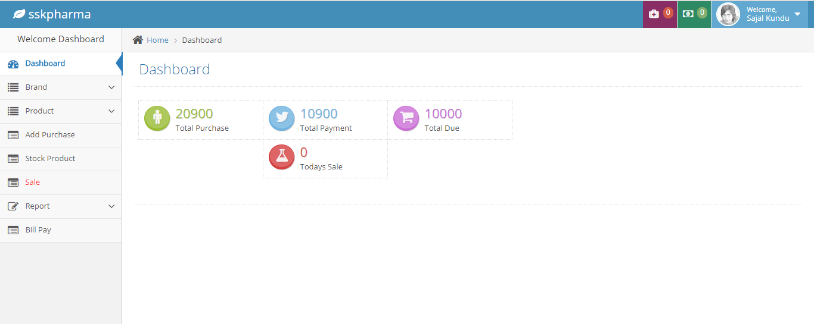
SELLER PANEL

Slide 15
TESTING
#Two kinds of testing we applied-
Testing is very important for every project, Here I’m using Unit testing
Like PHPUnit for testing the project By Terminal,
Another way like Functional Testing.

Slide 16
ADVANTAGES
Time Efficiency.
Search in users area.
Secure Business policy.
Auto Calculation sales and purchase.
Auto Generate Invoice.
Seller can manage suppliers.

Slide 17
PROBLEMS
Case sensitive (for searching).
Issues in interfaces.
Responsibilities of the employees (mistakes, cheatings).
Bill issuing.
Changing the server

Slide 18
FUTURE DEVELOPMENTS
Blood Information.
Provide home delivery services.
Add hospitals information.
Add doctors information.
Connect to doctor via our hotline.
Ambulance service.

Slide 19
Thank You

