Slide 1




Walchand College of Engineering, Sangli
A Goverment-Aided Autonomous Institute
Department of Electrical Engineering
AARAMBH
WCE-HACKATHON 2026
Notes:
Introduce the team and the problem statement number. One sentence: we built a small community power network where neighbours share solar power, settle shared energy through a prepaid ledger, and keep their essential lights on when the main grid fails.

Slide 2
Walchand College of Engineering, Sangli
A Goverment-Aided Autonomous Institute
Project overview
Title: Community Microgrid & Energy Sharing with Hierarchical Control
Team: URJA – Amogh Aralkar, Ganesh Tatgunti, Mohammad Zakir, Pranali Shinde, Atharva Shrivastava
Category: Hardware
Track: Renewable Energy
1 line Core Innovation Summary
A community microgrid where neighbours share surplus solar through a prepaid energy ledger: four ESP32 node controllers protect each house, the solar + battery plant and the community load, a main controller islands the community safely when the grid fails without ever cutting critical loads, and a Raspberry Pi shows it all live on a dashboard.
Notes:
Read the one-line summary slowly; it is the whole pitch. Critical loads are the essentials (a light, a phone charger, a medical device) that must never be cut, even at zero credit. Hierarchical control means two levels: small local controllers (nodes) protect their own equipment, and one main controller coordinates the whole community.

Slide 3
Walchand College of Engineering, Sangli
A Goverment-Aided Autonomous Institute
Problem statement:
PS #38 in brief
Build an intelligent microgrid controller that detects grid failure, manages locally generated renewable energy and storage, prioritises critical loads, and safely manages the transition from grid-connected to islanded operation.
Energy sharing: let neighbouring households trade and route localised solar power.
Solar surplus is not shared
A home with spare rooftop solar cannot sell it to the neighbour next door; it is wasted or exported cheaply.
1
2
No fair way to trade locally
Sharing needs per-household metering and a prepaid record of who bought and sold what.
3
Outages hit essentials first
When the grid fails, every load goes dark, including the ones that matter most.
4
Islanding must be safe
The community must disconnect from a dead grid (no back-feed) and reconnect smoothly.
5
Storage is used blindly
Batteries charge and discharge without regard to price or neighbours' needs.
Notes:
Lead with energy sharing: points 1 and 2 are the heart of PS #38. Microgrid: a small local power network that can run with the main grid or on its own ('islanded'). Back-feed means pushing power into a grid line that workers believe is dead; it is dangerous.

Slide 4
Walchand College of Engineering, Sangli
A Goverment-Aided Autonomous Institute
Proposed solution:
Power system simulated in MATLAB (AC: P and Q)
1
Peer-to-peer energy sharing
Surplus solar from House 1 and the community plant flows to House 2 and the community load.
Main grid
230 V AC
Grid switch
point of connection
Solar + BESS plant
5 kWp PV · 10 kWh battery · inverter
2
Hierarchical control
Nodes protect their own equipment, the main controller coordinates, the Pi shows it live.
community AC bus
3
Prepaid energy ledger
Each house's import/export is metered and settled as credit; RFID card top-up.
House 1
rooftop solar 3 kWp · seller
ESP32 node · prepaid ledger
House 2
no solar · buyer
ESP32 node · RFID prepaid card
Community load
600 W critical + 1.5 kW pump
ESP32 node
4
Grid-failure detection & islanding
Main controller opens the grid switch; the battery holds the community up.
5
Critical-load lifeline
Essentials stay on, even at zero credit.
USB serial
Real hardware: 4 ESP32 node controllers
H1 · H2 · Solar+BESS · Community load: relays, trip, E-stop, LEDs
Main controller (MATLAB)
modes · dispatch · ledger → Raspberry Pi
6
Active & reactive power
AC model tracks both P (real work) and Q (reactive) flows.
Notes:
Everything inside the dashed box is simulated in MATLAB: the main grid, the grid switch, one solar + battery plant (5 kWp, 10 kWh), two houses and a community load. House 1 has rooftop solar and sells its surplus; House 2 has no solar and buys through a prepaid RFID card. The community load has 600 W of critical load (lights, hall) and a 1.5 kW pump that can be shed. The real hardware is four ESP32 boards, one per component, connected by USB: each switches its relays, trips on over-current and has an E-stop. The main controller (MATLAB logic) decides the mode, the battery set-point, shedding and the ledger, and publishes everything to the Raspberry Pi over MQTT for the dashboard. Active power P does useful work; reactive power Q sloshes back and forth in AC systems and must also be supplied.

Slide 5
Walchand College of Engineering, Sangli
A Goverment-Aided Autonomous Institute
Technical approach: How it works
Hierarchical controller-in-the-loop
Operating modes
MATLAB plant
grid · switch · solar + battery plant · 2 houses · community load
BOOT
Everything OFF
GRID
Grid-connected: share solar, charge battery
measurements
V, f, P, Q, battery SOC
stable grid → close switch
commands
switch, shed, battery
grid lost
4 ESP32 node controllers (real boards)
H1 · H2 · Solar+BESS · Community load: relays, trip, E-stop, LEDs
Main controller
MATLAB logic: modes, dispatch, ledger → Pi
RESYNC
Grid back: match voltage and phase
ISLAND
Grid switch open: battery + solar run the community
Safety stays local: each node protects its own equipment and never cuts a critical load; the main controller checks every dashboard request.
Shed order in an outage: community pump → House 2 → House 1 flexible loads; critical loads never shed
Notes:
Left: the four ESP32 boards are real; the power system around them is simulated. Every second MATLAB sends each board its measurements over USB and the board replies, exactly as it would with real sensors. The main controller reads only those replies and the grid meter, then sends commands back. Right: a state machine, so the system is always in one clear mode. It islands when the grid is lost and reconnects only when the grid is stable and voltage and phase match (within 5 degrees), so it does not flap on and off. If the battery runs low in an outage, flexible loads are shed in a fixed order: the community pump first, then House 2, then House 1. Critical loads are never shed.

Slide 6
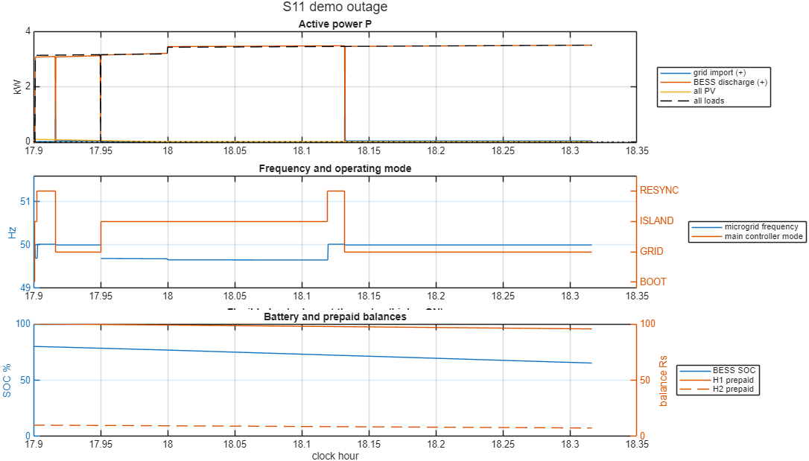
Walchand College of Engineering, Sangli
A Goverment-Aided Autonomous Institute
Technical approach: Simulation & results
Demo scenario: AC microgrid, 4 ESP32 nodes in the loop
13 / 13
test scenarios passed (outage, low battery, faulty house, prepaid, comms loss, dashboard requests)
40 / 40
random Monte Carlo runs passed
0
differences: ESP32 firmware vs MATLAB, 835,600 replies
What we will show live
1
Live demo panel (MATLAB)
Cut and restore the grid, change sun and load, inject faults, press E-stop, cut a node link, tap an RFID card.
2
Live dashboard (in the browser)
Raspberry Pi: MQTT → Node-RED + InfluxDB. Energy flow, battery, node status, prepaid balances and event log.
Grid lost 17:57–18:07: islands at once, battery carries all 3.5 kW, resyncs within 5° and reconnects. No load is shed; battery 80% → 65%.
3
Real boards in the loop
Hardware-in-the-loop run: 0 of 3,000 board replies differed from the MATLAB model.
Same rules in firmware and model: one parameter file feeds both.
Notes:
The chart is our demo scenario: an evening outage of about 10 minutes. Top: the battery (orange) supplies the loads (black dashed). Middle: the mode goes GRID → ISLAND → RESYNC → GRID; frequency stays near 50 Hz. Bottom: battery charge falls slowly from 80% to 65%. Be honest if asked: our model steps once per second, so at the instant the grid fails the bus is dead for one step before the switch opens; a real transfer switch is much faster. Monte Carlo = many random variations of the same day; 0 differences means the C++ firmware on the ESP32 made exactly the same decisions as the MATLAB model for 835,600 replies. On the right is what we will show live: the MATLAB demo panel and the Node-RED dashboard in the browser.

Slide 7
Walchand College of Engineering, Sangli
A Goverment-Aided Autonomous Institute
Impact and benefits:
Energy sharing
Solar surplus stays in the neighbourhood instead of being wasted
Sellers earn credit; buyers pay less than peak grid power
Less grid import at peak hours
Homes without panels still benefit from solar
Fair prepaid ledger
Every unit bought and sold is recorded per house.
Resilience
Critical loads stay on in outages and at zero credit.
Safe islanding
No back-feed to a dead grid line.
Basic load forecasting
Logged demand gives a next-hour trend to plan the battery.
Expected outcome
A simulated community microgrid run by four real ESP32 node controllers and a main controller: it shares solar between neighbours through a prepaid ledger, islands safely when the grid fails, keeps critical loads on, and shows everything live on a dashboard.
Notes:
Lead with energy sharing: it is what makes this a community microgrid rather than just a backup system. Load forecasting here is basic: a trend from the logged demand, used to plan when to charge the battery.

Slide 8
Walchand College of Engineering, Sangli
A Goverment-Aided Autonomous Institute
Future scope:
From model to real streets
Real power hardware: relays, energy meters, a bigger battery
Private dashboard per house and mobile top-up
More houses and a second solar plant
Field test of LCD and E-stop on every node
Live SCADA view
Animated single-line diagram of the grid in MATLAB.
Nodes over MQTT
ESP32 nodes talk over Wi-Fi instead of USB.
Main controller on a board
Move the MATLAB logic onto its own controller.
AI/ML forecasting
Solar and demand forecasts, anomaly detection.
Goal
A community microgrid that a real neighbourhood can install: safe islanding, fair sharing and essentials always on.

Slide 9
Walchand College of Engineering, Sangli
A Goverment-Aided Autonomous Institute
Link of sources and Reference:
[1] A. S. Aralkar et al., "Goodwatts-Intelligent Power Monitoring & Fault Protection System for Residential Buildings," in Advances in Power Systems and Applications, vol. 6, IIP, 2026, pp. 39-54. DOI: 10.58532/nbennurAPSAV6B1P1C3
[2] PIB, Ministry of Power (2023): Electricity (Rights of Consumers) Amendment Rules, Time-of-Day tariff. pib.gov.in/PressReleasePage.aspx?PRID=1934673
[3] PIB: Nationwide push for smart prepaid meters. pib.gov.in/PressReleaseIframePage.aspx?PRID=2202459
[4] IEEE 1547-2018: Interconnection of distributed energy resources with electric power systems (islanding)
[5] Espressif ESP32 datasheet. espressif.com
[6] MathWorks Simscape Electrical. mathworks.com/products/simscape-electrical.html]

