Slide 1




Walchand College of Engineering, Sangli
A Goverment-Aided Autonomous Institute
Department of Electrical Engineering
AARAMBH
WCE-HACKATHON 2026
Notes:
Introduce the team and the problem statement number. One sentence: we built a small community power network where neighbours share solar power, settle shared energy through a prepaid ledger, and keep their essential lights on when the main grid fails.

Slide 2
Walchand College of Engineering, Sangli
A Goverment-Aided Autonomous Institute
TEAM URJA
WCE-HACKATHON 2026
Notes:
Introduce the team and the problem statement number. One sentence: we built a small community power network where neighbours share solar power, settle shared energy through a prepaid ledger, and keep their essential lights on when the main grid fails.

Slide 3
Walchand College of Engineering, Sangli
A Goverment-Aided Autonomous Institute
Project overview
Title: URJA – ‘Unified Renewable Joint Energy Architecture’
Team: Amogh Aralkar, Ganesh Tatgunti, Mohammad Zakir, Pranali Shinde, Atharva Shrivastava
Category: Hardware
Problem Statement ID: PS38 – Community Microgrid & Load Sharing.
Track: Renewable Energy
1-line Core innovation summary
A community microgrid where neighbours share surplus solar through a prepaid energy ledger: 4 ESP node controllers protect each house, the solar + battery plant and the community load, a main controller islands the community safely when the grid fails without ever cutting critical loads, and a Raspberry Pi shoes it all live on a dashboard.
Notes:
Read the one-line summary slowly; it is the whole pitch. Critical loads are the essentials (a light, a phone charger, a medical device) that must never be cut, even at zero credit.

Slide 4
Walchand College of Engineering, Sangli
A Goverment-Aided Autonomous Institute
Problem statement:
PS #38 in brief
Build an intelligent microgrid controller that detects grid failure, manages locally generated renewable energy and storage, prioritizes critical loads, and safely manages the transition from grid-connected to islanded operation.
Energy sharing: let neighboring households trade and route localized solar power.
Solar surplus is not shared
A home with spare rooftop solar cannot sell it to the neighbour next door; it is wasted or exported cheaply.
1
2
No fair way to trade locally
Sharing needs per-household metering and a prepaid record of who bought and sold what.
3
Outages hit essentials first
When the grid fails, every load goes dark, including the ones that matter most.
4
Islanding must be safe
The community must disconnect from a dead grid (no back-feed) and reconnect smoothly.
5
Storage is used blindly
Batteries charge and discharge without regard to price or neighbours' needs.
Notes:
Lead with energy sharing: points 1 and 2 are the heart of PS #38. Microgrid: a small local power network that can run with the main grid or on its own ('islanded'). Back-feed means pushing power into a grid line that workers believe is dead; it is dangerous.

Slide 5
Walchand College of Engineering, Sangli
A Goverment-Aided Autonomous Institute
Proposed solution:
Power System Simulated in MATLAB (AC microgrid)
Peer-to-peer energy sharing
Surplus solar from House 1 and the community plant flows to House 2 and the community load.
1
2
Hierarchical control
Nodes protect their own equipment, the main controller coordinates, the Pi shows it live
3
Prepaid energy ledger
Each house's import/export is metered and settled as credit.
4
Grid-failure detection & islanding
Controller opens the grid switch and the battery holds the community up.
5
Critical-load lifeline
Essentials stay on, even at zero credit.
6
Active & reactive power
AC model tracks both P (real power) and Q (reactive power) flows.
Notes:
Everything inside the dashed box is a MATLAB/Simulink model: main grid, grid switch, shared battery, solar, three houses and a community place (for example a community hall with critical lights). The only real hardware is the ESP32, connected by USB: MATLAB sends it measurements, it sends back decisions, and LEDs show what it decided. Active power P does useful work; reactive power Q sloshes back and forth in AC systems and must also be supplied. Prepaid ledger: each house's energy bought and sold is recorded as credit. The AI/ML energy advisor (planned) runs in Python on a laptop: it forecasts next-hour solar and demand, plans the battery and load shedding ahead of time, and flags faulty sensors or abnormal loads. It only suggests; the ESP32 checks every suggestion against safety limits.

Slide 6
Walchand College of Engineering, Sangli
A Goverment-Aided Autonomous Institute
Technical approach: How it works ?
Hierarchical Controller-in-the-loop
Operating modes
MATLAB Plant
Grid · switch · solar + Battery · 2 houses · community load
BOOT
Everything OFF
GRID
Grid-connected: share solar, charge battery
measurements
V, f, P, Q, battery SOC
stable grid → close switch
commands
switch, shed, battery
grid lost
4 ESP32 controllers (real board)
H1 · H2 · Solar + BESS · Community Load : relay trip, E-stop, LEDs
AI/ML advisor
laptop · Python (planned)
suggests battery set-point, loads to shed, price
RESYNC
Grid back: match voltage, phase and Frequency
ISLAND
Grid switch open: battery + solar run the community
Safety stays local: Each node protects its own equipment and never cuts a critical load; the main controller checks every dashboard request.
Shed order in an outage: flexible loads community load → House 2 → House 1; critical loads never shed
Notes:
Left: the ESP32 is a real board; the power system around it is simulated. Every step MATLAB sends measurements over USB and the ESP32 replies with decisions, exactly as it would with real sensors. Right: a state machine, so the controller is always in one clear mode. It islands when the grid is lost and only reconnects after the grid is stable and voltages match, so it does not flap on and off. The AI/ML advisor (planned) runs in Python on a laptop. It reads the same log the controller produces and suggests a battery set-point, which loads to shed and a price. It is only an advisor: the ESP32 checks every suggestion against its safety limits and ignores it if it is unsafe or missing, falling back to the fixed rules.

Slide 7
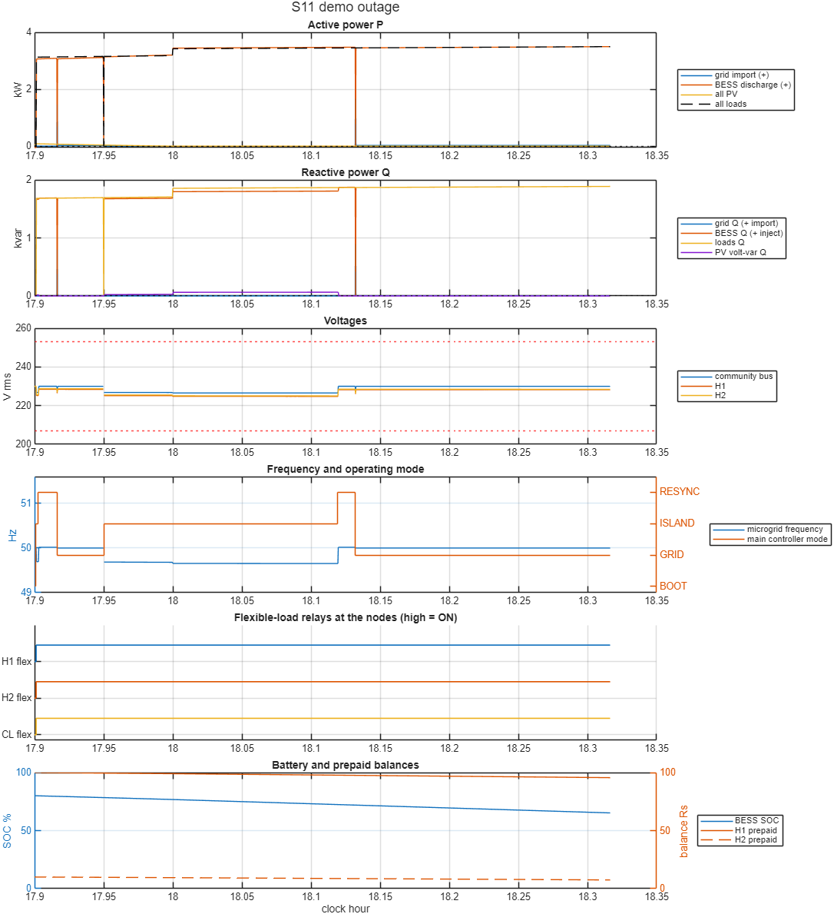
Walchand College of Engineering, Sangli
A Goverment-Aided Autonomous Institute
Technical approach: Simulation & AI/ML advisor
Demo scenario: AC microgrid, 4 ESP32 nodes in the loop
13 / 13
Test scenarios passed (outage, low battery, faulty house, zero credit, comms loss, dashboard requests…)
40 / 40
random Monte Carlo runs passed
0
differences: ESP32 firmware vs MATLAB model, 835,600 replies
Real-Time Data on Dashboard
1
Live demo Control Panel (MATLAB)
Cut and restore the Grid, change sun and load, inject faults, press E-stop, cut a node link, tap an RFID card
2
Live Dashboard (in the browser)
Raspberry Pi : MQTT Node-Red + InfluxDB. Energy flow, Battery, Node status, prepaid balances and event log.
3
Real Boards in the Loop
Controller Hardware in loop run : 0 of 30,000 board replies differed from the MATLAB.
Grid Lost 17:57 – 18:07 islands at once, battery carries all 3.5 kW,
RESYNCs within 5 and reconnects. No load is shed; Battery 80% 65%
Same rules in Firmware and model: one parameter file feeds both
Notes:
Be clear: these results come from our first model, a 12 V DC version used to prove the control logic; the AC model is in progress. Monte Carlo = many random variations; 0 differences means the C++ firmware made exactly the same decisions as the MATLAB model. AI/ML is planned and owned by our AI/ML team: (1) forecast solar and demand an hour ahead, (2) use the forecast to plan the battery and shed loads early, compared against our fixed-threshold rules, (3) detect faulty sensors or abnormal loads. Training data comes from thousands of simulated days plus real NASA POWER / PVGIS sunlight data; load data is synthetic, and we split train/test by day. The controller always keeps the final say on safety.

Slide 8
Walchand College of Engineering, Sangli
A Goverment-Aided Autonomous Institute
Impact and benefits:
Energy sharing
Solar surplus stays in the neighbourhood instead of being wasted
Sellers earn credit; buyers pay less than peak grid power
Less grid import at peak hours
Homes without panels still benefit from solar
Fair prepaid ledger
Every unit bought and sold is recorded per house.
Resilience
Critical loads stay on in outages and at zero credit.
Safe islanding
No back-feed to a dead grid line.
Basic Load Forecasting
Logged demand gives a next-hour trend to plan battery
Expected outcome
A simulated community microgrid run by a real ESP32 node controllers with and a main controller: it shares solar between neighbors through a prepaid ledger, plans the battery from forecasts, islands safely when the grid fails, and keeps critical loads on and shows everything live on dashboard.
Notes:
Lead with energy sharing: it is what makes this a community microgrid rather than just a backup system.

Slide 9
Walchand College of Engineering, Sangli
A Goverment-Aided Autonomous Institute
Link of sources and Reference:
[1] A. S. Aralkar et al., "Goodwatts-Intelligent Power Monitoring & Fault Protection System for Residential Buildings," in Advances in Power Systems and Applications, vol. 6, IIP, 2026, pp. 39-54. DOI: 10.58532/nbennurAPSAV6B1P1C3
[2] PIB, Ministry of Power (2023): Electricity (Rights of Consumers) Amendment Rules, Time-of-Day tariff. pib.gov.in/PressReleasePage.aspx?PRID=1934673
[3] PIB: Nationwide push for smart prepaid meters. pib.gov.in/PressReleaseIframePage.aspx?PRID=2202459
[4] IEEE 1547-2018: Interconnection of distributed energy resources with electric power systems (islanding)
[5] Espressif ESP32 datasheet. espressif.com
[6] MathWorks Simscape Electrical. mathworks.com/products/simscape-electrical.html]

