Slide 1




Walchand College of Engineering, Sangli
A Goverment-Aided Autonomous Institute
Department of Electrical Engineering
AARAMBH
WCE-HACKATHON 2026
PS #38 · Community Microgrid & Energy Sharing
Team: [Team name] · Hardware category
Notes:
Introduce the team and the problem statement number. One sentence: we built a small community power network where neighbours share solar power, pay with prepaid cards, and keep their essential lights on when the main grid fails.

Slide 2
Walchand College of Engineering, Sangli
A Goverment-Aided Autonomous Institute
Project overview
Title: Community Microgrid & Energy Sharing with Prepaid RFID Peer-to-Peer Solar Trading
Team: [Team name] (5 members: [names])
Category: Hardware
Track: PS #38 – Community Microgrid & Energy Sharing
1-line core innovation summary
A 12 V DC community microgrid where neighbours trade rooftop solar through prepaid RFID meters, and critical loads stay powered through grid outages, even at zero credit.
Notes:
Read the one-line summary slowly; it is the whole pitch. 'Critical loads' means the essentials in each home (a light, a phone charger, a medical device) that must never be cut. '12 V DC' means low-voltage direct current, which is safe to handle on a bench.

Slide 3
Walchand College of Engineering, Sangli
A Goverment-Aided Autonomous Institute
Problem statement:
PS #38 as given
Build an intelligent microgrid controller that detects grid failure, manages locally generated renewable energy and storage, prioritises critical loads, and safely manages the transition from grid-connected to islanded operation.
Hardware: a prepaid RFID-based energy dispensing meter that lets neighbouring households trade and route localised solar power.
Outages hit essentials first
When the grid fails, every load goes dark, including lights and medical devices that matter most.
1
Rooftop solar surplus is wasted
A home with spare solar cannot easily sell it to the neighbour next door who has none.
2
Islanding must be safe
A local network must disconnect from a dead grid (no back-feed) and reconnect smoothly when it returns.
3
No simple prepaid accounting
Sharing needs per-household metering and a fair record of who bought and sold what.
4
Notes:
Microgrid: a small local power network (a few homes, solar panels, a shared battery) that can run connected to the main grid or on its own. 'Islanded' means running on its own. Back-feed means pushing power into a grid line that workers believe is dead; it is dangerous, so the microgrid must physically disconnect first.

Slide 4
Walchand College of Engineering, Sangli
A Goverment-Aided Autonomous Institute
Proposed solution:
Grid emulator
12 V SMPS
Grid switch
relay + diode + 1 Ω
Shared battery
12 V 7 Ah sealed lead-acid
1
Detects grid failure, islands
Opens the grid switch about 1 s after the grid is lost (simulated).
12 V DC community bus
2
Critical-load lifeline
Essential loads stay on, even when a household's credit is zero.
3
Prepaid peer-to-peer trading
Neighbours tap an RFID card and buy local solar surplus.
House 1
solar seller
Solar panel + critical & flexible loads
House 2 (simulated)
solar seller
Solar panel + critical & flexible loads
House 3
no solar · buyer
critical & flexible loads
4
Fault isolation
An overloaded house is tripped; the rest of the bus stays up.
RFID prepaid meter
RFID prepaid meter
RFID prepaid meter
5
Safe reconnection
Reconnects only after 10 s of a stable grid.
Community controller · ESP32
islanding, load priority, protection
Raspberry Pi hub
MQTT · ledger · dashboard · AI manager
Notes:
Walk the picture top to bottom. The grid emulator is a power supply that plays the role of the main grid; unplugging it is our 'grid failure'. The bus is the shared pair of wires every house connects to. Two houses have solar and can sell; House 3 has none and buys. Each house has an RFID meter. The ESP32 microcontroller makes the fast safety decisions; the Raspberry Pi keeps the ledger, runs the dashboard and, later, the AI manager. House 2 is simulated in the prototype to save parts.

Slide 5
Walchand College of Engineering, Sangli
A Goverment-Aided Autonomous Institute
Technical approach: hardware & software
Hardware
Software
Controllers: 3× ESP32 (community node + 2 house meters), Raspberry Pi 4 hub
Simulation: MATLAB digital twin; Simulink / Simscape Electrical
Power: 12 V 7 Ah SLA battery, 12 V 5 A SMPS as grid emulator, 12 V-class solar panel (Vmp ≈ 18 V)
Firmware: C++ on ESP32 (Arduino / PlatformIO), constants generated from the MATLAB params file
Sensing: INA219 voltage/current sensors, one per source and house
Messaging: MQTT (Mosquitto broker on the Pi)
Switching: Relay module, P-MOSFET high-side switches on sources, Schottky diodes
Data & UI: Python: ledger database, web dashboard
Metering & UI: RC522 RFID reader + cards, 16×2 LCD
AI / ML: Python: optimisation and forecasting (planned)
Loads: 12 V LED (critical), LED strip / fan (flexible)
Safety by design: 12 V DC only · a fuse on every source · E-stop cuts the switch-driver supply · every switch OFF at power-up · shared ground
Notes:
Why 12 V DC instead of 230 V AC: it is safe to touch, parts are cheap, and direction of power flow (buying vs selling) is easy to measure with a DC sensor. 'High-side switch' means we switch the positive wire of a source, because all grounds are shared. SLA = sealed lead-acid battery. MQTT is a lightweight messaging system: devices 'publish' readings to a broker and others 'subscribe'.

Slide 6
Walchand College of Engineering, Sangli
A Goverment-Aided Autonomous Institute
Technical approach: control logic
BOOT
Everything OFF for 2 s
GRID
Grid-connected: charge battery, sell surplus
Rule | Setting (from one params file)
Critical loads | Always ON, even at zero credit (debt is logged)
Flexible loads (island) | Shed below SOC 40 / 42 / 45 % (H1/H2/H3); back on at +8 %
Battery emergency | SOC below 25 % → all flexible loads off
House over-current | > 1.5 A for 2 s → trip; 2 trips → lockout
Solar curtail | Bus above 14.2 V → reduce solar input
Sell surplus | Grid-connected and SOC above 90 % → export
stable 10 s and |ΔV| < 3 V → close switch
grid lost for 2 s
RESYNC
Grid is back: check voltages match
ISLAND
Grid switch open: battery + solar run the bus
grid back
Shed order in an outage: House 3 → House 2 → House 1
Notes:
This is a state machine: the controller is always in exactly one mode and moves between them on clear conditions. SOC = state of charge, the battery's fuel gauge from 0 to 100 %. 'Shedding' a load means switching it off to save the battery. Each house has a slightly different threshold so loads drop one at a time, not all at once. Waiting 10 s of stable grid before reconnecting stops the system from flapping on and off if the grid is unsteady. All these numbers live in one parameter file that both the simulation and the ESP32 firmware use.

Slide 7
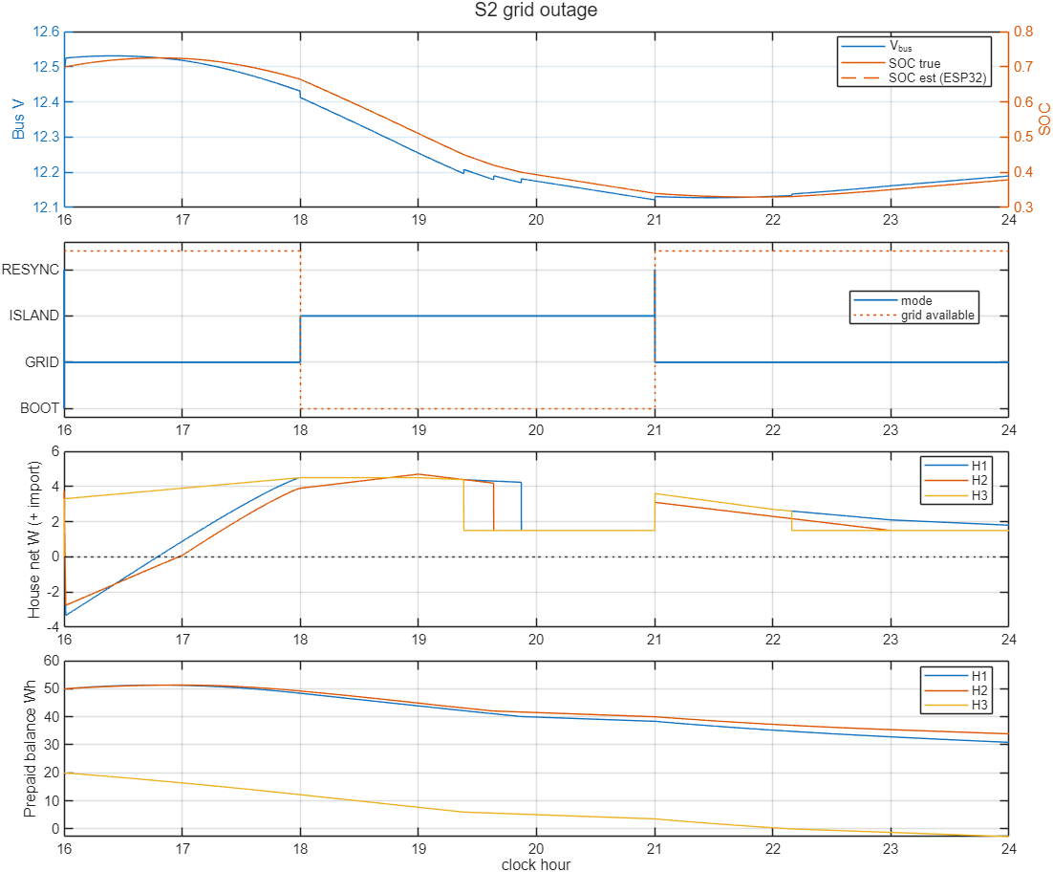
Walchand College of Engineering, Sangli
A Goverment-Aided Autonomous Institute
Technical approach: electrical simulation
One params file
MATLAB digital twin
8 scenarios + Monte Carlo
Firmware vs model (SIL)
ESP32 in the loop (next)
8 / 8
test scenarios passed
40 / 40
Monte Carlo runs passed (random outages, clouds, part tolerances, sensor noise)
0
mismatches: C++ firmware vs MATLAB model over 177,000 ticks
100 %
critical-load energy served in every outage scenario
Modelled: solar panel (diode model), SLA battery (voltage vs charge + internal resistance), grid emulator, 3 houses; bus solved every 1 s. Simulation only; bench values still to be measured.
Scenario S2: simulated evening, grid lost 18:00–21:00. Loads shed H3 → H2 → H1; critical loads never drop.
Notes:
A digital twin is a software copy of the hardware. We wrote it in MATLAB first so we could test dangerous situations (outages, faults, empty battery) safely. Monte Carlo means running many random variations to see if the design is robust, not just lucky. SIL (software-in-the-loop) means we ran the actual C++ firmware against the model and compared every decision tick by tick: zero differences. On the plot: top panel bus voltage and battery charge, second panel the mode, third panel each house's power (flexible loads drop one by one, critical 1.5 W stays), bottom panel prepaid balances.

Slide 8
Walchand College of Engineering, Sangli
A Goverment-Aided Autonomous Institute
Technical approach: simulation results
Scenario | What it tests | Bus V (min–max) | Lowest SOC | Critical served | Result
S1 Normal day | Sunny day, grid on: charging and trading | 12.35–14.20 | 55 % | 100 % | Pass
S2 Grid outage | 3-hour evening outage | 12.12–12.53 | 33 % | 100 % | Pass · islanded in 1 s
S3 Low-battery outage | Outage that starts with a weak battery | 12.00–12.27 | 22 % | 100 % | Pass
S4 Bad card | Invalid RFID taps → card lockout | 12.47–12.73 | 70 % | 100 % | Pass
S5 Zero credit | A household runs out of prepaid credit | 12.20–12.50 | 40 % | 100 % | Pass
S6 Faulty house | 2.5 Ω fault inside House 3 | 12.38–12.69 | 70 % | 100 % healthy houses* | Pass · H3 isolated
S7 Flapping grid | Grid drops and returns repeatedly | 12.46–12.64 | 70 % | 100 % | Pass · one clean reconnect
S8 Full battery | Battery full with solar surplus | 12.69–14.20 | 93 % | 100 % | Pass · solar curtailed
*House 3 is tripped and locked out on purpose to protect the bus; the other houses are unaffected. Pass rules: bus stays within 11.0–14.6 V, critical loads fully served, no relay chatter.
Notes:
Each row is one automated test with pass/fail rules written in advance. The bus voltage always stays inside the safe 11–14.6 V window for 12 V loads. In S6 we deliberately put a near-short inside House 3: the controller trips it twice and then locks it out, and the rest of the community keeps running. 'Chatter' means a switch flicking on and off rapidly; we found and fixed one such bug in simulation.

Slide 9
Walchand College of Engineering, Sangli
A Goverment-Aided Autonomous Institute
Technical approach: prepaid metering & P2P trading
1. Tap RFID card
at the house meter
Who sold to whom: simulated normal day (Wh)
Seller ↓ / Buyer → | House 1 | House 2 | House 3
House 1 | – | 0.0 | 8.6
House 2 | 0.0 | – | 7.2
House 3 | 0.0 | 0.0 | –
2. ESP32 checks the card ID
3 wrong taps → 60 s lockout
3. Valid card: credit added
+20 Wh per top-up (bench scale)
126.5 Wh
solar surplus sent to battery / grid
96.0 Wh
demand met by battery / grid
4. Meter counts energy every second
using debits credit, exporting earns it
Zero-credit rule: flexible loads switch off, the critical load stays on. The balance may go negative and is recovered at the next top-up.
Planned: peer-to-peer price follows India's Time-of-Day tariff (cheaper in solar hours).
5. Ledger on the Pi
records who sold to whom
Notes:
RFID: a contactless card, like a metro card, with a unique ID. Wh (watt-hour) is a unit of energy; our loads are only a few watts, so values are small, but the logic is the same at household scale. Reading the table: in the simulated day House 1 sold 8.6 Wh and House 2 sold 7.2 Wh to House 3. The zero-credit rule is our ethical choice: nobody loses essential power for running out of money.

Slide 10
Walchand College of Engineering, Sangli
A Goverment-Aided Autonomous Institute
Technical approach: monitoring dashboard
Community Microgrid · live
What it shows
ISLANDED
Mode and grid status at a glance
Bus voltage, battery SOC, solar power
Per house: power, credit, load status
Trades and alerts log
Bus voltage
12.3 V
Battery SOC
61 %
Solar now
9.8 W
Grid
OFF
House 1
Net: −2.1 W (selling)
Credit: 42 Wh
Critical ON · Flexible ON
House 2
Net: −1.4 W (selling)
Credit: 38 Wh
Critical ON · Flexible ON
House 3
Net: +1.5 W (buying)
Credit: 4 Wh
Critical ON · Flexible SHED
Data path
Battery SOC, last 8 h
Alerts
18:00 Grid lost → islanded
19:24 House 3 flexible load shed
21:00 Grid stable → reconnected
ESP32 meters
MQTT broker (Pi)
Database + web page
Design mock-up: layout planned, values illustrative (not built yet)
Notes:
This slide is a design, not a screenshot: the dashboard is planned and the numbers are illustrative (they mirror our outage simulation). Data path: each ESP32 publishes readings over Wi-Fi using MQTT; the Raspberry Pi's broker receives them, stores them in a database and serves a web page anyone on the local network can open on a phone.

Slide 11
Walchand College of Engineering, Sangli
A Goverment-Aided Autonomous Institute
Technical approach: AI/ML energy manager
Inputs
Grid available?
Buy / sell price (Time-of-Day)
Solar power, critical & flexible load
Battery SOC, household credit
AI energy manager
runs on the Raspberry Pi, talks to the controller over MQTT
Hard rule: never cuts a critical load
Outputs (suggestions)
Battery charge / discharge set-point
Which flexible loads to shed
Solar curtailment
P2P trades and price
Approach ladder: simple first, smarter later
Ranked objectives
1. Critical loads always served 2. Keep an outage reserve 3. Lower cost 4. Fairness
How we will measure it
Cost saved, self-sufficiency, unserved critical energy (must be 0), fairness between houses. Trained and tested on digital-twin data first.
4
Reinforcement learning (stretch)
3
Forecast solar & load (LightGBM / LSTM)
2
MPC: optimise the next hours
1
Rule-based baseline
Status: planned. The simulation already exports the data format the manager will use.
Notes:
The ESP32 rules keep the system safe on their own; the AI manager only makes it smarter (cheaper, fairer) and can never override the critical-load rule. MPC (model predictive control) means: predict the next few hours, choose the best plan, apply only the first step, repeat. Forecasting predicts tomorrow's solar and demand. Reinforcement learning learns a policy by trial and error in simulation; it is our stretch goal. Owned by our AI/ML lead.

Slide 12
Walchand College of Engineering, Sangli
A Goverment-Aided Autonomous Institute
Technical approach: status & build plan
Verified in simulation
Unit tests 5/5, incl. adding a 4th house with no code change
Scenarios 8/8 and Monte Carlo 40/40
Firmware logic = model (0 mismatches)
MATLAB ↔ ESP32 serial link tested on a real board
Build plan, one block at a time
1
MATLAB plant ↔ real ESP32 over USB
hardware-in-the-loop
2
One real house
INA219 + relay + RFID meter
3
Battery + grid switch
real islanding on the bench
Not yet verified
Full firmware build and flash on the ESP32
Bench values for battery, panel and SMPS (now assumed)
Wi-Fi/MQTT to the Pi, dashboard, AI manager
Stuck-relay and frozen-sensor faults
4
Raspberry Pi
MQTT, ledger, dashboard
5
AI baseline
rule-based manager on live data
Notes:
We are honest about what is proven. Everything on the green card is verified in simulation; the amber card lists what still needs real hardware. The build plan swaps one simulated block for real hardware at a time, so if something breaks we know exactly which block caused it. Hardware-in-the-loop: the real ESP32 controls a simulated plant running in MATLAB.

Slide 13
Walchand College of Engineering, Sangli
A Goverment-Aided Autonomous Institute
Impact and benefits:
Resilience
Critical loads stay on through outages and at zero credit.
More local solar used
Neighbours buy surplus before it goes to the grid.
Fair prepaid billing
Per-house metering and a clear ledger of every trade.
Safe islanding
Disconnects from a dead grid; no back-feed to line workers.
Low cost, scalable
12 V DC, off-the-shelf parts; adding a house is one row in the params file.
Grid-friendly
Ready for India's Time-of-Day tariffs: use and sell in solar hours.
Expected outcome
A working bench-scale 12 V community microgrid: shared battery, prepaid RFID metering, automatic islanding and reconnection, and a live dashboard, backed by a validated digital twin that scales to more houses.
Notes:
Close on outcomes, not features. If asked about scale: the same rules work at 48 V or with real inverters; our parameter file and tests are written so adding houses needs no code change (we tested a 4th house).

Slide 14
Walchand College of Engineering, Sangli
A Goverment-Aided Autonomous Institute
Link of sources and Reference:
[1] Aarambh WCE Hackathon 2026: Problem Statement #38, Community Microgrid & Energy Sharing (organiser document)
[2] PIB, Ministry of Power (2023): Electricity (Rights of Consumers) Amendment Rules, Time-of-Day tariff. pib.gov.in/PressReleasePage.aspx?PRID=1934673
[3] PIB: Nationwide push for smart prepaid meters. pib.gov.in/PressReleaseIframePage.aspx?PRID=2202459
[4] IEEE 1547-2018: Interconnection of distributed energy resources with electric power systems (islanding)
[5] Texas Instruments INA219 current/power monitor datasheet. ti.com/product/INA219
[6] NXP MFRC522 RFID reader datasheet. nxp.com/docs/en/data-sheet/MFRC522.pdf
[7] Espressif ESP32 datasheet. espressif.com
[8] Eclipse Mosquitto MQTT broker. mosquitto.org
[9] MathWorks Simscape Electrical. mathworks.com/products/simscape-electrical.html
[10] Project code: MATLAB digital twin + ESP32 firmware (mg_twin). [repository link]
Notes:
Sources for the problem, the Indian tariff context, the safety standard for islanding, and the main parts.

