Slide 1




Walchand College of Engineering, Sangli
A Goverment-Aided Autonomous Institute
Department of Electrical Engineering
AARAMBH
WCE-HACKATHON 2026
Notes:
Introduce the team and the problem statement number. One sentence: we built a small community power network where neighbours share solar power, pay with prepaid cards, and keep their essential lights on when the main grid fails.

Slide 2
Walchand College of Engineering, Sangli
A Goverment-Aided Autonomous Institute
Project overview
Title: Community Microgrid & Energy Sharing
Team: URJA – Amogh Aralkar, Ganesh Tatgunti, Mohammad Zakir, Pranali Shinde, Atharva Shrivastava
Category: Hardware
Track: Renewable Energy
1 line Core Innovation Ssummary
A community microgrid where neighbours share surplus solar through a prepaid energy ledger, an ESP32 controller islands the community safely when the grid fails, and critical loads are never cut.
Notes:
Read the one-line summary slowly; it is the whole pitch. Critical loads are the essentials (a light, a phone charger, a medical device) that must never be cut, even at zero credit.

Slide 3
Walchand College of Engineering, Sangli
A Goverment-Aided Autonomous Institute
Problem statement:
PS #38 as given
Build an intelligent microgrid controller that detects grid failure, manages locally generated renewable energy and storage, prioritises critical loads, and safely manages the transition from grid-connected to islanded operation.
Hardware: a prepaid RFID-based energy dispensing meter that lets neighbouring households trade and route localised solar power.
Solar surplus is not shared
A home with spare rooftop solar cannot sell it to the neighbour next door; it is wasted or exported cheaply.
1
2
No fair way to trade locally
Sharing needs per-household metering and a prepaid record of who bought and sold what.
3
Outages hit essentials first
When the grid fails, every load goes dark, including the ones that matter most.
4
Islanding must be safe
The community must disconnect from a dead grid (no back-feed) and reconnect smoothly.
5
Storage is used blindly
Batteries charge and discharge without regard to price or neighbours' needs.
Notes:
Lead with energy sharing: points 1 and 2 are the heart of PS #38. Microgrid: a small local power network that can run with the main grid or on its own ('islanded'). Back-feed means pushing power into a grid line that workers believe is dead; it is dangerous.

Slide 4
Walchand College of Engineering, Sangli
A Goverment-Aided Autonomous Institute
Proposed solution:
Simulated in MATLAB / Simulink (AC microgrid)
1
Peer-to-peer energy sharing
Surplus solar from House 1–2 flows to House 3 and the community place first.
Main grid
230 V AC
Grid switch
point of connection
Shared battery
BESS + inverter
Solar PV
+ inverter
2
Prepaid energy ledger
Each house's import/export is metered and settled as credit.
community AC bus
3
Grid-failure detection & islanding
Controller opens the grid switch and the battery holds the community up.
House 1
rooftop solar · seller
meter + prepaid ledger
House 2
rooftop solar · seller
meter + prepaid ledger
House 3
no solar · buyer
meter + prepaid ledger
Community place
critical loads
meter + prepaid ledger
4
Critical-load lifeline
Essentials stay on, even at zero credit.
USB serial
5
Active & reactive power
AC model tracks both P (real work) and Q (reactive) flows.
Real hardware: ESP32 controller
decides islanding, load priority and sharing · LEDs show grid, island and each house's state
Notes:
Everything inside the dashed box is a MATLAB/Simulink model: main grid, grid switch, shared battery, solar, three houses and a community place (for example a community hall with critical lights). The only real hardware is the ESP32, connected by USB: MATLAB sends it measurements, it sends back decisions, and LEDs show what it decided. Active power P does useful work; reactive power Q sloshes back and forth in AC systems and must also be supplied. Prepaid ledger: each house's energy bought and sold is recorded as credit.

Slide 5
Walchand College of Engineering, Sangli
A Goverment-Aided Autonomous Institute
Technical approach: How it works
Controller-in-the-loop
Operating modes
MATLAB / Simulink plant
grid · switch · battery · solar · 3 houses · community place
BOOT
Everything OFF
GRID
Grid-connected: share solar, charge battery
measurements
V, f, P, Q, battery SOC
stable grid → close switch
grid lost
commands
switch, shed, battery
ESP32 controller (real board)
state machine · load priority · sharing rules · LEDs
RESYNC
Grid back: match voltage
ISLAND
Grid switch open: battery + solar run the community
Every tunable number lives in one params file shared by model and firmware.
Shed order in an outage: flexible loads of House 3 → 2 → 1; critical loads never shed
Notes:
Left: the ESP32 is a real board; the power system around it is simulated. Every step MATLAB sends measurements over USB and the ESP32 replies with decisions, exactly as it would with real sensors. Right: a state machine, so the controller is always in one clear mode. It islands when the grid is lost and only reconnects after the grid is stable and voltages match, so it does not flap on and off.

Slide 6
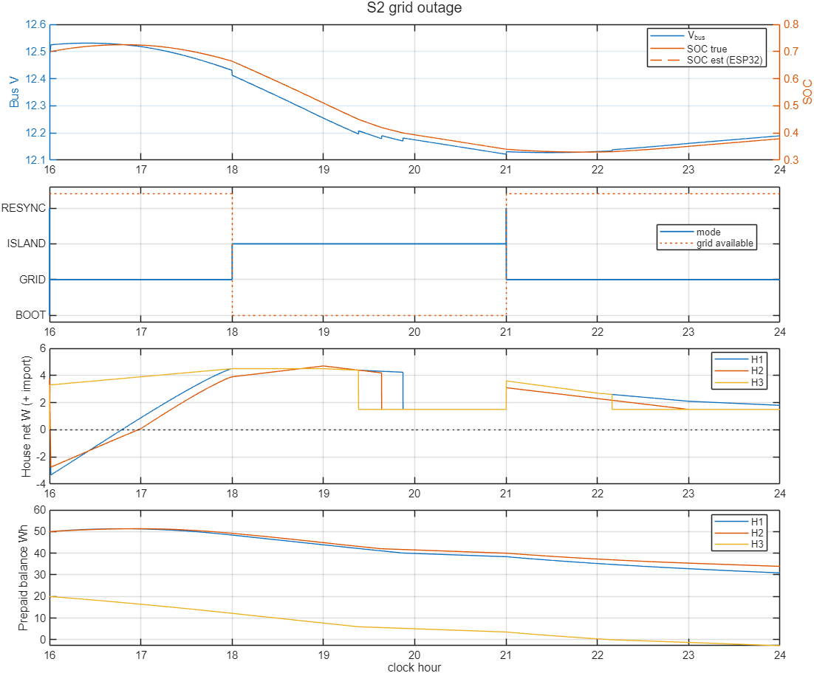
Walchand College of Engineering, Sangli
A Goverment-Aided Autonomous Institute
Technical approach: Simulation so far & next steps
Control-logic check on our 12 V DC model; AC model in progress
8 / 8
test scenarios passed (outage, low battery, faulty house, zero credit…)
40 / 40
random Monte Carlo runs passed
0
differences: ESP32 firmware vs MATLAB model, 177,000 steps
Next (planned)
AC model: Simulink AC microgrid with active (P) and reactive (Q) power flow; re-run the same tests.
AI/ML energy manager: Price-aware: buy when cheap, sell surplus, keep an outage reserve. Never cuts critical loads.
Dashboard: Live view of mode, power flows and each house's credit.
Grid lost 18:00–21:00: islanded, flexible loads shed H3 → H2 → H1, critical loads never drop.
Notes:
Be clear: these results come from our first model, a 12 V DC version used to prove the control logic. The decisions (when to island, what to shed, how to share) are the same for AC; the power-system model is what changes, and the AC model is in progress. Monte Carlo = many random variations to test robustness. The 0 differences means the C++ firmware made exactly the same decisions as the MATLAB model. AI/ML and the dashboard are planned, not built.

Slide 7
Walchand College of Engineering, Sangli
A Goverment-Aided Autonomous Institute
Impact and benefits:
Energy sharing
Solar surplus stays in the neighbourhood instead of being wasted
Sellers earn credit; buyers pay less than peak grid power
Less grid import at peak hours
Homes without panels still benefit from solar
Fair prepaid ledger
Every unit bought and sold is recorded per house.
Resilience
Critical loads stay on in outages and at zero credit.
Safe islanding
No back-feed to a dead grid line.
Scalable
Adding a house is one row in the params file.
Expected outcome
A simulated community microgrid run by a real ESP32 controller that shares solar between neighbours through a prepaid ledger, islands safely when the grid fails, and keeps critical loads on.
Notes:
Lead with energy sharing: it is what makes this a community microgrid rather than just a backup system.

Slide 8
Walchand College of Engineering, Sangli
A Goverment-Aided Autonomous Institute
Link of sources and Reference:
[1] A. S. Aralkar et al., "Goodwatts-Intelligent Power Monitoring & Fault Protection System for Residential Buildings," in Advances in Power Systems and Applications, vol. 6, IIP, 2026, pp. 39-54. DOI: 10.58532/nbennurAPSAV6B1P1C3
[2] PIB, Ministry of Power (2023): Electricity (Rights of Consumers) Amendment Rules, Time-of-Day tariff. pib.gov.in/PressReleasePage.aspx?PRID=1934673
[3] PIB: Nationwide push for smart prepaid meters. pib.gov.in/PressReleaseIframePage.aspx?PRID=2202459
[4] IEEE 1547-2018: Interconnection of distributed energy resources with electric power systems (islanding)
[5] Espressif ESP32 datasheet. espressif.com
[6] MathWorks Simscape Electrical. mathworks.com/products/simscape-electrical.html]

