Slide 1




Walchand College of Engineering, Sangli
A Goverment-Aided Autonomous Institute
Department of Electrical Engineering
AARAMBH
WCE-HACKATHON 2026
Notes:
Introduce the team and the problem statement number. One sentence: we built a small community power network where neighbours share solar power, settle shared energy through a prepaid ledger, and keep their essential lights on when the main grid fails.

Slide 2
Walchand College of Engineering, Sangli
A Goverment-Aided Autonomous Institute
Project overview
Title: Community Microgrid & Energy Sharing with an AI/ML Energy Advisor
Team: URJA – Amogh Aralkar, Ganesh Tatgunti, Mohammad Zakir, Pranali Shinde, Atharva Shrivastava
Category: Hardware
Track: Renewable Energy
1 line Core Innovation Ssummary
A community microgrid where neighbours share surplus solar through a prepaid energy ledger, an AI/ML advisor forecasts solar and demand to plan the battery, and an ESP32 controller islands the community safely when the grid fails, never cutting critical loads.
Notes:
Read the one-line summary slowly; it is the whole pitch. Critical loads are the essentials (a light, a phone charger, a medical device) that must never be cut, even at zero credit.

Slide 3
Walchand College of Engineering, Sangli
A Goverment-Aided Autonomous Institute
Problem statement:
PS #38 in brief
Build an intelligent microgrid controller that detects grid failure, manages locally generated renewable energy and storage, prioritises critical loads, and safely manages the transition from grid-connected to islanded operation.
Energy sharing: let neighbouring households trade and route localised solar power.
Solar surplus is not shared
A home with spare rooftop solar cannot sell it to the neighbour next door; it is wasted or exported cheaply.
1
2
No fair way to trade locally
Sharing needs per-household metering and a prepaid record of who bought and sold what.
3
Outages hit essentials first
When the grid fails, every load goes dark, including the ones that matter most.
4
Islanding must be safe
The community must disconnect from a dead grid (no back-feed) and reconnect smoothly.
5
Storage is used blindly
Batteries charge and discharge without regard to price or neighbours' needs.
Notes:
Lead with energy sharing: points 1 and 2 are the heart of PS #38. Microgrid: a small local power network that can run with the main grid or on its own ('islanded'). Back-feed means pushing power into a grid line that workers believe is dead; it is dangerous.

Slide 4
Walchand College of Engineering, Sangli
A Goverment-Aided Autonomous Institute
Proposed solution:
Simulated in MATLAB / Simulink (AC microgrid)
1
Peer-to-peer energy sharing
Surplus solar from House 1–2 flows to House 3 and the community place first.
Main grid
230 V AC
Grid switch
point of connection
Shared battery
BESS + inverter
Solar PV
+ inverter
2
AI/ML energy advisor
Forecasts solar & demand, plans the battery, flags faults; ESP32 keeps the final say.
community AC bus
3
Prepaid energy ledger
Each house's import/export is metered and settled as credit.
House 1
rooftop solar · seller
meter + prepaid ledger
House 2
rooftop solar · seller
meter + prepaid ledger
House 3
no solar · buyer
meter + prepaid ledger
Community place
critical loads
meter + prepaid ledger
4
Grid-failure detection & islanding
Controller opens the grid switch and the battery holds the community up.
5
Critical-load lifeline
Essentials stay on, even at zero credit.
USB serial
Real hardware: ESP32 controller
islanding · load priority · sharing · LED indicators
AI/ML energy advisor
forecasts · plans battery · flags faults
6
Active & reactive power
AC model tracks both P (real work) and Q (reactive) flows.
Notes:
Everything inside the dashed box is a MATLAB/Simulink model: main grid, grid switch, shared battery, solar, three houses and a community place (for example a community hall with critical lights). The only real hardware is the ESP32, connected by USB: MATLAB sends it measurements, it sends back decisions, and LEDs show what it decided. Active power P does useful work; reactive power Q sloshes back and forth in AC systems and must also be supplied. Prepaid ledger: each house's energy bought and sold is recorded as credit. The AI/ML energy advisor (planned) runs in Python on a laptop: it forecasts next-hour solar and demand, plans the battery and load shedding ahead of time, and flags faulty sensors or abnormal loads. It only suggests; the ESP32 checks every suggestion against safety limits.

Slide 5
Walchand College of Engineering, Sangli
A Goverment-Aided Autonomous Institute
Technical approach: How it works
Controller-in-the-loop
Operating modes
MATLAB / Simulink plant
grid · switch · battery · solar · 3 houses · community place
BOOT
Everything OFF
GRID
Grid-connected: share solar, charge battery
measurements
V, f, P, Q, battery SOC
stable grid → close switch
commands
switch, shed, battery
grid lost
ESP32 controller (real board)
state machine · load priority · sharing rules · LEDs
AI/ML advisor
laptop · Python (planned)
suggests battery set-point, loads to shed, price
RESYNC
Grid back: match voltage
ISLAND
Grid switch open: battery + solar run the community
ESP32 keeps the final say: every AI suggestion is checked against safety limits; if the AI fails, fixed priority rules take over.
Shed order in an outage: flexible loads of House 3 → 2 → 1; critical loads never shed
Notes:
Left: the ESP32 is a real board; the power system around it is simulated. Every step MATLAB sends measurements over USB and the ESP32 replies with decisions, exactly as it would with real sensors. Right: a state machine, so the controller is always in one clear mode. It islands when the grid is lost and only reconnects after the grid is stable and voltages match, so it does not flap on and off. The AI/ML advisor (planned) runs in Python on a laptop. It reads the same log the controller produces and suggests a battery set-point, which loads to shed and a price. It is only an advisor: the ESP32 checks every suggestion against its safety limits and ignores it if it is unsafe or missing, falling back to the fixed rules.

Slide 6
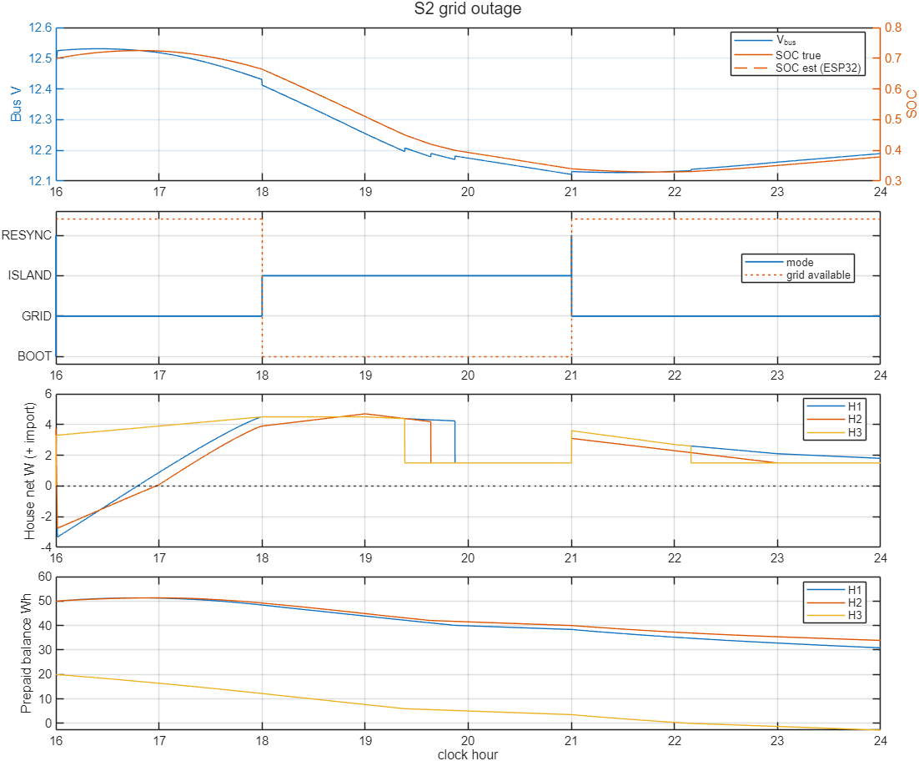
Walchand College of Engineering, Sangli
A Goverment-Aided Autonomous Institute
Technical approach: Simulation & AI/ML advisor
Control-logic check on our 12 V DC model; AC model in progress
8 / 8
test scenarios passed (outage, low battery, faulty house, zero credit…)
40 / 40
random Monte Carlo runs passed
0
differences: ESP32 firmware vs MATLAB model, 177,000 steps
AI/ML advisor (planned): where it adds value
1
Solar & load forecasting
Next-hour solar and demand per house: LightGBM / XGBoost on NASA POWER or PVGIS irradiance + simulated loads. Proof: forecast error (MAE).
2
Forecast-aware shedding & battery plan
Act before the battery runs low; show "critical loads last X h". Proof: vs fixed-SOC rules, longer survival, fewer needless sheds.
3
Anomaly detection
Isolation Forest on voltage/current flags frozen sensors and abnormal loads. Proof: detection rate on injected faults.
Grid lost 18:00–21:00: islanded, flexible loads shed H3 → H2 → H1, critical loads never drop.
Also next: AC Simulink model (P and Q flows) and a live dashboard.
Notes:
Be clear: these results come from our first model, a 12 V DC version used to prove the control logic; the AC model is in progress. Monte Carlo = many random variations; 0 differences means the C++ firmware made exactly the same decisions as the MATLAB model. AI/ML is planned and owned by our AI/ML team: (1) forecast solar and demand an hour ahead, (2) use the forecast to plan the battery and shed loads early, compared against our fixed-threshold rules, (3) detect faulty sensors or abnormal loads. Training data comes from thousands of simulated days plus real NASA POWER / PVGIS sunlight data; load data is synthetic, and we split train/test by day. The controller always keeps the final say on safety.

Slide 7
Walchand College of Engineering, Sangli
A Goverment-Aided Autonomous Institute
Impact and benefits:
Energy sharing
Solar surplus stays in the neighbourhood instead of being wasted
Sellers earn credit; buyers pay less than peak grid power
Less grid import at peak hours
Homes without panels still benefit from solar
Fair prepaid ledger
Every unit bought and sold is recorded per house.
Resilience
Critical loads stay on in outages and at zero credit.
Safe islanding
No back-feed to a dead grid line.
AI-optimised
Forecasts plan battery and sharing ahead; fewer needless load sheds.
Expected outcome
A simulated community microgrid run by a real ESP32 controller with an AI/ML advisor: it shares solar between neighbours through a prepaid ledger, plans the battery from forecasts, islands safely when the grid fails, and keeps critical loads on.
Notes:
Lead with energy sharing: it is what makes this a community microgrid rather than just a backup system.

Slide 8
Walchand College of Engineering, Sangli
A Goverment-Aided Autonomous Institute
Link of sources and Reference:
[1] A. S. Aralkar et al., "Goodwatts-Intelligent Power Monitoring & Fault Protection System for Residential Buildings," in Advances in Power Systems and Applications, vol. 6, IIP, 2026, pp. 39-54. DOI: 10.58532/nbennurAPSAV6B1P1C3
[2] PIB, Ministry of Power (2023): Electricity (Rights of Consumers) Amendment Rules, Time-of-Day tariff. pib.gov.in/PressReleasePage.aspx?PRID=1934673
[3] PIB: Nationwide push for smart prepaid meters. pib.gov.in/PressReleaseIframePage.aspx?PRID=2202459
[4] IEEE 1547-2018: Interconnection of distributed energy resources with electric power systems (islanding)
[5] Espressif ESP32 datasheet. espressif.com
[6] MathWorks Simscape Electrical. mathworks.com/products/simscape-electrical.html]

