Slide 1
SOC-Based Passive Cell Balancing for a
Series-Connected Li-ion Battery Pack
Mini Project, Energy Storage Systems for Electric Vehicles (7EL304)
Presented by: Group of 5 (names)
Guided by: (faculty name)
Department of Electrical Engineering | October 2026
Notes:
Introduce the group and the topic: a simulation study of passive cell balancing driven by state of charge rather than voltage.

Slide 2
Outline
I. Introduction and motivation
II. Problem statement
III. Objectives and system specification
IV. Cell modelling and validation
V. Pack model architecture
VI. Balancing control law and BMS supervisor
VII. Simulation results
VIII. Discussion, limitations and future work
IX. Conclusion
Cell model (ECM)
Validation vs. script
3S pack + bleed circuits
SOC-based balancing
Mode supervisor
Results and metrics
Notes:
Walk through the structure. The right-hand chain is the method in the order it was built.

Slide 3
I. Introduction: Cell Imbalance in Series Packs
EV and BESS packs connect many cells in series; the same current flows through every cell
Manufacturing spread in capacity, internal resistance (R0) and self-discharge makes cells drift apart in state of charge (SOC)
The weakest cell reaches the upper voltage limit first during charging and the lower limit first during discharging
Consequence: loss of usable pack capacity and accelerated ageing of the weakest cell
Cell balancing equalises SOC so that the full pack capacity remains usable
Q_pack = min(Q₁, Q₂, … , Qₙ)
In a series string the usable capacity is bounded by the smallest cell; cells in series add voltage, not ampere-hours.
I
Cell 1
2.5 Ah
Cell 2
2.5 Ah
Cell 3
2.5 Ah
Fig. 1. Series string: identical current, different capacity.
Notes:
Series connection is why imbalance matters: the pack can only deliver what its weakest cell allows.

Slide 4
I. Introduction: Passive and Active Balancing
TABLE I
COMPARISON OF BALANCING METHODS
Attribute | Passive (dissipative) | Active (charge transfer)
Principle | Excess charge of high-SOC cells dissipated in a bleed resistor | Charge moved from high-SOC to low-SOC cells
Hardware | Switch + resistor per cell (often inside the monitor IC) | Capacitors, inductors, transformers or DC-DC converters
Energy efficiency | Low: surplus energy lost as heat | High: surplus energy reused
Balancing current | Low; typically 1-5 % of cell capacity [3]; ~65-96 mA in TI BQ769x2 [1] | Higher; limited by converter rating
Cost / complexity | Low; widely adopted in commercial BMS [3] | Higher control and component count
This work uses passive balancing: it is the prevalent industrial method and isolates the effect of the balancing decision rule.
Notes:
Passive balancing is simple and cheap but wastes energy; active balancing is efficient but complex. We study passive.

Slide 5
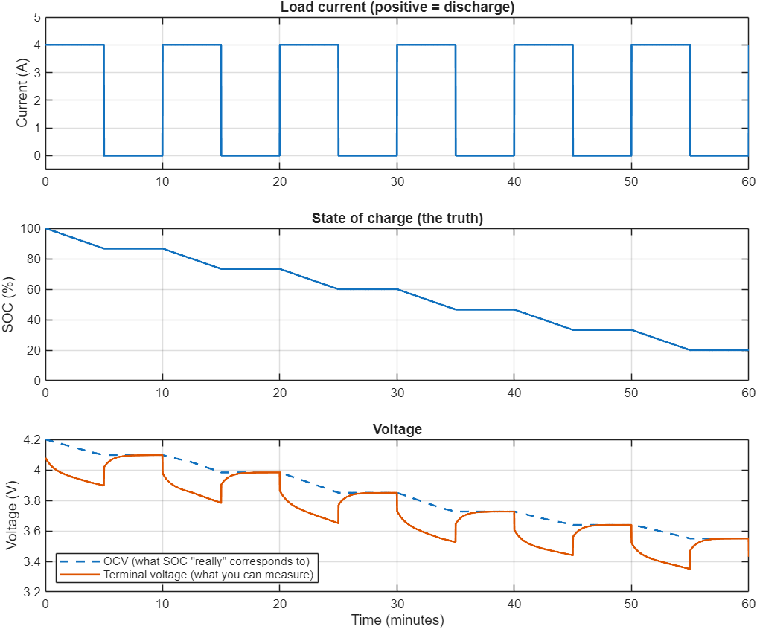
II. Problem Statement: Terminal Voltage Is a Poor SOC Indicator
Conventional balancers trigger on cell voltage differences
Under current, the terminal voltage deviates from OCV(SOC) by the ohmic drop I·R0 and the RC polarisation voltage
At identical SOC the simulated cell reads 3.897 V at the end of a 4 A pulse and 4.097 V after 5 min rest: a 0.20 V error
Voltage-based decisions can therefore bleed the wrong cell or balance unnecessarily
The effect is stronger for LFP chemistry, whose flat OCV curve weakens voltage as an SOC proxy [4]
Proposed: base the balancing decision on SOC [2]
Fig. 2. Single-cell pulse test (4 A, 5 min on / 5 min off).
Notes:
This is the motivation. SOC is constant during the rest period, but the voltage recovers by 0.2 V.

Slide 6
III. Objectives and Scope
Model a 3S Li-ion pack in MATLAB/Simulink with Simscape Battery
Implement per-cell passive balancing with an SOC-based decision rule and hysteresis
Operate the pack through a supervisory mode cycle: charge, rest, discharge, rest
Evaluate identical cells and cells with capacity and R0 mismatch
Quantify balancing time, dissipated energy and final SOC spread
TABLE II
SCOPE OF THE STUDY
In scope | Out of scope (future)
Passive balancing | Active balancing
True (model) SOC | SOC estimation (CC, EKF)
CC charging + cut-off | CC-CV charging
Electrical model | Thermal model
Notes:
State what is and is not covered so that the results are read in the right context.

Slide 7
III. System Specification
TABLE III
PACK AND SIMULATION PARAMETERS
Parameter | Value
Configuration | 3S1P (three cells in series)
Cell | Li-ion 18650 type, 3.7 V nominal, 2.5 Ah
Pack capacity | 2.5 Ah
Pack voltage | 11.1 V nominal (9.0-12.6 V)
Pack energy | 27.75 Wh
Charge / discharge current | 1.25 A (0.5C)
Charge cut-off / resume | 4.20 V / 4.15 V (highest cell)
Discharge limit | 3.00 V (lowest cell)
Bleed resistor | 47 Ω per cell (≈ 88 mA, ≈ 0.37 W)
Balancing ON / OFF threshold | ΔSOC > 1.0 % / < 0.5 %
BMS sample time | 1 s
Pack energy: E = 3 × 3.7 V × 2.5 Ah = 27.75 Wh
Bleed current 4.15 V / 47 Ω ≈ 88 mA ≈ 3.5 % of 1C, inside the typical 1-5 % range [3]
Mismatch case: Cell 2 at 2.3 Ah limits usable capacity to 2.3 Ah (≈ 25.5 Wh, -8 %)
Notes:
Pack capacity equals the cell capacity because the cells are in series. The mismatch case lowers it to the weakest cell.

Slide 8
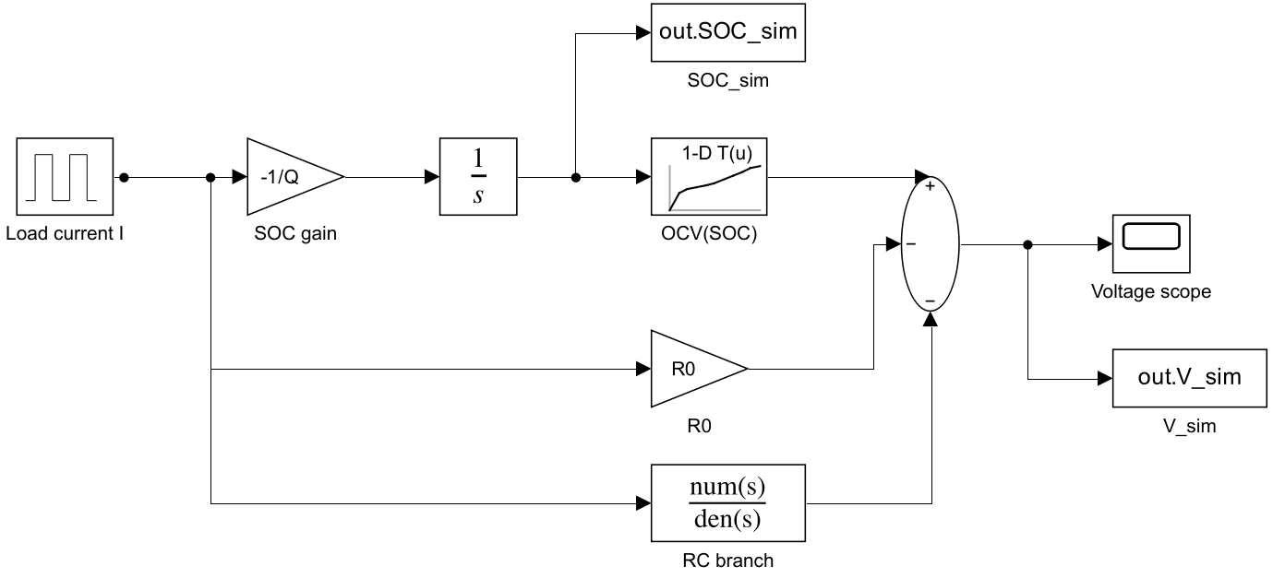
IV. Cell Model: First-Order Equivalent Circuit
R₁
OCV(SOC)
R₀
+ V_t
C₁
Fig. 3. First-order (1-RC) equivalent circuit model.
SOC(t) = SOC₀ − (1/Q) ∫ I(τ) dτ
dV₁/dt = −V₁ /(R₁C₁) + I / C₁
Fig. 4. Equivalent circuit implemented with Simulink blocks.
V_t = OCV(SOC) − I·R₀ − V₁
I > 0 discharge. Parameters (validation): Q = 2.5 Ah, R₀ = 30 mΩ, R₁ = 20 mΩ, C₁ = 2000 F (τ = 40 s).
Notes:
SOC by Coulomb counting, OCV from a lookup table, instantaneous drop across R0 and slow recovery from the RC pair.

Slide 9
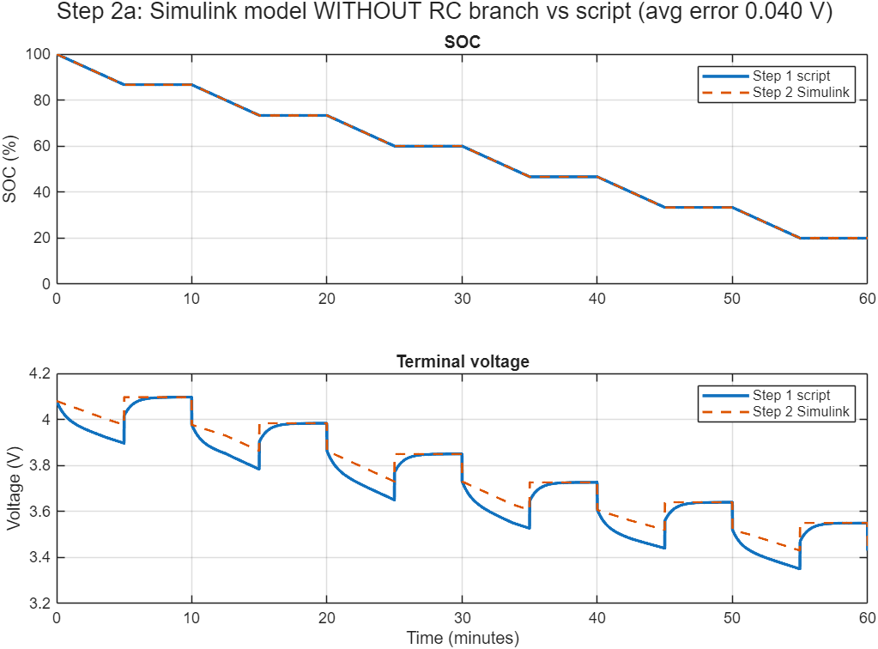
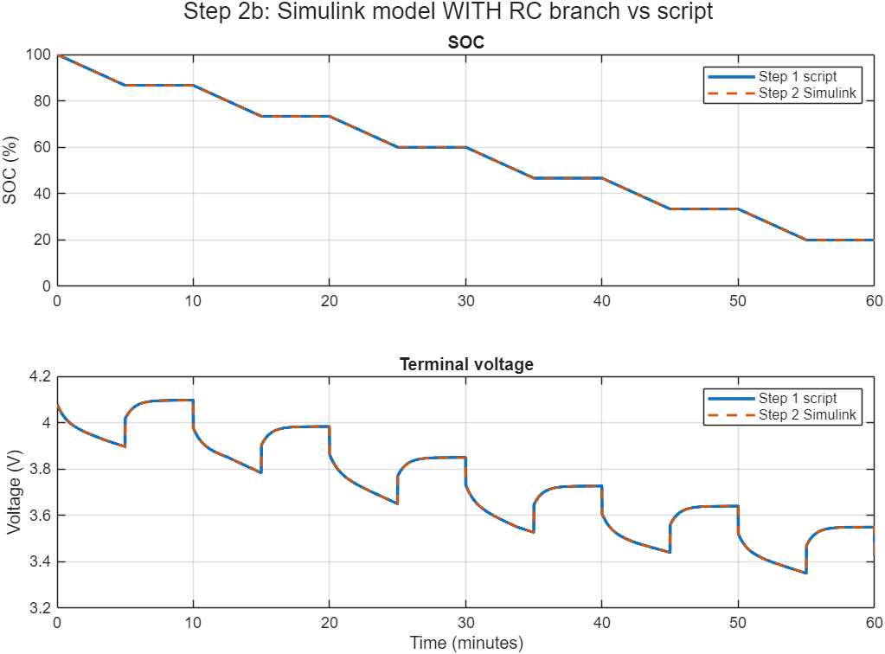
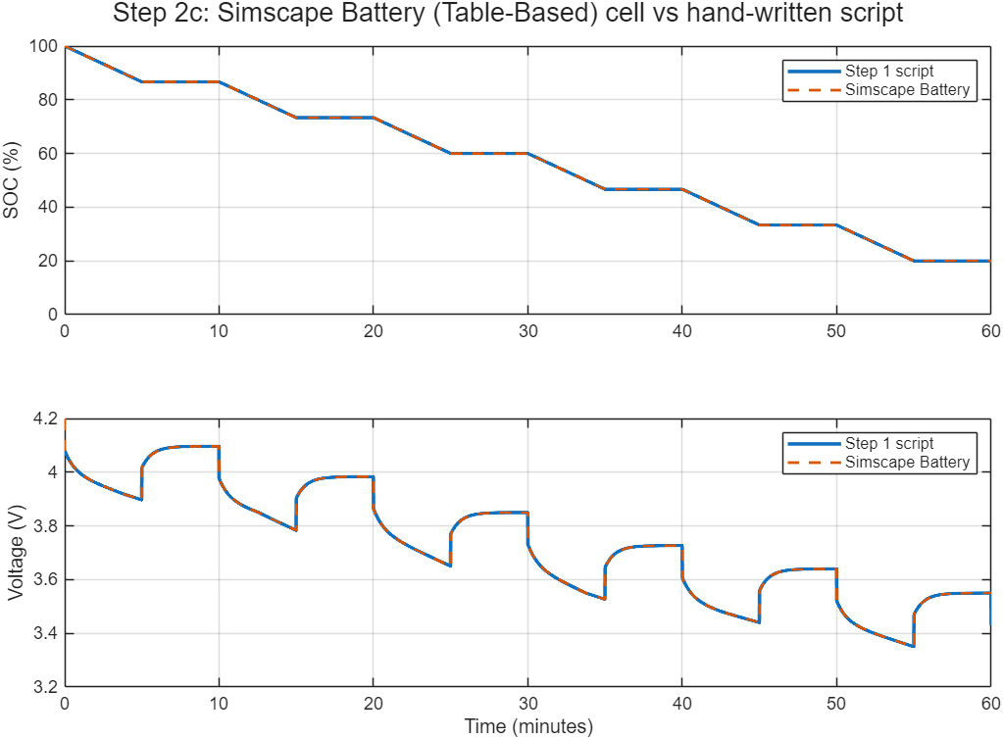
IV. Model Validation Against a Reference Script
Fig. 5. Simulink, no RC branch.
Fig. 6. Simulink, with RC branch.
Fig. 7. Simscape Battery block.
TABLE IV
MEAN ABSOLUTE TERMINAL-VOLTAGE ERROR VS. SCRIPT
Implementation | Mean error | Remark
Simulink, without RC branch | 0.040 V | Polarisation dynamics missing
Simulink, with RC branch | 0.0001 V | Matches reference
Simscape Battery (Table-Based) | 0.0006 V | Used for the pack model
Notes:
The same equations were implemented three ways. The library block reproduces our hand-derived model, so it is trusted for the pack.

Slide 10
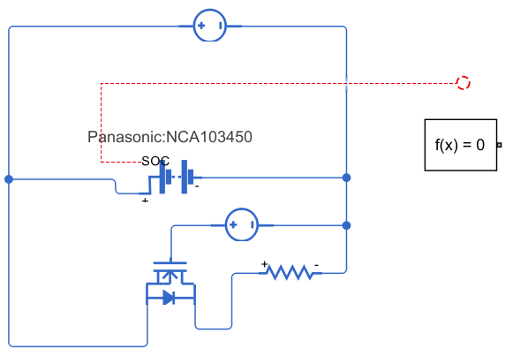
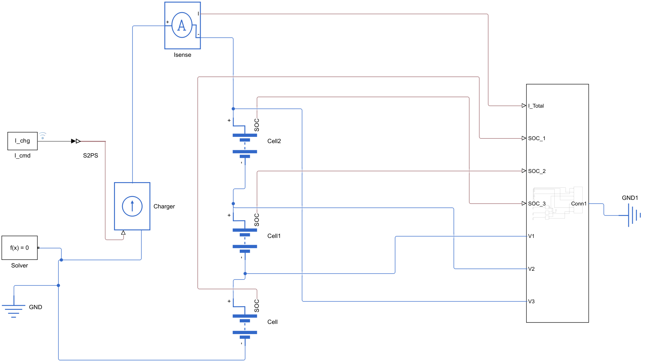
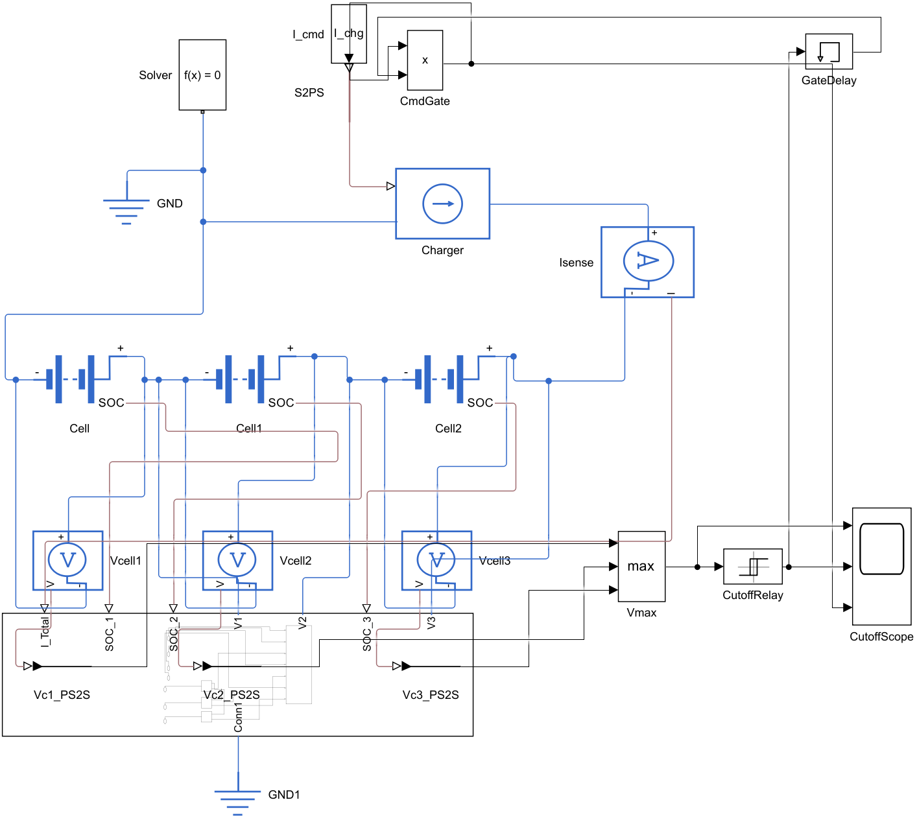
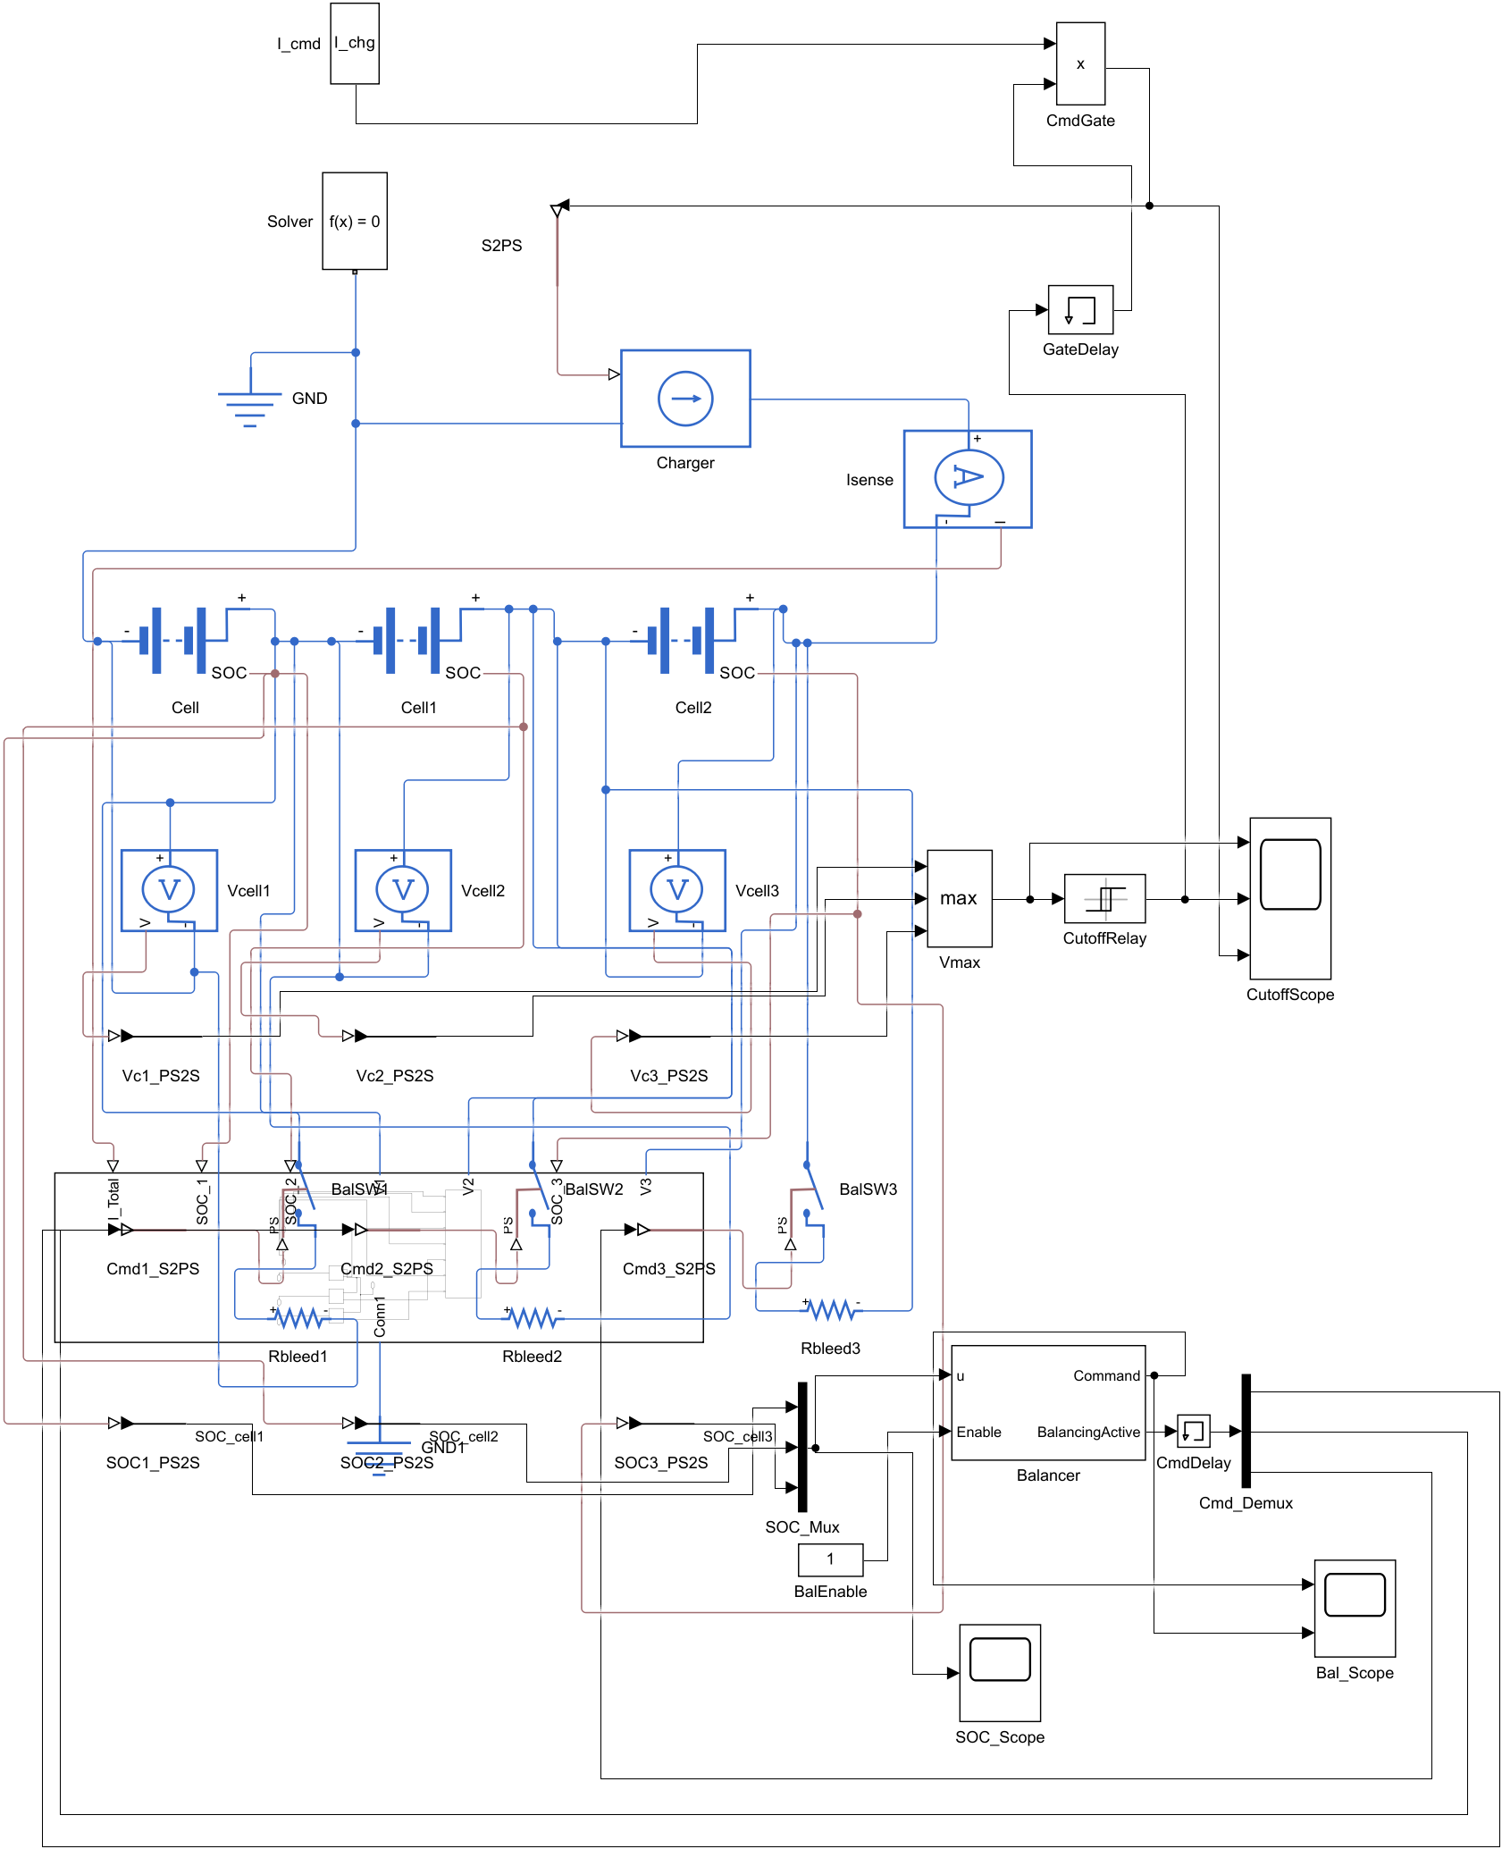
V. Model Development Iterations
Fig. 8. Single cell, MOSFET and resistor.
Fig. 9. 3S string with CC charger.
Fig. 10. Voltage sensing and 4.2 V cut-off.
Fig. 11. Bleed circuits: 41-block flat model.
Each iteration added one function and was verified before the next. Iteration 4 worked but its wiring was hard to follow, which motivated the subsystem architecture.
Notes:
Incremental development: one feature per iteration. The flat model in iteration 4 became unreadable.

Slide 11
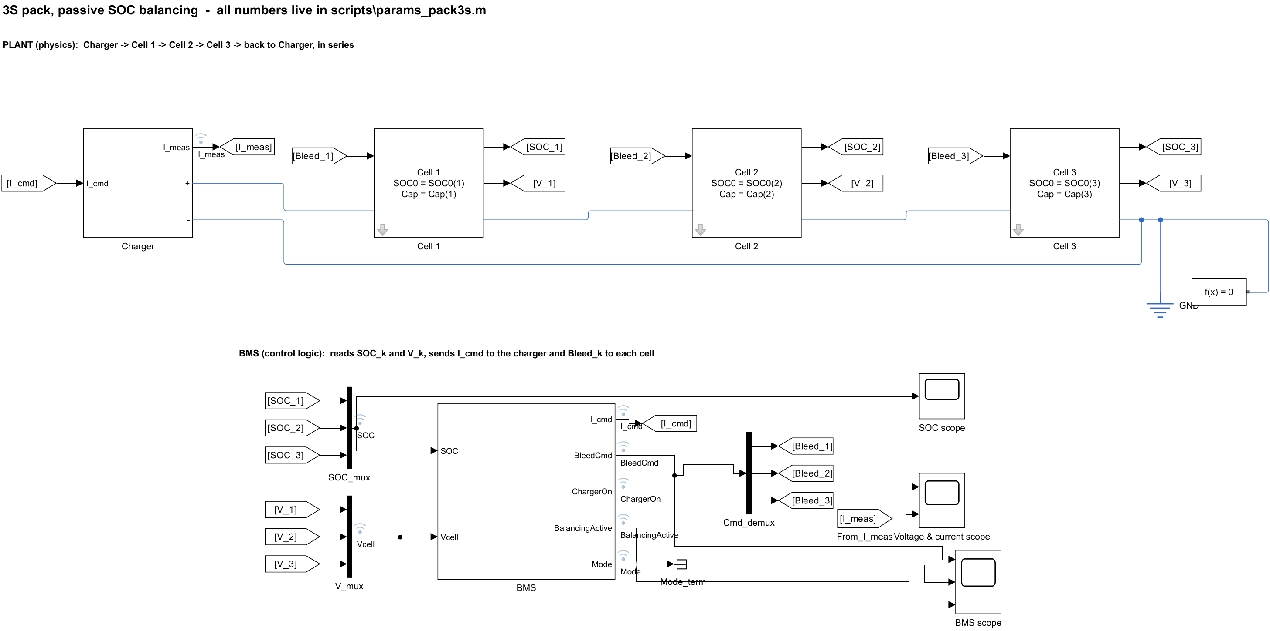
V. Final Model Architecture: Subsystem Decomposition
Flat model restructured into subsystems for easier viewing and reuse
Plant (physics) separated from BMS (control), as hardware and firmware are in a real pack
Signals routed with Goto/From tags instead of crossing wires
All parameters in a single script (params_pack3s.m); no values typed into blocks
Same behaviour as the flat model with a fraction of the visible wiring
Fig. 12. Top level of the final model (plant above, BMS below).
Notes:
The model was reorganised into Cell, Charger and BMS subsystems. This made the model readable and easy to extend with modes.

Slide 12
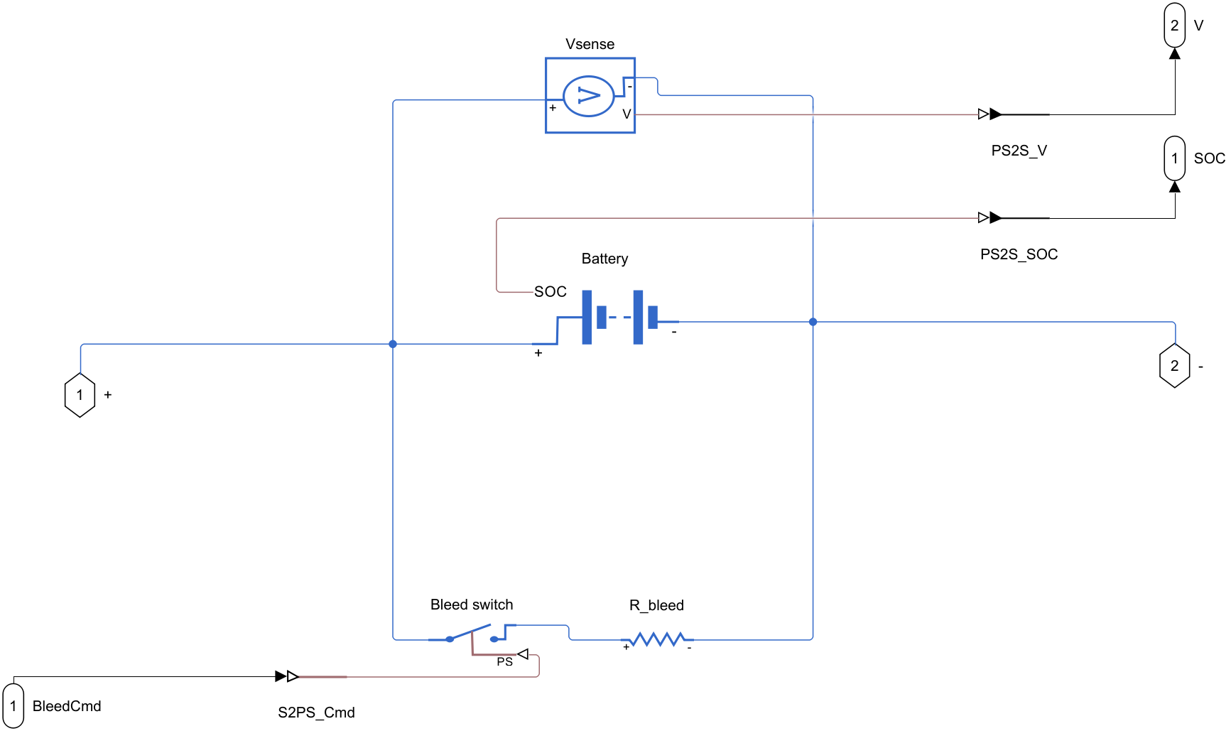
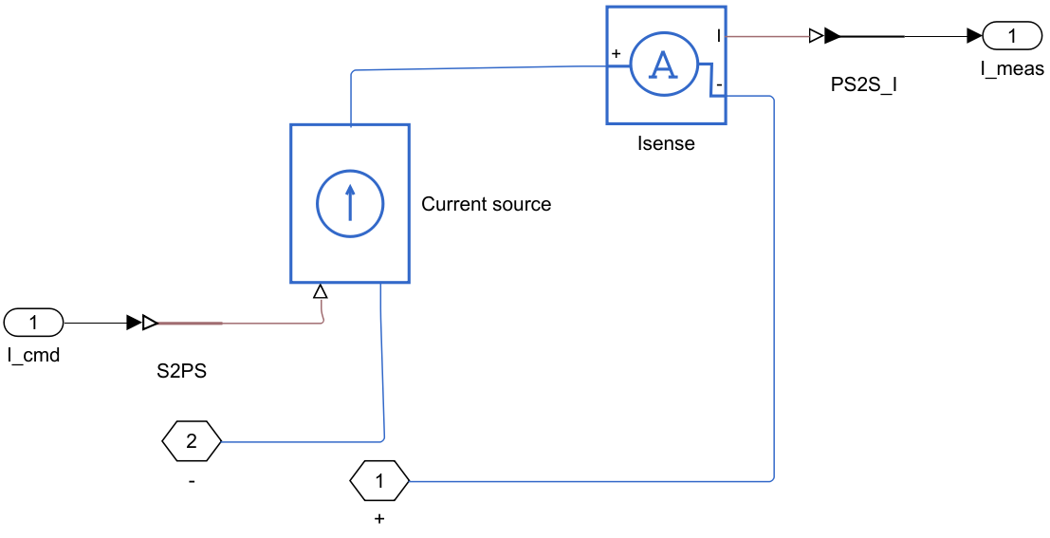
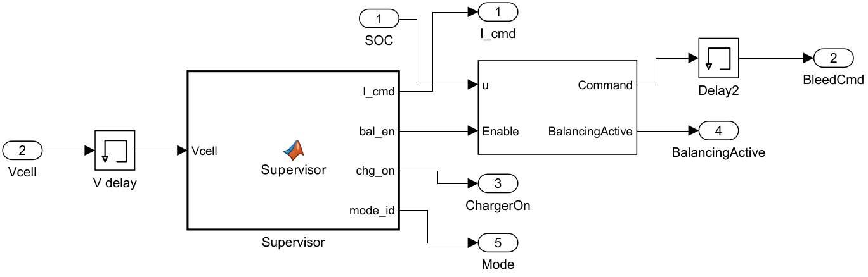
V. Subsystem Contents
Fig. 14. Charger: controlled current source (+ charge, − discharge).
Fig. 13. Cell k: battery, bleed switch, 47 Ω resistor, sensors.
Fig. 15. BMS: supervisor and balancing logic.
Notes:
Each Cell subsystem is masked, so its initial SOC and capacity are visible on the block.

Slide 13
VI. SOC-Based Balancing Control Law
ΔSOCₖ = SOCₖ − minⱼ(SOCⱼ)
Sₖ
Bleed switch Sₖ (per cell, evaluated every 1 s):
Sₖ → ON if ΔSOCₖ > 1.0 %
Sₖ → OFF if ΔSOCₖ < 0.5 %
Sₖ unchanged otherwise (hysteresis band)
Balancing permitted only when the supervisor sets bal_en = 1
ON
Lowest-SOC cell is the reference; only cells above it are bled
Hysteresis prevents switch chattering on small differences and measurement noise
Decision variable is SOC, not terminal voltage, so load current does not corrupt the decision
Implemented with the Simscape Battery Passive Cell Balancing block [5]
OFF
0.5
1.0
ΔSOC (%)
Fig. 16. Hysteresis characteristic of the bleed switch.
Notes:
Switch turns on above 1 percent difference from the lowest cell and off below 0.5 percent.

Slide 14
VI. BMS Supervisor: Operating Modes
CHARGE
REST
DISCHARGE
REST
+1.25 A
90 min
0 A
20 min
−1.25 A
40 min or V_min
0 A
10 min
Balancing ON
Balancing ON
Balancing OFF
Balancing ON
Fig. 17. Timed mode cycle of the supervisor (returns to CHARGE).
TABLE V
SUPERVISOR TRANSITION RULES
Implemented as a MATLAB Function block (discrete, 1 s)
Balancing blocked in DISCHARGE: bleeding while the load drains the pack would waste energy twice
One-step memory on measured voltages avoids an algebraic loop
Mode | Current command | Exit condition
CHARGE | +I_chg; 0 if V_max ≥ 4.20 V until V_max < 4.15 V | t ≥ 90 min
REST | 0 | t ≥ 20 min
DISCHARGE | −I_dis | t ≥ 40 min or V_min ≤ 3.0 V
REST | 0 | t ≥ 10 min → CHARGE
Notes:
The supervisor sets the pack current and whether balancing is allowed. Balancing is disabled while discharging.

Slide 15
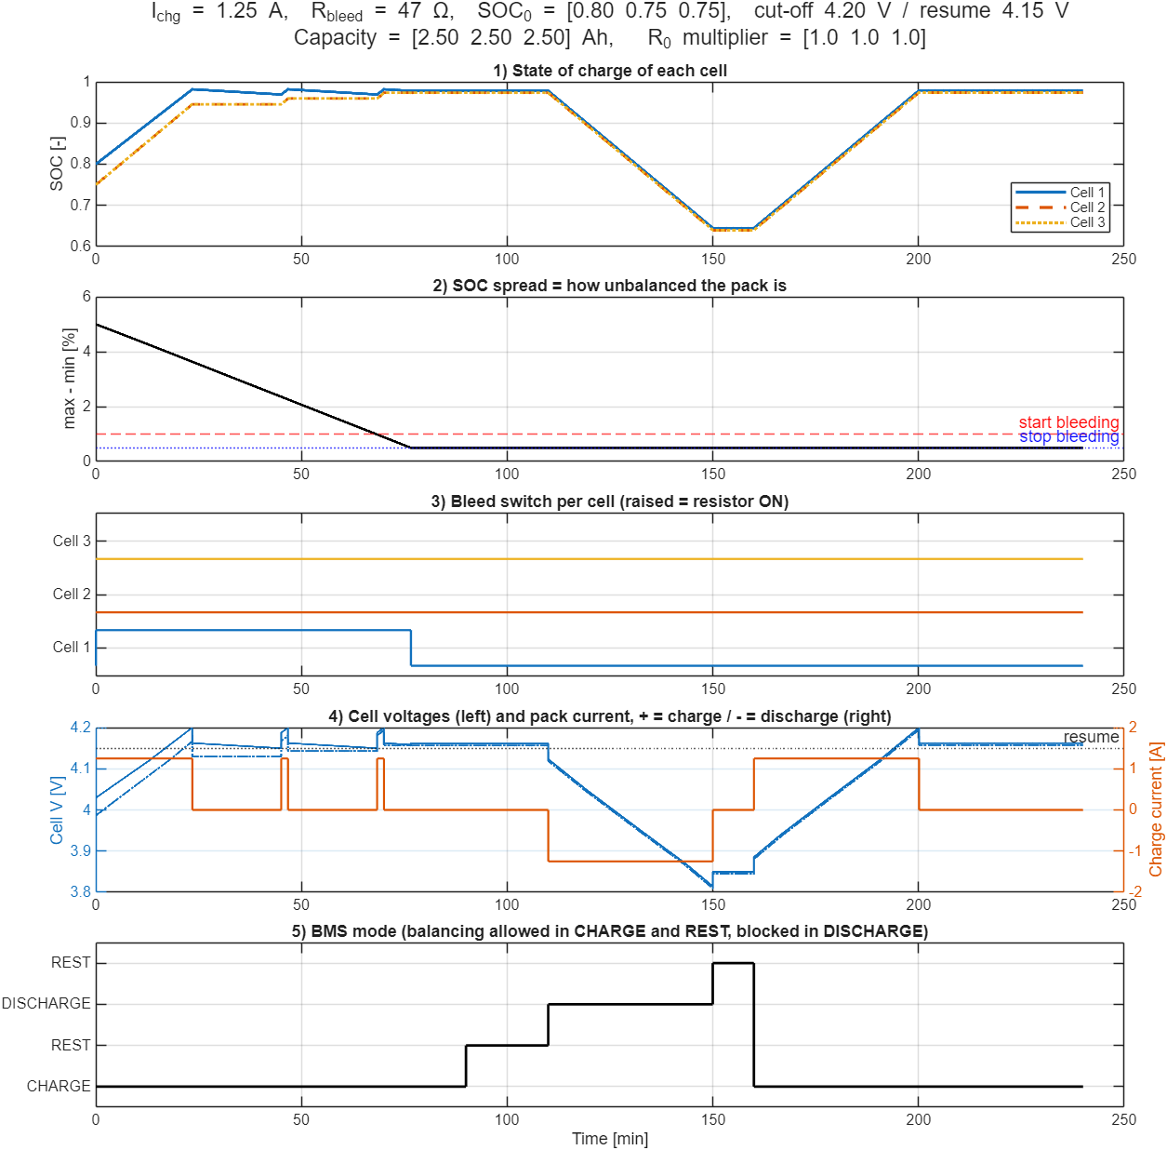
VII. Results A: Identical Cells
Initial SOC = 0.80 / 0.75 / 0.75; Q = 2.5 / 2.5 / 2.5 Ah; R₀ scale = 1 / 1 / 1
SOC spread reduced from 5.0 % to below 1 % in 68.1 min (during charging)
Only Cell 1 (highest SOC) is bled; total bleed time 76.6 min
Dissipated energy: 1680 J (0.47 Wh), 1.7 % of pack energy
Spread settles at 0.5 %, the hysteresis OFF threshold
No new imbalance after discharge: identical cells drift together
Fig. 18. SOC, spread, bleed commands, voltages/current, mode.
Notes:
With identical cells only the initial SOC offset has to be removed. One cell bleeds and the pack converges within one charge.

Slide 16
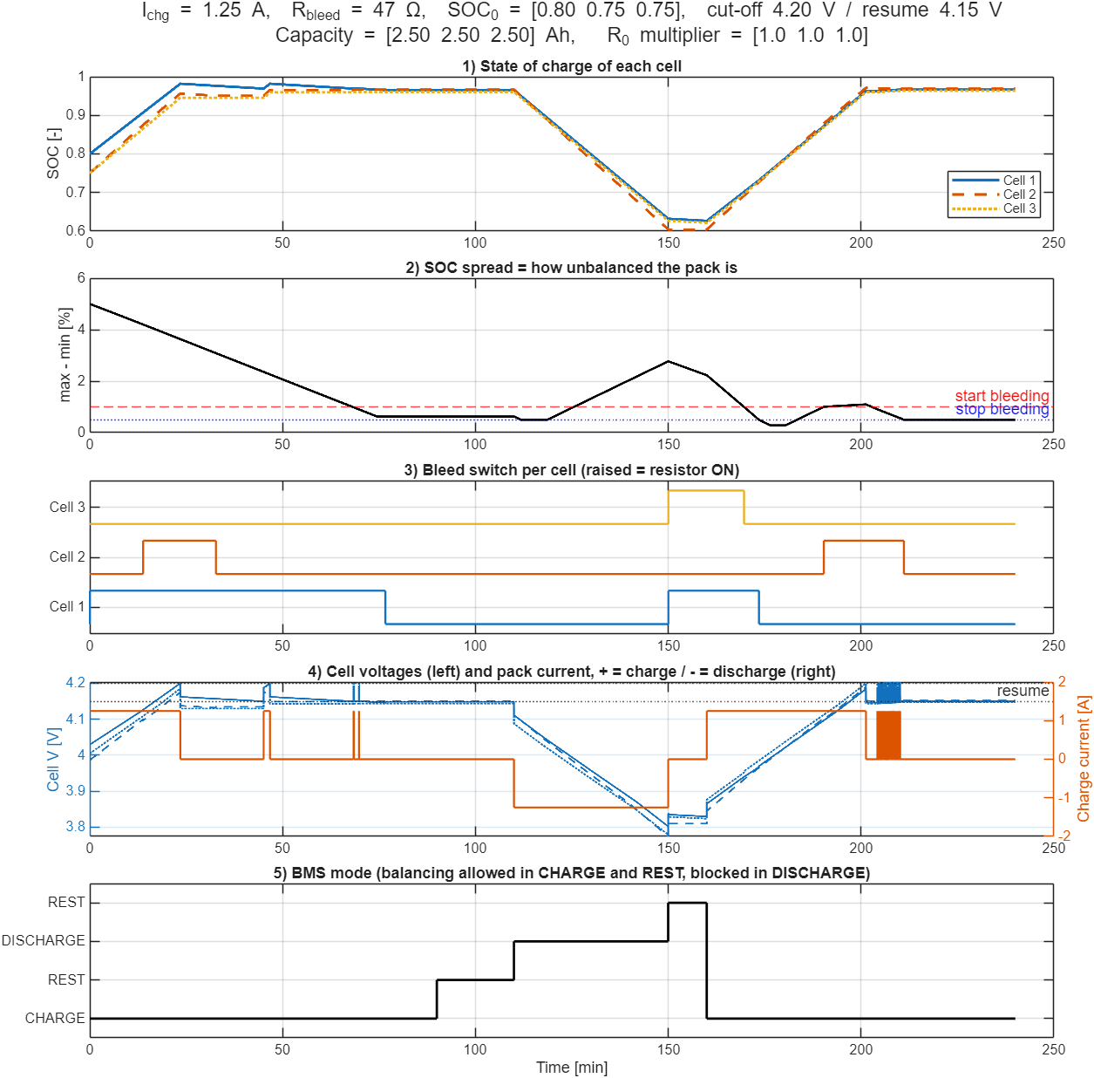
VII. Results B: Capacity and Resistance Mismatch
Initial SOC = 0.80 / 0.75 / 0.75; Q = 2.5 / 2.3 / 2.5 Ah; R₀ scale = 1 / 1 / 1.5
During discharge the 2.3 Ah cell is depleted faster; spread grows from 0.5 % to 2.8 %
Balancing in the following rest and charge restores the spread to 0.5 %
All three cells bled at some point: 100 / 39.6 / 19.6 min
Dissipated energy: 3374 J (0.94 Wh), 3.4 % of pack energy per cycle, twice Case A
Imbalance is regenerated every cycle, so balancing is a continuous task
Fig. 19. Same cycle with mismatched cells.
Notes:
This is the realistic case. Capacity mismatch recreates imbalance every discharge, and passive balancing pays for it in heat.

Slide 17
VII. Quantitative Comparison
TABLE VI
BALANCING PERFORMANCE OVER ONE CYCLE (240 MIN)
Metric | Case A: identical cells | Case B: mismatched cells
Capacity (Ah) / R₀ scale | 2.5, 2.5, 2.5 / 1, 1, 1 | 2.5, 2.3, 2.5 / 1, 1, 1.5
Usable pack capacity | 2.5 Ah (27.75 Wh) | 2.3 Ah (≈ 25.5 Wh)
Time to spread < 1 % (first charge) | 68.1 min | 68.1 min
Peak spread after discharge | ≈ 0.5 % | 2.8 %
Bleed ON time, Cell 1 / 2 / 3 | 76.6 / 0 / 0 min | 100 / 39.6 / 19.6 min
Energy dissipated in resistors | 1680 J (0.47 Wh) | 3374 J (0.94 Wh)
Dissipated / pack energy | 1.7 % | 3.4 %
Final SOC spread | 0.50 % | 0.50 %
Mismatch does not slow the initial convergence but doubles the energy dissipated, because new imbalance is created in every discharge.
Notes:
Read across the rows. The main difference is energy: mismatch doubles the heat lost per cycle.

Slide 18
VIII. Discussion
SOC-based passive balancing restores the pack within one charge-rest period in both cases
Capacity mismatch, not initial SOC offset, is the persistent source of imbalance in operation
Passive balancing cost scales with mismatch: about 1 Wh per cycle in this 27.75 Wh pack
Restricting balancing to CHARGE and REST avoids dissipating energy while the load is drawing from the pack
Terminal voltage under load misrepresents SOC by up to 0.2 V in this cell, supporting an SOC-based trigger
0.20 V
voltage error at equal SOC
68 min
to reach < 1 % spread
0.94 Wh
dissipated per cycle (Case B)
Notes:
Summarise what the numbers mean for a real pack.

Slide 19
VIII. Limitations and Future Work
TABLE VII
LIMITATIONS AND PLANNED EXTENSIONS
Limitation in this work | Planned extension
BMS uses the true (model) SOC | SOC estimation: Coulomb counting with sensor offset, then an Extended Kalman Filter
No direct voltage-triggered baseline | Switchable voltage-based rule on the same pack for a head-to-head comparison
CC charging with hard cut-off | CC-CV charging profile
Electrical model only | Thermal model of cells and bleed resistors
Energy dissipated as heat | Active balancing with a bidirectional buck-boost converter and PI current control
Three-cell pack | Scale to 12S/16S modules
Notes:
The biggest simplification is the use of true SOC. Estimation with an EKF is the next step.

Slide 20
IX. Conclusion
A 3S Li-ion pack (11.1 V, 2.5 Ah, 27.75 Wh) with per-cell passive balancing was modelled in Simulink/Simscape Battery
The cell model was validated against an independent script (error ≤ 0.6 mV)
An SOC-based control law with hysteresis and a mode supervisor reduced the SOC spread from 5 % to 0.5 %
Capacity mismatch regenerates imbalance each discharge and doubles the dissipated energy (0.47 Wh → 0.94 Wh per cycle)
The subsystem architecture provides a base for SOC estimation and active balancing
TABLE VIII
COURSE OUTCOME MAPPING
Outcome / Module | Coverage
CO2 | Pack operation: charge, rest, discharge, cut-offs
CO3 | BMS: balancing, protection, supervisor
Module II | SOC, OCV, R₀, capacity
Module III | BMS and cell equalisation
Module IV | Converters (future work)
Notes:
Close with the main result and how the work maps to the course.

Slide 21
References
[1] Texas Instruments, "Cell balancing with BQ769x2 battery monitors," Application Note SLUAA81. [Online]. Available: https://www.ti.com/lit/pdf/sluaa81
[2] "Cell balancing paradigms: Advanced types, algorithms, and optimization frameworks," arXiv:2411.05478, 2024. [Online]. Available: https://arxiv.org/abs/2411.05478
[3] "A deeper look into active balancing on BMS, Part 1," Embedded Computing Design. [Online]. Available: https://embeddedcomputing.com
[4] "State-of-charge estimation for onboard LiFePO4 batteries with adaptive state update in specific open-circuit-voltage ranges," Applied Energy, 2023. [Online]. Available: https://www.sciencedirect.com/science/article/abs/pii/S0306261923009455
[5] The MathWorks, Inc., "Simscape Battery: Battery (Table-Based) and Passive Cell Balancing blocks," MATLAB R2025b documentation, 2025.

Slide 22
Thank You
Questions?
Model and scripts: MATLAB project SOC_Based_Cell_Balancing (models/, scripts/, results/)

