Slide 1
Plan
Company
Team
Tools
Setting up our data base
Collecting data from an API
Storing data in our data base (first attempt!).
Finding empty values (and maybe dropping them)
Notes:
Asomeojw

Slide 2
Macquarie Group
One of the biggest banks in Australia (but not well known outside Australia)
First bank to do 24 hour foreign exchange trading
Big investor in renewable energy and infrastructure
Big in trade of commodities (things like metals, orange juice, wheat, oil, energy...)

Slide 3
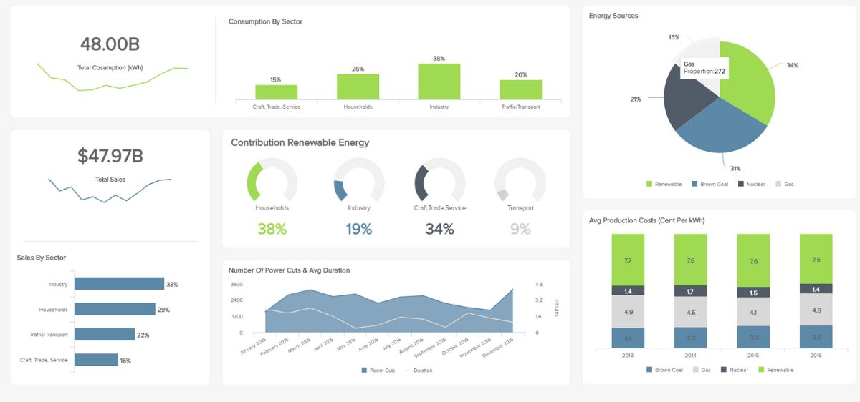
Team
The data engineering analytics team is close to 16 people. We collect data and put it in a data base and create dashboards.
Notes:
Why do banks (or other organizations: energy companies, councils) spend money on this?

Slide 4
Decisions
When we have data and we understand it, we can make more informed and better business decisions.
For example: If we know there’s going to be very sunny and windy weather tomorrow, we know renewable energies will be very productive, so the cost of energy will come down. We may decide to wait until tomorrow to buy our energy supply.
Notes:
Why do banks (or other organizations: energy companies, councils) spend money on this?

Slide 5

Main technology
Analytics: Python, SQL, Amazon Web Services (AWS cloud technologies), Linux, bash, Git, Airflow and Dataiku.

Slide 6
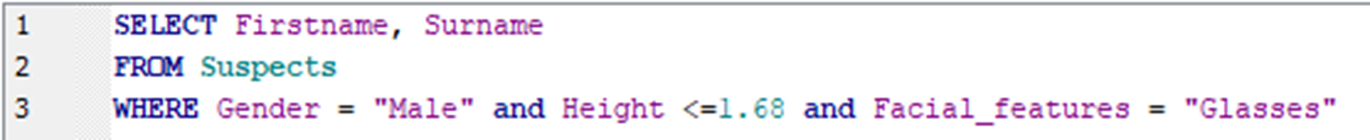
Main technology
SQL: A language used to put in or pull data out of the database in an organized manner.
https://www.codecademy.com/learn/learn-sql

Slide 7
Plan
Company
Team
Tools
Scenario and setting up our data base
Collecting data from an API
Storing data in our data base (first attempt!).
Finding duplicates (and maybe dropping them)
Finding empty values (and maybe dropping them)
Notes:
Asomeojw

Slide 8
Scenario
A secondary school is joining Ark. There was a problem with student data and Computer Science and Maths data is missing. They have made an API (application programming interface) in this case the API as a way for Ark to collect the data.
Ark already has a lot of data (addresses, parents...), but want to retrieve the exam results by subject:
Student ID
Student Name
Group (the name they use for sets)
Maths
Computer Science

Slide 9
Preparing the virtual environment
The school may be blocking us from modifying the system, one way we may be able to get around this is by creating a virtual environment (venv from now on) Venvs are special folders where we can install the Python libraries that we will need in isolation from our main system (so we are not touching our main Python installation). This allows us to keep our system clean and if we use a venv for each project, makes it easy to know exactly what libraries we need for that project.

Slide 10

Preparing the virtual environment
In your terminal write python -m venv aas_venv You should see a folder appear that is called aas_venv appear in the VS code explorer pane on the left

Slide 11
Activating the virtual environment
When we activate the venv, we make sure that the Python the computer is using is the one in the venv folder. Write in the terminal aas_venv/Scripts/activate (you may need to write activate.bat or Activate.ps1 depending on the windows version) You should now see the name of the venv at the beginning of the terminal prompt (will look a bit different on your computer).

Slide 12
Installing Pandas and Requests 1
Libraries are pre-written code that you can use to avoid to write it yourself. You probably remember importing random to use randint. We will need two extra libraries for this workshop. Requests: used to make requests to web addresses (get, post, delete, put...) Pandas: very popular to work with data.

Slide 13
Installing Pandas and Requests 2
To install requests you have to write in your terminal pip install requests To install pandas… take a guess!

Slide 14
Preparing the database
We need to store the data somewhere and that’s why we are using a database.
We are using sqlite3 which requires no set up (comes with Python), but most organizations will have much more complex set ups and different ways to prepare it to take the data in.
Open VS code and create a new python file.
Call it data_engineering_tutorial.py

Slide 15
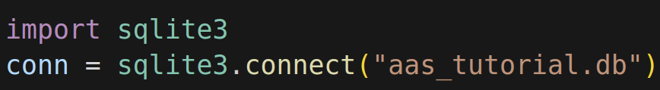
1 Creating a connection
This code creates the connection. If the database does not exist already, it will be automatically created when we connect.

Slide 16

2 Creating a cursor
With many databases, we cannot directly access the database, so we have to create a middle man (the cursor) that interacts with the database. When you want something to happen, you tell the cursor to do it.

Slide 17
3 Creating a table
We have created a database, but we need a way to store the data in an organized way. We are about to create a table to do that.

Slide 18
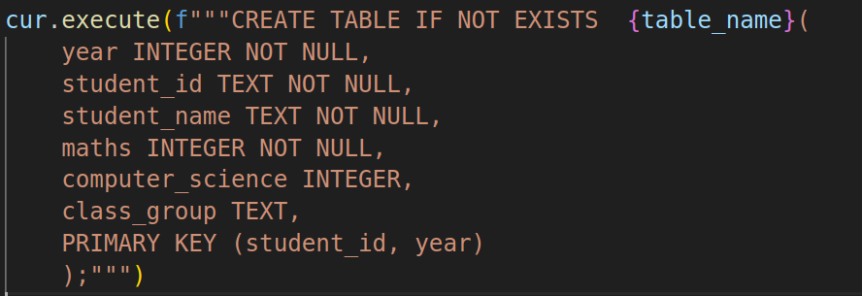
3 Creating a table
Constraint
Column name
Data type
Data type
Constraint

Slide 19
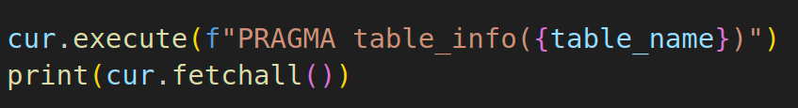
4 Checking our table exists
We use this to check that the table has been created and looks the way we want.

Slide 20
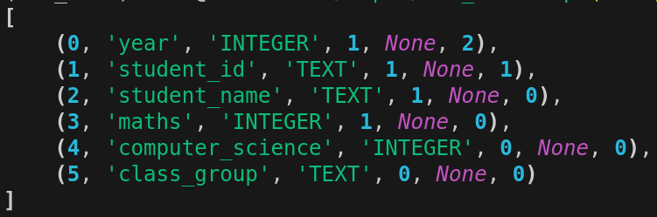
Checking our table exists
This is the output.
Default
Value
Primary
Key
Not
Null
Primary
Key

Slide 21
Plan
Company
Team
Tools
Scenario and setting up our data base
Collecting data from an API
Storing data in our data base (rename column)
Drop column we do not need
Finding empty values (and maybe dropping them)
Notes:
Asomeojw

Slide 22
Collecting data from an API
Now we will start writing the code that gets the data from the API and puts it in our database.

Slide 23
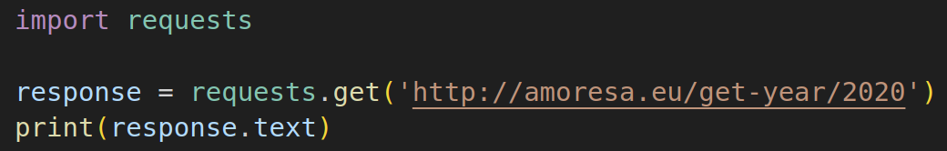
Collecting data from an API
Import the requests gallery (if you do not have it already, you’ll have to write ‘pip install requests’ in the terminal)
Make a get request to amoresa.eu/get-year/2020

Slide 24
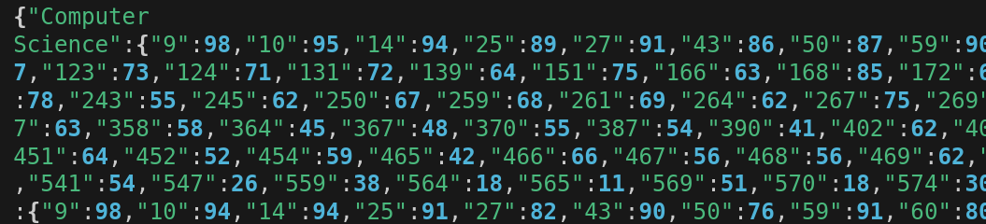
Collecting data from an API
This is what the data looks like. It is organized, but not in a way that a person can make sense of it, that’s why we want to put it in a database.
Question? Do you know any data structure that looks kind of similar?
Notes:
Bla, bla

Slide 25
Collecting data from an API
The response looks very similar to a python dictionary (you do not need to know it for GCSE) and a bit like an array, however, it is not a dictionary, it’s a json (java script object notation) string

Slide 26
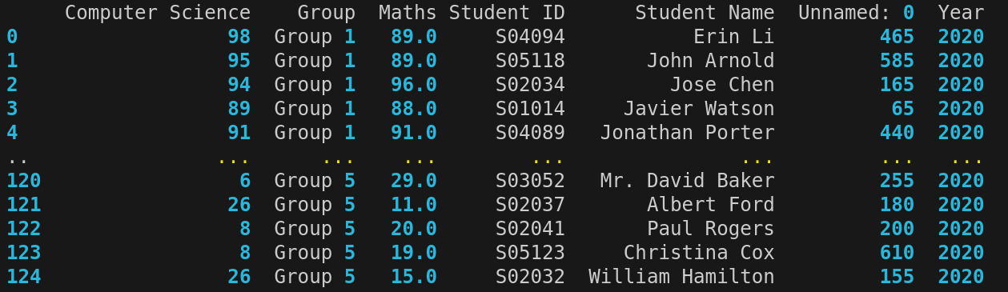
Storing the data in a data frame
The previous string contains our data, but it is not the best way to work with data and put it in our database. In order to make working with the data easier, we will convert the string into a new format called a data frame.

Slide 27
Storing the data in a data frame
A lot of work with data is done using data frames. Data frames are a type of data structure that has columns and rows (like a 2D array).
How does this relate to our database table?

Slide 28
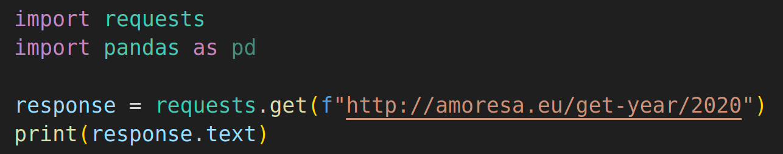
Storing the data in a dataframe
Pandas is the most popular library to work with data frames in the working world.
Task: If you have not done yet, import pandas as pd

Slide 29
Storing the data in a data frame
Pandas can convert many things into data frames:
CSV files: pd.read_csv(‘name_of_the_file.csv’)
Excel files: pd.read_excel(‘name_of_the_file.xlsx’)
What kind of data did we get back from the api call?
Guess what you have to write to convert it to a pandas df.

Slide 30
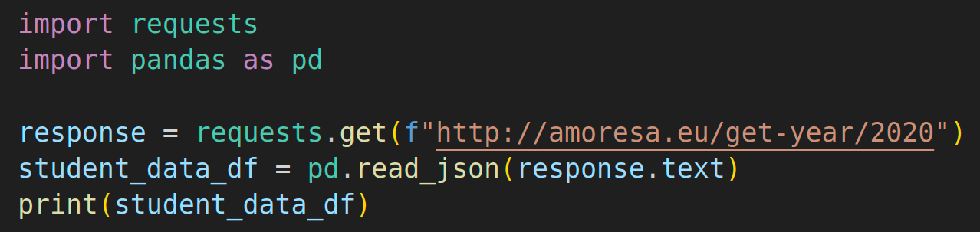
Storing the data in a dataframe
You can use pd.read_json(thejsonstring) to make the dataframe.

Slide 31
Storing the data in a dataframe
Challenge: The API gives you access to a database that has data for years 2020 to 2024.
How could your get the script to print all the data?

Slide 32
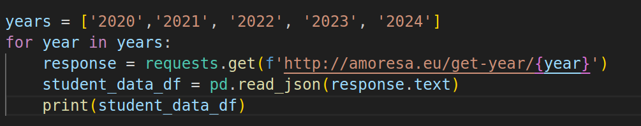
Collecting data from an API
A solution

Slide 33
Concatenating dataframes
There are quite a few ways you can concatenate data frames, this is a suggested one.
1) Create an empty list to put all the data frames in
2) Append the data frame for each year to the list.
2) Use pandas’ concat method to concatenate (join) the whole list into a single data frame.

Slide 34
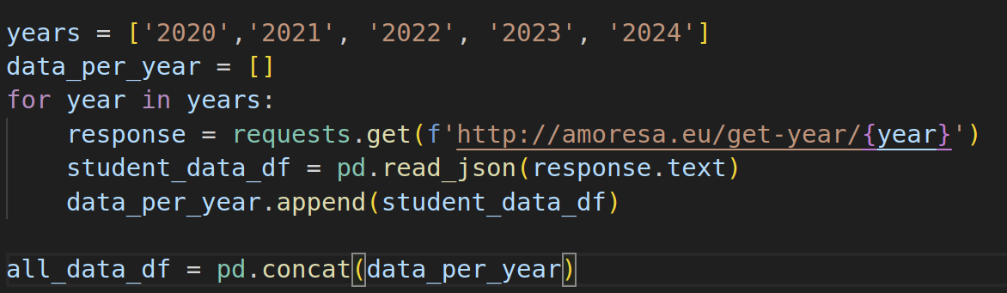
Concatenating dataframes
A solution

Slide 35
Plan
Company
Team
Tools
Scenario and setting up our data base
Collecting data from an API
Storing data in our data base (first attempt!).
Finding duplicates (and maybe dropping them)
Finding empty values (and maybe dropping them)
Notes:
Asomeojw

Slide 36
Adding data to our DB
Attempt 1) We follow this step to add data to our DB (but it will fail this time around)
Use the pandas data frame method to_sql. Passing the name of the table, the connection, if_exists append (which means append the data if the table already exists) and index false (which means, ignore the index of the dataframe)
DON’T RUN YOUR CODE YET!
Notes:
Watch out, if the db name is not exactly the same as the one created initially, a new DB will be created and it will seem to work! A quick pragma table_info(table_name) query will show how it is different.

Slide 37
Adding data to our DB
We can see below what the data frame looks like. We can also see the query we used to create the table.
We are going to put the data frame into the database table. Can you see where the error may be?

Slide 38
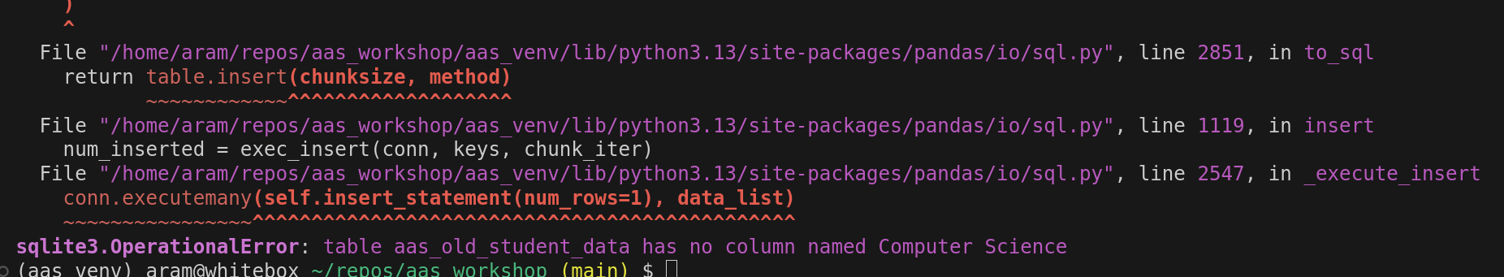
Adding data to our DB
When we run it we get an error because our table does not have a column called ‘Computer Science’.

Slide 39

Adding data to our DB
Let’s have a look at the names of our columns. Add the code to print them below

Slide 40
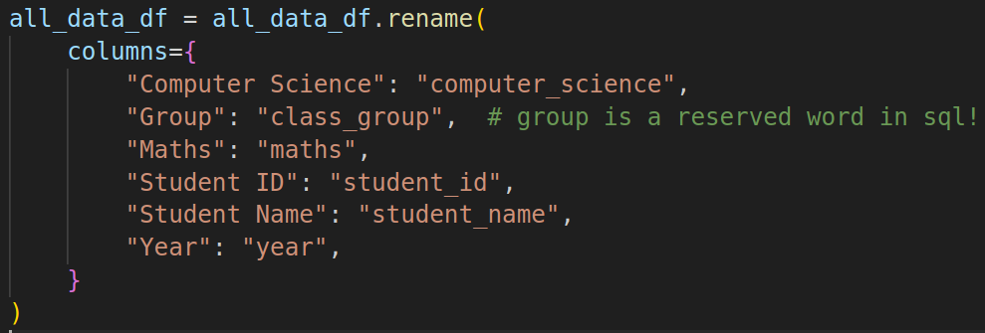
Adding data to our DB
Let’s rename our columns (as usual, there are many ways, this is one).
The columns in the dataframe
Code to rename the columns
The columns in the database
DON’T RUN YOUR CODE YET!

Slide 41
Adding data to our DB
Attempt 2. Let’s move the all_data_df.to_sql line to the end and try again.
Something will fail. Guesses? (Check the names for the columns in the data frame that we printed before)

Slide 42
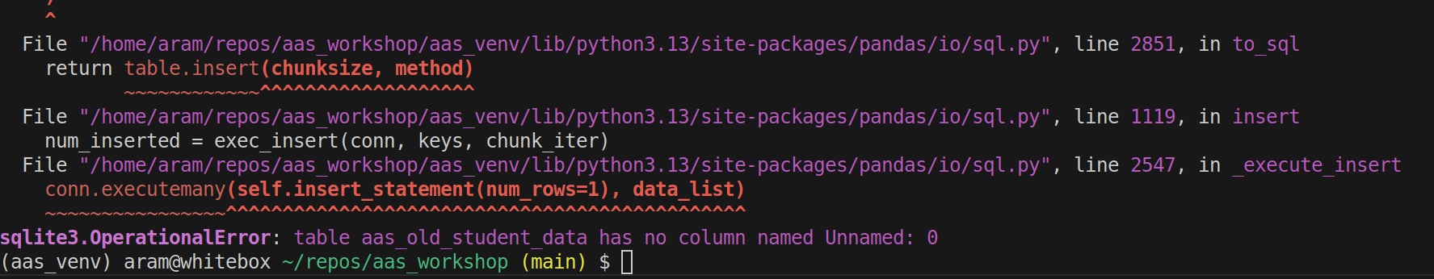
Adding data to our DB
Attempt 2. We have a column that we do not need!

Slide 43
Adding data to our DB
Let’s drop the column we do not need.

Slide 44
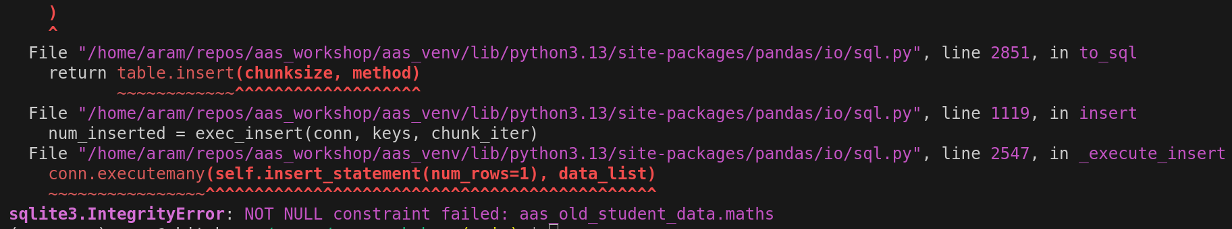
Adding data to our DB
Attempt 4. This one will fail too, but should be the last one to fail!
Let’s move the all_data_df.to_sql line to the end and try again.
NOT NULL constraint failed… What does that mean?
NOT NULL constraint

Slide 45
Adding data to our DB
Remember that NOT NULL constraint we added when we created our DB?
Each row needs it
Everyone does Maths, but not computer science!

Slide 46

Adding data to our DB
Let’s drop all the rows with gaps in maths, which is a NOT NULL column.

Slide 47
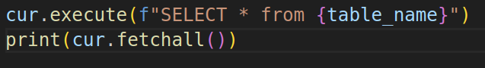
Adding data to our DB
Attempt 5. This time we will succeed!
Let’s move the all_data_df.to_sql line to the end and try again.
You may want to add this to the end of your code to double check that the data is really in our database.

Slide 48
Now what?
One the data is in the database the users can use it themselves (do their queries to figure out what to buy or sell or plan strategies) or you may be asked to create a dashboard to help the users make decisions.
Make a new file called practice_querying.py

Slide 49
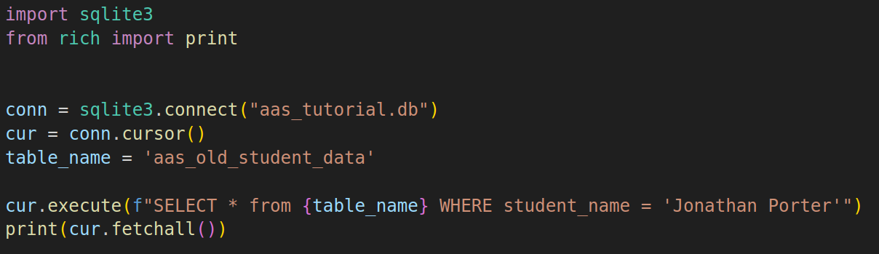
Now what?
You can in the new file practice querying the database.
For example, how could you check how Jonathan Porter has done over the years in Maths and Computer Science?

Slide 50
Other example questions
How could you find the 5 top students for computer science for 2024 and give them an award?
How could find the students with the lowest marks in Maths in 2024 to give them extra support?

