Slide 1
Plan
Company
Team
Tools
Setting up our data base
Collecting data from an API
Storing data in our data base (first attempt!).
Finding duplicates (and maybe dropping them)
Finding empty values (and maybe dropping them)
Notes:
Asomeojw

Slide 2
Macquarie Group
One of the biggest banks in Australia (but not well known outside Australia)
First bank to do 24 hour foreign exchange trading
Big investor in renewable energy and infrastructure
Big in trade of commodities (things like metals, orange juice, wheat, oil, energy...)

Slide 3


Team
Data engineering is close to 30 people, with two subteams:
Analytics: Collects data from sources and puts it in the internal data warehouse (combination of databases specially organized for retrieving data (as opposed to adding data)) and creates dashboards.
Platforms: Takes care of all the machines and software that the analytics team works with.

Slide 4
Main technology
Analytics: Python, SQL, Amazon Web Services (AWS cloud technologies), Linux, bash, Git, Airflow and Dataiku.
Platforms: Mostly same tools but in a different way. They use python less, but AWS and bash a lot more. They also use Go (a programming language) and Grafana.

Slide 5
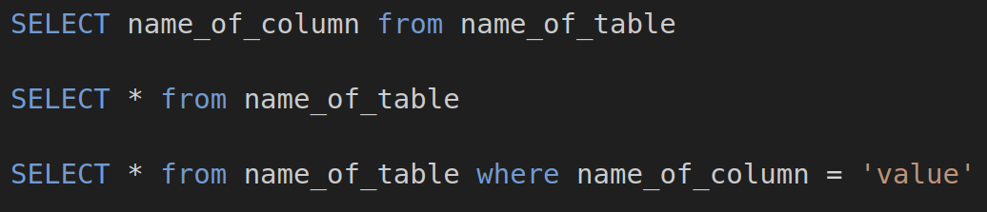
Main technology
SQL: Structured query language (mainly we use this to get data out of our data lake)
https://www.codecademy.com/learn/learn-sql

Slide 6


Main technology
Amazon Web Services (AWS cloud technologies)
There are literally hundreds of services now.
The ones we probably use the most are:
EC2: Virtual Machines (a computer emulated inside of a more powerful computer)
S3: Cloud Object Storage (it is ‘elastic’, so you pay for what you use)
https://explore.skillbuilder.aws/learn/learning-plans/82/cloud-foundations-learning-plan
https://aws.amazon.com/training/digital/aws-cloud-quest/

Slide 7

Main technology
Linux: Open source operating system. Our EC2s (the AWS virtual machines) run Linux (instead of Windows or MacOS)
https://training.linuxfoundation.org/training/introduction-to-linux/

Slide 8
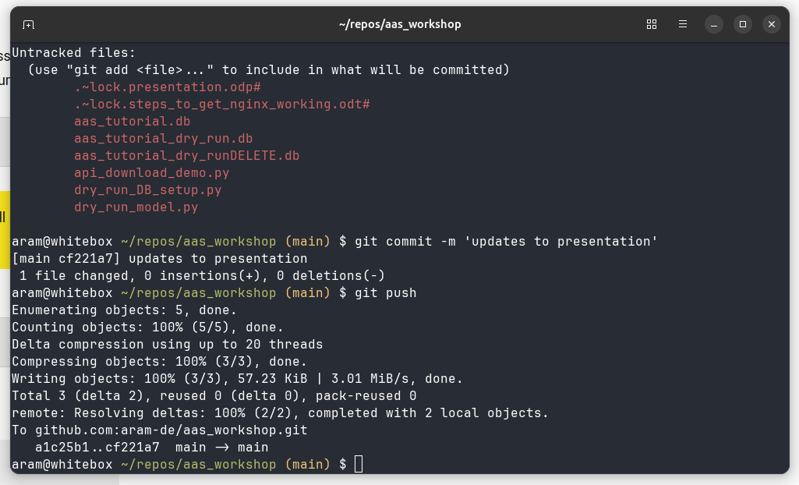
Main technology
Bash: Old (but fast and efficient) programming language. I use it mostly to tell computers to move, copy, delete or execute files but it can do more!
mv original_file.csv /my_target_folder/
rm -r folder_i_want_to_delete/
https://gitlab.com/slackermedia/bashcrawl

Slide 9
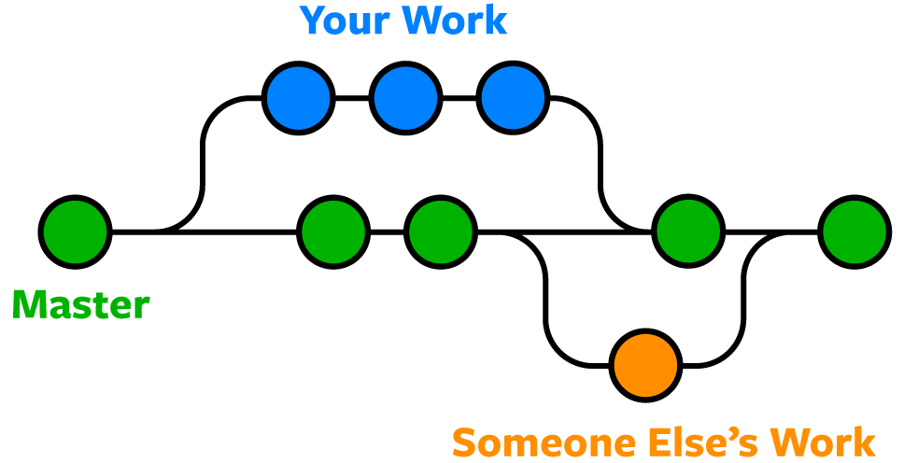
Main technology
Git: A distributed version control system. It allows you to save your work in different versions and combine it with the work of other people.
www.udacity.com/course/version-control-with-git--ud123

Slide 10
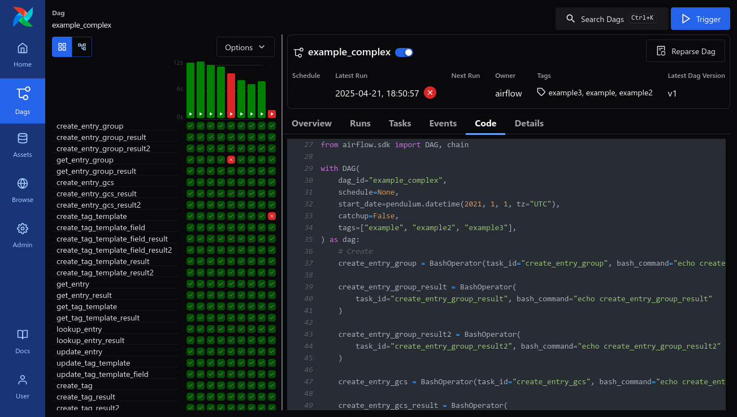
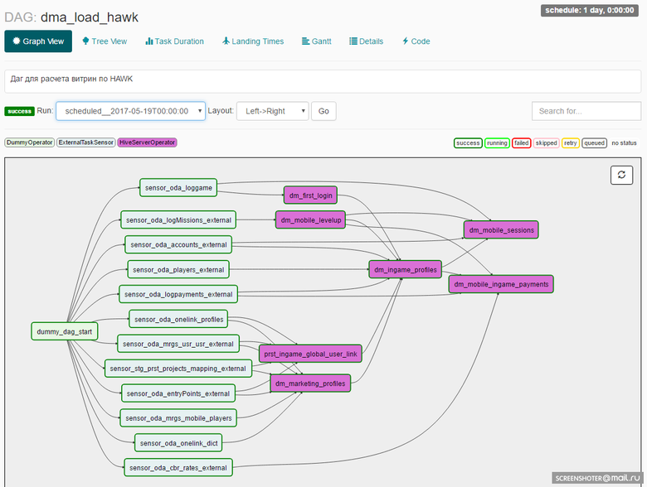
Main technology
Airflow: An orchestration platform we use to time when we launch the data extraction scripts and coordinate the following steps that put the data into our data lake.

Slide 11
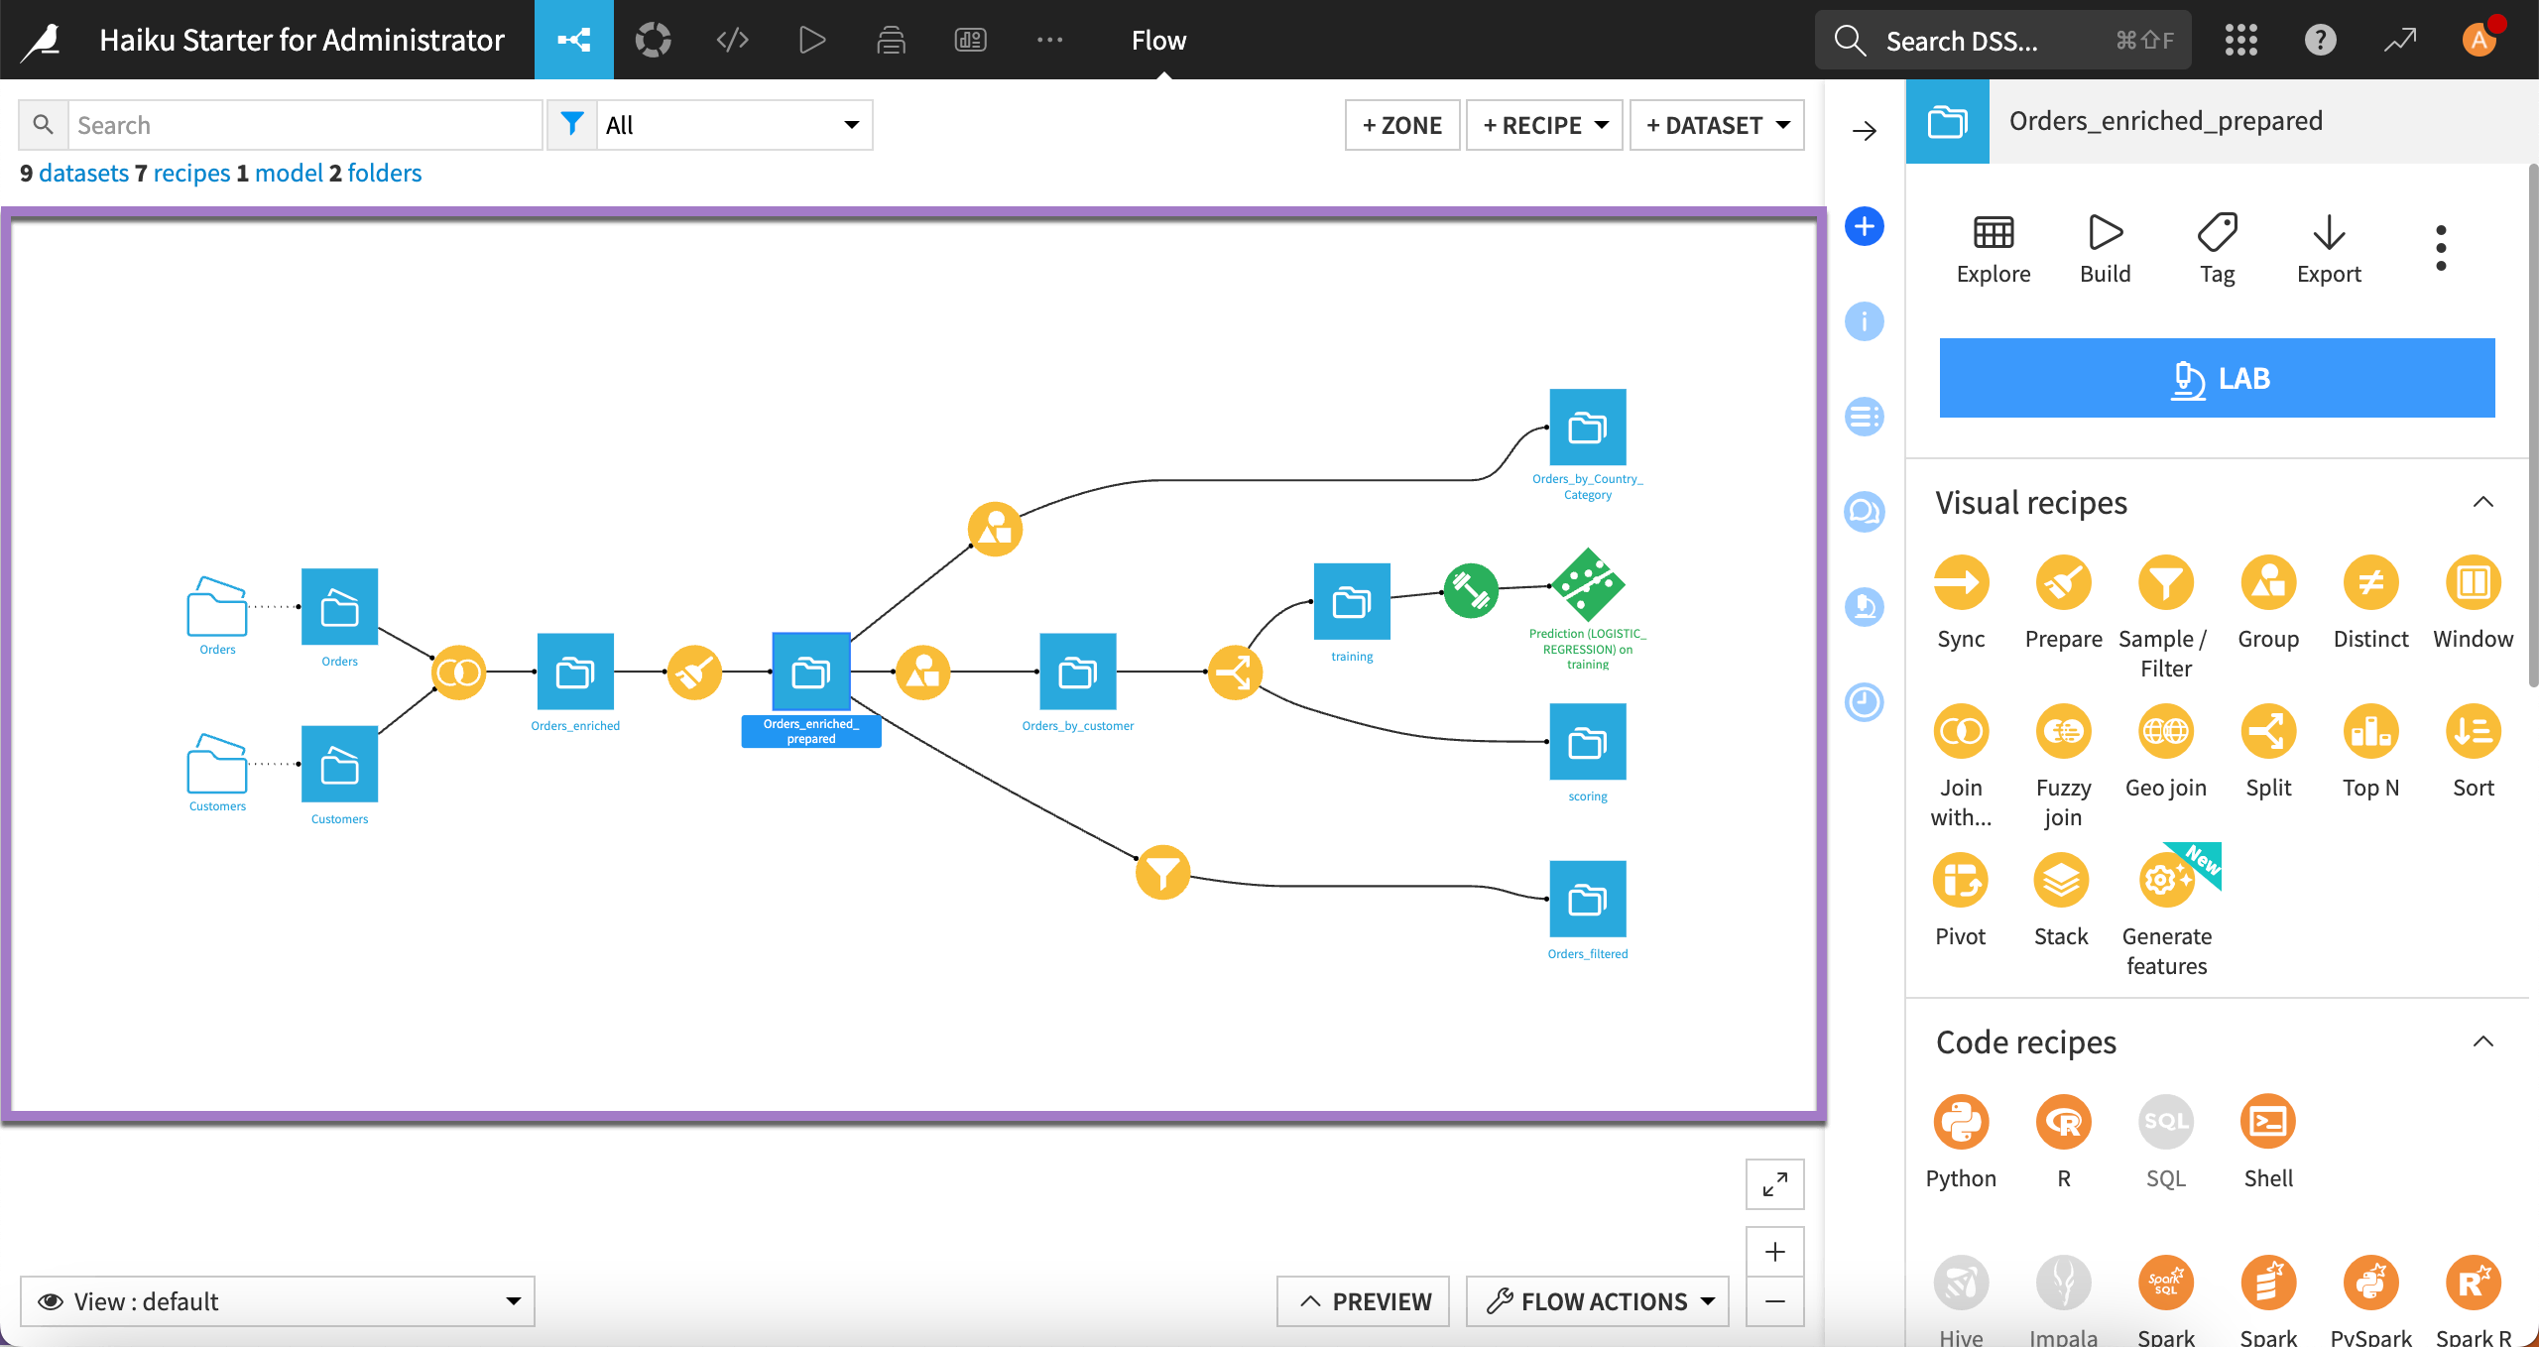
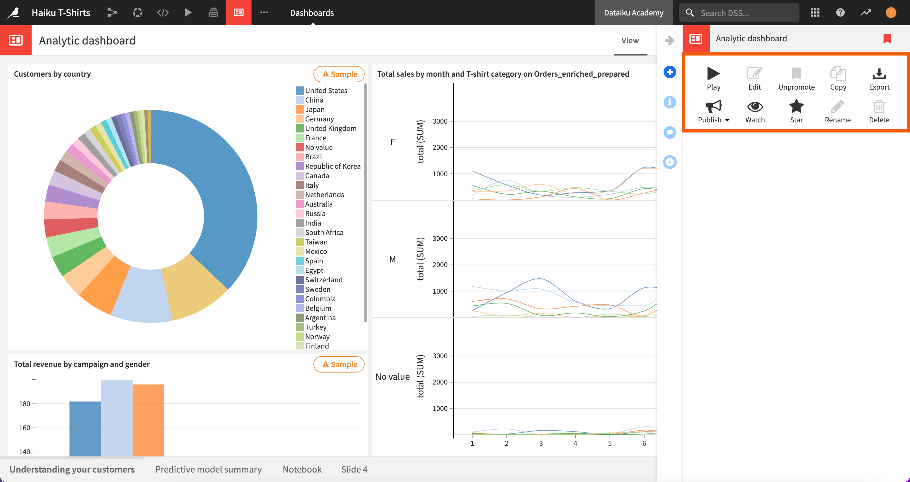
Main technology
Dataiku: a data science platform, we use to combine different processes that we apply to data to generate new data and to create dashboards.

Slide 12
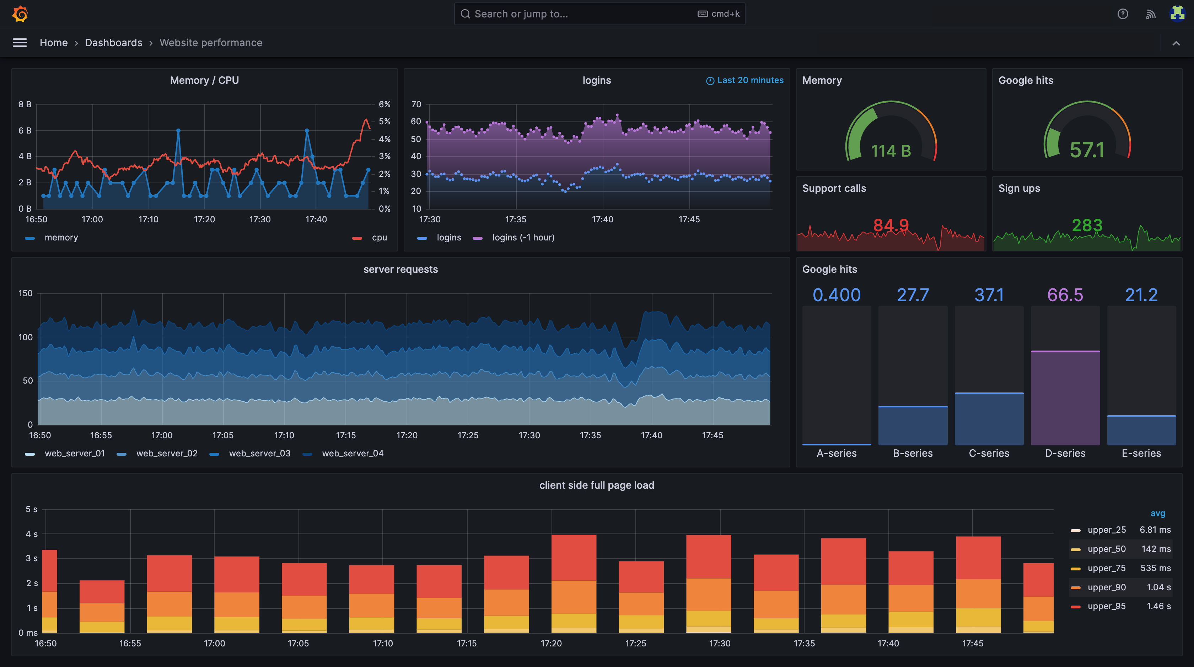
Main technology
Grafana: A data visualization and monitoring system.

Slide 13
Plan
Company
Team
Tools
Scenario and setting up our data base
Collecting data from an API
Storing data in our data base (first attempt!).
Finding duplicates (and maybe dropping them)
Finding empty values (and maybe dropping them)
Notes:
Asomeojw

Slide 14
Scenario
A secondary school has changed academy trust and is joining Ark. The previous academy trust used a cloud solution to store student data and have made an API available to Ark to collect it.
Ark already has a lot of data (addresses, parents...), but want to retrieve:
Student ID
Student Name
Year
English
Maths
History
Computer Science
Science
Group

Slide 15
Preparing the database
We are using sqlite3 which requires no set up (comes with Python), but most organizations will have much more complex set ups and different ways to prepare it to take the data in.
Open VS code and create a new python file.
Call it db_setup.py

Slide 16
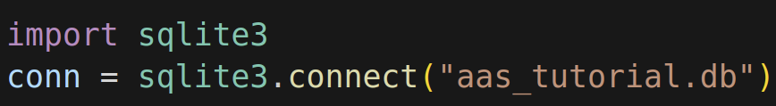
Creating a connection
This code creates the connection. If the database does not exist already, it will be automatically created when we connect.

Slide 17

Creating a cursor
This code creates a cursor. The cursor is kind of a virtual robot that interacts with the database. When you want something to happen, you tell the cursor to do it.

Slide 18
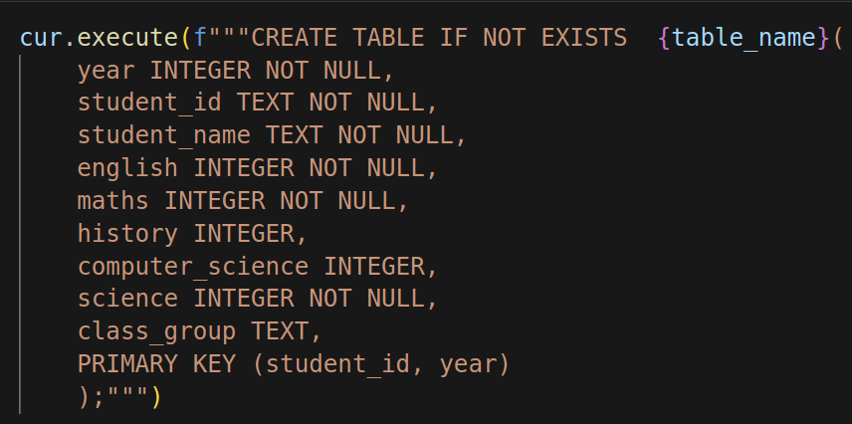
Creating a table
Constraint
Column name
Data type
Data type
Constraint

Slide 19
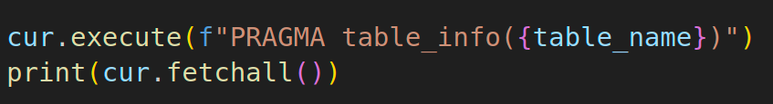
Checking our table exists
This code uses the special command pragma to check the table schema (the metadata that tells us what the table should look like)

Slide 20
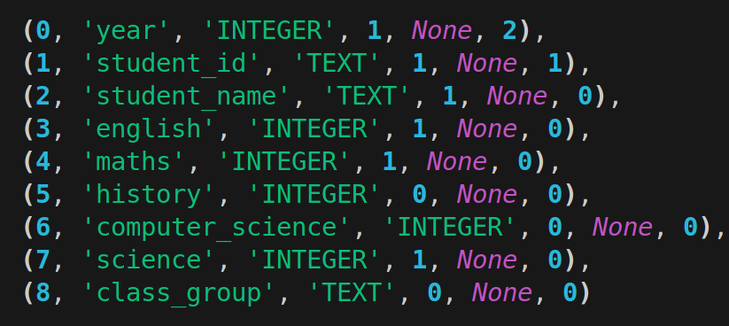
Checking our table exists
The output is a list of tuples.
Default
Value
Primary
Key
Not
Null

Slide 21
Plan
Company
Team
Tools
Scenario and setting up our data base
Collecting data from an API
Storing data in our data base (first attempt!).
Finding duplicates (and maybe dropping them)
Finding empty values (and maybe dropping them)
Notes:
Asomeojw

Slide 22
Collecting data from an API
Make a new python file. Call it api_download.py

Slide 23
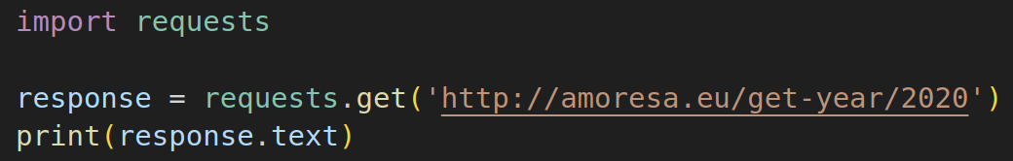
Collecting data from an API
Import the requests gallery (if you do not have it already, you’ll have to pip install it)
Make a get request to amoresa.eu/get-year/2020

Slide 24
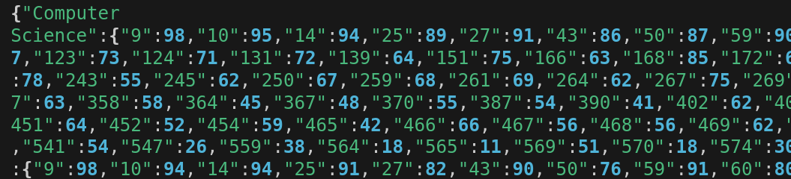
Collecting data from an API
Question? Do you know of any data structure that looks similar to the output? (Hint: Curly brackets and colons)
Notes:
Bla, bla

Slide 25
Collecting data from an API
The response looks very similar to a python dictionary (notice the curly brackets and the colon used as separator), however, it is not a dictionary, it’s a json (java script object notation) string

Slide 26
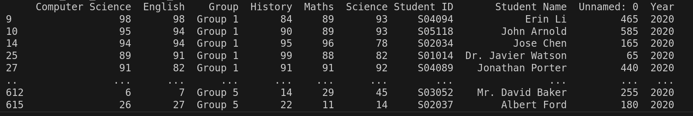
Storing the data in a data frame
A lot of work with data is done using data frames. Data frames are a type of data structure (like lists and dictionaries) that has columns and rows (like a table)

Slide 27
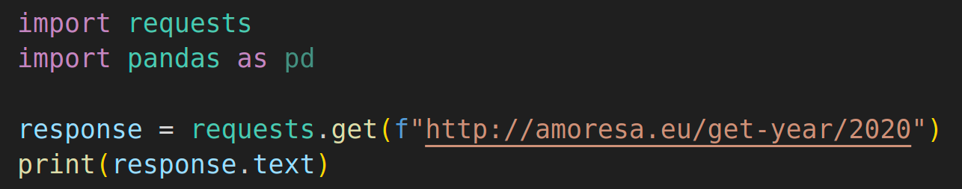
Storing the data in a dataframe
There are quite a few popular libraries to work with dataframes, but Pandas is probably the most popular one.
Task: If you have not done yet, import pandas as pd

Slide 28
Storing the data in a data frame
Pandas can convert many things into data frames:
CSV files: pd.read_csv(‘name_of_the_file.csv’)
Excel files: pd.read_excel(‘name_of_the_file.xlsx’)
What was the type of data we got back from the api call?
Guess what you have to write to convert it to a pandas df.

Slide 29
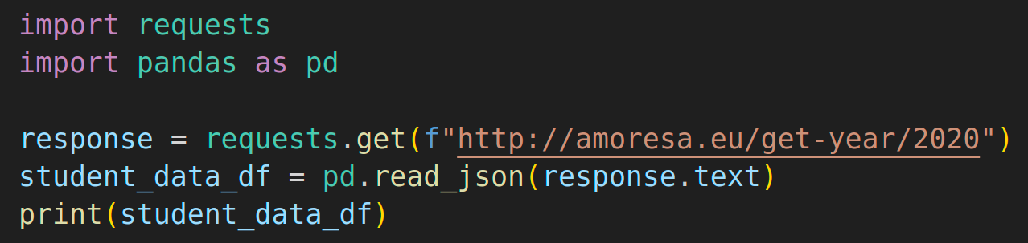
Storing the data in a dataframe
You can use pd.read_json(thejsonstring) to make the dataframe.

Slide 30
Storing the data in a dataframe
Challenge: The API gives you access to a database that has data for years 2020 to 2024.
How could your get the script to print all the data?

Slide 31
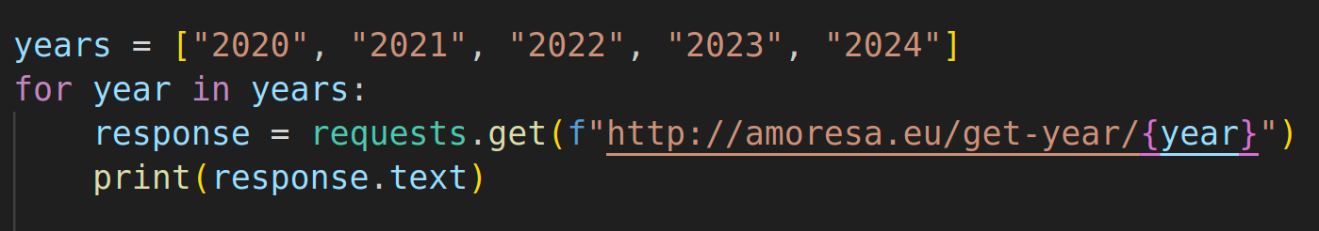
Collecting data from an API
A solution

Slide 32
Concatenating dataframes
There are quite a few ways you can concatenate data frames, this is a suggested one.
1) Create a list to put all the data frames in
2) Append the data frame for each year to the list.
2) Use pandas’ concat method to concatenate the whole list into a single data frame.

Slide 33
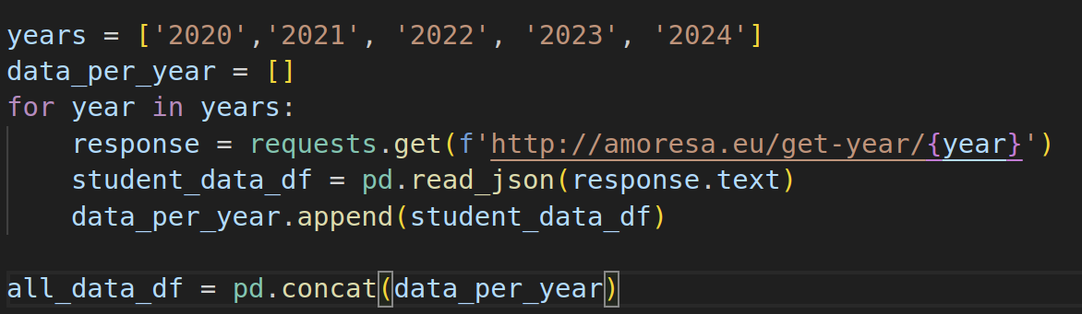
Concatenating dataframes
A solution

Slide 34
Plan
Company
Team
Tools
Scenario and setting up our data base
Collecting data from an API
Storing data in our data base (first attempt!).
Finding duplicates (and maybe dropping them)
Finding empty values (and maybe dropping them)
Notes:
Asomeojw

Slide 35
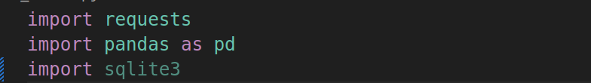
Adding data to our DB
We are going to work with the DB we set up earlier on, so let’s import sqlite3 at the top of our api_download.py. Then go back to the bottom, under

Slide 36
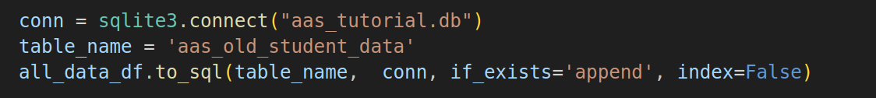
Adding data to our DB
Attempt 1) At the bottom of api_download.py We follow these steps to add data to our DB (but they will fail this time around)
1) Create a connection like when we first created our DB (to the same DB)
2) Select the name for the table we created
3) Use the pandas data frame method to_sql. Passing the name of the table, the connection, if_exists append (which means append the data if the table already exists) and index false (which means, ignore the index of the dataframe)
Notes:
Watch out, if the db name is not exactly the same as the one created initially, a new DB will be created and it will seem to work! A quick pragma table_info(table_name) query will show how it is different.

Slide 37
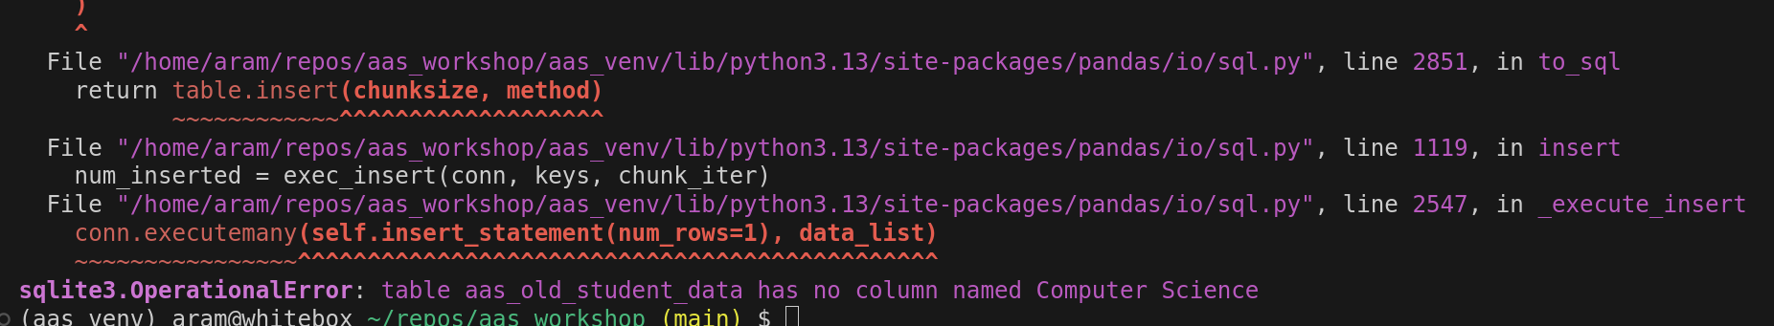
Adding data to our DB
When we run it we get an error because our table does not have a column called ‘Computer Science’.

Slide 38
Adding data to our DB
We got an error because our table does not have a column called ‘Computer Science’, when we created it we called it ‘computer_science’!

Slide 39

Adding data to our DB
Let’s have a look at the names of our columns. Add the code to print them bel

Slide 40
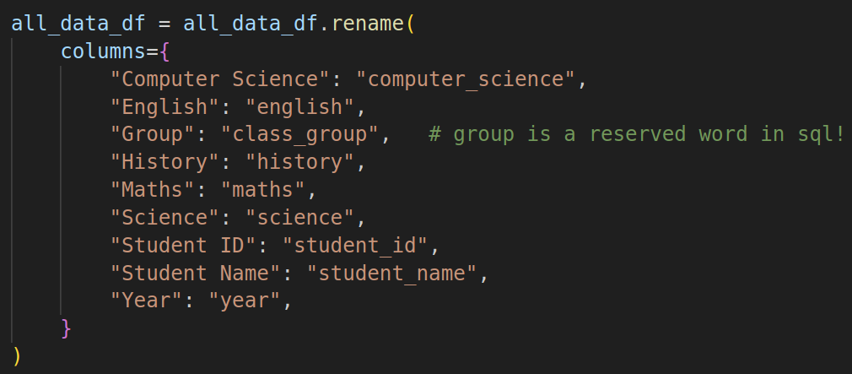
Adding data to our DB
Let’s rename our columns (as usual, there are many ways, this is one).
The columns in the dataframe
Code to rename the columns
The columns in the database

Slide 41
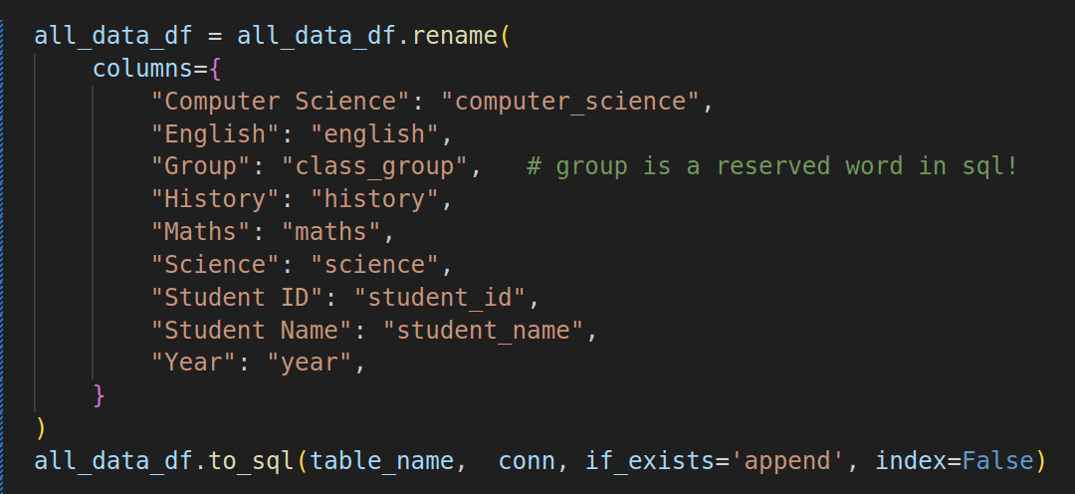
Adding data to our DB
Attempt 2. Let’s move the all_data_df.to_sql line to the end and try again.
Something will fail. Guesses? (Check the names for the columns in the data frame that we printed before)

Slide 42
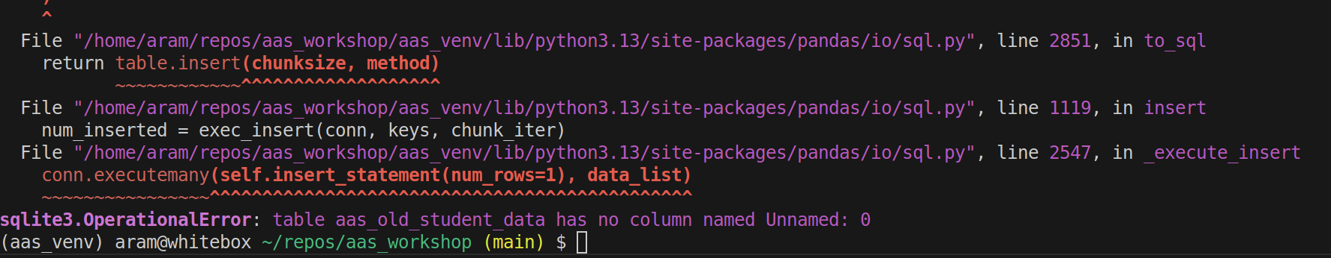
Adding data to our DB
Attempt 2. We have a column that we do not need!

Slide 43
Adding data to our DB
Let’s drop the column we do not need.

Slide 44
Adding data to our DB
Attempt 3. Move the all_data_df.to_sql line to the very end and… will fail again!
Unique constraint failed… What does that mean?

Slide 45
Adding data to our DB
Remember that special constraint ‘primary key’ we added when we created our DB?

Slide 46
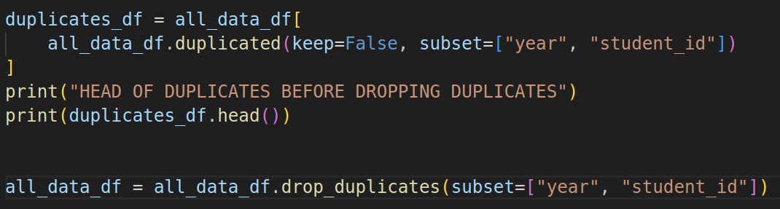
Adding data to our DB
Getting an error because ‘Unique constraint failed’ means that we have some rows where the combination of the values for student_id and year is repeated!
We can see them (don´t need to) and drop them (need to)!
Selects dupes
This deletes the dupes

Slide 47
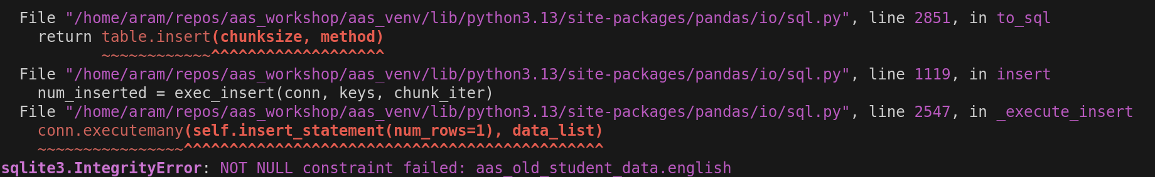
Adding data to our DB
Attempt 4. This one will fail too, but should be the last one to fail!
Let’s move the all_data_df.to_sql line to the end and try again.
Unique constraint failed… What does that mean?
NOT NULL constraint

Slide 48
Adding data to our DB
Remember that NOT NULL constraint we added when we created our DB?
Each row needs it
Everyone does English
Not everyone does this!

Slide 49
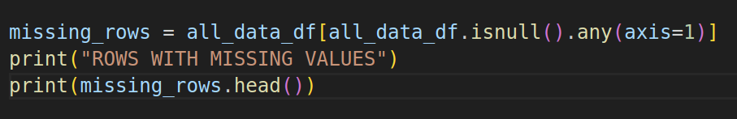
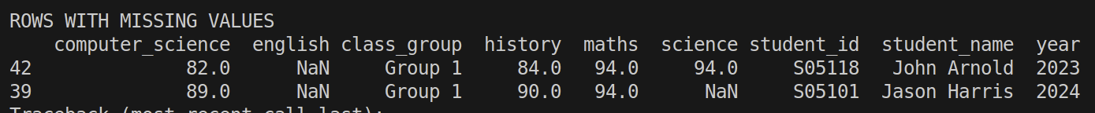
Adding data to our DB
Let’s have a look at the columns with gaps.

Slide 50
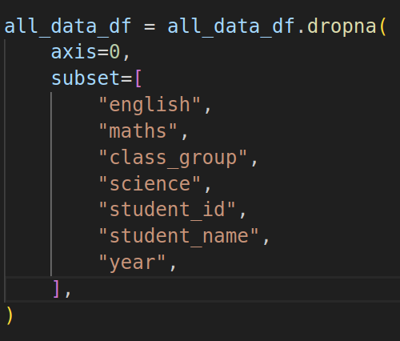
Adding data to our DB
Let’s drop all the rows with gaps in the NOT NULL columns.

Slide 51
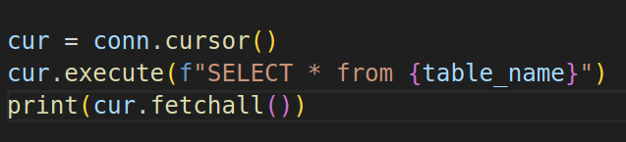
Adding data to our DB
Attempt 5. This time we will succeed!
Let’s move the all_data_df.to_sql line to the end and try again.
You may want to add this to the end of your code to double check that the data is really in our database.

Slide 52
Now what?
One the data is in the database the users can use it themselves (do their queries to figure out what to buy or sell or plan strategies) or you may be asked to create a dashboard to help the users make decisions.

