Slide 1

Game Proposal:
Road Rush
Prepared By:
Mustafa Muhamad
Aram Asaad
Bashar Bahjat

Slide 2
The Vision
"I want to create a driving game where the player must dodge traffic at increasing speeds without brake, creating a feeling of constant tension.
Player Identity
There will be one player that acts as a Driver surviving on a highway with no brakes.
2. The Goal
The goal is not just to reach a distance, but driving until the player collects three stars.

Slide 3
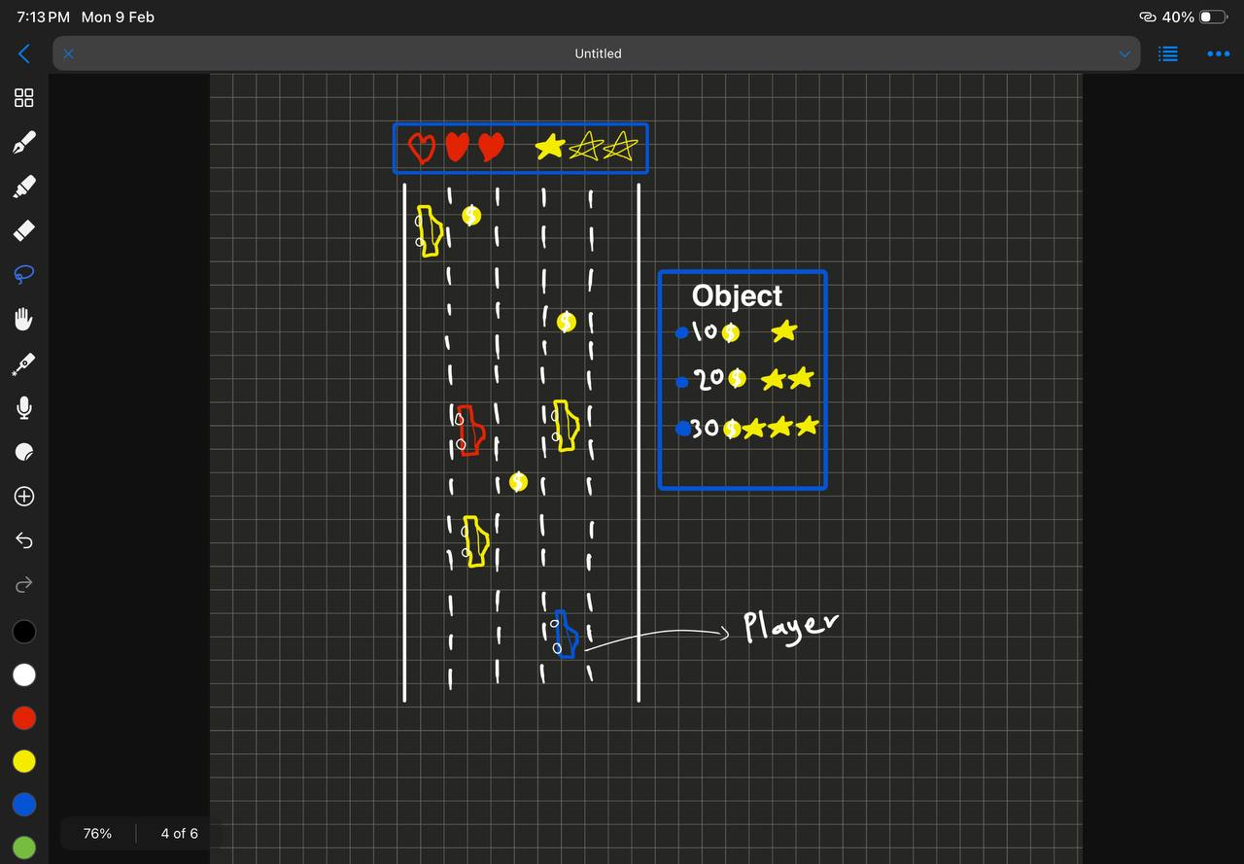
Player Mode Sketch

Slide 4
3.Rules
Verbs:
Steer Left / Steer Right: The player controls the car by changing the car's position on the road to left and right.
Impact: Moving lanes allows the player to dodge traffic and collect coins
Limitations:
No Brakes: The car moves forward automatically. The player cannot stop or slow down.
Lane Limits: the player cannot drive on the grass or off the screen.
Learning The Rules at First:
Tutorial: A "Tap to Steer" prompt appears at the start.
And Hitting a wall removes a Heart, instantly teaching the player what is dangerous.

Slide 5
4. Challenges
Obstacles:
Concrete Blockers: These are like walls on the road. If you hit them, you lose a Heart immediately.
Opponents:
Yellow Car: It moves in a straight line. It acts like a moving wall because it does not chase you. It is easy to avoid.
Red Car: This car is smart. It sees which lane you are in and moves to block you. You have to trick it to get past.
Resources:
Hearts: You have 3 lives. You must keep them to stay in the game.
Coins: You must take risks to collect 10, 20, or 30 coins to get Stars.

Slide 6
Game Engine
Graphics System:
2D Rendering: Must support sprites (images) for cars and road tiles.
Scrolling: The engine needs to scroll the background layer continuously to simulate speed.
Physics & Collision:
Collision: The engine must detect when the Player's Box overlaps with an Enemy's Box (Axis-Aligned Bounding Box).
Audio System:
Channels: Needs at least 2 channels one for Looping Music (Engine hum/Background) and one for Sound Effects (Crash/Coin pickup).

Slide 7
Systems
The Road :
Endless Scroll: The road loops forever.
4-Lane Grid: Objects can only spawn in lanes 1, 2, 3, or 4.
Global Progression:
Speed Multiplier: Every 10 seconds, the "Game Speed" variable increases by a rate.
Traffic: spawning of cars.
Environment(Objects):
Walls: Spawn at fixed intervals.
Patterns: Coins spawn in lines randomly.

Slide 8
Game Mechanics
Entities (Game Objects):
Avatar: The Blue Car (Player controlled).
Simple Enemy: Yellow Car.
Complex Enemy: Red Car.
Static Hazard: Concrete Wall.
Triggers: Coins (Add Score) and Stars (Progress Token).
Resource Mechanics:
Health System: Integer value (Max: 3). Decrements on collision.
Score System: Integer value. Increments on Coin collection.

Slide 9
User Interface
Input Controls (Player → System):
Digital Tapping: The game uses simple "Tap Left" or "Tap Right" .
Visual Feedback (System → Player):
Heads Up Display (HUD):
Hearts: Displayed at the top-left (Static).
Stars: Displayed at the top-right (Updates on collection).
Audio Feedback (System → Player):
Positive Feedback: when collecting a Coin (Rewards the player).
Negative Feedback: Loud hitting sound when hitting a wall or a car.
Interface Modes (State Changes):
Standard Mode: The screen is bright and clear.
Critical Mode: When Health = 1, the screen dims. This interface change urgently warns the player that the next hit is fatal.

Slide 10
Content

Slide 11
Thank You

