Slide 1
Module 7
Developing SharePoint 2010 Workflows
Notes:
Module 7: Developing SharePoint 2010 Workflows
Course 10175A

Slide 2
Module Overview
Creating Workflows by Using SharePoint Designer
Creating Workflows with Visual Studio 2010
Lab: Creating Workflows for SharePoint 2010
Notes:
Module 7: Developing SharePoint 2010 Workflows
Course 10175A
Presentation: 45 minutes
Lab: 90 minutes
Required materials
To teach this module, you need the Microsoft® Office PowerPoint® file 10175A_M07.ppt.
Important: It is recommended that you use Office PowerPoint 2002 or a later version to display the slides for this course. If you use Office PowerPoint Viewer or an earlier version of Office PowerPoint, all the features of the slides might not be displayed correctly.
Preparation tasks
To prepare for this module:
Read all of the materials for this module.
Practice performing the demonstrations and the lab exercises.
Work through the Module Review section, and determine how you will use this section to reinforce student learning and promote knowledge transfer to on-the-job performance.
Make sure that students are aware that there are additional information and resources for the module on the Course Companion CD.

Slide 3
Lesson 1: Creating Workflows by Using SharePoint Designer
Creating SharePoint Designer Workflows
Creating Initiation Form Parameters
Creating Local Variables
Types of Conditions
Types of Actions
Building SharePoint Designer Workflows
Notes:
Module 7: Developing SharePoint 2010 Workflows
Course 10175A
Use this slide to provide a brief introduction to the topics. Do not teach technical points here.

Slide 4
Creating SharePoint Designer Workflows
Types of workflow
  List workflow (documents and lists)
  Site workflow
  Reusable workflow
Importing and exporting workflows
  Import from Visio
  Export to Visio
Notes:
Module 7: Developing SharePoint 2010 Workflows
Course 10175A
You should show how to start creating a workflow in SharePoint Designer after you have discussed the points on the slide. Do not add forms, actions or conditions just yet, and you should do that over the next few topics.

Slide 5
Creating Initiation Form Parameters
What is an initiation form parameter?
Creating initiation form parameters
  Single line of text
  Multiple lines of text
  Number (1, 1.0, 100)
  Date and Time
  Choice (menu to choose from)
  Yes/No (check box)
  Person or Group
  Hyperlink or Picture
  Assignment Stages
Default column settings
Notes:
Module 7: Developing SharePoint 2010 Workflows
Course 10175A
Continue with the demo to show the UI for creating Initiation Form Parameters.

Slide 6
Creating Local Variables
What is a local variable?
Creating Local Variables
  Boolean
  Date/Time
  Integer
  List Item Id
  Number
  String
Notes:
Module 7: Developing SharePoint 2010 Workflows
Course 10175A
Continue with the demo to show the UI for creating local variable.

Slide 7
Types of Conditions
What is a condition?
Common conditions
  If any value equals value
  If current item field equals value
Other conditions
Notes:
Module 7: Developing SharePoint 2010 Workflows
Course 10175A
Continue with the demo to show the UI for creating conditions.

Slide 8
Types of Actions
What is an action?
Types of actions
  Core actions
  Document set actions
  List actions
  Relational actions
  Task actions
  Utility actions
Notes:
Module 7: Developing SharePoint 2010 Workflows
Course 10175A
Continue with the demo to show the UI for creating Initiation actions.

Slide 9
Building SharePoint Designer Workflows
Creating steps
  Else-If branches
  Parallel steps
  Setting variables
Impersonation steps
Check for errors
Workflow settings
Notes:
Module 7: Developing SharePoint 2010 Workflows
Course 10175A

Slide 10
Lesson 2: Creating Workflows by Using Visual Studio 2010
Types of Workflows
Developing Workflows
Workflow Initiation Forms
Sequential Workflows
State Machine Workflows
Notes:
Module 7: Developing SharePoint 2010 Workflows
Course 10175A
Use this slide to provide a brief introduction to the topics. Do not teach technical points here.

Slide 11
Types of Workflows
List workflows
  Associated with a specific list instance
Site workflows
  Associated with a site (SPWeb) object
Notes:
Module 7: Developing SharePoint 2010 Workflows
Course 10175A

Slide 12
Developing Workflows
SharePoint 2010 Workflow engine from .NET 3.5 Framework
SharePoint 2010 Project Item Templates
  Sequential workflow
  State machine workflow
Workflow Events
  Workflow_Initialized
  Workflow_Completed
  Improved nested logic
Notes:
Module 7: Developing SharePoint 2010 Workflows
Course 10175A

Slide 13
Workflow Initiation Forms
Design in Visual Studio
GetInitiationData method returns data from the form to the workflow
  You will typically return XML or a discrete value
Data retrieved through the SPWorkflowActivationProperties object
Code Sample
Notes:
Module 7: Developing SharePoint 2010 Workflows
Course 10175A

Slide 14
Sequential Workflows
Well-defined start and end points
Well-defined path through the sequential steps
Can include:
  Decision-making
  Branching
  Parallel steps
  Loops
Notes:
Module 7: Developing SharePoint 2010 Workflows
Course 10175A
If you want to, you can show the completed solution from the lab, and explain how it works. This will be especially useful if students are new to workflows in Visual Studio.

Slide 15
State Machine Workflows
Deals primarily with different machine states
Actions put the workflow into
one of the states that you define
No predefined path through
the workflow or between states
Notes:
Module 7: Developing SharePoint 2010 Workflows
Course 10175A

Slide 16
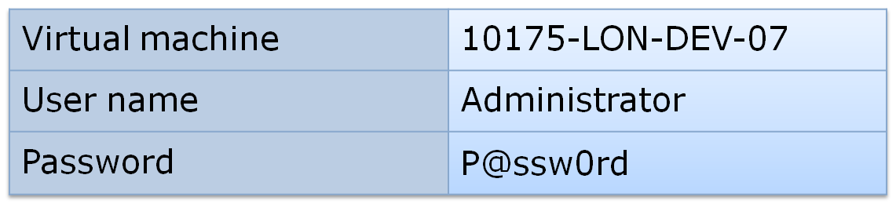
Lab: Creating Workflows for SharePoint 2010
Exercise 1: Creating Workflows by Using SharePoint Designer
Exercise 2: Creating a Sequential Workflow by Using Visual Studio 2010
Logon information
Estimated time: 90 minutes
Notes:
Module 7: Developing SharePoint 2010 Workflows
Course 10175A

Slide 17
Lab Review
What SharePoint Designer workflow did you create and what did it do?
What Visual Studio workflow did you create and what did it do?
Notes:
Module 7: Developing SharePoint 2010 Workflows
Course 10175A
Use the questions on the slide to guide the debriefing after students have completed the lab exercises.

Slide 18
Module Review
In this module, you have learned to:
  Create SharePoint workflows by using SharePoint Designer
  Create SharePoint workflows by using Visual Studio 2010
Notes:
Module 7: Developing SharePoint 2010 Workflows
Course 10175A
Use this slide to summarize the module and ask further questions to ensure students have learned key concepts
Review Questions
What are advantages of creating workflows by using SharePoint Designer?
How do you get started creating workflows by using SharePoint Designer?
Name some of the features of SharePoint Designer workflows
What types of object can you associate a workflow with by using Visual Studio 2010?
What types of workflows can you create by using Visual Studio 2010?

