Slide 1
Module 11
Developing Sandboxed Solutions
Notes:
Module 11: Developing Sandboxed Solutions
Course 10175A

Slide 2
Module Overview
Sandboxing and User Solutions
Restrictions for Sandboxed Solutions
Lab: Creating Sandboxed Solutions for SharePoint 2010
Notes:
Module 11: Developing Sandboxed Solutions
Course 10175A
Presentation: 45 minutes
Lab: 45 minutes
Required materials
To teach this module, you need the Microsoft® Office PowerPoint® file 10175A_M11ppt.
Important: It is recommended that you use Office PowerPoint 2002 or a later version to display the slides for this course. If you use Office PowerPoint Viewer or an earlier version of Office PowerPoint, all the features of the slides might not be displayed correctly.
Preparation tasks
To prepare for this module:
Read all of the materials for this module.
Practice performing the demonstrations and the lab exercises.
Work through the Module Review section, and determine how you will use this section to reinforce student learning and promote knowledge transfer to on-the-job performance.
Make sure that students are aware that there are additional information and resources for the module on the Course Companion CD.

Slide 3
Lesson 1: Sandboxing and User Solutions
Overview of User Solutions
The Sandboxed Environment
Sandboxed Solutions and Visual Studio 2010
Debugging Sandboxed Solutions by Using
Visual Studio 2010
Notes:
Module 11: Developing Sandboxed Solutions
Course 10175A
Use this slide to provide a brief introduction to the topics. Do not teach technical points here.

Slide 4
Overview of User Solutions
What are User Solutions?
Solution Galleries in SharePoint Sites
Benefits of User Solutions
  Rapid configuration
  Flexibility
  Stability
Monitoring and managing User Solutions
  Quotas and resource usage
  Notifications
  Auto-disablement
Notes:
Module 11: Developing Sandboxed Solutions
Course 10175A
It is tempting to cover this slide quickly, but you should not rush through it.
You MUST use this slide to set the context of the benefits of sandboxed solutions, otherwise the module will appear as a list of things you cannot do as a developer. So you must set the scene here so that students understand the benefits of the entire concept to an organization. That way, you can put the disallowed operation and types that you will talk about later in this module into context, and the students will then realize why those elements are not allowed.
You could also demo the Solution Gallery in a SharePoint site to set the context further for how we are delegating administrative responsibility to site administrators (with the safety net of the sandboxed environment).

Slide 5















The Sandboxed Environment
Sandbox User Code processes
  SPUCHostService.exe
  SPUCWorkerProcessProxy.exe
  SPUCWorkerProcess.exe
Host Service
Worker Process
Untrusted Code
Subset Object Model
Execution Manager
Full Object Model
Notes:
Module 11: Developing Sandboxed Solutions
Course 10175A
This slide builds, so be sure you discuss each concept as the build progresses.

Slide 6
Sandboxed Solutions and Visual Studio 2010
IntelliSense Features
  Restricted namespaces and object types
Build Process
  Compilation against the full object model
Deployment
  Validation
  Solution Gallery
  Activation
  WSP files
Notes:
Module 11: Developing Sandboxed Solutions
Course 10175A

Slide 7
Debugging Sandboxed Solutions by Using Visual Studio 2010
Deploying and debugging from Visual Studio
  Automatic attachment to the SPUCWorkerProcess.exe process
Debugging a deployed solution
  Manually attach the debugger to the SPUCWorkerProcess.exe process
Notes:
Module 11: Developing Sandboxed Solutions
Course 10175A

Slide 8
Lesson 2: Restrictions for Sandboxed Solutions
Project Types and Project Item Types
Data Access
Allowed and Disallowed Operations
Notes:
Module 11: Developing Sandboxed Solutions
Course 10175A
Use this slide to provide a brief introduction to the topics. Do not teach technical points here.

Slide 9
Project Types and Project Item Types
Allowed and disallowed project types
Allowed and disallowed project item types
Notes:
Module 11: Developing Sandboxed Solutions
Course 10175A

Slide 10
Data Access
Access to SharePoint data
Database access
Notes:
Module 11: Developing Sandboxed Solutions
Course 10175A

Slide 11
Allowed and Disallowed Operations
Allowed operations
Disallowed operations
Exception-handling characteristics
Notes:
Module 11: Developing Sandboxed Solutions
Course 10175A

Slide 12
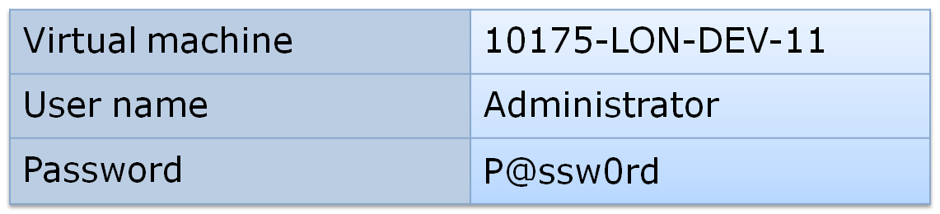
Lab: Creating Sandboxed Solutions for SharePoint 2010
Exercise 1: Creating a Sandboxed Solution by Using Visual Studio 2010
Exercise 2: Investigating Allowed and Disallowed Operations in Sandboxed Solutions
Logon information
Estimated time: 45 minutes
Notes:
Module 11: Developing Sandboxed Solutions
Course 10175A

Slide 13
Lab Review
How did you create a sandboxed solution by using Visual Studio?
To where did Visual Studio deploy your sandboxed solution?
How can you stop a sandboxed solution from running without removing it completely?
What types of operations worked in your sandboxed solution?
What types of operations did not work in your sandboxed solution?
Notes:
Module 11: Developing Sandboxed Solutions
Course 10175A
Use the questions on the slide to guide the debriefing after students have completed the lab exercises.

Slide 14
Module Review
In this module, you have learned about:
  Sandboxing and User Solutions
  Sandboxed Operations
Notes:
Module 11: Developing Sandboxed Solutions
Course 10175A
Use this slide to summarize the module and ask further questions to ensure students have learned key concepts
Review Questions
What are the benefits of sandboxed solutions?
How can administrators manage user solutions?
How are operations in sandboxed solutions validated?
Are sandboxed solutions compiled against the full object model?

