Slide 1
Module 13
Developing Content Management Solutions
Notes:
Module 13: Developing Content Management Solutions
Course 10175A

Slide 2
Module Overview
Developing Enterprise Content Management Solutions
Developing Web Content Management Solutions
Lab: Branding SharePoint Sites
Notes:
Module 13: Developing Content Management Solutions
Course 10175A
Presentation: 30 minutes
Lab: 30 minutes
Required materials
To teach this module, you need the Microsoft® Office PowerPoint® file 10175A_M13.ppt.
Important: It is recommended that you use Office PowerPoint 2002 or a later version to display the slides for this course. If you use Office PowerPoint Viewer or an earlier version of Office PowerPoint, all the features of the slides might not be displayed correctly.
Preparation tasks
To prepare for this module:
Read all of the materials for this module.
Practice performing the demonstrations and the lab exercises.
Work through the Module Review section, and determine how you will use this section to reinforce student learning and promote knowledge transfer to on-the-job performance.
Make sure that students are aware that there are additional information and resources for the module on the Course Companion CD.

Slide 3
Lesson 1: Developing Enterprise Content Management Solutions
Document Management in SharePoint Server 2010
Working with Document Sets
Working with Content Types
Working with Digital Assets
Programming with Word Automation Services
Notes:
Module 13: Developing Content Management Solutions
Course 10175A
Use this slide to provide a brief introduction to the topics. Do not teach technical points here.

Slide 4
Document Management in SharePoint Server 2010
Content Organizer
Content Organizer document flow
Content Organizer rules
  Content type constraints
  Property conditions
Notes:
Module 13: Developing Content Management Solutions
Course 10175A

Slide 5
Working with Document Sets
What are Document Sets?
How are Document Sets used?
Developer Opportunities
  Customizing Document Set Welcome Pages
  Assembling Document Sets by using workflows
Notes:
Module 13: Developing Content Management Solutions
Course 10175A

Slide 6
Working with Content Types
Creating Content Types
  Browser
  SharePoint Designer 2010
  Visual Studio 2010
Notes:
Module 13: Developing Content Management Solutions
Course 10175A

Slide 7
Working with Digital Assets
Digital Asset Content Types
  Content Type field descriptions
Configuring the Rich Media Player object
  ECMAScript properties
Notes:
Module 13: Developing Content Management Solutions
Course 10175A

Slide 8
Programming with Word Automation Services
What is Word Automation Services?
Developing solutions for Word Automation Services
Notes:
Module 13: Developing Content Management Solutions
Course 10175A

Slide 9
Lesson 2: Developing Web Content Management Solutions
Master Pages and Page Layouts
Applying Themes and Styles
Notes:
Module 13: Developing Content Management Solutions
Course 10175A
Use this slide to provide a brief introduction to the topics. Do not teach technical points here.

Slide 10
Master Pages and Page Layouts
Master Pages
Developing custom Master Pages
Page Layouts
Notes:
Module 13: Developing Content Management Solutions
Course 10175A

Slide 11
Applying Themes and Styles
Themes
  Applying Office themes to SharePoint sites
  Applying themes programmatically
Styles
Notes:
Module 13: Developing Content Management Solutions
Course 10175A

Slide 12
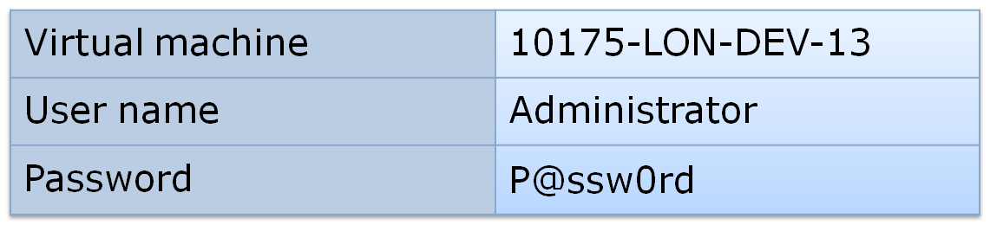
Lab: Branding SharePoint Sites
Exercise 1: Customizing Master Pages
Exercise 2: Applying a Theme to a SharePoint Site
Logon information
Estimated time: 30 minutes
Notes:
Module 13: Developing Content Management Solutions
Course 10175A

Slide 13
Lab Review
How did you create a theme by using Microsoft Office?
How did you apply a theme to a SharePoint Site?
Notes:
Module 13: Developing Content Management Solutions
Course 10175A
Use the questions on the slide to guide the debriefing after students have completed the lab exercises.

Slide 14
Module Review
In this module, you have learned about:
  Enterprise Content Management Solutions
  Web Content Management Solutions
Notes:
Module 13: Developing Content Management Solutions
Course 10175A
Use this slide to summarize the module and ask further questions to ensure that students have learned key concepts.

Slide 15

Course Evaluation
Notes:
Module 13: Developing Content Management Solutions
Course 10175A
Remind students to complete the course evaluation.

