Slide 1
20488A
Developing Microsoft SharePoint Server 2013 Core Solutions

Slide 2

Welcome!
Thank you for joining us today.
We’ve worked together with Microsoft Learning Partners and Microsoft IT Academies to bring you a world-class learning experience, including:
Microsoft Certified Trainers + Instructors. Your instructor is a premier technical and instructional expert who meets ongoing certification requirements.
Customer Satisfaction Guarantee. Our Partners offer a satisfaction guarantee and we hold them accountable for it. At the end of class, please complete an evaluation of
today’s experience. We value your feedback!
Certification Benefits. After training, consider pursuing a Microsoft Certification, to help distinguish your technical expertise and experience. Ask your instructor about available exam promotions and discounts.
We wish you a great learning experience and ongoing career success!

Slide 3
Introductions
Name
Company affiliation
Title/function
Job responsibility
Exchange Server experience
Active Directory experience
Your expectations for the course

Slide 4
Hello
Instructor: <Instructor Name>
<Title or other credentials, e.g. Microsoft Certified Trainer>
<Affiliation/Company>
<A few words about my technical and professional experience>

Slide 5
Facilities
Class hours
Building hours
Parking
Restrooms
Meals
Phones
Messages
Smoking
Recycling

Slide 6
About This Course
Audience
Course Prerequisites
Course Objectives
What You Can Expect
Notes:
Audience
This course is intended for professional developers who develop solutions for SharePoint products and technologies in a team-based, medium-sized to large development environment. While some familiarity with SharePoint solution development is required, candidates are not expected to have prior experience with the new features in SharePoint Server 2013.
The ideal candidate is a technical lead with at least four years of SharePoint and web development experience. The candidate is responsible for designing custom code for projects that are deployed to or interact with SharePoint environments. This includes:
Selecting an appropriate approach and building customizations in SharePoint.
Creating and implementing a strategy for solution packaging, deployment, and upgrading.
Identifying SharePoint data and content structures for customizations.
Performing diagnostics and debugging.
Planning and designing applications for scalability and performance.
Identifying and mitigating performance issues of customizations.
Understanding authentication and authorization.
Experience with Windows PowerShell.
Broad familiarity with SharePoint capabilities.
Familiarity with Online Services such as Azure and SharePoint Online.
<More …>

Slide 7
Hidden Slide
Do not delete this slide
Notes:
Course Prerequisites
In addition to their professional experience, students who attend this training should already have the following technical knowledge:
A working knowledge of using Visual Studio 2010 or Visual Studio 2012 to develop solutions.
A basic working knowledge of SharePoint solution development, either in SharePoint 2013 or in earlier versions of SharePoint.
A working knowledge of Visual C# and the .NET Framework 4.5.
A basic understanding of ASP.NET and server-side web development technologies, including request/response and the page lifecycle.
A basic understanding of AJAX and asynchronous programming techniques.
A basic working knowledge of client-side web technologies including HTML, CSS, and JavaScript.
Familiarity with approaches to authentication and authorization, including claims-based authentication.
Course Objectives
After completing this course, students will be able to:
Identify SharePoint development opportunities and make appropriate design choices.
Work with core server-side objects.
Query and update list data.
Design and manage features and solutions.
Develop code for customer server-side components.
Manage and customize authentication and authorization.
Create custom sites and lists and manage the site lifecycle.
Explain the capabilities and design choices for apps for SharePoint.
Use the client-side object model and the REST API.
Distribute and deploy apps for SharePoint.
Create custom workflows to automate business processes.
Use fields and content types to manage taxonomy.
Customize the appearance and behavior of user interface elements.
Customize navigation and branding.
What You Can Expect
In this course, students learn core skills that are common to almost all SharePoint development activities. These include working with the server-side and client-side object models, developing and deploying features, solutions, and apps, managing identity and permissions, querying and updating list data, managing taxonomy, using workflow to manage business processes, and customizing the user interface.

Slide 8
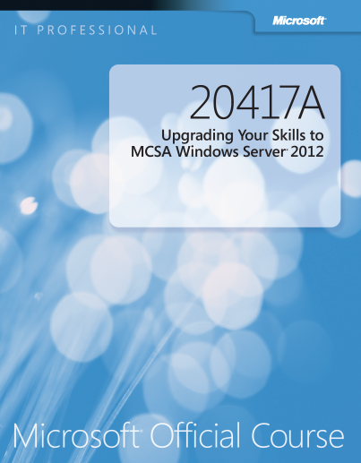
Your Course Materials
Designed to optimize your classroom learning experience.
And support you back on the job.
Microsoft Official Course Handbook
Organized by Modules
Includes Labs + Lab Answer Keys
Module Reviews + Takeaways—great for on-the-job reference
NOTE
This is an early-to-market edition of the course. Upon release of the next edition, you will be able to access the digital companion content at: microsoft.com/learning/companionmoc
Notes:
For courseware covering pre-release software:
The content of this course and its labs are based on a pre-release version of software. This course may not cover software features that are still in development, and software may be substantially changed prior to commercial release.
This course is provided as-is, to provide early insights and help students get a head start with new technologies. When the software is finalized for commercial release, the course will be updated with final graphics and a full editorial review. At this time, the students can download an updated version of the course companion content at the Microsoft Learning site.

Slide 9
Course Outline
Module 1: SharePoint as a Developer Platform
Module 2: Working with SharePoint Objects
Module 3: Working with Lists and Libraries
Module 4: Designing and Managing Features and Solutions
Module 5: Working with Server-Side Code
Module 6: Managing Identity and Permissions
Module 7: Managing Custom Components and Site Lifecycles
Module 8: Introducing Apps for SharePoint

Slide 10
Course Outline (continued)
Module 9: Client-Side SharePoint Development
Module 10: Developing Remote-Hosted Apps
Module 11: Publishing and Distributing Apps
Module 12: Automating Business Processes
Module 13: Managing Taxonomy
Module 14: Customizing User Interface Elements
Module 15: Working with Branding and Navigation

Slide 11
Related Courses
20489A: Developing Microsoft SharePoint Server 2013 Advanced Solutions
See the full line of Microsoft Training and Certification resources at: http://www.microsoft.com/learning/

Slide 12
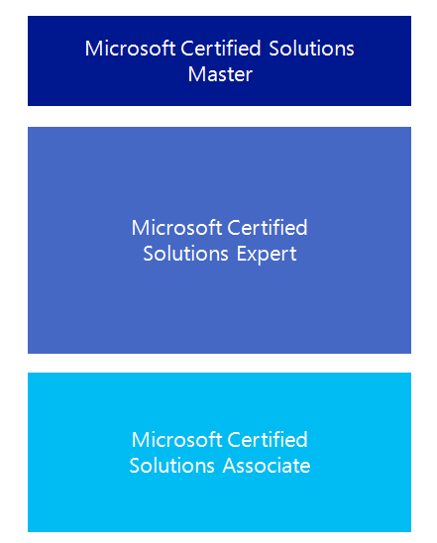

Microsoft Certification Program
Get trained. Get certified.
Get ahead.
Microsoft Certifications demonstrate you have the skills to design, deploy, and optimize the latest technology solutions.
Ask your Microsoft Learning Partner how you can prepare for certification.
Also see:
http://www.microsoft.com/learning/
certification

Slide 13

Preparing for the Labs
Your lab activities will be centered around a fictitious company that we’ll call Contoso Pharmaceuticals.
By working through the labs, you will learn how to create interactive SharePoint 2013 applications.
To complete the labs, you will work in a virtual machine (VM) environment.

Slide 14

Virtual Machine Environment
Virtual Machine Name: | Use as:
20488A-LON-SP-xx (where xx is the module number) | Domain controller and SharePoint development computer
Notes:
There is one virtual machine for each module in the course. The demonstration and lab files are located on the E:\ drive of this virtual machine.

Slide 15
Demonstration: Using Hyper-V Manager
In this demonstration, you will learn how to:
Open Hyper-V Manager
Navigate the various sections/panes within Hyper-V Manager
Virtual Machines (VMs), Snapshots, and Actions: Server-specific and VM-specific
Identify the VMs used in the labs for this course
Take a Snapshot and Apply a Snapshot
Connect to a VM
Start and log on to a VM
Switch between full screen and window modes
Revert to the previous Snapshot
Shut down a VM
When to use Shut Down or Turn off
Close Hyper-V Manager

