Slide 1
Module 1
SharePoint as a Developer Platform
Notes:
20488A
1: SharePoint as a Developer Platform

Slide 2
Module Overview
Introducing the SharePoint Developer Landscape Choosing Approaches to SharePoint Development Understanding SharePoint 2013 Deployment and Execution Models
Notes:
20488A
1: SharePoint as a Developer Platform

Slide 3
Lesson 1: Introducing the SharePoint Developer Landscape
SharePoint Server 2013 Workloads Developer Tools for SharePoint Server 2013 What's New for Developers in SharePoint 2013 The SharePoint 2013 Technology Stack The SharePoint Page Rendering Process Discussion: Page Rendering in SharePoint Entry Points for Developers in SharePoint 2013 Demonstration: Developer Tools for SharePoint 2013
Notes:
20488A
1: SharePoint as a Developer Platform

Slide 4
SharePoint Server 2013 Workloads
Portals and Collaboration
Search
Enterprise Content Management
Web Content Management
Social and Communities
Business Connectivity Services
Business Intelligence
Notes:
Provide a brief run-through of the SharePoint Server 2013 workloads:
Portals and Collaboration. SharePoint provides many core capabilities, such as the ability to create sites, workspaces, libraries, and lists, which enable teams to work together effectively regardless of their physical location.
Search. SharePoint provides a comprehensive and highly extensible search platform that enables users to find information from a variety of content sources across an organization.
Enterprise Content Management. SharePoint provides a range of functionality to support business processes, such as workflow, records management, and tools for eDiscovery and compliance.
Web Content Management. SharePoint provides comprehensive Content Management System (CMS) features that can be used to manage and maintain a corporate Web presence.
Social and Communities. SharePoint provides functionality that enables users to connect with one another, share news and information, and build communities around common interests.
Business Connectivity Services. SharePoint enables you to integrate data from external systems into solutions for SharePoint sites and Microsoft Office 2013 applications.
Business Intelligence. SharePoint provides a range of capabilities for providing insight into business data, from built-in tools such as Excel Services and PerformancePoint Services to integration with SQL Server 2012 Analysis Services and SQL Server 2012 Reporting Services.
20488A
1: SharePoint as a Developer Platform

Slide 5
Developer Tools for SharePoint Server 2013
Microsoft Visual Studio 2012
Microsoft Office Tools for Visual Studio 2012
Microsoft SharePoint Designer 2013
Web design tools
Notes:
Briefly cover the commonly used development tools:
Microsoft Visual Studio 2012. Visual Studio is an integrated development environment (IDE) that provides a range of productivity tools, debugging and deployment functionality, and integration with Team Foundation Server.
Microsoft Office Tools for Visual Studio 2012. This plug-in for Visual Studio provides templates for SharePoint Server 2013, including Apps for SharePoint and Apps for Office as well as server-side custom components.
Microsoft SharePoint Designer 2013. SharePoint Designer is a free desktop application that offers a range of capabilities for customizing sites and creating non-code-based custom components for SharePoint. For example, you can use SharePoint Designer to create workflows and build declarative Business Data Connectivity (BDC) models. Although SharePoint Designer began as a tool for power users, it is now central to many aspects of the SharePoint development process.
Web Design Tools. SharePoint 2013 introduces new processes for designing and branding SharePoint sites and pages. These processes enable web designers to create SharePoint pages by using standard web technologies—HTML, CSS, and JavaScript—in standard web design applications. You can then use built-in SharePoint utilities to add the required SharePoint functionality to the designer's wireframe web pages.
20488A
1: SharePoint as a Developer Platform

Slide 6
What's New for Developers in SharePoint 2013
The SharePoint App Model
New Client-Side Programming Models
JavaScript
.NET Framework client
Silverlight/Mobile
REST/Odata endpoints
New Design Model
New Workflow Model
Other Key Enhancements
Notes:
Provide a high-level overview of the SharePoint app model (see the student handbook for details). Emphasize that there are two ways to publish and consume apps:
Office Marketplace. This is a public gallery of apps for SharePoint, hosted by Microsoft. Organizations can purchase and download apps from the Office Marketplace. Developers can publish apps to the Office Marketplace.
Corporate Catalog. This is a private, organization-specific gallery of apps for SharePoint. SharePoint administrators can create a corporate catalog for each web application in a SharePoint farm. Developers can publish apps to a corporate catalog to make them available for use within the organization.
Talk briefly around the four client-side programming models.
Provide a brief overview of the new design model and the new workflow model, both of which have been completely overhauled for SharePoint 2013.
Finish by mentioning some of the other key enhancements in SharePoint 2013, such as new social functionality and the redesigned search service.
20488A
1: SharePoint as a Developer Platform

Slide 7
The SharePoint 2013 Technology Stack
SharePoint Server 2013
Office Web Apps Server 2013
SharePoint Foundation 2013
Workflow Manager 1.0
IIS 8 and
ASP.NET 4.0
.NET Framework 4.5
Windows Server/Windows Azure
Notes:
This topic is designed to provide students with a high-level overview of SharePoint and related technologies, rather than any kind of detailed logical architecture. Keep the topic brief. Use the slide to illustrate key changes from SharePoint 2010, most notably that Office Web Apps Server is now a separate product and workflow now runs on a separate platform.
Note: the specified versions of ASP.NET (4.0) and the .NET Framework (4.5) may seem incongruous to developers who are less familiar with .NET. The MCSA prerequisites cover the distinction between the .NET Framework and ASP.NET.
20488A
1: SharePoint as a Developer Platform

Slide 8
The SharePoint Page Rendering Process
Application pages
Physical page on file system
Content pages
Virtual page in content database
Customized content pages
Ghosting and unghosting
Safe mode parser
Notes:
Consider using the virtual machine to show students examples of application pages and content pages. You may also want to open the web.config file for a SharePoint web application and show the SafeMode element. Ensure that students are clear on the distinction between application pages and content pages.
20488A
1: SharePoint as a Developer Platform

Slide 9
Discussion: Page Rendering in SharePoint
Is a web part page a content page or an application page?
When might you want to deploy a custom application page to a SharePoint environment?
Notes:
This topic should be a brief knowledge check rather than a prolonged discussion. Ask students to suggest answers to the questions and correct any misapprehensions before you continue.
Question: Is a web part page a content page or an application page?
Answer: If you create a new web part page through the SharePoint UI, it's a content page.
Question: When might you want to deploy a custom application page to a SharePoint environment?
Answer: A large number of unghosted pages can cause slow down the SharePoint environment, as the entire page must be stored in and retrieved from the content database. Unghosted pages can also cause issues when the SharePoint environment is upgraded, as ghosted pages on the file system are updated but unghosted pages in the content database are not.
20488A
1: SharePoint as a Developer Platform

Slide 10
Entry Points for Developers in SharePoint 2013
Server-side object model
Managed code
Windows PowerShell
Client.svc
REST/OData clients
Client-side object models
Declarative customizations
Notes:
Mention that SharePoint 2010 supported REST-based list operations through the listdata.svc service. This service remains for backwards compatibility, but the client.svc service supports a far more comprehensive set of operations through REST and OData.
This topic is designed to provide a high-level overview of API choices. Avoid providing too much detail at this stage.
20488A
1: SharePoint as a Developer Platform

Slide 11
Demonstration: Developer Tools for SharePoint 2013
In this demonstration, you will see a brief overview of the developer tools for SharePoint 2013.
Notes:
Adapt your delivery of this demonstration to the capabilities of the class. If the class is already broadly familiar with Visual Studio and SharePoint Designer, keep the demonstration very brief. If the class is less familiar with the tools, you may want to spend a little more time exploring project items and capabilities.
Preparation Steps
You may want to start the virtual machine in advance to save time during the demonstration.
Demonstration Steps
Start the 20488A-LON-SP-01 virtual machine.
Log on to the LONDON machine as CONTOSO\Administrator with password Pa$$w0rd.
On the Start screen, type Visual Studio 2012, and then click Visual Studio 2012.
On the Start Page, click New Project.
In the New Project dialog box, in the left navigation pane, under Templates, expand Visual C#, expand Office/SharePoint, and then click SharePoint Solutions.
Point out that there are project templates for both SharePoint 2010 and SharePoint 2013. The SharePoint 2013 templates are provided by Microsoft Office Developer Tools for Visual Studio 2012.
In the left navigation pane, under Office/SharePoint, click Apps.
In the center pane, click App for SharePoint 2013.
In the Name box, type Demo1.
In the Location box, type E:\Demofiles, and then click OK.
In the New app for SharePoint dialog box, under What is the name of your app for SharePoint, type Demo.
Under What SharePoint site do you want to use for debugging your app, type http://dev.contoso.com.
Under How do you want to host your app for SharePoint, review the available options, click SharePoint-hosted, and then click Finish.
20488A
1: SharePoint as a Developer Platform
(More notes on the next slide)

Slide 12
Lesson 2: Choosing Approaches to SharePoint Development
Declarative Components Client-Side Code Web Parts Application Pages Timer Jobs Event Receivers Workflow Discussion: Choosing a Suitable Development Approach
Notes:
The aim of this lesson is to familiarize students with the various approaches to SharePoint development that are available to them, together with the advantages and disadvantages of each approach. At this stage, you are not teaching the students how to use each approach; instead, you are just equipping them to evaluate which approach is best suited to particular scenarios. Where necessary, emphasize that each approach is covered in more detail later in the course.
Bear in mind that deployment models—features, apps, farm solutions, and sandboxed solutions—are covered in the next lesson. As such, avoid discussing packaging and deployment in any detail in this lesson.
20488A
1: SharePoint as a Developer Platform

Slide 13
Declarative Components
Use declarative components to deploy:
Site columns
Content types and content type bindings
List templates and list instances
Event registrations and custom actions
Workflows, files, and more
When should you use declarative components?
Whenever you can
Where can you use declarative components?
SharePoint Online
On-premises deployments
Notes:
Provide a brief overview of what you can do with declarative components. Focus on when and where you should use declarative components, rather than on providing any technical detail. Subsequent modules provide the technical detail.
20488A
1: SharePoint as a Developer Platform

Slide 14
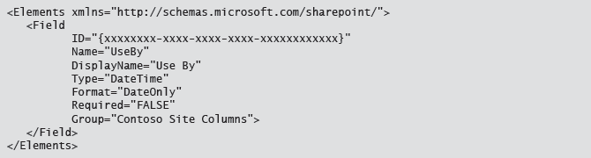
Site Column Declaratively

Slide 15
Client-Side Code
Use client-side code to:
Interact with core SharePoint artifacts and functionality
Interact with SharePoint Server workloads
Perform almost any operations within the scope of a site collection
When should you use client-side code?
Preferred approach when you need to programmatically interact with a SharePoint site collection
Where can you use client-side code?
SharePoint Online
On-premises deployments
Notes:
This topic evaluates client-side coding as a broad approach to SharePoint development. Specific deployment and execution models, such as apps for SharePoint, are covered in the next lesson.
20488A
1: SharePoint as a Developer Platform

Slide 16
Web Parts
Use web parts to:
Create custom functionality with user interaction
Connect to other web parts
When should you create web parts?
Consider apps first
Use web parts when you specifically want to leverage the web part framework
Where can you use web parts?
SharePoint Online (sandboxed solutions only)
On-premises deployments (farm and sandboxed solutions)
Notes:
Provide a brief overview of how web parts work, and focus on when and where you should use them. Emphasize that apps for SharePoint are now the preferred approach, unless you specifically want to leverage the web part framework (for example to connect web parts). Subsequent modules provide the technical detail.
20488A
1: SharePoint as a Developer Platform

Slide 17
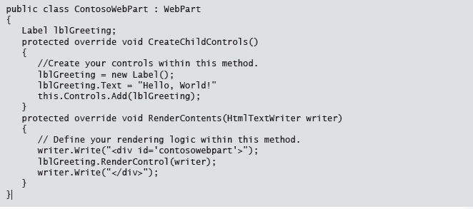
WebPart

Slide 18
Application Pages
Use custom application pages to:
Expose functionality to every site in a SharePoint farm
When should you create a custom application page?
When there are no other options
Consider apps first
Where can you use custom application pages?
On-premises deployments (subject to policy and administrative approval)
Not available for SharePoint Online
Notes:
Describe briefly how custom application pages work – essentially they plug directly into the ASP.NET page rendering process. Focus on when and where you should consider using custom application pages.
20488A
1: SharePoint as a Developer Platform

Slide 19
Timer Jobs
Use custom timer jobs to:
Run background tasks on a scheduled basis
Process queues of work items on a scheduled basis
When should you create a custom timer job?
When you do not require user interaction
When you want to remove logic from the page load process
Where can you use custom timer jobs?
On-premises deployments (subject to policy and administrative approval)
Not available for SharePoint Online
Notes:
Provide a conceptual overview of timer jobs, and talk about when and where you should consider using a timer job. Subsequent modules provide the technical detail.
20488A
1: SharePoint as a Developer Platform

Slide 20
Event Receivers
Use event receivers to:
Run background tasks on a scheduled basis
Process queues of work items on a scheduled basis
When should you create an event receiver?
When you do not require user interaction
When you want to remove logic from the page load process
Where can you use event receivers?
On-premises deployments
SharePoint Online
Notes:
Provide a brief overview of event receivers in SharePoint, including event receiver categories and the concepts of before events and after events. Talk about when and where you should consider using an event receiver. Subsequent modules provide the technical detail.
20488A
1: SharePoint as a Developer Platform

Slide 21
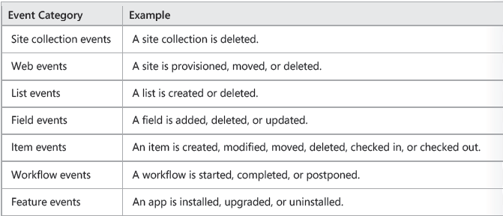
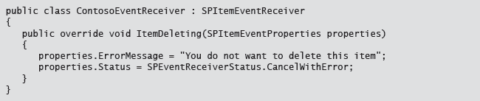
Event Receiver Types

Slide 22
Workflow
Use workflows to:
Automate business processes
Manage the flow of documents and information
When should you create a workflow?
When you need to capture input from multiple users
When you need to create logic that reacts to changes in documents or sites
Where can you use event receivers?
On-premises deployments
SharePoint Online
Notes:
Briefly describe the concept of workflow as a tool for modeling and automating business processes. Talk about when and where you should consider creating a workflow. Subsequent modules provide the technical detail.
20488A
1: SharePoint as a Developer Platform

Slide 23
Lesson 3: Understanding SharePoint 2013 Deployment and Execution Models
SharePoint Features Farm Solutions Sandboxed Solutions Apps for SharePoint
Notes:
Remember that this is an introductory module, which aims to give students a high-level view of the SharePoint development landscape. Later modules provide far more detail on how to build Features, solutions, and apps, so avoid being drawn into providing "how-to" information. This lesson is designed solely to provide an overview of the execution and deployment models that are available.
20488A
1: SharePoint as a Developer Platform

Slide 24
SharePoint Features
Anatomy of a Feature
Feature folder
Feature manifest file
Element manifests
Element files
Feature deployment
Deployment to WFE server file system
Deployment as part of SharePoint app or solution
Notes:
Provide an overview of the SharePoint Feature framework. The student handbook includes an example of a Feature.xml file.
20488A
1: SharePoint as a Developer Platform

Slide 25
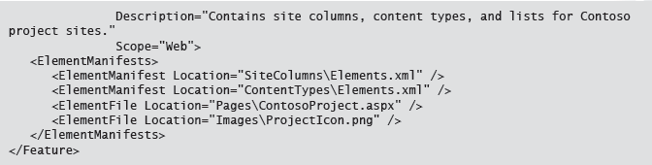
Feature Manifest

Slide 26
Farm Solutions
Anatomy of a farm solution
Solution manifest
Assemblies
Files
Features
Capabilities are unlimited
Deploy any server-side components
Deployment options may be limited
Prohibited in SharePoint Online
May be prohibited in on-premises deployments
Notes:
Provide an overview of farm solutions as a vehicle for packaging and managing the lifecycle of SharePoint components. Subsequent modules provide more technical detail.
20488A
1: SharePoint as a Developer Platform

Slide 27
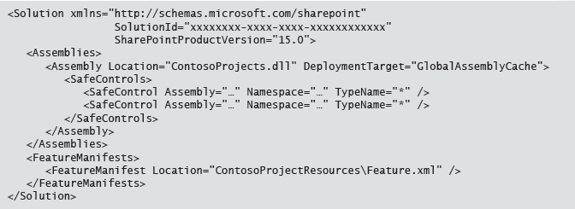
Farm Solution

Slide 28
Sandboxed Solutions
Structured in the same way as a farm solution
Deployed to a Solutions Gallery
Scoped to a site collection
Functionality is constrained:
Isolated worker process
No access to server-side file system
Limited access to SharePoint object model
Resource consumption governed by quota system
Apps for SharePoint are now the preferred approach
Notes:
Provide a brief overview of the sandboxed solution framework, focusing on the capabilities and constraints. Emphasize that sandboxed solutions are largely considered deprecated in favor of apps for SharePoint.
20488A
1: SharePoint as a Developer Platform

Slide 29
Apps for SharePoint
Distribution
Publish to App Catalog
Publish to Office Marketplace
Encapsulation
No server-side code
All SharePoint artifacts hosted within app web
Development models
SharePoint-hosted
Remote-hosted
Interaction
Full page
App part
Command extensions
Notes:
Provide a brief overview of how apps are packaged, deployed, and provisioned.
In the student workbook, the third paragraph states:
When a user installs an app, the app provisions its own subsite within the host web. This subsite is known as the app web.
Technically speaking, the app web is only provisioned if the app needs to deploy resources to SharePoint. If the app is remote-hosted and does not contain any declarative components, an app web is not created. Adding this explanation to the student manual at this point in the course would cloud the issue; however, you may want to provide clarification if challenged.
20488A
1: SharePoint as a Developer Platform

Slide 30
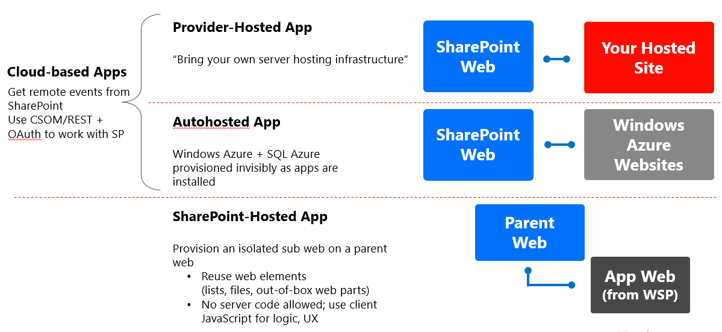
App Models

Slide 31
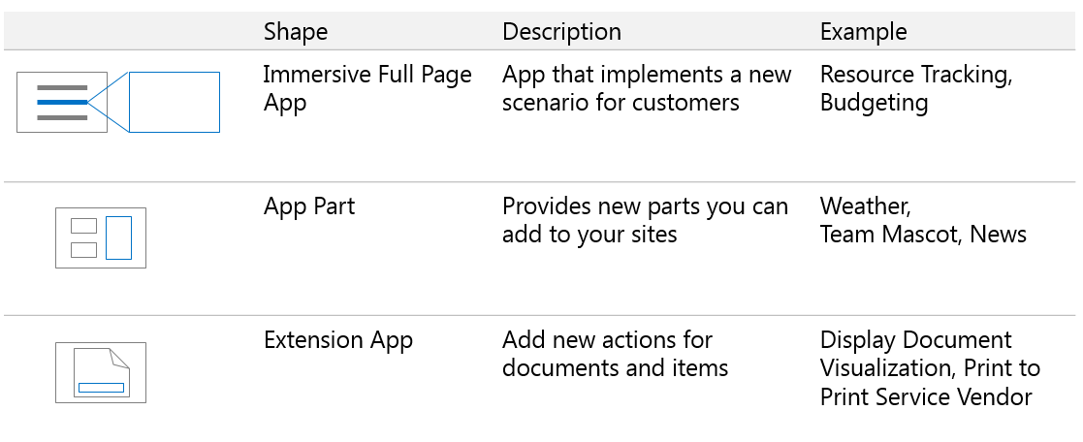
App Shapes

Slide 32
Lab: Comparing Web Parts and App Parts
Exercise 1: Creating and Deploying a SharePoint Web Part Exercise 2: Creating and Deploying a SharePoint App Part
Logon Information
Virtual Machine: 20488A-LON-SP-01
User name: CONTOSO\administrator
Password: Pa$$w0rd
Estimated Time: 30 minutes
Notes:
Exercise 1: Creating and Deploying a SharePoint Web Part
In this exercise, you will create and deploy a web part that provides a personalized greeting to the current user. First, you will create a new Visual Web Part project in Visual Studio 2012. You will then explore the artifacts that Visual Studio creates for you, and refactor the solution to use more intuitive names for the solution components. You will then create a simple user interface and add some code to generate a personalized greeting. Finally, you will deploy and test the web part.
Exercise 2: Creating and Deploying a SharePoint App Part
In this exercise, you will create and deploy an app part that provides a personalized greeting to the current user, in a similar way to the web part you created in the previous exercise. First, you will create a new SharePoint App project in Visual Studio 2012. You will explore the artifacts that Visual Studio creates for you, and you will then add and configure a Client Web Part component to the app project. You will add some JavaScript code to generate a personalized greeting, and you will test the app part on a developer site.
20488A
1: SharePoint as a Developer Platform

Slide 33
Lab Scenario
You have been asked to provide the developer team at Contoso with an overview of how to create and deploy custom SharePoint 2013 components. As part of this process, you will create a simple web part in Visual Studio 2012 You will explore the structure of the solution in Visual Studio and then deploy it to your SharePoint development environment. You will then create a simple App Part in Visual Studio 2012, explore the solution, and deploy it to your SharePoint development environment.
Notes:
20488A
1: SharePoint as a Developer Platform

Slide 34
Module Review and Takeaways
Review Question(s)
Notes:
Review Question(s)
Question
Which of the following best describes unmodified content pages in SharePoint 2013?
( )Option 1: The page template and the page content are stored on the server-side file system.
( )Option 2: The page template and the page content are stored in the content database.
( )Option 3: The page template is stored on the server-side file system, and the page content is stored in the content database.
( )Option 4: The page template is stored in the content database, and the page content is stored on the server-side file system.
( )Option 5: The page template is stored in the configuration database, and the page content is stored in the content database.
Answer
(√) Option 3: The page template is stored on the server-side file system, and the page content is stored in the content database.
Question
You need to automate a business process that collects information from several different users. Which approach to development should you use?
( )Option 1: Create a web part.
( )Option 2: Create an application page.
( )Option 3: Create a timer job.
( )Option 4: Create an event receiver.
( )Option 5: Create a workflow.
Answer
(√) Option 5: Create a workflow.
20488A
1: SharePoint as a Developer Platform
(More notes on the next slide)

Slide 35
Notes:
Question
You need to make a list template, together with custom site columns and content types, available to users across Contoso. Which deployment model should you use?
( )Option 1: Create and install a feature. Manually activate the feature on site collections where the list template is required.
( )Option 2: Create a feature within a sandboxed solution. Install the sandboxed solution on site collections where the list template is required.
( )Option 3: Create a feature within a farm solution. Install the solution at the farm scope. Activate the feature on site collections where the list template is required.
( )Option 4: Create a feature within a SharePoint app. Publish the app to your Corporate Catalog. Add the app on site collections where the list template is required.
( )Option 5: Create and install a feature. Use feature stapling to associate the feature with the Project Site template.
Answer
(√) Option 4: Create a feature within a SharePoint app. Publish the app to your Corporate Catalog. Add the app on site collections where the list template is required.
20488A
1: SharePoint as a Developer Platform

