Slide 1
Module 3
Working with Lists and Libraries
Notes:
20488A
3: Working with Lists and Libraries

Slide 2
Module Overview
Using List and Library Objects Querying and Retrieving List Data Working with Large Lists
Notes:
20488A
3: Working with Lists and Libraries

Slide 3
Lesson 1: Using List and Library Objects
Understanding the List and Library Class Hierarchy Retrieving List and Library Objects Creating and Deleting List and Library Objects Working with List Items Demonstration: Creating List Items Working with Fields Working with Files
Notes:
20488A
3: Working with Lists and Libraries

Slide 4
Understanding the List and Library Class Hierarchy
SPDocumentLibrary
Inherits from…
SPList
Contains collection of…
Contains collection of…
Contains collection of…
SPField
SPListItem
SPFolder
One-to-one
Contains collection of…
SPFile
Notes:
Emphasize the following points:
The SPList class represents all lists, including document libraries.
The SPListItem class represents all list items, including documents in a library. If the list is a document library, the list item has an associated file.
Ensure all students know what a field is in the context of SharePoint lists. Mention that fields are called columns in the SharePoint UI but fields in the object model.
As you teach the remaining topics in this lesson, you may want to refer back to this slide if you need to reiterate the relationship between key classes.
20488A
3: Working with Lists and Libraries

Slide 5
Retrieving List and Library Objects
Retrieve lists and libraries from the parent SPWeb instance
Cast to SPDocumentLibrary if required
var web = SPContext.Current.Web;
// Use an indexer.
SPList documents = web.Lists["Documents"];
// Use a method.
SPList images = web.GetList("Lists/Images");
if (documents is SPDocumentLibrary)
{
var docLibrary = (SPDocumentLibrary)documents;
}
Notes:
Talk through the various approaches to retrieving lists and libraries. Emphasize that the SPList class does not include a constructor; you can only instantiate SPList objects by retrieving them from the parent SPWeb instance.
Emphasize that you cannot instantiate or retrieve an SPDocumentLibrary instance directly. You must first retrieve the SPList instance and then cast it to SPDocumentLibrary.
20488A
3: Working with Lists and Libraries

Slide 6
Creating and Deleting List and Library Objects
Terminology:
List definition
List template
List instance
Creating list instances
Deleting list instances
var web = SPContext.Current.Web;
Guid listID = web.Lists.Add("Title", "Description",
SPListTemplateType.Contacts);
var web = SPContext.Current.Web;
SPList list = web.Lists["Title"];
list.Delete();
Notes:
Ensure that students are clear on the differences between list definitions, list templates, and list instances before you cover how to create list instances.
Consider using Windows PowerShell to illustrate the list templates that are available on a standard SharePoint team site:
Start the SharePoint 2013 virtual machine.
Launch Windows PowerShell ISE.
Run the following command to load the SharePoint snap-in:
Add-PSSnapin Microsoft.SharePoint.PowerShell
4. Run the following command to get a reference to a team site:
$web = Get-SPWeb http://team.contoso.com
5. Run the following command to retrieve a list of available list templates:
$web.ListTemplates | select Name
20488A
3: Working with Lists and Libraries

Slide 7
Working with List Items
Adding items to a list
SPList.Items.Add()
Retrieving and modifying list items
SPList.GetItemById(int ID)
SPList.GetItemByUniqueId(Guid uniqueID)
Deleting list items
SPListItem.Delete()
SPList.Items.Delete(int index)
SPList.Items.DeleteItemById(int ID)
Notes:
Walk the students through the examples in the student handbook. Emphasize the difference between the integer identifier for a list item and the index of the list item in a collection. Confusion between the two is a common source of errors when developers start working with SharePoint list items.
Emphasize that students should not query list items by enumerating a list item collection, as this is extremely computationally expensive. Querying list data is covered in the next lesson.
20488A
3: Working with Lists and Libraries

Slide 8
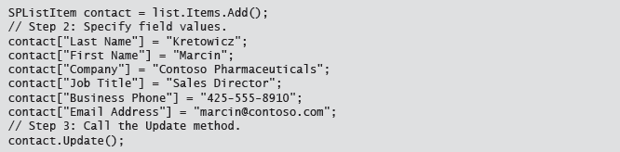
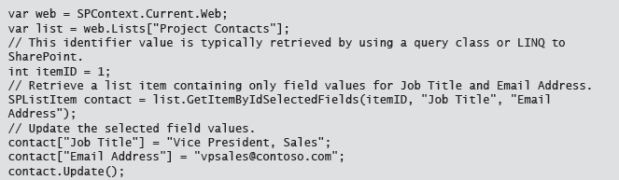
Adding / Modifiying a List Item

Slide 9
Demonstration: Creating List Items
In this demonstration, you will see an example of how to create list items programmatically.
Notes:
The key points of this demonstration are in the code you add. In the first block of code, you illustrate how to populate a list control with the available choices from a choice field. In the second block of code, you illustrate how to create a list item in three stages:
Call the SPListItemCollection.Add method.
Set field values on the new list item.
Call the SPListItem.Update method.
Preparation Steps
You may want to start the virtual machine in advance to save time during the demonstration.
Demonstration Steps
Start the 20488A-LON-SP03 virtual machine.
Log on to the LONDON machine as CONTOSO\Administrator with password Pa$$w0rd.
In a File Explorer window, browse to E:\Democode\WorkingWithListItems, and then double-click WorkingWithListItems.sln.
If the How do you want to open this type of file (.sln) dialog box appears, click Visual Studio 2012.
In Visual Studio, in Solution Explorer, expand the WorkingWithListItems project node, expand the WorkingWithListItems project item node, and then double-click WorkingWithListItems.ascx.
At the bottom of the center pane, click Design.
Point out that the user control consists of a simple UI with a text box named txtTitle, a text box named txtDescription, a radio button list named rblPriority, and a button named btnSubmit.
20488A
3: Working with Lists and Libraries
(More notes on the next slide)

Slide 10
Working with Fields
Field classes and field value classes
Simple field types accept simple values
Complex field types have specific field value classes
Setting complex field values
Retrieving complex field values
Double latitude = 51.4198;
Double longitude = -2.6147;
var geoValue = new SPFieldGeolocationValue(latitude,
longitude);
item["location"] = geoVal;
var geoValue = item["location"] as
SPFieldGeolocationValue;
Double latitude = geoValue.Latitude;
Double longitude = geoValue.Longitude;
Notes:
Walk the students through the examples in the student handbook.
Explain that not all field classes have a corresponding field value class, only the more complex field types. Explain that in many cases you can retrieve complex field values as strings, but the string is often in an unfriendly format. Using field value classes removes the need for complex parsing logic and makes code more readable.
20488A
3: Working with Lists and Libraries

Slide 11
Working with Files
Retrieving files
Get files from SPWeb object or SPFolder object
Use an indexer (SPWeb.Files or SPFolder.Files)
Use a method (SPWeb.GetFile, SPWeb.GetFileAsString)
Checking files in and out
Adding and updating files
SPFileCollection.Add method
if (file.CheckOutType == SPFile.SPCheckOutType.None)
{
file.CheckOut();
// Update the file as required….
file.CheckIn("File updated.");
}
Notes:
Walk the students through the examples in the student handbook.
Emphasize that the primary approach to retrieving files is to go through an SPWeb instance or an SPFolder instance. While you can retrieve an SPFile directly from the corresponding SPListItem, instantiating a list item purely to retrieve a file would add unnecessary computational expense.
Ensure students understand the concepts behind check-ins and check-outs, as well as how to check files in and out programmatically.
Emphasize that you can use the SPFileCollection.Add method to update existing files as well as to add new files.
20488A
3: Working with Lists and Libraries

Slide 12
Lesson 2: Querying and Retrieving List Data
Approaches to Querying List Data Discussion: Retrieving List Data in Code Building CAML Queries Using the SPQuery Class Using the SPSiteDataQuery Class Using LINQ to SharePoint Using SPMetal to Generate Entity Classes Demonstration: Generating Entity Classes in Visual Studio 2012
Notes:
20488A
3: Working with Lists and Libraries

Slide 13
Approaches to Querying List Data
Avoid enumerating list item collections
Computationally expensive
SharePoint provides alternative, optimized approaches
SharePoint query classes
SPQuery
SPSiteDataQuery
LINQ to SharePoint
LINQ to SharePoint Provider
SPMetal tool
Notes:
Emphasize that enumerating list item collections is a very bad idea, and then provide an overview of the two main approaches to retrieving list item data: query classes, and LINQ to SharePoint. Focus on the concepts at this stage, as later topics in the lesson go into the details of each approach.
20488A
3: Working with Lists and Libraries

Slide 14
Discussion: Retrieving List Data in Code
When should you retrieve custom list data in code?
What built-in alternatives should you consider before you retrieve custom list data in code?
Notes:
Use this discussion to get students to think about when retrieving list data in code is appropriate. In many cases, developers create coded solutions when built-in SharePoint components will meet the project requirements. For example:
If you simply want to filter and sort the list items, you can customize the view through the user interface.
If you want to completely customize the way list items are displayed, you can customize the view in SharePoint Designer by using Extensible Stylesheet Language Transformations (XSLT) or client-side rendering.
If you want to aggregate data from multiple lists, consider the Content Query Web Part.
In most cases, you will only need to retrieve list data in code if you need to perform some actions on the list items you retrieve.
20488A
3: Working with Lists and Libraries

Slide 15
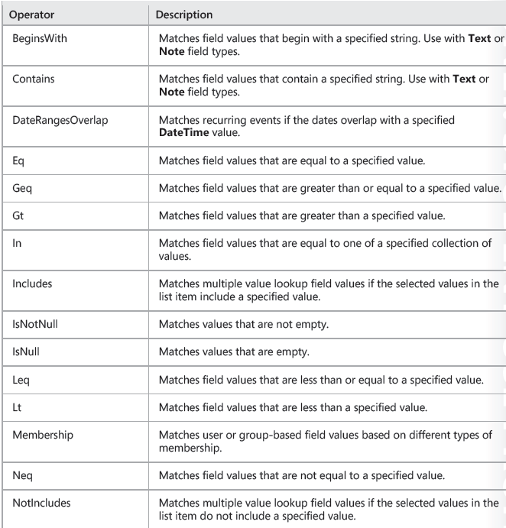
CAML Query Operators

Slide 16
Building CAML Queries
The Where clause
Using comparison operators
Combining comparison operators
<Query>
<Where>
<And>
<Leq>
<FieldRef Name="Inventory"></FieldRef>
<Value Type="Integer">300</Value>
</Leq>
<Eq>
<FieldRef Name="OrderPlaced"></FieldRef>
<Value Type="Boolean">false</Value>
</Eq>
</Where>
</Query>
Notes:
Talk through the following key areas from the student handbook, using the example on the slide to illustrate various constructs:
The purpose of the Where clause.
The different comparison operators you can use.
Combining comparison operators by using And and Or joins.
20488A
3: Working with Lists and Libraries

Slide 17
Using the SPQuery Class
Construct an SPQuery instance
Set CAML query properties
Call SPList.GetItems, passing the SPQuery instance
SPQuery query = new SPQuery();
query.Query = @"[CAML query text]";
var web = SPContext.Current.Web;
var list = web.Lists["Company Cars"];
SPListItemCollection items = list.GetItems(query);
Notes:
Talk the students through the basic three-step process for using the SPQuery class.
You do not need to explain how to use joins and projected fields; simply make the students aware that the capability exists.
20488A
3: Working with Lists and Libraries

Slide 18
Using the SPSiteDataQuery Class
Construct an SPSiteDataQuery instance
Set CAML query properties
Call SPWeb.GetSiteData, passing the SPSiteDataQuery instance
SPSiteDataQuery query = new SPSiteDataQuery();
query.Query = @"[CAML query text]";
query.Webs = @"<Webs Scope=""SiteCollection"" />";
query.Lists = @"<Lists ServerTemplate=""107"" />";
var web = SPContext.Current.Web;
DataTable results = web.GetSiteData(query);
Notes:
Talk the students through the basic three-step process for using the SPSiteDataQuery class.
Explain the different options for scoping the query by using the Webs and Lists properties. Explain that in most cases you should use the ViewFields property to constrain the fields returned by the query. (The example in the student handbook includes the ViewFields property.)
Emphasize that the SPSiteDataQuery approach returns a DataTable, not an SPListItemCollection. As such, you cannot use this approach to retrieve multiple list items in order to modify them.
20488A
3: Working with Lists and Libraries

Slide 19
Using LINQ to SharePoint
Use LINQ syntax to query SharePoint lists
LINQ to SharePoint provider converts LINQ statements into CAML queries
Requires generation of entity classes
TeamDataContext teamWeb = new
TeamDataContext("http://team.contoso.com");
var blueCars = from car in teamWeb.CompanyCars
where car.Color.Contains("Blue")
select car;
Notes:
Talk through the following key points:
LINQ to SharePoint provides an alternative to building CAML queries.
The LINQ to SharePoint Provider converts LINQ statements into CAML queries for execution on the server.
To use LINQ to SharePoint, you must generate entity classes. You can use the SPMetal tool to generate entity classes for a SharePoint website.
The top-level entity class inherits from DataContext. The DataContext instance is the starting point for any LINQ to SharePoint query.
20488A
3: Working with Lists and Libraries

Slide 20
Using SPMetal to Generate Entity Classes
Use the web option to indicate the target site
Use the code option to specify the output code file
Add user and password options to run in a different user context
Use the parameter option to specify a parameter file for customized output
SPMetal /web:http://team.contoso.com /code:TeamSite.cs
SPMetal /web:http://team.contoso.com /code:TeamSite.cs
/user:administrator@contoso.com /password:Pa$$w0rd
SPMetal /web:http://team.contoso.com /code:TeamSite.cs
/parameters:TeamSite.xml
Notes:
Provide a brief overview of SPMetal and run through the key command line options, as shown on the slide. Explain in general terms what you can do with a parameters XML file, but refer students to the product documentation for specifics.
20488A
3: Working with Lists and Libraries

Slide 21
Demonstration: Generating Entity Classes in Visual Studio 2012
In this demonstration, you will see how to use SPMetal to generate entity classes for a SharePoint site.
Notes:
As you work through the demonstration, ensure students understand the high-level tasks you are performing. These high-level tasks are as follows:
Add the file location of SPMetal.exe to the Path environment variable, so that you can invoke the SPMetal tool from any directory.
Invoke the SPMetal tool in the pre-build commands for the Visual Studio project, such that SPMetal generates a code file in the project directory.
Import the code file into the Visual Studio project and briefly demonstrate how to use it.
Demonstration Steps
Connect to the 20488A-LON-SP-03 virtual machine.
If you are not already logged on, log on to the LONDON machine as CONTOSO\Administrator with password Pa$$w0rd.
On the Start screen, type Computer, right-click Computer, and then click Properties.
In the System window, click Advanced system settings.
In the System Properties dialog box, click Environment Variables.
In the Environment Variables dialog box, under System variables, select the Path row, and then click Edit.
In the Edit System Variable dialog box, in the Variable value box, press End, type the following, and then click OK:
;C:\Program Files\Common Files\Microsoft Shared\Web Server Extensions\15\BIN
Note: Take care not to edit or delete any of the existing values in the Path variable.
8. In the Environment Variables dialog box, click OK.
20488A
3: Working with Lists and Libraries
(More notes on the next slide)

Slide 22
Lab A: Querying and Retrieving List Data
Exercise 1: Querying List Items Exercise 2: Updating List Items
Logon Information
Virtual Machine: 20488A-LON-SP-03
User name: CONTOSO\administrator
Password: Pa$$w0rd
Estimated Time: 30 minutes
Notes:
Exercise 1: Querying List Items
In this exercise, you will configure a web part to retrieve data by using the SPQuery class. First, you will construct a query object and configure various CAML-based properties. Next, you will use this query object to retrieve items from the Expenditure Requests list. Finally, you will bind the results to an ASP.NET ListView control.
In this exercise, you will modify the Expense Checker web part to enable users to approve or reject expense items.
20488A
3: Working with Lists and Libraries

Slide 23
Lab Scenario
The finance department at Contoso uses a SharePoint list to track capital expenditure requests and approvals. The team wants a quicker way to approve low-value requests in bulk. Your task is to create a custom web part that enables finance team members to rapidly locate all requests for expenditure of less than $500 and to approve these requests in bulk.
Notes:
20488A
3: Working with Lists and Libraries

Slide 24
Lab Discussion: LINQ to SharePoint versus SPQuery
In what scenarios do you think the LINQ to SharePoint approach might be the best choice?
When do you think the SPQuery approach might be more appropriate?
Notes:
In most cases it is a matter of personal preference. LINQ to SharePoint is easier to create, easier to read, and easier to maintain. The SPQuery approach is slightly more efficient, as it does not rely on a LINQ provider to convert LINQ syntax into CAML. The SPQuery class also has some additional capabilities, such as the ability to query external lists, which are not available in LINQ to SharePoint.
20488A
3: Working with Lists and Libraries

Slide 25
Lesson 3: Working with Large Lists
Understanding List Performance Management Overriding List View Thresholds Using the ContentIterator Class
Notes:
20488A
3: Working with Lists and Libraries

Slide 26
Understanding List Performance Management
Query throttling
5,000 items for users
20,000 items for auditors and administrators
Happy hour
Permit larger queries during daily time windows
Allow larger queries at periods of low demand
Indexing strategies
Careful indexing makes queries more efficient
Notes:
Talk through the concepts of query throttling and indexing.
Be sure to point out that the list view thresholds of 5,000 for users and 20,000 for administrators are default values. These values are configured at the web application level by farm administrators.
If questions arise, explain that you can configure indexing in the schema for a list definition. Site administrators can configure indexing on existing lists through the browser UI.
20488A
3: Working with Lists and Libraries

Slide 27
Overriding List View Thresholds
Use the SPQuery.QueryThrottleMode property to override list view thresholds
Object model overrides must be enabled at the web application level
SPQuery query = new SPQuery();
query.Query = @"[CAML query text]";
query.QueryThrottleMode =
SPQueryThrottleOption.Override;
Notes:
Talk through the example in the student handbook. Emphasize that:
You can only override list view thresholds programmatically if object model overrides are enabled at the web application level.
You should consider other options, such as using a ContentIterator or adding list indices, before you consider using object model overrides.
20488A
3: Working with Lists and Libraries

Slide 28
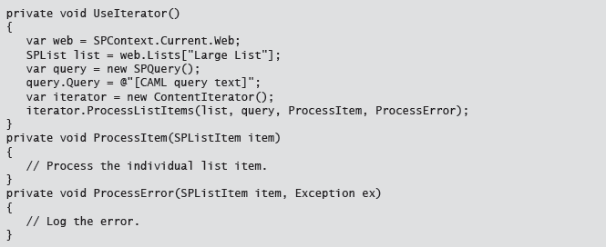
Using the ContentIterator Class
Breaks queries down into manageable chunks
Uses callback methods to process individual items
Notes:
Talk through the example. Mention that the ContentIterator class has other applications beyond list queries, such as working with multiple sites and multiple lists.
20488A
3: Working with Lists and Libraries

Slide 29
Lab B: Working With Large Lists
Exercise 1: Using the ContentIterator Class
Logon Information
Virtual Machine: 20488A-LON-SP-03
User name: CONTOSO\administrator
Password: Pa$$w0rd
Estimated Time: 30 minutes
Notes:
Exercise 1: Using the ContentIterator Class
In this exercise, you will modify the Expense Checker web part to support large lists. You will edit the code that queries the capital expenditure approval list so that it retrieves and processes one list item at a time, thereby preventing any issues arising from list throttling limits.
20488A
3: Working with Lists and Libraries

Slide 30
Lab Scenario
The finance team at Contoso has warned that the capital expenditure approval list may grow beyond 5,000 items. To avoid encountering problems with list query throttling limits, and the adverse performance impacts of submitting large list queries, you must modify the web part you created in the first exercise to use the ContentIterator class.
Notes:
20488A
3: Working with Lists and Libraries

Slide 31
Module Review and Takeaways
Review Question(s)
Notes:
Review Question(s)
Question
Which class represents a column in a SharePoint list?
( )Option 1: SPField
( )Option 2: SPFieldValue
( )Option 3: SPListItem
( )Option 4: SPFile
( )Option 5: SPFolder
Answer
(√) Option 1: SPField
Question
You have created and configured an SPQuery object named query. You have also retrieved an SPList instance
named list. You want to use the query object to retrieve data from the list. Which code sample should you use?
( )Option 1: var items = query.Execute(list);
( )Option 2: var items = list.GetSiteData(query);
( )Option 3: var items = query.GetItems(list);
( )Option 4: var items = list.GetItems(query);
( )Option 5: var items = list.ExecuteQuery(query);
Answer
20488A
3: Working with Lists and Libraries
(More notes on the next slide)

Slide 32
Notes:
(√) Option 4: var items = list.GetItems(query);
Question
What is the default list view threshold for regular users?
( )Option 1: 200
( )Option 2: 500
( )Option 3: 2,000
( )Option 4: 5,000
( )Option 5: 20,000
Answer
(√) Option 4: 5,000
20488A
3: Working with Lists and Libraries

