Slide 1
Module 4
Designing and Managing Features and Solutions
Notes:
20488
4: Designing and Managing Features and Solutions

Slide 2
Module Overview
Working with Features Developing Solutions Working with Sandboxed Solutions
Notes:
20488
4: Designing and Managing Features and Solutions

Slide 3
Lesson 1: Working with Features
Introduction to Features Developing Features Using Feature Receivers Defining Feature Dependencies Demonstration: Developing a Feature Manually Deploying Features Versioning and Upgrading Features Demonstration: Upgrading a Feature
Notes:
20488
4: Designing and Managing Features and Solutions

Slide 4
Introduction to Features
Deploy declarative components by using CAML –based XML files
SharePoint root\LAYOUTS\FEATURES folder
Farm solution, sandboxed solution, or an app
Feature manifest (feature.xml) file
Scope
Notes:
This topic should mainly be a recap from module 1.
20488
4: Designing and Managing Features and Solutions

Slide 5
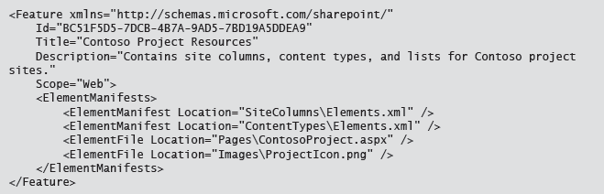
Developing Features
Feature manifest (feature.xml)
Element manifest (elements.xml)
Notes:
20488
4: Designing and Managing Features and Solutions

Slide 6
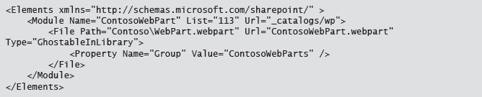
Developing Features
Feature manifest (feature.xml)
Element manifest (elements.xml)

Slide 7
Using Feature Receivers
Handle Feature lifecycle events
Feature activated
Feature deactivated
Feature installed
Feature uninstalled
Feature upgrading
Inherit from the SPFeatureReceiver class
Feature manifest attributes that must be defined:
ReceiverAssembly
ReceiverClass
Notes:
20488
4: Designing and Managing Features and Solutions

Slide 8
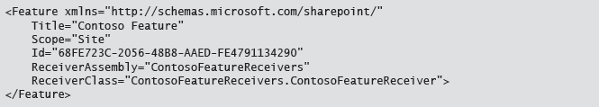
Feature Receiver

Slide 9
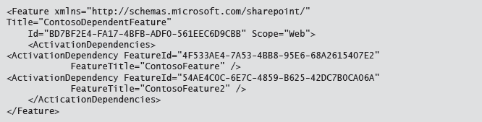
Defining Feature Dependencies
Define in the Feature manifest
Notes:
20488
4: Designing and Managing Features and Solutions

Slide 10
Demonstration: Developing a Feature
In this demonstration you will see how to:
Edit a Feature by using Visual Studio
Define Feature dependencies by using Visual Studio
Add an event receiver to a Feature
Edit Feature.xml files manually in Visual Studio
Notes:
This demonstration uses blank Features to demonstrate the Feature designer in Visual Studio. Ensure that the students are aware that normally you would add additional items to the solution, and then associate each of those with a Feature.
If time permits you could extend this demonstration by adding some new site columns and a content type to the solution, and then adding those to the existing Features. Site columns could be added to Feature1, and the content type could be added to Feature2. The pre-defined dependencies ensure that the site columns are deployed if the content type is deployed.
Preparation Steps
Log on to 20488A-LON-SP-04 as CONTOSO\Administrator, with the password Pa$$w0rd.
Demonstration Steps
On the Start screen, type Visual Studio, and then click Visual Studio 2012.
In Visual Studio, under Start, click Open Project.
In the Open Project dialog box, browse to E:\Demofiles\Developing a Feature, click DevelopingAFeature.sln, and then click Open.
In Solution Explorer, expand Features.
Point out the two existing Features.
Double-click Feature1.
View the Feature designer, but do not make any changes.
In Solution Explorer, right-click Feature1, and then click Add Event Receiver.
Review the Feature1.EventReceiver.cs class. Point out each of the methods which are currently commented.
Point out where the event receiver code file is added in Solution Explorer.
Double-click Feature2.
20488
4: Designing and Managing Features and Solutions
(More notes on the next slide)

Slide 11
Manually Deploying Features
App, farm solution, sandboxed solution, or manual deployment
15\TEMPLATES\FEATURES\CustomFeature folder
Install-SPFeature
Enable-SPFeature
Disable-SPFeature
Uninstall-SPFeature
Notes:
It is important that students understand that while they can use this approach to deploy a Feature, and may need to know some of this process if they are taking the course exam, typically they would use a solution or app to complete the deployment. Make students aware that solutions are covered later in this module, and apps are covered later in the course.
20488
4: Designing and Managing Features and Solutions

Slide 12
Versioning and Upgrading Features
<Feature ... Version="3.0.0.0">
<ElementManifests>...</ElementManifests>
<UpgradeActions>
<VersionRange BeginVersion="1.0.0.0“ EndVersion=“3.0.0.0">
<ApplyElementManifests>
<ElementManifest Location=“Location" />
</ApplyElementManifests>
<MapFile FromPath=“Original” ToPath=“New” /> <AddContentTypeField ContentTypeId=“GUID” FieldId=“GUID” PushDown=“True|False” />
<CustomUpgradeAction Name=“Name”>
<Parameters>...</Parameters>
</CustomUpgradeAction>
</VersionRange>
</UpgradeActions>
</Feature>
Notes:
20488
4: Designing and Managing Features and Solutions

Slide 13
Demonstration: Upgrading a Feature
In this demonstration you will see how to modify a Feature manifest to upgrade a Feature.
Notes:
It is important that you use a new instance of PowerShell each time you run a PowerShell script. If you open a PowerShell window, and then use the same PowerShell instance to run the scripts the upgrade will fail.
Preparation Steps
Log on to 20488A-LON-SP-04 as CONTOSO\Administrator, with the password Pa$$w0rd.
Demonstration Steps
In File Explorer, browse to E:\Demofiles\Upgrading a Feature\ContosoFeatureV1\ContosoFeature.
Double-click feature.xml.
In the How do you want to open this type of file (.xml)? dialog box, click Microsoft Visual Studio 2012.
Point out the Version attribute, and the ElementManifests element and children.
Explain that this Feature adds two site columns named Invoice Name and Invoice Number.
Close Visual Studio 2012.
Copy the E:\Demofiles\Upgrading a Feature\ContosoFeatureV1\ContosoFeature folder to the C:\Program Files\Common Files\microsoft shared\Web Server Extensions\15\TEMPLATE\FEATURES folder.
In File Explorer, browse to E:\Demofiles\Upgrading a Feature.
Right-click InstallFeatures.ps1, and then click Edit.
Point out the cmdlets which install the ContosoFeature Feature, and then install the Feature on the http://dev.contoso.com site.
Close Administrator: Windows PowerShell ISE.
Right-click InstallFeatures.ps1, and then click Run with PowerShell.
20488
4: Designing and Managing Features and Solutions
(More notes on the next slide)

Slide 14
Lesson 2: Developing Solutions
Introduction to Farm Solutions Packaging a Solution Demonstration: Creating a Solution Deploying Solutions Defining Solution Dependencies Understanding Solution Versioning
Notes:
20488
4: Designing and Managing Features and Solutions

Slide 15
Introduction to Farm Solutions
Server-side component deployment
Deploy once; propagation to SharePoint servers
Reduce the risk of human error
Retract solutions
Alternatives
App
Sandboxed solution
Notes:
This topic should be a recap from module 1.
20488
4: Designing and Managing Features and Solutions

Slide 16
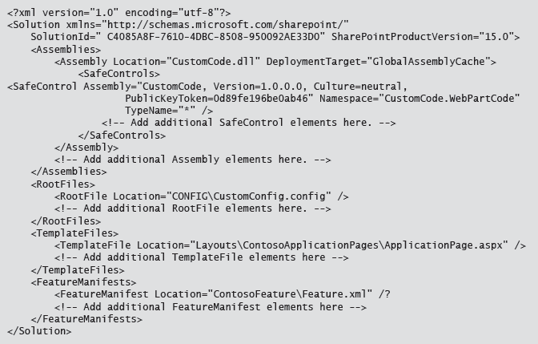
Packaging a Solution
Cabinet file with wsp extension
Visual Studio or makecab.exe
Manifest.xml file

Slide 17
Demonstration: Creating a Solution
In this demonstration you will see how to:
Create a solution by using Visual Studio.
Map SharePoint folders.
Add assemblies and define safe control entries.
Add Features to a solution.
Edit the solution manifest manually in Visual Studio.
Teacher Book 4-14
Notes:
When you create the solution discuss the options between sandboxed and farm solutions, and for choosing a debugging site. Explain that the choice of debugging site depends on the type of solution that the student intends to develop. For example, if they plan to develop a farm-scoped feature then the Central Administration web site might be a suitable selection. For components with other scopes, another site collection may be more appropriate. Also make sure that students understand that these options are used by Visual Studio to aid with debugging and development, but do not have any impact on the structure of the solution file produced.
Preparation Steps
Log on to 20488A-LON-SP-04 as CONTOSO\Administrator, with the password Pa$$w0rd.
Demonstration Steps
On the Start screen, type Visual Studio, and then click Visual Studio 2012.
In Visual Studio, on the FILE menu, point to New, and then click Project.
In the New Project dialog box, in the Templates pane expand Visual C#, expand Office/SharePoint, and then click SharePoint Solutions.
Click SharePoint 2013 - Empty Project, in the Name box, type FarmSolution, in the Location box, type E:\Demofiles, and then click OK.
In the SharePoint Customization Wizard dialog box, in the What site do you want to use for debugging box, type http://dev.contoso.com.
Click Deploy as a farm solution, and then click Finish.
In Solution Explorer, double-click Package.
In the solution designer, on the Advanced tab, click Add, and then click Add Existing Assembly.
In the Add Existing Assembly dialog box, explain the purpose of the Source Path box, Safe Controls, and Class Resources sections, and then click Cancel.
20488
4: Designing and Managing Features and Solutions
(More notes on the next slide)

Slide 18
Deploying Solutions
Add-SPSolution
LiteralPath
Install-SPSolution
Identity
GACDeployment
CompatibilityLevel
Uninstall-SPSolution
Identity
CompatibilityLevel
Remove-SPSolution
Identity
Notes:
20488
4: Designing and Managing Features and Solutions

Slide 19
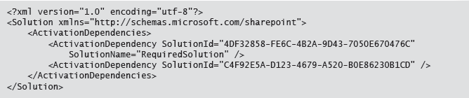
Defining Solution Dependencies
Use in conjunction with Feature dependencies
Define in the solution manifest

Slide 20
Understanding Solution Versioning
Update options
Retract, uninstall, and then reinstall
Use Update-SPSolution
Retracting solution not always possible
E.g. content type in use
Updating solution has some restrictions
E.g. cannot add or remove Features
Assembly binding redirection
Notes:
20488
4: Designing and Managing Features and Solutions

Slide 21
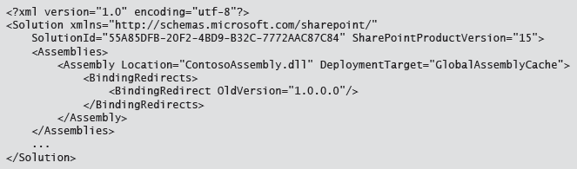
Assembly Binding Redirection

Slide 22
Lab A: Working with Farm Solutions
Exercise 1: Create a Farm Solution Exercise 2: Create a Feature Exercise 3: Upgrade a Solution
Logon Information
Virtual machine: 20488A-LON-SP-04
User Name: CONTOSO\administrator
Password: Pa$$w0rd
Estimated Time: 45 minutes
Notes:
Exercise 1: Create a Farm Solution
In this exercise, you will create a farm solution to deploy the timer job. The timer job which you must deploy is provided as a pre-compiled assembly. You will add the assembly to the solution, and then deploy the solution to verify that the assembly is correctly added to the global assembly cache on deployment of the farm solution, and removed from the global assembly cache on retraction of the farm solution.
Exercise 2: Create a Feature
In this exercise, you will create a Feature to install the timer job. You will add code to handle the activation and deactivation of the Feature. In the activation event handler, you will install the timer job. In the deactivation event handler you will uninstall the timer job.
Finally you will deploy the solution and verify that the timer job is installed and functions as expected.
Exercise 3: Upgrade a Solution
In this exercise, you will apply versioning to the Feature and solution. Initially you will apply versioning to the current solution, and then you will deploy the initial version to the farm.
You will then increment the version numbers of the solution and the Feature. You will add code to handle the upgrade, add a custom upgrade action to the Feature.xml file, and then update the version of the timer job assembly deployed by the solution.
Finally, you will publish the updated solution and use PowerShell to update the version of the solution in the SharePoint solution store. You will also use PowerShell to disable and re-enable the Feature, updating the timer job.
20488
4: Designing and Managing Features and Solutions

Slide 23
Lab Scenario
Contoso often needs to order items from key suppliers. When the staff in Contoso's contact center speaks to customers, they may need to check supplier stock levels before they can proceed with an order. As information comes from several different suppliers, Contoso maintains a single list which contains approximate stock levels from their suppliers. Contoso retrieves this information by using web services provided by their suppliers. Updating the stock list can be a slow process, as it involves calling several web services, some of which have high latency. To reduce page load time, developers in Contoso have created a timer job which periodically updates the list without blocking the web worker process thread. Staff are trained that the stock levels indicated by the internal list may be slightly out of date, and they have an alternative system for obtaining accurate stock levels if the list suggests stock levels are low. The developers tested the timer job by using PowerShell commands to install the timer job. This was acceptable in their development environment; however, you now need to package the timer job for deployment. As the web services provided by the third parties occasionally change, it is important that you have a robust strategy for handling updates to the timer job.
To ensure that the timer job is deployed and installed on all servers correctly you will create a solution package for the timer job. You will create a Feature with a Feature receiver to deploy the timer job. Finally, you will add code to upgrade the timer job and test the upgrade process.
Notes:
20488
4: Designing and Managing Features and Solutions

Slide 24
Lesson 3: Working with Sandboxed Solutions
Working in the Sandbox Sandbox Restrictions and How to Extend the Scope of a Sandboxed Solution Deploying Sandbox Solutions Versioning and Upgrading Sandbox Solutions Using Solution Validators Discussion Question
Notes:
20488
4: Designing and Managing Features and Solutions

Slide 25
Working in the Sandbox
Solution Scope
Object Model Restrictions
Execution Model
Developing Sandboxed Solutions
Sandboxed Solution or App
Notes:
20488
4: Designing and Managing Features and Solutions

Slide 26
Sandbox Restrictions and How to Extend the Scope of a Sandboxed Solution
Restricted to the current site collection
Subset of the standard server side object model classes and methods available
Client side object models and hybrid solutions
Notes:
20488
4: Designing and Managing Features and Solutions

Slide 27
Deploying Sandbox Solutions
Packaged in a .wsp solution file
Deployed by a site collection administrator
Two stage process for deployment:
Upload to the solution gallery
Activate solution
Notes:
20488
4: Designing and Managing Features and Solutions

Slide 28
Versioning and Upgrading Sandbox Solutions
Very similar to upgrading a farm solution
Solution id must remain the same in the updated version
Version number should be incremented
File name must change as both old and new version remain in the solution gallery
Features are all updated immediately
Notes:
20488
4: Designing and Managing Features and Solutions

Slide 29
Using Solution Validators
SPSolutionValidator
Id
Default constructor
Non-default constructor
Signature
ValidateSolution
ValidateAssembly
properties.Valid
SPUserCodeService
SPUserCodeService.Local
SolutionValidators.Add
SolutionValidators.Remove
Notes:
Explain the process for creating and deploying a custom solution validator. When you explain the process for creating a solution validator, emphasize the importance of creating a default constructor. Ensure students are aware that omitting a default constructor could leave their SharePoint environment in an invalid state due to serialization errors.
20488
4: Designing and Managing Features and Solutions

Slide 30
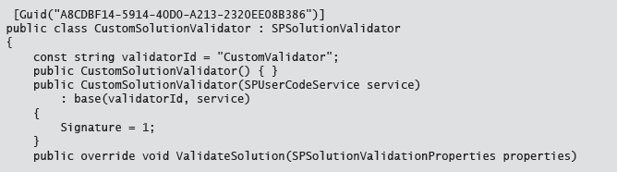
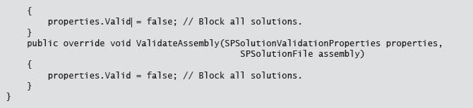
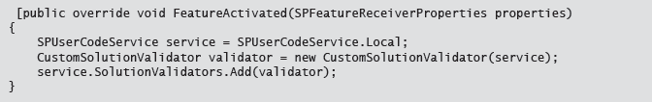
Solution Validator

Slide 31
Discussion Question
When would you choose a sandbox solution?
When would you not choose to use a sandbox solution?
Notes:
Answers could include:
When developing solutions for SharePoint Online.
When you want to enable site collection administrators to deploy a solution.
When developing a solution where the solution would not be trusted as a farm solution.
To convert an existing farm solution for use with SharePoint Online.
Reasons not to use a sandbox solution could include:
When you need to access data across site collections.
When you need to develop components which are not supported by sandboxed solutions such as timer jobs.
Although this topic provides an opportunity to discuss the relative benefits of a sandbox solution, this would be a good opportunity to emphasize to students that generally in SharePoint 2013 developing an app is preferable to developing a sandboxed solution.
20488
4: Designing and Managing Features and Solutions

Slide 32
Lab B: Working with Sandboxed Solutions
Exercise 1: Create a Solution Validator
Logon Information
Virtual machine: 20488A-LON-SP-04
User Name: CONTOSO\Administrator
Password: Pa$$w0rd
Estimated Time: 15 minutes
Notes:
Exercise 1: Create a Solution Validator
In this exercise you will, develop a custom solution validator. The solution validator will check the name of the sandboxed solution file, and deny any solutions which do not have the correct name.
After you have developed the solution validator, you will deploy the solution validator to the farm by using a farm solution, and test the solution validator by attempting to upload and activate sandboxed solutions in a site collection.
20488
4: Designing and Managing Features and Solutions

Slide 33
Lab Scenario
Developers in Contoso have developed a sandboxed solution, which site collection administrators can choose to add to their site collection if they consider it appropriate. Managers are concerned that by enabling and distributing sandbox solutions, site collection administrators may be able to upload third party solutions. They want to prevent this, but do not want to add additional work for SharePoint administrators each time the company produce a new sandbox solution.
You must implement a solution validator which prevents other solutions from activating on the farm.
Notes:
20488
4: Designing and Managing Features and Solutions

Slide 34
Module Review and Takeaways
Review Question(s)
Notes:
Review Question(s)
Question
Which of the following statements most accurately describes a Feature?
( )Option 1: A Feature is deployed in a folder to file system, and must contain a feature.xml file and an elements.xml file.
( )Option 2: A Feature can be deployed to the file system, and must contain a feature.xml file which contains a Feature element and an ElementManifests element.
( )Option 3: A Feature can be deployed to the file system, and must contain a feature.xml file which contains a Feature element.
( )Option 4: A Feature is deployed to the content database, and must contain a feature.xml file and an elements.xml file.
( )Option 5: A Feature can be deployed to the file system or the content database, and must contain a feature.xml file and an elements.xml file.
Answer
(√) Option 3: A Feature can be deployed to the file system, and must contain a feature.xml file which contains a Feature element.
Question
A solution cannot be uninstalled if a dependent solution is installed.
( )False
( )True
Answer
(√)False
( )True
20488
4: Designing and Managing Features and Solutions
(More notes on the next slide)

Slide 35
Notes:
Question
Which of the following statements is true?
( )Option 1: Sandboxed solutions can be installed by any user in a site, and they are not monitored.
( )Option 2: Sandboxed solutions can be installed by a site collection administrator in a site collection, and they are monitored and throttled.
( )Option 3: Sandboxed solutions must be installed by a farm administrator, and they require access to the server.
( )Option 4: Sandboxed solutions can be installed by a web application administrator in a web application, and they are monitored and throttled.
( )Option 5: Sandboxed solutions can be installed by any user in a site collection, and they are not monitored.
Answer
(√) Option 2: Sandboxed solutions can be installed by a site collection administrator in a site collection, and they are monitored and throttled.
20488
4: Designing and Managing Features and Solutions

