Slide 1
Module 5
Working with Server-Side Code
Notes:
20488
5: Working with Server-Side Code

Slide 2
Module Overview
Developing Web Parts Using Event Receivers Using Timer Jobs Storing Configuration Data
Notes:
20488
5: Working with Server-Side Code

Slide 3
Lesson 1: Developing Web Parts
Introduction to Web Parts Understanding the Web Part Lifecycle Visual Web Parts Demonstration: Creating a Visual Web Part The .webpart File
Notes:
20488
5: Working with Server-Side Code

Slide 4
Introduction to Web Parts
Do not require app infrastructure or any special services/service applications to run
Can expose and consume data with other web parts
Inherit from the WebPart class
Deployed as assembly, with a .webpart definition file
Use app part instead where possible
Notes:
Ensure that students are aware that an app part is now the preferred approach, but that there are instances where a web part is still appropriate. In some limited cases not having an app environment might be a reason, but the ability to use web part connections is likely to be a more common reason.
20488
5: Working with Server-Side Code

Slide 5
Understanding the Web Part Lifecycle
OnInit
OnLoad
CreateChildControls
EnsureChildControls
SaveViewState
OnPreRender
Page.PreRenderComplete
Render
RenderContents
OnUnload
Notes:
Focus on the more commonly overridden methods, specifically the CreateChildControls, OnPreRender and RenderContents methods. Explain that you use these methods to add controls, populate controls with data, and display controls respectively. Also, explain that control postback events occur between these two methods, and highlight the importance of not loading data in the CreateChildControls method (it might overwrite changes made that should be processed as part of a control postback event handler).
Ensure students are aware that the execution order is different for postback requests.
20488
5: Working with Server-Side Code

Slide 6
Visual Web Parts
Inherit from the WebPart class
Define interface in a custom control (ascx) file
Expose an additional lifecycle method Page_Load
Available in both farm and sandboxed solutions
Notes:
For students who have developed web parts for previous versions of SharePoint ensure they are aware that SharePoint 2013 adds support for visual web parts in sandboxed solutions.
20488
5: Working with Server-Side Code

Slide 7
Demonstration: Creating a Visual Web Part
In this demonstration, you will see how to:
Add a visual web part to a Visual Studio solution
Add a control to a visual web part
Edit control properties
Debug a visual web part by using Visual Studio
Notes:
Students will modify a non-visual web part in the lab, but this will be there only exposure to the visual web part. After this topic might be a good opportunity to ask students if they have any questions.
Preparation Steps
Log on to 20488A-LON-SP-05 as CONTOSO\Administrator, with the password Pa$$w0rd.
Demonstration Steps
On the Start screen, click Desktop.
On the Desktop, on the taskbar, click File Explorer.
In File Explorer, browse to E:\Demofiles\VisualWebPart, and then double-click VisualWebPart.sln.
If you are prompted to choose a program to open the file, click Visual Studio 2012.
In Visual Studio, in Solution Explorer, right-click VisualWebPart, point to Add, and then click New Item.
In the Add New Item - VisualWebPart dialog box, click Visual Web Part, and then click Add.
In Solution Explorer, point out the two .cs code-behind files.
Double-click VisualWebPart1.ascx.cs. Explain that students should add their logic to this class.
In Solution Explorer, double-click VisualWebPart1.ascx.g.cs. Explain that this class contains auto-generated code, and is updated by Visual Studio. Ensure students are aware that they should not edit this file. Point out that this is a partial class and is merged with the other code file when the class is compiled.
On the VisualWebPart1.ascx tab, click Design.
From the Toolbox, drag a Button to the design canvas.
In Properties, in the Text box, type Click Me.
On the design canvas, double-click the button.
20488
5: Working with Server-Side Code
(More notes on the next slide)

Slide 8
The .webpart File
XML file containing a web part definition
Stored in web part gallery
Identifies the assembly and type which contains the web part
Contains web part metadata such as the web part name, description, and display group
Notes:
Ensure students are aware that Visual Studio will generate a .webpart file when they add a webpart to a solution. Ensure students are familiar with the web part gallery, as this is very important to understanding the purpose of the .webpart file.
20488
5: Working with Server-Side Code

Slide 9
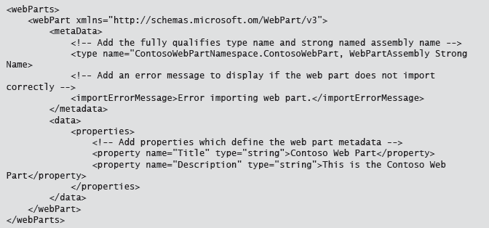
WebPart Definition File

Slide 10
Lesson 2: Using Event Receivers
Introduction to Event Receivers Developing an Event Receiver Deploying an Event Receiver Discussion Question
Notes:
20488
5: Working with Server-Side Code

Slide 11
Introduction to Event Receivers
Handle External Actions
Event Hosts
SPSite
SPWeb
SPList
SPContentType
Event Synchronization
Before Events (ing)
After Events (ed)
Notes:
Make sure that students are aware that you can implement remote event receivers with SharePoint. Ensure that students understand that the term remote event receivers in SharePoint 2013 refers to an event receiver which is hosted as part of an app for SharePoint, and is remote to the event farm, rather than code which runs on a SharePoint server which responds to remote events.
20488
5: Working with Server-Side Code

Slide 12
Developing an Event Receiver
Inherit from Base Class
SPWebEventReceiver
SPListEventReceiver
SPItemEventReceiver
SPEmailEventReceiver
SPWorkflowEventReceiver
SPSecurityEventReceiver
Override Methods
Cancel Before Events
Without an error message
With an error message
With a page redirect
Notes:
Ensure students are aware that they can only cancel an event in a before event, but that they could reverse the change in an after event programmatically if there solution requires it. Caution students that reversing an event in an after event may cause user confusion as the success message will already have been displayed in the user's browser.
20488
5: Working with Server-Side Code

Slide 13
Deploying an Event Receiver
Deploy manually (bad practice)
Deploy with a solution and Feature (best practice)
Bind event receiver to an event host with code
Bind event receiver to an event host declaratively
Common properties
Assembly
Class
Type
Name (optional)
Synchronization (optional)
SequenceNumber (optional)
Notes:
Explain that by default Visual Studio adds an elements.xml file to your solution which binds the event declaratively. Explain the SequenceNumber property and its purpose, but remind students that after events which by default run asynchronously may run in parallel and events with a greater sequence number may complete before those with a lower sequence number.
20488
5: Working with Server-Side Code

Slide 14
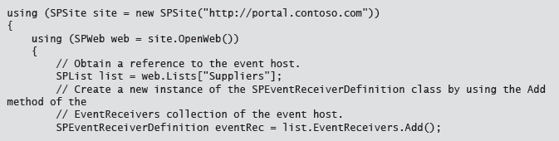
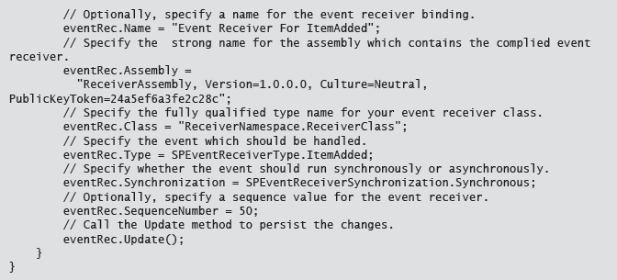
Bind Event Receiver using Code

Slide 15
Lesson 3: Using Timer Jobs
Introduction to Timer Jobs Developing a Timer Job Deploying a Timer Job Demonstration: Examining Timer Job Schedules Work Item Timer Jobs Developing a Work Item Timer Job
Notes:
20488
5: Working with Server-Side Code

Slide 16
Introduction to Timer Jobs
Long running processes
Processor intensive processes
One time or regular schedule
Reduce instantaneous load on server farm
OWSTIMER.exe
Notes:
This topic is intended as an introduction. More details on how to develop timer jobs is covered later in this lesson.
20488
5: Working with Server-Side Code

Slide 17
Developing a Timer Job
Create a class which derives from SPJobDefinition
Add a default constructor
Add a non-default constructor
Name (string)
Web application (SPWebApplication)
Server (SPServer)
Lock Type (SPJobLockType)
Override the Execute method
Notes:
This topic is intended as a how-to topic. Ensure students are familiar with the process for developing a timer job before you proceed from this topic. Emphasize the importance of adding both constructors, and explain that they should never call the default constructor; but it is necessary for SharePoint internals.
20488
5: Working with Server-Side Code

Slide 18
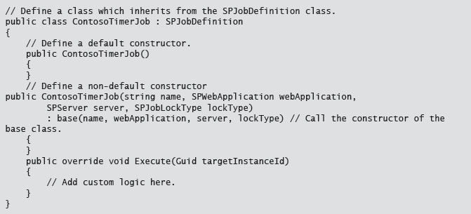
Timer Job Pattern

Slide 19
Deploying a Timer Job
Use a Feature and Feature receiver
Create a new instance of the job
Create a schedule
SPMinuteSchedule
SPHourlySchedule
SPDailySchedule
SPWeeklySchedule
SPMonthlySchedule
SPYearlySchedule
Assign the schedule to the job
Call the Update method
Notes:
Ensure that students understand that the time window on a schedule indicates the timer during which a job can start, and does not cause the process to terminate if the job is not complete when the end time is reached. Explain that this enables SharePoint to run the timer job at different times on different servers to reduce load on the server farm.
20488
5: Working with Server-Side Code

Slide 20
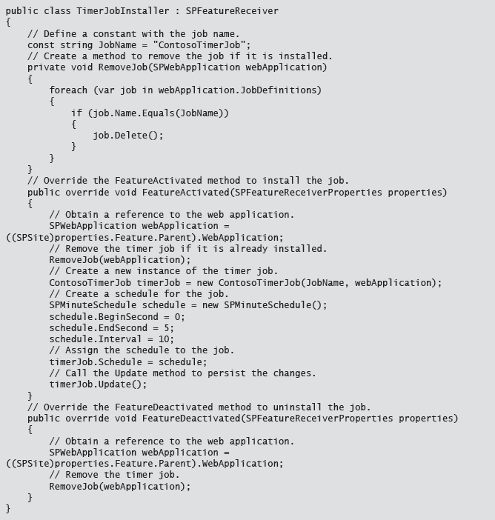
Timer Job Deployment

Slide 21
Demonstration: Examining Timer Job Schedules
In this demonstration, you will review:
The timer jobs included in SharePoint 2013
The timer service process
Notes:
This is a short demonstration designed to give students some context of how SharePoint uses timer jobs and the context in which they run. The content of this demonstration is more typically used by IT professionals than developers, so you should not spend too long on this demonstration unless students have any specific questions.
Preparation Steps
Log on to 20488A-LON-SP-05 as CONTOSO\Administrator, with the password Pa$$w0rd.
Demonstration Steps
On the Start screen, type Central Administration, and then press Enter.
On the Central Administration web site, click Monitoring.
On the Monitoring page, under Timer Jobs, click Review Job Definitions.
On the Job Definitions page, point out the standard timer jobs which are used by SharePoint. Point out that in addition to providing extensibility for developers, SharePoint also uses timer jobs extensively for internal operations.
Click App Installation Service.
On the Edit Timer Job page, point out the recurring schedule, and the Run Now button.
Close Internet Explorer.
On the Start screen, type Services, and then click Services.
In Services, double-click the SharePoint Timer Service.
In the SharePoint Timer Service Properties (Local Computer) dialog box, point out that the internal service name is SPTimerV4. Explain the importance of this for when you control services from a command line.
Point out the path to executable, and the executable name OWSTIMER.exe. Remind students that timer jobs run in this process and do not have a web context.
On the Log On tab, point out that this service runs under the farm account credentials. Explain that, by default, this gives timer jobs full access to the farm, including write permissions on the configuration database.
20488
5: Working with Server-Side Code
(More notes on the next slide)

Slide 22
Work Item Timer Jobs
Process a set (or queue) of items
Queue managed by SharePoint
Use code to add items to the queue
Timer job run on a schedule
Batch or single item processing
Notes:
Ensure students are aware the typically elevated privileges are required to add items to the queue, which prevents the use of sandboxed solutions for adding items to the queue.
20488
5: Working with Server-Side Code

Slide 23
Developing a Work Item Timer Job
Create a class which derives from SPWorkItemJobDefinition
Add a default constructor
Add a non-default constructor
Name (string)
Web application (SPWebApplication)
Override the WorkItemType method
Override the DisplayName property
Optionally override the BatchFetchLimit property
Override either the ProcessWorkItem or the ProcessWorkItems method
Notes:
Ensure students are aware that they should delete the work item from the work item queue after processing it to ensure that the same items does not get submitted again the next time that the timer job runs.
20488
5: Working with Server-Side Code

Slide 24
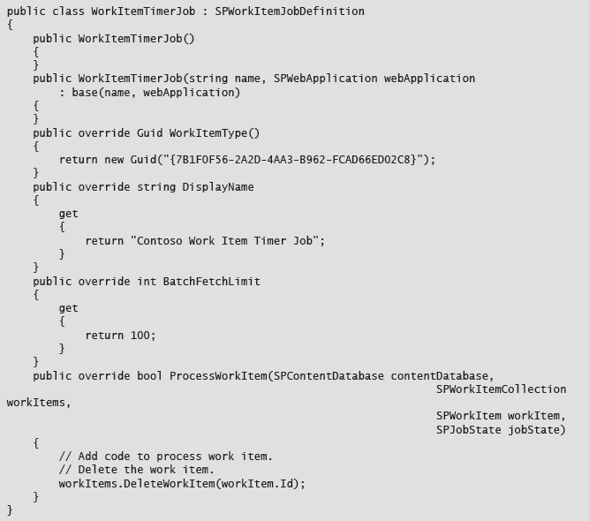
Work Item Timer Job

Slide 25
Lesson 4: Storing Configuration Data
Configuration Storage Options Using Property Bags Manipulating Web.config Files Storing Hierarchical Data Discussion Question
Notes:
20488
5: Working with Server-Side Code

Slide 26
Configuration Storage Options
Configuration data requirements
Many Options
SharePoint list
Property bags
Configuration files
Persisted objects
Considerations
How often configuration changes
Scope of configuration data
Visibility of data to users
Notes:
Although lists can be used to store configuration data, they are not covered in any detail in this lesson. This is because students should already be familiar with working with list data. Ensure students are aware that using a list to store configuration data does not differ from using a list for any other purpose.
20488
5: Working with Server-Side Code

Slide 27
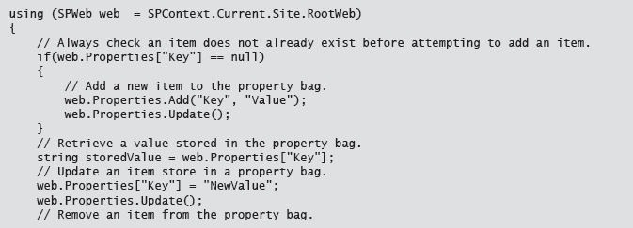
Using Property Bags

Slide 28
Manipulating Web.config Files
Data with low change frequency
Requires IIS restart
Not compatible with timer jobs or sandboxed solutions
Use SPWebConfigModification class to deploy changes to all servers
Notes:
Highlight the benefit of the SPWebConfigModification class, and ensure students are aware that this is the preferred method for updating configuration files as it ensures that the changes are made to all servers across the farm.
20488
5: Working with Server-Side Code

Slide 29
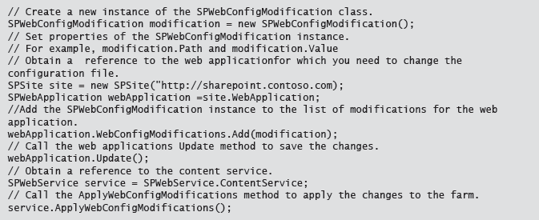
web.config

Slide 30
Storing Hierarchical Data
Inherit from SPPersistedObject, and annotate with Guid attribute
Include default and non-default constructors
public PersistedClass() { }
Public PersistedClass(string name, SPPersistedObject parent) : base (name, parent) { }
Add Persisted attributes to fields (not properties)
Use SPPersistedObject.GetChild<>() to retrieve values
Require read and write permissions on the configuration database
Notes:
Discuss the flexibility that storing hierarchical data provides, but highlight the risks, specifically corrupting the configuration database if you attempt to persist an object which is not serializable, or does not contain a default constructor.
20488
5: Working with Server-Side Code

Slide 31
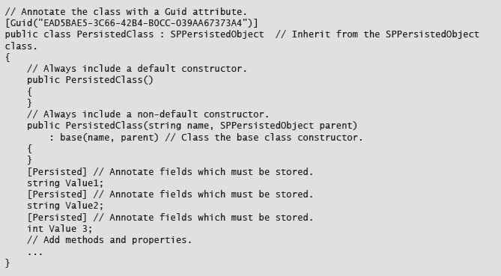
Persisted Object

Slide 32

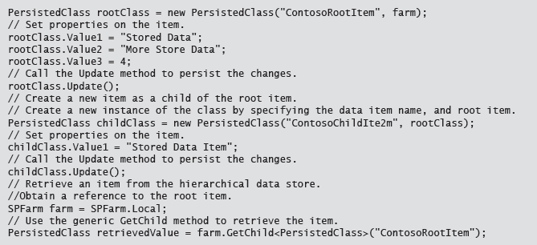
Using Persisted Object

Slide 33
Discussion Question
When would you choose each of the configuration storage options?
SharePoint Lists
Property Bags
Hierarchical Storage
Web.config File
Notes:
You could use the following ideas to drive the discussion:
SharePoint Lists
When storing a collection of structured data which must be exposed in its raw format to end users.
When data is needed outside the web application context (e.g. a timer job).
Property Bags
When storing a variety of unstructured data.
When storing a single instance of a type.
When data does not need to be exposed to end users.
When you need a different data set for different instances of your solution e.g. site level.
When data is needed outside the web application context (e.g. a timer job).
Hierarchical Storage
When storing hierarchical data.
When only using serializable data types.
When data does not need to be exposed to end users.
Web.config File
When storing a single data value for use by all instances of a solution within a web application.
When code runs in the context of a web application (in the w3wp process).
When storing a variety of unstructured data.
When storing simple data types.
20488
5: Working with Server-Side Code

Slide 34
Lab: Working with Server-Side Code
Exercise 1: Developing an Event Receiver Exercise 2: Updating a Web Part Exercise 3: Creating a Timer Job
Logon Information
Virtual machine: 20488A-LON-SP-05
User Name: CONTOSO\administrator
Password: Pa$$w0rd
Estimated Time: 45 minutes
Notes:
Exercise 1: Developing an Event Receiver
In this exercise, you will create an event receiver. You will add code to the event receiver to handle items being added, updated, or deleted from a list. The code will update a property stored in a site-level property bag. You will then modify the default Feature to associate the event receiver with the correct list. Finally you will deploy the event receiver to the server.
Exercise 2: Updating a Web Part
In this exercise, you will modify an existing web part to retrieve a value stored in a site-level property bag. The web part will check if the value exists, and if it does display the information when the web part is rendered. You will deploy the web part, and add the web part to a page.
Finally, you will test the functionality of the event receiver developed in the previous exercise, and the web part by adding expense items to the expense tracking list and verifying that the correct total displays on the web part.
Exercise 3: Creating a Timer Job
In this exercise, you will create a timer job which enumerates the expense tracking lists for each department. The timer job will add items to a list of the manager's team site. You will then develop a Feature receiver to install the timer job, and then deploy the timer job to the server. You will test the timer job by viewing the overview list on the manager's team site.
20488
5: Working with Server-Side Code

Slide 35
Lab Scenario
To help managers monitor departmental expenses, Contoso have decided that all expenses should be tracked in SharePoint. Your colleagues have already created custom lists for each department which employees can use to store expense details. They have also created a simple web part which informs users that they should now add their expenses to a SharePoint list.
Management want to make employees more aware of how much their department spends on expenses. You will amend the web part so that it also contains an estimated departmental total. As the number of expenses per department may grow very large, you do not want to enumerate every expense item in the list each time someone views the web part; instead you will store the current total in the site property bag. You will create an event receiver which updates this total each time an item is added or changed in the expenses list.
Senior managers also want better oversight into departmental spending. To support senior management, you will create a timer job which will run once a day. The timer job will update a list with the latest totals from each department by retrieving the latest data from each departmental site. Both the overview list and the departmental web part will only display estimated data; Contoso's finance department will produce accurate expense reports by using alternative software. You will use farm solutions to deploy each component.
Notes:
20488
5: Working with Server-Side Code

Slide 36
Module Review and Takeaways
Review Question(s)
Notes:
Review Question(s)
Question
A visual web part cannot be installed in a sandboxed solution.
( )False
( )True
Answer
(√)False
( )True
Question
Which of the following identifies the default synchronization for events?
( )Option 1: Both before and after events run synchronously.
( )Option 2: Both before and after events run asynchronously.
( )Option 3: Before events run synchronously, and after events run asynchronously.
( )Option 4: Before events run asynchronously, and after events run synchronously.
( )Option 5: Before events run synchronously, after events do not have a default synchronization.
Answer
(√) Option 3: Before events run synchronously, and after events run asynchronously.
Question
Timer jobs run with full control, in a separate process from the web worker process.
( )False
( )True
20488
5: Working with Server-Side Code
(More notes on the next slide)

