Slide 1
Module 6
Managing Identity and Permissions
Notes:
20488A
06: Managing Identity and Permissions

Slide 2
Module Overview
Understanding Identity Management in SharePoint 2013 Managing Permissions in SharePoint 2013 Configuring Forms-Based Authentication Customizing the Authentication Experience
Notes:
20488A
06: Managing Identity and Permissions

Slide 3
Lesson 1: Understanding Identity Management in SharePoint 2013
Authentication in SharePoint Authentication Types and Methods How SharePoint Represents Users Impersonation Discussion: Scenarios for Impersonation
Notes:
20488A
06: Managing Identity and Permissions

Slide 4

Authentication in SharePoint
SharePoint uses external authentication providers.
Classic-Mode Authentication
Claims-Mode Authentication:
Claims Providers
Claims-Based
Application
Claims Issuer
AD DS
SharePoint Web Application
Security Token Service
ASP.NET FBA
1. User obtains token
AD FS
2. User sends token to SharePoint
Custom Claims Provider
Notes:
Use the graphic on the slide to illustrate the SharePoint components, and external components, that are involved in authentication.
20488A
06: Managing Identity and Permissions

Slide 5
Authentication Types and Methods
Windows Authentication
Only supported by Internet Explorer
Requires an AD DS user account
Authentication methods include Kerberos, NTLM, and Basic
FBA Authentication
Uses ASP.NET membership providers for authentication
Uses ASP.NET role provider for group membership
Many providers available
SAML Authentication
Supports federated authentication providers such as AD FS
Notes:
This topic includes three additional slides, which you can use to illustrate each authentication type and describe how they execute step-by-step. When you use these slides, remember to emphasize the differences between authentication types.
20488A
06: Managing Identity and Permissions

Slide 6
Windows Authentication
Anonymous request
SharePoint requests token
Credentials sent
Credentials forwarded to AD DS
Security groups obtained
Claims token created and returned
Token sent to SharePoint
AD DS Domain Controller
4
5
SharePoint STS
6
3
User
SharePoint Web Application
2
1
Notes:
Use this additional slide to describe and illustrate the Windows Authentication mechanism.
20488A
06: Managing Identity and Permissions

Slide 7
Forms-Based Authentication
Anonymous request
SharePoint redirects user to logon page
Authentication form submitted
Credentials forwarded to ASP.NET membership provider
Roles obtained from ASP.NET roles provider
Claims token created and returned
Token sent to SharePoint
Membership Provider
Roles Provider
4
5
SharePoint STS
6
3
User
SharePoint Web Application
2
1
Notes:
Use this additional slide to describe and illustrate the FBA mechanism.
20488A
06: Managing Identity and Permissions

Slide 8
SAML Authentication
Anonymous request
SharePoint redirects user
User submits credentials
Credentials validated against remote authentication provider
SAML token returned to user
User requests resource with token
STS uses SAML token to create claims token
Claims used for authentication
Remote Authentication Provider
4
Federated Authentication Provider
5
SharePoint STS
3
7
User
SharePoint Web Application
2
1, 6
Notes:
Use this additional slide to describe and illustrate the SAML authentication mechanism.
20488A
06: Managing Identity and Permissions

Slide 9
Impersonation
Using Elevated Privileges
Impersonating a Specific User
SPSecurity.RunWithElevatedPrivileges(delegate () {
using (SPSite site = new SPSite("http://site") {
//Execute operations here }
});
using (SPSite site = new SPSite(SPContext.Current.Site.Url, accessToken))
{
//Operations executed in this using block have the //permissions of the SpecialAccess account
}
Notes:
Emphasize that impersonation should be used only when it is absolutely necessary and then with great care. It is the developer's responsibility to ensure that impersonation does not result in any compromise to the security infrastructure within SharePoint, Windows, or any associated system. Since impersonation can circumvent permission levels assigned by administrators, developers must check all user input thoroughly and ensure that no security compromises arise. If developers cannot be completely confident that impersonation can be used without damaging security, they should not use it.
20488A
06: Managing Identity and Permissions

Slide 10
Discussion: Scenarios for Impersonation
Discuss the following scenarios:
Setup Code in a Farm Solution
Setting Permissions in a SharePoint List
Recording Approvals
Notes:
Make sure that the students read each scenario in full from the student notebook before beginning each discussion. The following notes may help your discussion:
Setup Code in a Farm Solution
Usually, when a SharePoint user installs a SharePoint farm solution, their user account is the owner of any lists the solution creates. As the owner of the list, the user can assign full control permission. To avoid this, you can use RunWithElevatedPrivileges in the feature receiver to create the list. This ensures that the list owner is the SharePoint system, not any user account. In this way you can ensure that no SharePoint user accounts can have full control over the list.
Setting Permissions in a SharePoint List
This scenario does not require impersonation. Instead, either manually or in code, assign full control permission to the HR managers group or role. This ensures that HR managers can assign permissions to other users.
Recording Approvals
In most cases, when a user modifies any item in a SharePoint list or library, other users can see who modified the item. This is important for auditing changes. In this case, you can create a dedicated SharePoint user account and grant permission to the documents list. In the approval code, obtain the user token for this account and use it to impersonate the account as the approval is made. Authors will see only that the dedicated account made the approval, not the name of the editor who reviewed their work.
20488A
06: Managing Identity and Permissions

Slide 11
Lesson 2: Managing Permissions in SharePoint 2013
Permissions Classes Checking Permissions Assigning Permissions Managing Access to Resources
Notes:
20488A
06: Managing Identity and Permissions

Slide 12
How SharePoint Represents Users
SPUser
SPGroup
SPPrincipal
SPUser user = SPContext.Current.Web.CurrentUser;
SPUserCollection users = SPContext.Current.Web.AllUsers;
Notes:
20488A
06: Managing Identity and Permissions

Slide 13
Permissions Classes
SPSecurableObject represents a list, library, website or item
SPRoleDefinition represents a permissions level
SPRoleAssignment represents the assignment of a permission level to a security principal such as a user or group
Notes:
Ensure that students are clear on the difference between a base permission and a permission level, which is also calls a role definition.
20488A
06: Managing Identity and Permissions

Slide 14
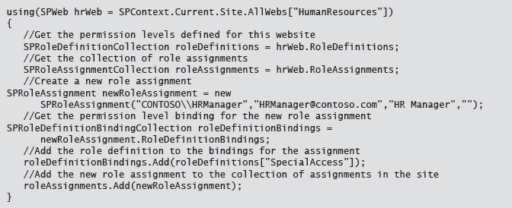
Permissions

Slide 15
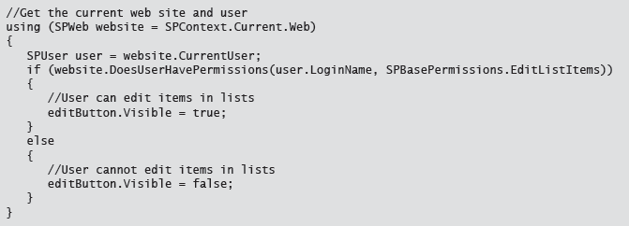
Checking Permissions
Notes:
20488A
06: Managing Identity and Permissions

Slide 16
Assigning Permissions
Assigning a Permissions Level
Create a new SPRoleAssignment
Add a role definition binding to the assignment
Add the assignment to the RoleAssignments collection on the securable object
Creating a Custom Permissions Level
Create a new SPRoleDefinition
Add permissions to the BasePermissions collection
Add the role definition to the RoleDefinitions collection on the website
Notes:
20488A
06: Managing Identity and Permissions

Slide 17
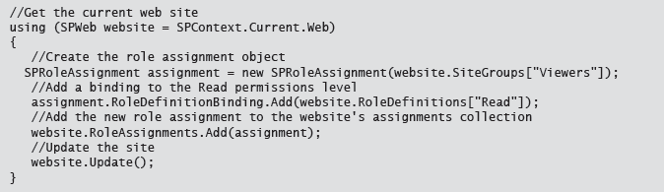
Assigning a Permissions Level

Slide 18
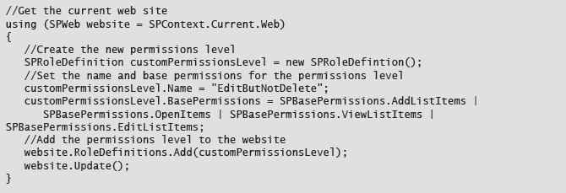
Creating a Custom Permissions Level

Slide 19
Managing Access to Resources
Permissions Inheritance
Breaking inheritance
Restoring inheritance
Anonymous Access
Enabling anonymous users to access a site
Assigning permissions to anonymous users
Notes:
Emphasize that simple permissions levels assigned at the site level tend to result in fewer support calls, because it is easy for users to understand the level of access they expect to receive. Such permission levels also make it easier for administrators to troubleshoot incorrect permissions, because there is only one object where permissions levels are applied. If developers do need to break inheritance and assign permissions to multiple, lower level objects, they should document their permissions levels carefully to ease diagnosis.
20488A
06: Managing Identity and Permissions

Slide 20
Lab A: Managing Permissions Programmatically in SharePoint 2013
Exercise 1: Managing List Permissions Programmatically
Logon Information
Virtual Machine: 20488A-LON-SP-06
Username: CONTOSO\Administrator
Password: Pa$$w0rd
Estimated Time: 15 minutes
Notes:
Exercise 1: Managing List Permissions Programmatically
A colleague has created a new SharePoint project in Visual Studio and added the Financials document library to the project. You have been asked to add code to this project that ensures that only site owners and members of the Managers group can access documents in the Financials library when the solution is deployed to any SharePoint site.
20488A
06: Managing Identity and Permissions

Slide 21
Lab Scenario
Contoso plan to add a document library named Financials to every project site on the company intranet portal. Because this document library will contain sensitive financial data, you must restrict who can access the library. Only the site owners group of each project site, together with the members of the Managers security group, should be able to view documents in the Financials library
Notes:
20488A
06: Managing Identity and Permissions

Slide 22
Lab Review
In the Task 2, when you called the BreakRoleInheritance method, you passed the value false. What would happen if you passed the value true instead? In Task 4, you granted Contribute permissions to members of the Managers AD DS security group. What other method could you use to grant this permission when permission inheritance is enabled?
Notes:
Question
In the Task 2, when you called the BreakRoleInheritance method, you passed the value false. What would happen if you passed the value true instead?
Answer
If you passed the value true, role inheritance is broken, but the initial permissions for the library are copied from the parent site.
Question
In Task 4, you granted Contribute permissions to members of the Managers AD DS security group. What other method could you use to grant this permission when permission inheritance is enabled?
Answer
You could add the Managers security group to the Site Members SharePoint group, which has the Contribute permission level by default.
20488A
06: Managing Identity and Permissions

Slide 23
Lesson 3: Configuring Forms-Based Authentication
Forms-Based Authentication Overview Creating Custom Membership Providers Creating Custom Role Providers Registering Providers Discussion: Federation and Custom Provider Scenarios
Notes:
20488A
06: Managing Identity and Permissions

Slide 24
Forms-Based Authentication Overview
Architecture
Membership Providers
Role Providers
Credential Stores
Advantages and Disadvantages
Notes:
20488A
06: Managing Identity and Permissions

Slide 25
Creating Custom Membership Providers
To create a custom membership provider:
Inherit the System.Web.Security.MembershipProvider class
Override the following methods:
GetUser
FindUsersByEmail
FindUsersByName
GetAllUsers
ValidateUser
Notes:
20488A
06: Managing Identity and Permissions

Slide 26
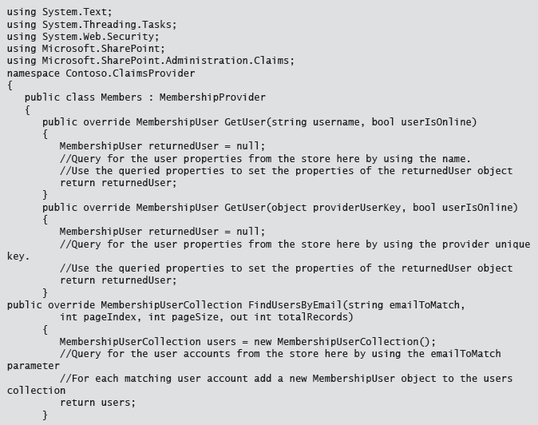
Custom Membership Provider

Slide 27
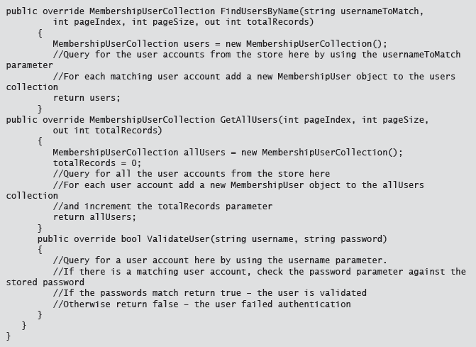
Custom Membership Provider

Slide 28
Creating Custom Role Providers
To create a custom role provider
Inherit the System.Web.Security.RoleProvider class
Override the following methods:
GetRolesForUser
RoleExists
Notes:
20488A
06: Managing Identity and Permissions

Slide 29
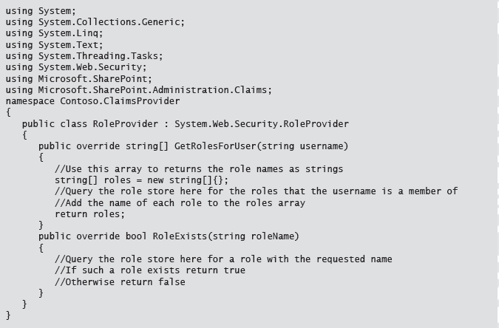
Custom Role Provider

Slide 30
Registering Providers
To use a custom membership provider or role provider:
Deploy the provider
Create a new web application and configure it to use the provider
Configure the web.config files for:
The Central Administration site
The Secure Token Server
The new web application
Notes:
20488A
06: Managing Identity and Permissions

Slide 31
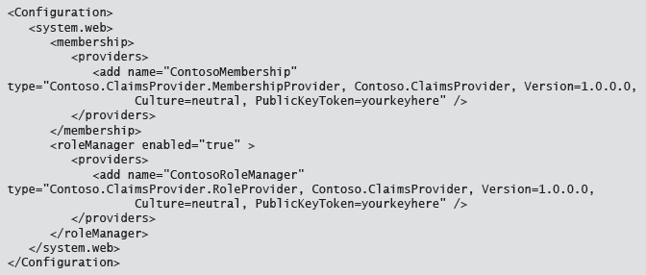
web.config

Slide 32
Discussion: Federation and Custom Provider Scenarios
Scenario: A Custom Credential Store
Read the scenario and then discuss the following questions:
Can user accounts in the custom directory system be used to access SharePoint without migrating them into AD DS?
Can forms authentication be used to check credentials that are stored in the custom directory system?
Can federated SAML authentication be used to check credentials that are stored in the custom directory system?
Notes:
Ensure that all students read the scenario before discussing the questions. This scenario is designed to provoke a discussion rather than to dictate correct answers. Use the following points to guide your discussion:
Can user accounts in the custom directory system be used to access SharePoint without migrating them into AD DS?
If you can write .NET managed code that can access the accounts in the directory system, then SharePoint can authenticate accounts. For example, you could create a custom FBA authentication provider that calls the custom directory to authenticate credentials.
Can forms authentication be used to check credentials that are stored in the custom directory system?
Again, is .NET managed code can call the directory service, this is possible.
Can federated SAML authentication be used to check credentials that are stored in the custom directory system?
Since the directory service is not standards-compliant, it seems unlikely that a federated authentication provider, such as AD FS, could trust the custom directory service.
20488A
06: Managing Identity and Permissions

Slide 33
Lesson 4: Customizing the Authentication Experience
What is a Claims Provider? Creating a Claims Provider Deploying a Claims Provider Creating a Custom Login Page
Notes:
20488A
06: Managing Identity and Permissions

Slide 34
What is a Claims Provider?
A claims provider is a component that formulates the claims that SharePoint incorporates into the user’s security token at authentication.
SharePoint uses claims to:
Authorize access to resources.
Help users to pick from a list of their fellow users.
Notes:
Make sure that students do not confuse claims providers with FBA membership providers or FBA role providers.
20488A
06: Managing Identity and Permissions

Slide 35
Creating a Claims Provider
To create a custom claims provider, derive from SPClaimProvider and implement:
SupportsEntityInformation
FillClaimsForEntity()
FillSchema
FillClaimTypes
FillClaimValueTypes
FillEntityTypes
Notes:
20488A
06: Managing Identity and Permissions

Slide 36
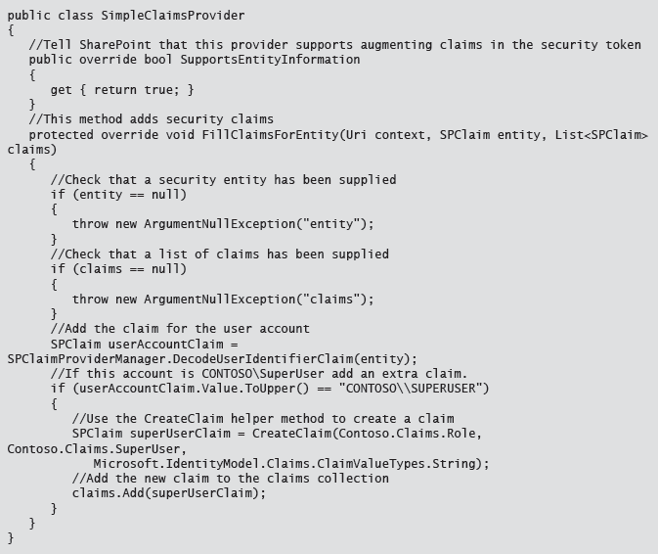
Claims Provider

Slide 37
Deploying a Claims Provider
To deploy a claims provider, create a feature receiver:
Derive the feature receiver from the SPClaimProviderFeatureRecieverClass
Override the following properties
ClaimProviderAssembly
ClaimProviderType
ClaimProviderDisplayName
ClaimProviderDescription
Notes:
20488A
06: Managing Identity and Permissions

Slide 38
Creating a Custom Login Page
To create a custom login page for FBA:
Create a new empty SharePoint project.
Add a new application page to the project.
Add references to Microsoft.SharePoint.Security.dll and Microsoft.SharePoint.IdentityModel.dll
Use the SPClaimsUtility.AuthenticateFormsUser method to log the user in.
Package and deploy the solution.
In Central Administration, configure a web application to use the new login page.
Notes:
20488A
06: Managing Identity and Permissions

Slide 39
Lab B: Creating and Deploying a Custom Claims Provider
Exercise 1: Creating a Custom Claims Provider Exercise 2: Supporting Search and Resolve in a Claims Provider Exercise 3: Deploying and Testing a Claims Provider
Logon Information
Virtual Machine: 20488A-LON-SP-06
Username: CONTOSO\Administrator
Password: Pa$$w0rd
Estimated Time: 45 minutes
Notes:
Exercise 1: Creating a Custom Claims Provider
In this exercise, you will create a custom claims provider and implement the code required to support claims augmentation.
Exercise 2: Supporting Search and Resolve in a Claims Provider
In this exercise, you will add the code necessary to support People Picker functionality, including search and resolve operations.
Exercise 3: Deploying and Testing a Claims Provider
In this exercise, you will create a feature and feature receiver that can deploy the Contoso location claims provider. You will also test the claims provider in the development site.
20488A
06: Managing Identity and Permissions

Slide 40
Lab Scenario
The research team at Contoso is working on some highly confidential research. The team wants to be able to restrict access to information based on where a user logs on. Your task is create a custom claims provider that augments the user's claim token with location information.
Notes:
20488A
06: Managing Identity and Permissions

Slide 41
Lab Review
Why can you not use a class that derives from SPFeatureReceiver to deploy a claims provider? You want to create a claims provider that augments claims in the user's security token but does not show up in the People Picker dialog. Which methods should you implement in the SPClaimProvider class?
Notes:
Question
Why can you not use a class that derives from SPFeatureReceiver to deploy a claims provider?
Answer
You must derive the feature receiver from the SPClaimProviderFeatureReceiver class in order to deploy a claims provider because specialized properties such as ClaimProviderAssembly and ClaimProviderDisplayName are not supported by SPFeatureReceiver.
Question
You want to create a claims provider that augments claims in the user's security token but does not show up in the People Picker dialog. Which methods should you implement in the SPClaimProvider class?
Answer
You should implement FillClaimTypes, FillClaimValues, FillClaimsForEntity, and FillEntityTypes.
20488A
06: Managing Identity and Permissions

Slide 42
Module Review and Takeaways
Review Question(s) Best Practice
Notes:
Review Question(s)
Question
You are writing a SharePoint farm solution that must reassign permissions for the Financials library. The farm solution is deployed under the security context of your personal user account. You find that the solution is prevented from reassigning the permissions required. How can you ensure that the solution can always overcome these restrictions?
Answer
Use the RunWithElevatedPrivileges method to execute the code as the SharePoint system account.
Question
True or false: To enable SharePoint to authenticate user credentials against a custom user store, you must create a custom FBA role provider.
( )False
( )True
Answer
(√)False
( )True
Best Practice: By using custom claim providers to restrict access to resources, you can secure your SharePoint farm and comply with legislation in your legal jurisdiction without using or publishing confidential information about your users.
20488A
06: Managing Identity and Permissions

