Slide 1
Module 7
Introducing Apps for SharePoint
Notes:
20488A
08: Introducing Apps for SharePoint

Slide 2
Module Overview
Overview of Apps for SharePoint Developing Apps for SharePoint
Notes:
20488A
08: Introducing Apps for SharePoint

Slide 3
Lesson 1: Overview of Apps for SharePoint
What is a SharePoint App? Hosting SharePoint Apps Autohosted and Provider Hosted Apps Developer Tools and Technologies Host Webs, App Webs, and Remote Webs App Entry Points Data Storage and Access Packaging and Publishing Apps Discussion – Choosing Technologies
Notes:
20488A
08: Introducing Apps for SharePoint

Slide 4
What is a SharePoint App?
A SharePoint app is a custom solution for SharePoint that runs entirely outside any SharePoint server processes
App Model Design Goals:
Apps must be supported both on-premises and in the cloud
App code never runs within the SharePoint host environment
App code accesses SharePoint data through web services
App code is authenticated and runs under a distinct identity
Apps are published in app catalogs and Office Store
Notes:
20488A
08: Introducing Apps for SharePoint

Slide 5



Hosting SharePoint Apps
SharePoint
SharePoint
Hosted App
Cloud
Hosted App
Web Pages
Scripts
Style Sheets
Web Pages
Scripts
Style Sheets
Server-Side Code
Databases
Browser
Notes:
20488A
08: Introducing Apps for SharePoint

Slide 6
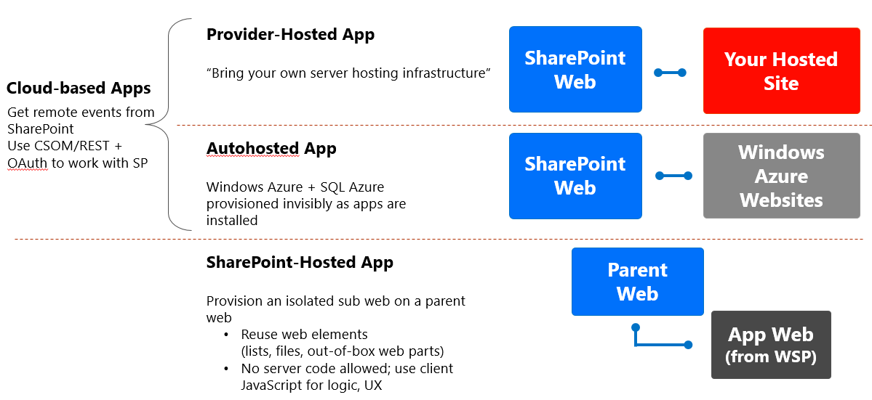
App Models

Slide 7
Autohosted and Provider Hosted Apps
The need for tenant isolation
Building and provisioning a provider hosted app
Building and provisioning an autohosted app
Notes:
Emphasize that both provider hosted apps and autohosted apps are subtypes of cloud hosted apps. Their differences center on how tenants' data is isolated and how new instances of the app are provisioned.
20488A
08: Introducing Apps for SharePoint

Slide 8
Developer Tools and Technologies
Client-Side Technologies
Scripting Language
Script Libraries
Server-Side Technologies
ASP.NET
Web Pages
Web Forms
MVC
PHP
Ruby on Rails
Development Environments
Visual Studio 2012
Napa
Notes:
20488A
08: Introducing Apps for SharePoint

Slide 9
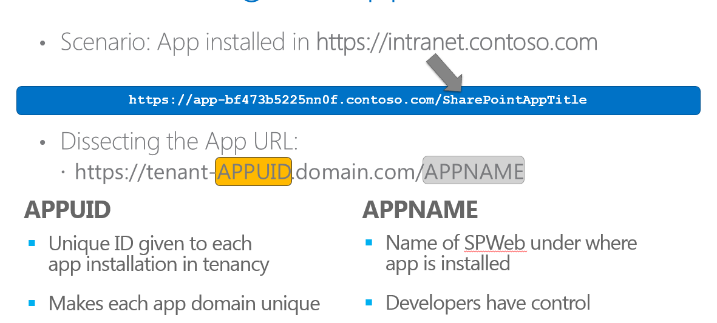
Host Webs, App Webs, and Remote Webs
Host Webs - App Webs - Remote Webs
App Installation Scope
App Web Domains
Notes:
20488A
08: Introducing Apps for SharePoint

Slide 10
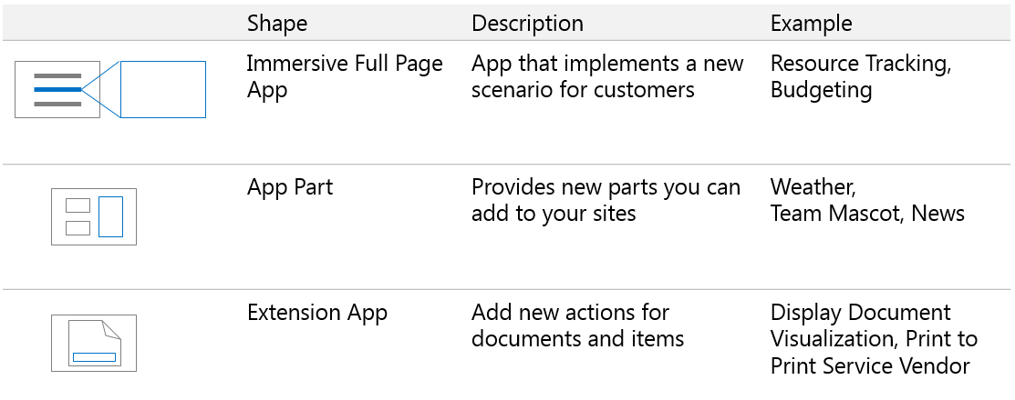
App Entry Points
App Entry Points
Notes:
20488A
08: Introducing Apps for SharePoint

Slide 11
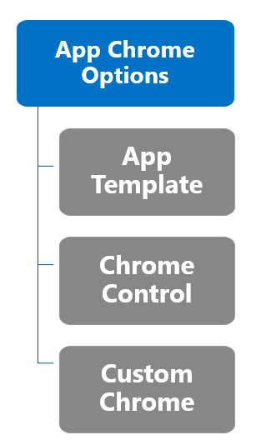

Chrome Control
Use the Chrome Control to inherit style and links from the host web in a cloud app
Must include “Back to Site” link in upper-left

Slide 12
Data Storage and Access
Client Side Object Model
.NET Framework Object Model
REST API
App Authentication
Internal Authentication
External Authentication
Data Outside SharePoint
Notes:
20488A
08: Introducing Apps for SharePoint

Slide 13
Packaging and Publishing Apps
Packaging Apps
.app file extension
A package typically includes the following files:
AppManifest.xml
AppIcon.png
Solution file
Data Tier Application Package
Publishing Apps
Office Store
App Catalogs
Notes:
20488A
08: Introducing Apps for SharePoint

Slide 14
Discussion – Choosing Technologies
Creating a photo management app for a magazine
Design Decisions:
Hosting Model?
Development Tool?
Photo Storage Location?
Photo Storage Web?
Entry Points?
Publishing Location?
Notes:
This discussion is intended to model the design decisions a team of developers might face when they plan a real SharePoint app. Therefore, there may not be a single correct set of answers to the questions. Instead, encourage your students to think through the design decisions for themselves and form a consensus. Point out the following points to the students as part of this discussion:
The magazine uses an on-premises SharePoint farm. Therefore, you cannot create an autohosted app to address these requirements because autohosted apps can only run within an Office 365 SharePoint tenancy. Either a SharePoint hosted app or a provider hosted app could be used.
This app requires a SharePoint workflow. Napa does not support workflow development so Visual Studio should be used.
The app has been developed for specific magazine, so it should be published in the app catalog of the magazine's SharePoint web application. However, the magazine could also consider generating a return on the app development investment by publishing the app in the Office Store. Other customers may want to buy the functionality you develop, if it is a common requirement in your industry or related industries.
20488A
08: Introducing Apps for SharePoint

Slide 15
Lesson 2: Developing Apps for SharePoint
Communicating with SharePoint Visual Studio Templates for SharePoint Apps Demonstration: How to Create a SharePoint App from a Visual Studio Template Cross Domain Calls Licenses for SharePoint Apps
Notes:
20488A
08: Introducing Apps for SharePoint

Slide 16
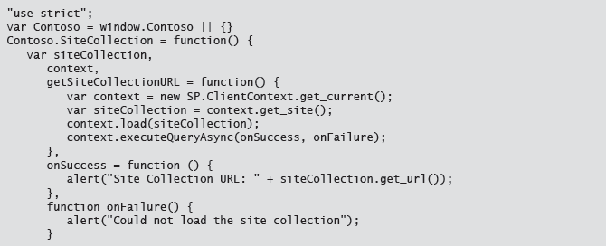
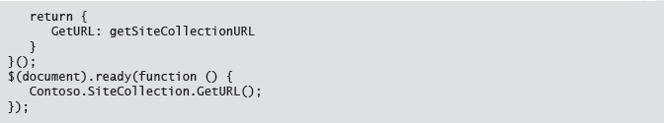
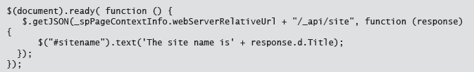
CSOM & REST

Slide 17
Visual Studio Templates for SharePoint Apps
The App for SharePoint 2013 project template
Default files in an app project
Visual Studio item templates
Notes:
20488A
08: Introducing Apps for SharePoint

Slide 18
Demonstration: How to Create a SharePoint App from a Visual Studio Template
In this demonstration, you will see:
How to create a new SharePoint hosted app project in Visual Studio 2012
The default structure and important files within a SharePoint app
How to deploy and debug an app in the development SharePoint farm
Notes:
Preparation Steps
None
Demonstration Steps
In the result pane of the Hyper-V Manager console, in the Name list of the Virtual Machines area, right-click 20488A-LON-SP-08, and then click Connect.
To log on to 20488A-LON-SP-08, click the Ctrl+Alt+Delete button.
In the User name text box, type CONTOSO\Administrator, in the Password box, type Pa$$w0rd, and then click the Forward button.
On the Start screen, click Visual Studio 2012.
In Visual Studio, click File, click New, and then click Project.
In the tree view on the left, navigate to Templates/Visual C#/Office/SharePoint/Apps.
In the list of templates, click App for SharePoint 2013.
In the Name text box, type HelloWorldApp and then click OK.
In the New App for SharePoint dialog box, in the What is the name of your app for SharePoint text box, type Hello World.
In the What SharePoint site do you want to use for debugging your app text box, type http://dev.contoso.com and then click Validate.
In the Connection Successful message box, click OK.
In the How do you want to host your app for SharePoint drop-down list, select SharePoint-hosted, and then click Finish.In Solution Explorer, expand the Features folder.
Explain to the students that Feature1 is used to deploy lists, libraries, and other SharePoint content to the app web.
Expand the Content folder.
20488A
08: Introducing Apps for SharePoint
(More notes on the next slide)

Slide 19
Cross Domain Calls
Using the Cross Domain Library
Access content in the app web from JavaScript in a remote web
SP.RequestExecutor.js
AppWebProxy.aspx
Using the Web Proxy
Access content in SharePoint or elsewhere from JavaScript in a remote web
SP.WebRequestInfo
Trusting domains for cross domain calls
Notes:
20488A
08: Introducing Apps for SharePoint

Slide 20
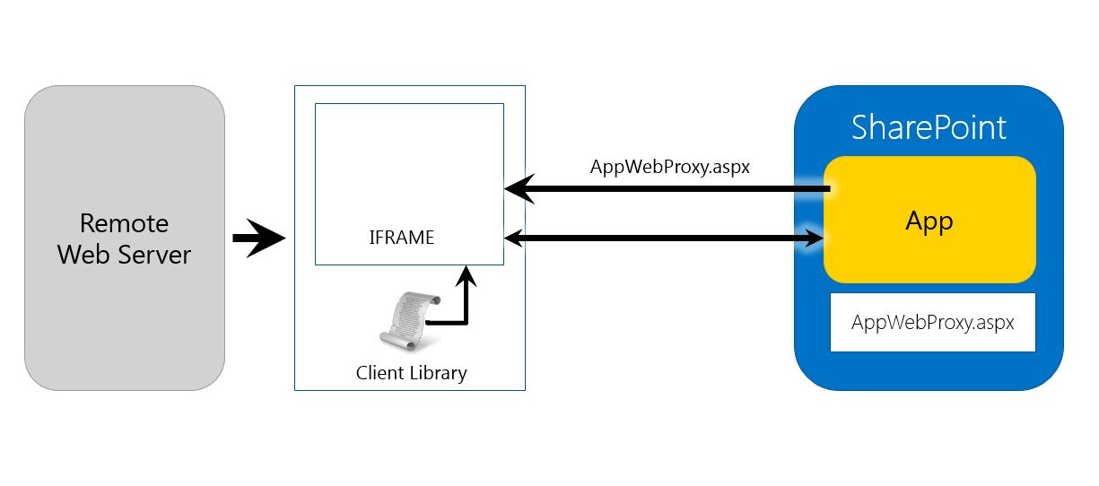
Cross Domain Calls

Slide 21
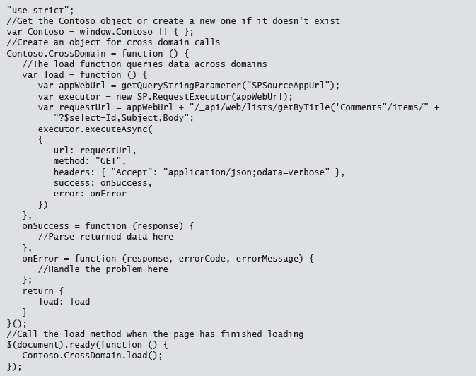
Cross Domain Calls

Slide 22
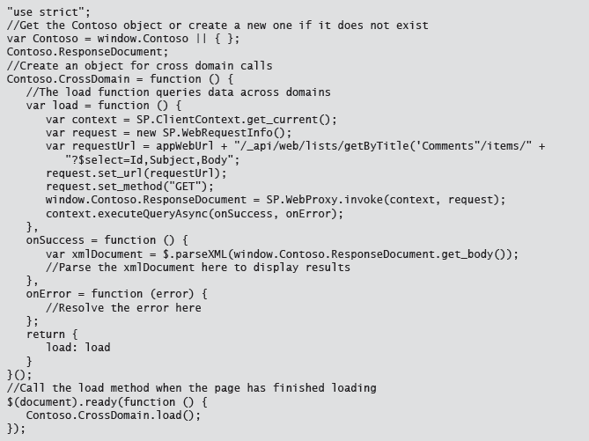
Alternative Way: Web Proxy

Slide 23
Licenses for SharePoint Apps
The Office Store License Framework
Downloading License Tokens from SharePoint
Checking License Tokens with the Office License Verification Web Service
Using Test Licenses
Notes:
20488A
08: Introducing Apps for SharePoint

Slide 24
Lab: Creating a Site Suggestions App
Exercise 1: Creating a New SharePoint App Exercise 2: Using the Client-Side Object Model
Logon Information
Virtual Machine: 20488A-LON-SP-08
Username: CONTOSO\Administrator
Password: Pa$$w0rd
Estimated Time: 45 minutes.
Notes:
Exercise 1: Creating a New SharePoint App
You have been asked to build a site suggestions app that enables users to submit feedback on the design and facilities available in a SharePoint site. You have decided to create the app in Visual Studio and add site columns, a content type, and a list to store feedback items. In this exercise, you will complete these tasks to create your app web infrastructure.
Exercise 2: Using the Client-Side Object Model
Now that you have created the Site Suggestions SharePoint app and the site columns, content type and list instance that it requires, you can add the user interface elements and the JavaScript code that enable users to create new feedback items and to browse feedback from other people.
You will start by adding an App.js file which has the necessary functions and the Contoso namespace defined. However these functions are incomplete. You will add JavaScript CSOM code to complete the app.
20488A
08: Introducing Apps for SharePoint

Slide 25
Lab Scenario
The management team at Contoso wants to ensure that the new SharePoint 2013 intranet deployment meets the needs of end users. The team has asked you to investigate ways of capturing user feedback consistently across a variety of site collections. In this lab, you will develop an app that enables users to submit feedback and to view the feedback submitted by other users.
Notes:
20488A
08: Introducing Apps for SharePoint

Slide 26
Lab Review
In Exercise 2, Task 3 you added styles to the App.css style sheet. How would the app function if you had not performed this step? When you click on a suggestion in the list, the suggestion fades in smoothly. How is this fade achieved in the code?
Notes:
Question
In Exercise 2, Task 3 you added styles to the App.css style sheet. How would the app function if you had not performed this step?
Answer
The app would function correctly but the layout and presentation of the user interface elements may look incorrect.
Question
When you click on a suggestion in the list, the suggestion fades in smoothly. How is this fade achieved in the code?
Answer
The following line of code implements the fade in:
$('#item-display').fadeIn('fast');
20488A
08: Introducing Apps for SharePoint

Slide 27
Module Review and Takeaways
Review Question(s) Tools Best Practice Common Issues and Troubleshooting Tips
Notes:
Review Question(s)
Question
Your company has created an app that manages company assets such as equipment. You have been asked to integrate this with the host web so that users can place the app on a Web Part page. What kind on entry point does this require?
Answer
An App Part entry point.
Tools
Visual Studio. This is the primary IDE to use for developing SharePoint apps of all kinds.
Napa. This is a web based IDE that is designed to make it very easy to create simple apps.
Best Practice: If you can develop your custom functionality as an app, you should do so in preference to developing farm solutions or sandboxed solutions. The reason for this recommendation is that apps have better isolation, and therefore greater stability, than solutions. Also, a completed app can be marketed in the Office Store.
Best Practice: Always use JavaScript in combination with script libraries for client-side code. JavaScript is widely supported and script libraries help to circumvent awkward browser differences that can needlessly increase a developer's workload.
Common Issues and Troubleshooting Tips
Common Issue: When you call the jQuery() or $() function, you see an error message.
Troubleshooting Tip: The jQuery() or $() function is a core jQuery function. If you cannot call it, your app probably does not include the jQuery library. To fix this, include a <script> element that links to jQuery in your app page. You will see more information on linking to jQuery in Module 9.
20488A
08: Introducing Apps for SharePoint

