Slide 1
Module 8
Client-Side SharePoint Development
Notes:
20488A
09: Client-Side SharePoint Development

Slide 2
Module Overview
Using the Client-Side Object Model for JavaScript Using the REST API with JavaScript Using the Client-Side Object Model for Managed Code
Notes:
20488A
09: Client-Side SharePoint Development

Slide 3
Lesson 1: Using the Client-Side Object Model for JavaScript
Overview of the CSOM for JavaScript Using the Client Context Object Loading Objects and Running Queries Demonstration: How to Use Load and LoadQuery Reading SharePoint Data Changing SharePoint Data Handling Server-Side Errors
Notes:
20488A
09: Client-Side SharePoint Development

Slide 4
Overview of the CSOM for JavaScript
Components of the CSOM
Linking to Script Libraries
Using the CSOM Proxy
App
SharePoint
Custom JavaScript
Content DB
JavaScript CSOM
JSON
Client.svc
Service Proxy
XML
Notes:
20488A
09: Client-Side SharePoint Development

Slide 5
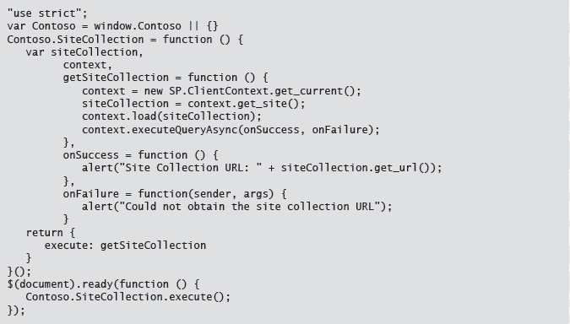
Using the Client Context Object
Notes:
The code on the slide shows how to use the client context object in an asynchronous call. Note that the code omits the encapsulation code used in the example in the student notes because there is insufficient room. When you discuss the code on the slide, remind the students of the importance of encapsulation and refer them to the code example in the student workbook.
20488A
09: Client-Side SharePoint Development

Slide 6
Loading Objects and Running Queries
Loading Objects
The Context.Load() method
The Context.LoadQuery() method
Executing Operations
Asynchronous
Synchronous
Notes:
20488A
09: Client-Side SharePoint Development

Slide 7
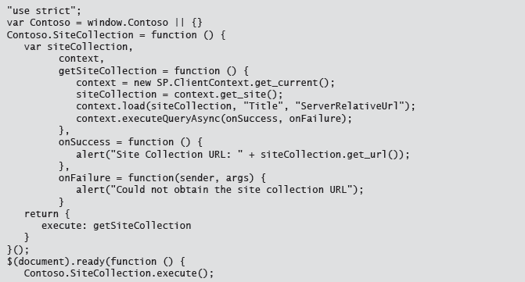
Loading Objects

Slide 8
Demonstration: How to Use Load and LoadQuery
In this demonstration, you will see how to:
Use the load method from the JavaScript CSOM to load items
Loop through results by using an enumerator
Use the loadQuery method from the JavaScript CSOM to load items
Loop through results by using the forEach method
Notes:
Preparation Steps
Start the 20488A-LON-SP-09 virtual machine.
Log on to the LONDON machine as CONTOSO\Administrator with a password Pa$$w0rd.
Start File Explorer.
Navigate to E:\Democode\Starter\LoadItemsDemo.
Double-click LoadItemsDemo.sln.
If the How do you want to open this type of file (.sln)? dialog box appears, click Visual Studio 2012.
Demonstration Steps
In Solution Explorer, expand the Scripts folder, and then double-click App.js.
Locate the following code:
var getItemsWithLoad = function () {
};
Place the cursor within the located function.
Type the following code:
var discussionList = context.get_web().get_lists().getByTitle('Discussion');
context.load(discussionList);
Press Enter.
Type the following code:
var items = discussionList.getItems('');
7. Press Enter.
8. Type the following code:
20488A
09: Client-Side SharePoint Development
(More notes on the next slide)

Slide 9
Reading SharePoint Data
Reading all the lists in a site:
Getting a List by Title
Getting Items in a List by Using a CAML Query
Getting an Item by ID
Notes:
20488A
09: Client-Side SharePoint Development

Slide 10
Changing SharePoint Data
Creating a new list in a site
Creating a new item in a list
Using SP.ListItemCreationInformation
Updating an existing item in a list
Deleting an item from a list
Notes:
20488A
09: Client-Side SharePoint Development

Slide 11
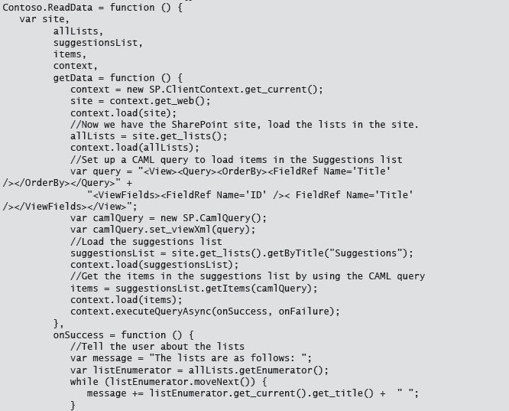
Reading SharePoint Data

Slide 12
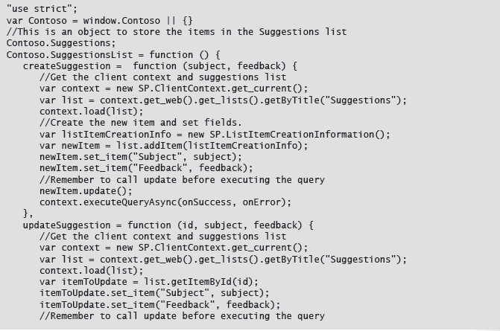
Create Item

Slide 13
Handling Server-Side Errors
By default, a server-side error causes the whole batch of operations to fail.
To avoid this, you can use an Error Handling Scope to define server-side try/catch/finally blocks
var e = new SP.ExceptionHandlingScope(context);
var s = e.startScope();
var t = e.startTry();
//This is the try block
t.dispose();
var c = e.startCatch();
//This is the catch block
c.dispose();
Notes:
There is not space to show all the relevant code on the slide so the most important calls have been included. Make sure students refer to the student manual for a complete version of the code.
20488A
09: Client-Side SharePoint Development

Slide 14
Lesson 2: Using the REST API with JavaScript
Overview of the REST API SharePoint REST API URLs Reading Data Creating and Updating Data
Notes:
20488A
09: Client-Side SharePoint Development

Slide 15
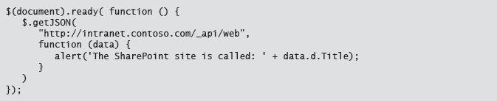
Overview of the REST API
RESTful Services:
Use Logical URLs to specify objects
Use HTTP verbs to specify operations
Use OData to exchange data
The SharePoint Client.svc service is a REST API
Notes:
In the code example, the address of the SharePoint site ("http://intranet.contoso.com") is hard-coded into the request. This makes the example easy to understand but is not sensible in most apps, where you do not know the address of the app web or host web at coding time. If students ask about this hard-coded URL, explain that they will see how to obtain the URL of the current site later in the module.
20488A
09: Client-Side SharePoint Development

Slide 16
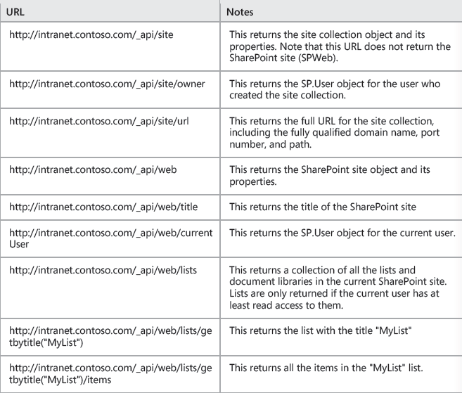
SharePoint REST API URLs
Address of the REST API
URLs for Common SharePoint Objects
Using OData Operators
Notes:
The REST API URL on the slide demonstrates all the parts of an advanced URL. Point out to the students the URL of the SharePoint site, the address of the Client.svc service, the method used to obtain the items in the MyList list and the three OData operators used to control the items returned.
20488A
09: Client-Side SharePoint Development

Slide 17
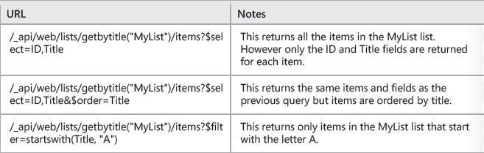
Sample Usage

Slide 18
Reading Data
Using the _spPageContextInfo.webServerRelativeUrl property
The jQuery getJSON() function
The jQuery ajax() function
Notes:
20488A
09: Client-Side SharePoint Development

Slide 19
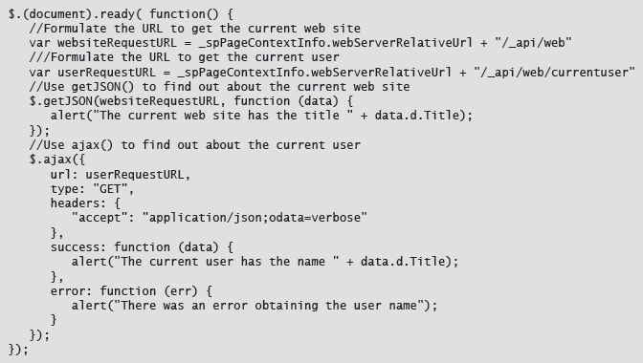
Reading Data

Slide 20
Creating and Updating Data
Creating New Items
Formulate a URL to the parent list in the REST API
Use the POST verb
Updating Existing Items
Formulate a URL to the item itself
Use the PATCH, MERGE, or PUT verbs
Deleting Items
Formulate a URL to the item itself
Use the DELETE verb
Always pass a form digest
Notes:
20488A
09: Client-Side SharePoint Development

Slide 21
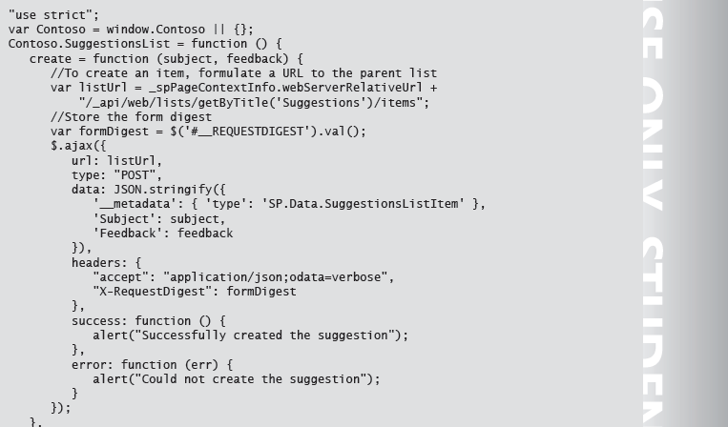
REST Create

Slide 22
Lab A: Using the REST API with JavaScript
Exercise 1: Creating List Relationships Exercise 2: Add Vote Recording Exercise 3: Display Votes for Each Suggestion
Logon Information
Virtual Machine: 20488A-LON-SP-09
Username: CONTOSO\Administrator
Password: Pa$$w0rd
Estimated Time: 45 minutes
Notes:
In the lab for Module 8, students created a SharePoint hosted app to gather site suggestions from users. The resulting app is the starting point for this lab. In the previous lab, the JavaScript CSOM was used to access SharePoint. In this lab, students will write code that uses the REST API. You should emphasize this difference in your introduction to the lab.
Exercise 1: Creating List Relationships
In order to add voting functionality to your app, you must create a list in the app web that will store votes. You must also link each vote to the suggestion it relates to. In this exercise, you will create the site columns, content type, and list instance to support voting.
Exercise 2: Add Vote Recording
In this exercise, you will enable users to register a positive or negative vote for each suggestion. The code you will add uses the jQuery ajax() function to call the REST API.
Exercise 3: Display Votes for Each Suggestion
Now that users can register positive and negative votes for each suggestion, you must add code that displays the net votes with the suggestion that they relate to. The net votes value is the number of positive votes for a suggestion minus the number of negative votes.
20488A
09: Client-Side SharePoint Development

Slide 23
Lab Scenario
The management team at Contoso has asked that you extend the Site Suggestions app to include more sophisticated functionality. In particular, they want users to be able to vote on suggestions made by others. Votes can be positive or negative and the net votes should be displayed with each item.
Notes:
20488A
09: Client-Side SharePoint Development

Slide 24
Lab Review
In the code that retrieves and displays votes, how did you ensure only votes for the current suggestion are retrieved from SharePoint? In Exercise 2, you passed a form digest with REST request. Why was this form digest unnecessary in the REST request you formulated in Exercise 3?
Notes:
Question
In the code that retrieves and displays votes, how did you ensure only votes for the current suggestion are retrieved from SharePoint?
Answer
You used the $filter OData operator in the REST URL that you sent to the SharePoint REST API.
Question
In Exercise 2, you passed a form digest with REST request. Why was this form digest unnecessary in the REST request you formulated in Exercise 3?
Answer
Form digests are only necessary with data modification REST requests, such as POST and PATCH requests.
20488A
09: Client-Side SharePoint Development

Slide 25
Lesson 3: Using the Client-Side Object Model for Managed Code
Overview of the Managed CSOM Using Client Context, Loading Objects, Executing Queries Reading SharePoint Data Changing SharePoint Data Handling Server-Side Errors
Notes:
Throughout this lesson, you should take care to emphasize two things:
The similarities between code written for the JavaScript CSOM and code written for the Managed CSOM. For example, both models use a client context object.
The differences between code written for the JavaScript CSOM and code written for the Managed CSOM. For example, the Managed CSOM requires lambda expressions to specify property names. JavaScript does not support lambda expressions, so you must use strings to specify property names.
20488A
09: Client-Side SharePoint Development

Slide 26
Overview of the Managed CSOM
When to Use the Managed CSOM
Components of the Managed CSOM
Using the CSOM Proxy
Application
SharePoint
Custom C# Code
Content DB
Managed CSOM
JSON
Client.svc
Service Proxy
XML
Notes:
20488A
09: Client-Side SharePoint Development

Slide 27
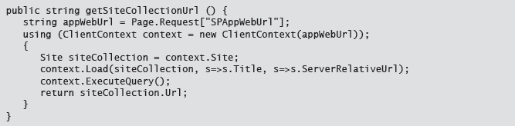
Using Client Context, Loading Objects, Executing Queries
Notes:
20488A
09: Client-Side SharePoint Development

Slide 28
Reading SharePoint Data
Obtain a collection of lists in a site:
Obtain a list by its title:
Obtain items in a list by using a CAML query:
ListCollection allLists = currentWeb.Lists;
List suggestionsList = allLists.GetByTitle("Suggestions");
ListItemCollection items = suggestionsList.GetItems(camlQuery);
Notes:
It is helpful to compare the code in this topic with the code in the "Reading SharePoint Data" topic in Lesson 1, which performs the same queries by using the JavaScript CSOM.
20488A
09: Client-Side SharePoint Development

Slide 29
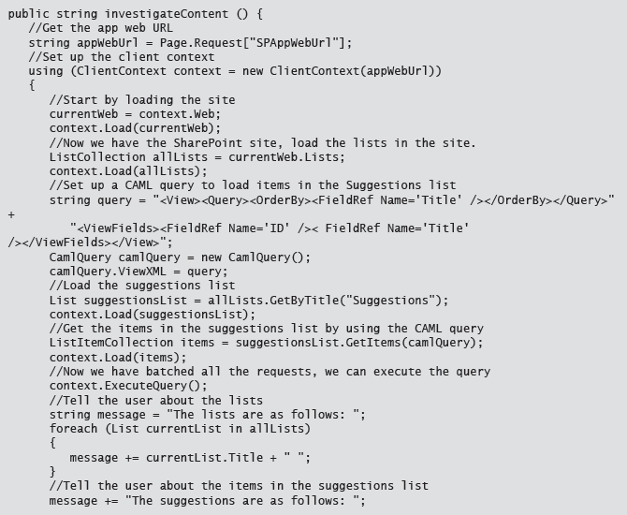
Query SharePoint Data

Slide 30
Changing SharePoint Data
Creating Lists
Create a ListCreationInformation object
Pass the object to Web.Lists.Add()
Creating Items
Create a ListItemCreationInformation object
Pass the object to List.AddItem()
Updating Items
Set fields on an item
Call Item.Update()
Deleting Items
Call Item.DeleteObject()
Notes:
20488A
09: Client-Side SharePoint Development

Slide 31
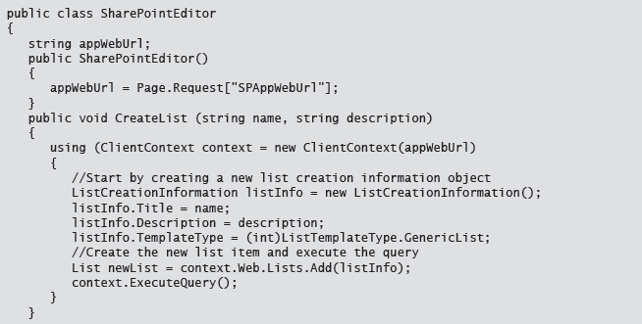
CRUD

Slide 32
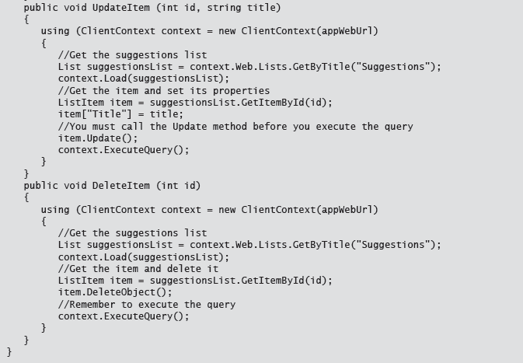
CRUD

Slide 33
Handling Server-Side Errors
Use an exception handling scope for server-side errors as in the JavaScript CSOM
Use using() { } code blocks to ensure correct disposal of objects
Ensure there is only one call to ExecuteQuery() after the exception handling scope is disposed of
Notes:
20488A
09: Client-Side SharePoint Development

Slide 34
Lab B: Using the Client-Side Object Model for Managed Code
Exercise 1: Create The Mileage Claim List Exercise 2: Add Mileage Claim Creation Code Exercise 3: Display Mileage Claims on the App Start Page
Logon Information
Virtual Machine: 20488A-LON-SP-09
Username: CONTOSO\Administrator
Password: Pa$$w0rd
Estimated Time: 30 minutes
Notes:
Exercise 1: Create The Mileage Claim List
The Mileage Reporter app requires a SharePoint list to store mileage claims. In this exercise, you will create site columns, a content type, and the list itself. You will create these objects in the SharePoint app web.
Exercise 2: Add Mileage Claim Creation Code
Now that you have created the Claims lists in the SharePoint app web, you can write code in the remote web that creates mileage claims. Your code will use the Managed CSOM to communicate with SharePoint.
Exercise 3: Display Mileage Claims on the App Start Page
In the exercise, you will add the code that reads all the existing claims from the Claims list and displays those claims on the app's start page. You will also test the completed app.
20488A
09: Client-Side SharePoint Development

Slide 35
Lab Scenario
The field sales team at Contoso must regularly submit expense claims for mileage. Due to the fluctuating price of fuel, variable tax rates, and other factors, some salespeople find it difficult to calculate their expense claims accurately. To help the sales team, you will implement an app that calculates mileage expenses. To ensure that the app always uses the latest formula, and to remove the processing burden from client browsers, you decide to create an autohosted app. The app will prompt users for the required information, calculate the expenses that the salesperson is able to claim, and then submit the claim on behalf of the salesperson.
Notes:
20488A
09: Client-Side SharePoint Development

Slide 36
Lab Review
In Exercise 2, how did you ensure that all pages in the remote web could locate the app web in SharePoint to read or write data?
Notes:
Question
In Exercise 2, how did you ensure that all pages in the remote web could locate the app web in SharePoint to read or write data?
Answer
You wrote code that stored the SPAppWebUrl query string parameter in a Session variable.
20488A
09: Client-Side SharePoint Development

Slide 37
Module Review and Takeaways
Review Question(s) Common Issues and Troubleshooting Tips
Notes:
Review Question(s)
Question
You are writing a SharePoint-hosted app and you want to access the items in a SharePoint list. Which of the following technologies can you use to write your code:
The JavaScript CSOM
The REST API
The .NET Managed CSOM
Answer
You can use the JavaScript CSOM or the REST API in this app.
Common Issues and Troubleshooting Tips
Common Issue: A REST API request that modifies a SharePoint item generates an error.
Troubleshooting Tip: If you do not include the form digest in your REST request headers, SharePoint will deny your request to prevent malicious attacks.
20488A
09: Client-Side SharePoint Development

