Slide 1
Module 9
Developing Remote Hosted SharePoint Apps
Notes:
20488A
10: Developing Remote Hosted SharePoint Apps

Slide 2
Module Overview
Overview of Remote Hosted Apps Configuring Remote-Hosted Apps Developing Remote-Hosted Apps
Notes:
20488A
10: Developing Remote Hosted SharePoint Apps

Slide 3
Lesson 1: Overview of Remote Hosted Apps
Introducing Remote Hosted Apps Authentication Mechanisms Provider Hosted Apps Autohosted Apps Discussion - Choosing An App Hosting Model
Notes:
20488A
10: Developing Remote Hosted SharePoint Apps

Slide 4
Introducing Remote Hosted Apps
SharePoint App
Pages, lists, and other resources in app web
Authentication provided by SharePoint
Isolation provided by farm or tenancy
Autohosted App
Can only be installed in Office 365
Authentication provided by Windows Azure ACS
Isolation provided by auto-provisioning SQL Database
Provider Hosted App
App provider must maintain the remote web
Authentication provided by an S2S trust
Isolation must be built by the provider
Notes:
20488A
10: Developing Remote Hosted SharePoint Apps

Slide 5
Authentication Mechanisms
Internal Authentication
SharePoint pages and sites
SharePoint hosted apps
Remote hosted apps that use the cross-domain library
External Authentication
With OAuth and Windows Azure ACS
Autohosted Apps
With an S2S Trust
Provider hosted apps
Notes:
20488A
10: Developing Remote Hosted SharePoint Apps

Slide 6

Provider Hosted Apps
Database
SharePoint
S2S Trust
Web Server
Host Web
Remote Web
Managed CSOM
Cross Domain Library
Notes:
20488A
10: Developing Remote Hosted SharePoint Apps

Slide 7
Autohosted Apps
Windows Azure
SQL Database
SharePoint in Office 365
OAuth Trust
Host Web
Remote Web
Managed CSOM
Cross Domain Library
Notes:
20488A
10: Developing Remote Hosted SharePoint Apps

Slide 8
Discussion - Choosing An App Hosting Model
Which app hosting model would you use in the following scenarios?
A Shared Knowledge Base
A Photo Library
A Customer Relationship Management App
Notes:
Lead the class in a discussion of each scenario. Make sure the students read the full scenario in their student notes. In each case, identify the features of each programming model that make it suitable or unsuitable for the website in question.
A Shared Knowledge Base
In this scenario, a single database, which contains the technical articles, must be shared by multiple tenants. This can only be implemented by created a provider hosted app because both SharePoint hosted apps and autohosted apps enforce content isolation.
A Photo Library
The scenario implies that each tenant will have an isolated library of photos. You can implement this by creating a SharePoint app, in which case you must use content types in SharePoint libraries and lists to store photos, comments, and other data. You could also create an autohosted app, in which case you could store photos and comments in a SQL Database. However, this model limits the market for your app, because it can only be installed for Office 365 customers. Finally you could implement a photo library as a provider hosted app, but you must write code to ensure isolation and maintain a web server or web farm to host the remote web.
A Customer Relationship Management App
Since the app requires a database you cannot build this functionality as a SharePoint hosted app. Since you want customers to install your app in Office 365 and on-premise farms, you cannot build this functionality as an autohosted app. This scenario requires a provider hosted app.
20488A
10: Developing Remote Hosted SharePoint Apps

Slide 9
Lesson 2: Configuring Remote-Hosted Apps
Configuring Autohosted App Authentication Configuring Provider Hosted App Authentication Requesting App Permissions
Notes:
20488A
10: Developing Remote Hosted SharePoint Apps

Slide 10
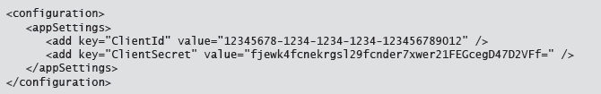
Configuring Autohosted App Authentication
Understanding App Principals and App Identifiers
App Manifest Requirements:
Web.config Requirements
Notes:
20488A
10: Developing Remote Hosted SharePoint Apps

Slide 11
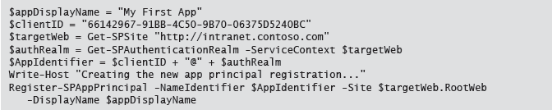
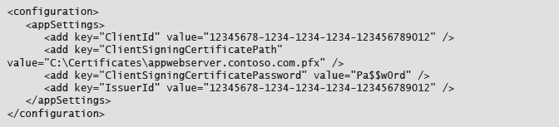
Configuring Provider Hosted App Authentication
Registering App Principals
App Manifest Requirements
Web.Config Requirements
Notes:
20488A
10: Developing Remote Hosted SharePoint Apps

Slide 12
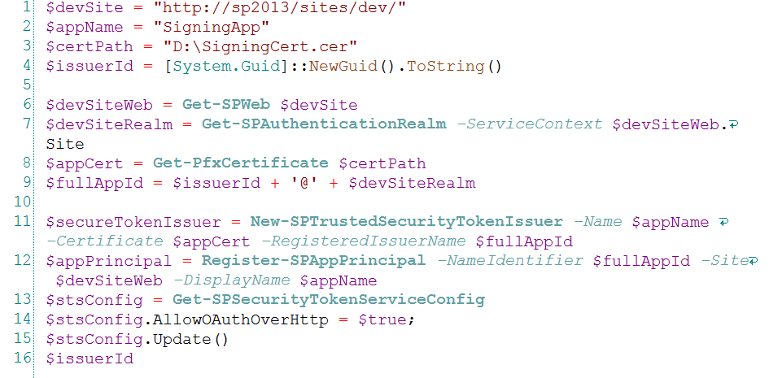
Configuring an S2S Trust

Slide 13
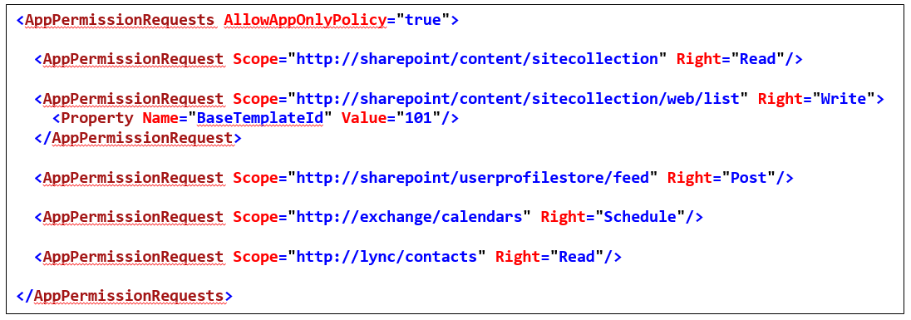
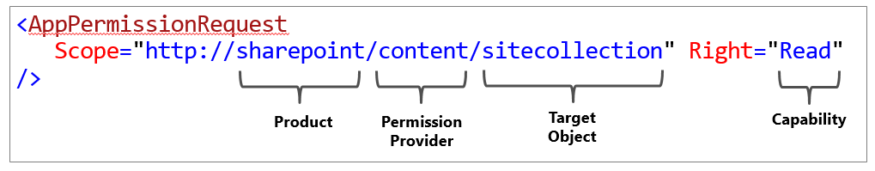
Requesting App Permissions
Notes:
The code on the slide shows some example app permission requests that developers can include in the app manifest file. Use the slide to explain the following concepts: the Right attribute, the Scope attribute, products, permission providers, and target object types.
20488A
10: Developing Remote Hosted SharePoint Apps

Slide 14
Lab A: Configuring a Provider-Hosted SharePoint App
Exercise 1: Configuring An S2S Trust Relationship Exercise 2: Creating a Provider Hosted App
Logon Information
Virtual Machine: 20488A-LON-SP-10
Username: CONTOSO\Administrator
Password: Pa$$w0rd
Estimated Time: 30 minutes
Notes:
Exercise 1: Configuring An S2S Trust Relationship
In order for your provider hosted app to communicate with SharePoint and access resources, you must:
Create an X.509 Certificate for the trust relationship and export the private key in an encrypted file.
Register the Certificate with IIS.
Create a Trusted Token Issuer in the SharePoint farm.
Create an App Principal for the app.
In this exercise, you will complete these tasks by adding key lines of code to PowerShell scripts. You will then execute the scripts in order to configure the trust relationship
Exercise 2: Creating a Provider Hosted App
The PowerShell scripts you completed and executed have created all the required elements for the S2S trust to function. In this exercise, you will create a new provider hosted app and configure it to use the trust relationship. You will also add a permission request to the app and write code that retrieves some simple data from the host web.
20488A
10: Developing Remote Hosted SharePoint Apps

Slide 15
Lab Scenario
The finance team at Contoso stores sales ledgers and purchase ledgers for different regions in separate lists within the finance team site. Invoices are issued and paid in local currency, so each ledger entry is stored with a region. Entries in the Regions list store the currency and exchange rate for each region. The chief financial officer wants to be able to view and compare sales ledger and purchase ledger balances for each region in one place. Your task is to implement this functionality in a provider-hosted app. In this lab you will configure trust relationships and configure the app settings. In the next lab, you will develop the functionality of the app.
Notes:
20488A
10: Developing Remote Hosted SharePoint Apps

Slide 16
Lab Review
The certificate you created and used in this lab to configure the S2S trust relationship is not suitable for a completed provider hosted app that is published to the Office Store. Why is this? In the default code for the Contoso Ledgers app, what method on the TokenHelper class is used to obtain the client context object?
Notes:
Question
The certificate you created and used in this lab to configure the S2S trust relationship is not suitable for a completed provider hosted app that is published to the Office Store. Why is this?
Answer
The certificate you created and used in this lab is not trusted by all users of the Office Store.
Question
In the default code for the Contoso Ledgers app, what method on the TokenHelper class is used to obtain the client context object?
Answer
The default code uses the TokenHelper.GetS2SClientContextWithWindowsIdentity() method to obtain the client context object.
20488A
10: Developing Remote Hosted SharePoint Apps

Slide 17
Lesson 3: Developing Remote-Hosted Apps
Choosing Technologies Coding Security Requirements The Chrome Control Demonstration: Using the Chrome Control
Notes:
20488A
10: Developing Remote Hosted SharePoint Apps

Slide 18
Choosing Technologies
Server-Side Technologies
Non Microsoft Technologies
ASP.NET
Web Pages
Web Forms
MVC
Server-Side Calls to SharePoint
Managed CSOM
REST API
Client-Side Call to SharePoint
JavaScript CSOM
REST API
Notes:
20488A
10: Developing Remote Hosted SharePoint Apps

Slide 19
Coding Security Requirements
Token Types
Context Tokens
Access Tokens
Refresh Tokens
Using the TokenHelper Class
Accessing the context token
Obtaining an access token and including it in subsequent requests
Notes:
20488A
10: Developing Remote Hosted SharePoint Apps

Slide 20
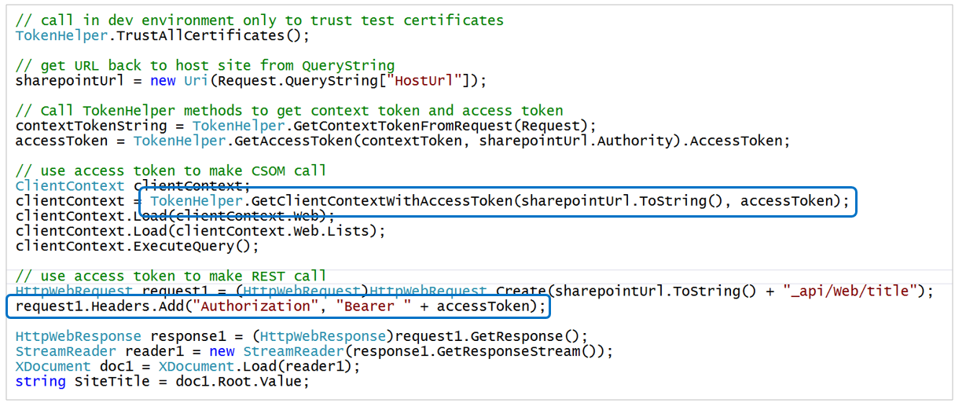

Slide 21
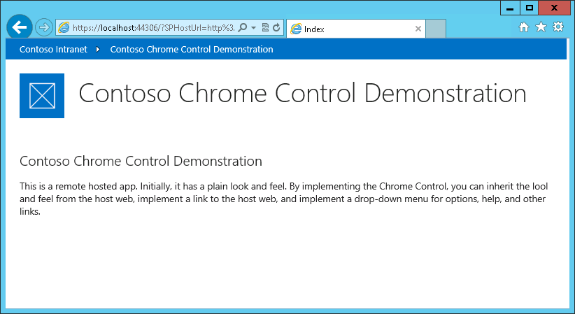
The Chrome Control
Use the Chrome Control to inherit style and links from the host web.
Notes:
20488A
10: Developing Remote Hosted SharePoint Apps

Slide 22
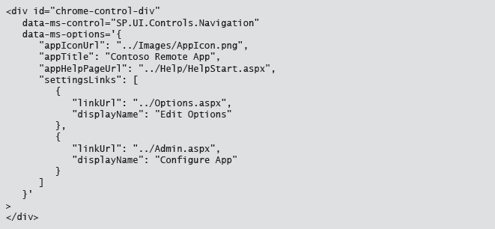
Chrome Options

Slide 23
Demonstration: Using the Chrome Control
In this demonstration, you will see how to:
Include the Chrome Control script file in a remote web project
Link to the Chrome Control script file in an MVC template view
Set options for the Chrome Control in JavaScript
Render the Chrome Control in JavaScript
Notes:
Preparation Steps
Start the 20488A-LON-SP-10 Virtual Machine, if not already running.
Log in as CONTOSO\Administrator, with a password of Pa$$w0rd.
Start File Explorer, and browse to E:\Democode\Starter\ChromeControlDemo.
Double-click ChromeControlDemo.sln.
In the How do you want to open this type of file (.sln)? dialog box, click Visual Studio 2012.
Demonstration Steps
On the DEBUG menu, click Start Debugging.
In the Security Alert dialog box, click Yes.
In the Security Warning dialog box, click Yes.
In the Do you trust Chrome Control Demo? page, click Trust It.
Note: SharePoint displays the remote hosted app. Notice that no links are displayed and there is a plain look and feel.
Close Internet Explorer.
In the Solution Explorer pane, in the ChromeControlDemoRemoteWeb project, right-click Scripts, point to Add, and then click Existing Item.
In the Add Existing Item dialog box, browse to C:\Program Files\Common Files\microsoft shared\Web Server Extensions\15\TEMPLATE\LAYOUTS.
In the list of files, click sp.ui.controls.js, and then click Add.
Expand the Views folder, expand the Shared folder, and then double-click _Layout.cshtml.
Locate the following line of code:
<script type="text/javascript" src="~/Scripts/App.js"></script>
20488A
10: Developing Remote Hosted SharePoint Apps
(More notes on the next slide)

Slide 24
Lab B: Developing a Provider-Hosted SharePoint App
Exercise 1: Working with SharePoint Data Exercise 2: Using the Chrome Control
Logon Information
Virtual Machine: 20488A-LON-SP-10
Username: CONTOSO\Administrator
Password: Pa$$w0rd
Estimated Time: 30 minutes
Notes:
Exercise 1: Working with SharePoint Data
You have created a very simple provider hosted app with a functioning S2S trust relationship. The app displays two item counts from SharePoint lists in the host web. In this exercise, you will extend this simple app to display sales totals and purchase totals in both local currencies and US dollars. This summary will be helpful to company executives. The app will calculate totals according to the contents of three lists in the host web:
Regions. This list stores currency regions in which Contoso operates. For each item, the list stores the name of the region, the name of the local currency and the exchange rate against US dollars.
Sales Ledger. This list stores individual sales items for every region. Sales staff record details that include the customer and the amount for the sale in their local currency. They also choose a region from the Regions list.
Purchase Ledger. This list stores individual purchases for every region. Buyers record the supplier name and the amount in their local currency. They also choose a region.
The app will use the amounts and the exchange rates from the Regions list to total sales and purchases in US dollars.
Exercise 2: Using the Chrome Control
You have built an application that displays and summarizes data from three lists in the host web. The app uses an S2S trust relationship to authenticate with SharePoint. However the app currently has a plain look and feel that does not blend with the host web. In this exercise, you will fix this problem by implementing the Chrome Control in your app.
20488A
10: Developing Remote Hosted SharePoint Apps

Slide 25
Lab Scenario
Now that you have created a server-to-server trust relationship and configured your app settings, you can start to add functionality to your app. The app must sum ledger balances for each region, convert all balances into US Dollars, and present a summary of the information. You want to ensure that the app inherits the look and feel of the host web and so you have decided to implement the Chrome Control.
Notes:
20488A
10: Developing Remote Hosted SharePoint Apps

Slide 26
Lab Review
The Contoso Ledgers app you created accessed data in the host web and displayed it to the user. If you created the necessary lists in the app web, what changes could you make to your code?
Notes:
Question
The Contoso Ledgers app you created accessed data in the host web and displayed it to the user. If you created the necessary lists in the app web, what changes could you make to your code?
Answer
You would not need to add <AppPermissionRequest> elements to the app manifest file if the app only accessed lists in the app web.
20488A
10: Developing Remote Hosted SharePoint Apps

Slide 27
Module Review and Takeaways
Review Question(s) Best Practice
Notes:
Review Question(s)
Question
You have noticed that many of the Office 365 customers in your industry want extra customer relationship management functionality in their SharePoint online tenancy. You decide to build an app to satisfy these specialized requirements. What hosting model is easiest for you to build?
Answer
An autohosted app is the easiest type of app to build
Question
True or False: The Chrome Control can only be used with provider hosted apps
( )False
( )True
Answer
(√)False
( )True
Question
You are building a provider hosted app, which you want to publish to the Office Store. You want customers with on-premise SharePoint farms to be able to use your app and you do not want to use a Windows Azure account. How should you configure authentication?
( )Option 1: You do not need to configure authentication because each user's SharePoint account can be used to access all resources.
( )Option 2: Use OAuth authentication with an X.509 certificate to create the trust relationship.
( )Option 3: Use S2S authentication with an X.509 certificate to create the trust relationship.
( )Option 4: Use an isolated SQL Database for authentication with an X.509 certificate to create the trust relationship
20488A
10: Developing Remote Hosted SharePoint Apps
(More notes on the next slide)

Slide 28
Notes:
( )Option 5: Use OAuth authentication with the ACS service, which has a default trust relationship with Office 365
Answer
(√) Option 3: Use S2S authentication with an X.509 certificate to create the trust relationship.
Best Practice: Use the Chrome Control whenever you want your app to blend with the host web's look and feel. You cannot be sure that the host web will always use the familiar SharePoint look and feel so, if you hardcode the usual SharePoint design into your app, the app may not look like the customer's host web. The Chrome Control avoids this problem by downloading the style sheet and headers elements from the host web at run time.
Best Practice: If you want to use an S2S trust relationship with a provider hosted app, purchase an X.509 certificate from a globally-trusted certificate authority. If you use a certificate you created yourself, customers see error messages and warnings when they install your app that discourage them from proceeding with the installation.
20488A
10: Developing Remote Hosted SharePoint Apps

