Slide 1
Module 10
Publishing and Distributing Apps
Notes:
20488A
11: Publishing and Distributing Apps

Slide 2
Module Overview
Understanding the App Management Architecture Understanding App Packages Publishing Apps Installing, Updating, and Uninstalling Apps
Notes:
20488A
11: Publishing and Distributing Apps

Slide 3
Lesson 1: Understanding the App Management Architecture
Service Applications for App Management Publishing Locations
Notes:
20488A
11: Publishing and Distributing Apps

Slide 4
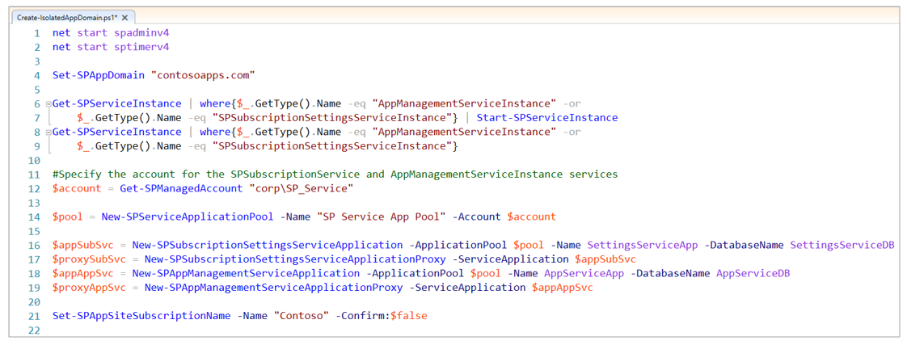
Service Applications for App Management
The App Management Service
Create by using Central Administration or PowerShell
The Site Subscription Settings Service
Create by using PowerShell
Notes:
20488A
11: Publishing and Distributing Apps

Slide 5
Publishing Locations
App Packages are published in:
The Office Store
For global access
An App Catalog
For access from the same web application
Notes:
20488A
11: Publishing and Distributing Apps

Slide 6
Lesson 2: Understanding App Packages
App Package Format Packages for Remote Hosted Apps Demonstration: Exploring an App Package
Notes:
20488A
11: Publishing and Distributing Apps

Slide 7
App Package Format
Common App Package Contents
AppManifest.xml
Required for all apps
AppIcon.png
Recommended for all apps
App Web Solution
Required for SharePoint hosted apps
Optional for remote hosted apps
Host Web Features
Optional for all apps
Notes:
20488A
11: Publishing and Distributing Apps

Slide 8
Packages for Remote Hosted Apps
SharePoint Hosted App
Package
Autohosted App
Package
Provider Hosted App Package
App Manifest
App Icon
Solution Package:
Web Pages
Scripts
SharePoint Items
App Manifest
App Icon
Web Deploy Package
Remote Web
Data Tier Application Package
Database
App Manifest
App Icon
Notes:
20488A
11: Publishing and Distributing Apps

Slide 9
Demonstration: Exploring an App Package
In this demonstration, you will see how to:
Explore the contents of a SharePoint app package by renaming the .app file.
Explore the contents of a solution file within an app package by renaming the .wsp file
The app package explored in this demonstration is for a SharePoint hosted app.
Notes:
Preparation Steps
Start the 20488A-LON-SP-11 Virtual Machine, if not already running.
Log in as CONTOSO\Administrator, with a password of Pa$$w0rd.
Open File Explorer, and browse to E:\Democode.
Demonstration Steps
In File Explorer, right-click SiteSuggestionsApp.app, and then click Rename.
Select the file extension .app, type .zip, and then press Enter.
In the Rename dialog box, click Yes.
Right-click SiteSuggestionsApp.zip, and then click Extract All.
In the Extract Compressed (Zipped) Folder dialog box, click Extract.
Double-click AppIcon.png.
Note: Windows Photo Viewer displays the app icon file.
Switch to File Explorer.
Right-click AppManifest.xml, point to Open with, and then click Microsoft Visual Studio 2012.
Note: Visual Studio displays the contents of the app manifest.
Switch to File Explorer.
Right-click SiteSuggestionsApp.wsp, and then click Rename.
Select the file extension .wsp, type .cab, and then press Enter.
In the Rename dialog box, click Yes.
Double-click SiteSuggestionsApp.cab.
Right-click Feature.xml, and then click Extract.
20488A
11: Publishing and Distributing Apps
(More notes on the next slide)

Slide 10
Lesson 3: Publishing Apps
The Publishing Wizard Publishing to the Office Store Publishing to an App Catalog
Notes:
20488A
11: Publishing and Distributing Apps

Slide 11
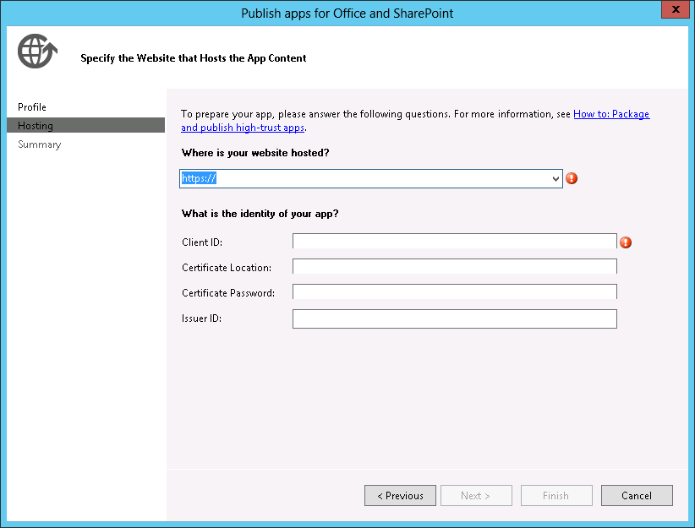
The Publishing Wizard
Notes:
20488A
11: Publishing and Distributing Apps

Slide 12
Publishing to the Office Store
The Office Store is a global catalog of apps for SharePoint, Office, and Azure
A Dashboard Seller Account is required
Upload you apps and provide:
A title
A version number
A description
A category
A logo
Screenshots
Microsoft tests and approves the quality of all apps
https://sellerdashboard.microsoft.com/Registration
Notes:
20488A
11: Publishing and Distributing Apps

Slide 13
Publishing to an App Catalog
You can use an App Catalog to publish an app to the users of a single tenancy or web application
Use Central Administration to create a new App Catalog site
Upload app package files to the app catalog and complete the metadata to publish apps
Notes:
20488A
11: Publishing and Distributing Apps

Slide 14
Lab A: Publishing an App to a Corporate Catalog
Exercise 1: Creating an App Catalog Exercise 2: Creating an App Package Exercise 3: Publishing an App Package
Logon Information
Virtual Machine: 20488A-LON-SP-11
Username: CONTOSO\Administrator
Password: Pa$$w0rd
Estimated Time: 30 minutes
Notes:
Exercise 1: Creating an App Catalog
Before you can publish an app in your SharePoint farm, you must create an app catalog in which to publish it. In this exercise, you will create the catalog.
Exercise 2: Creating an App Package
In this exercise, you will create a new package for the Site Suggestions app.
Exercise 3: Publishing an App Package
Now that you have an app catalog and an app package, you can publish the package in the app catalog. When this process is complete, users can see and install your app in their host webs.
20488A
11: Publishing and Distributing Apps

Slide 15
Lab Scenario
The Site Suggestions app that you developed earlier in this course is now ready to be distributed on the Contoso intranet. To ensure that everything goes smoothly, you want to run through the publishing process. In this lab, you will create a new app catalog on your development machine and publish the Site Suggestions app to it.
Notes:
20488A
11: Publishing and Distributing Apps

Slide 16
Lab Review
Where does the app catalog look for the version number of the app you upload? A developer, working on a new app for the marketing department, has shown a user the latest features of the app, which is approaching completion. The user wants to install the app in the marketing site but when he clicks add an app he cannot find the app in any of the lists. What should you tell the user?
Notes:
Question
Where does the app catalog look for the version number of the app you upload?
Answer
In the app manifest file.
Question
A developer, working on a new app for the marketing department, has shown a user the latest features of the app, which is approaching completion. The user wants to install the app in the marketing site but when he clicks add an app he cannot find the app in any of the lists. What should you tell the user?
Answer
Tell the user that the app is not yet published and so cannot yet be located in the app catalog or installed in a site.
20488A
11: Publishing and Distributing Apps

Slide 17
Lesson 4: Installing, Updating, and Uninstalling Apps
App Installation Updating an App Uninstalling Apps
Notes:
20488A
11: Publishing and Distributing Apps

Slide 18
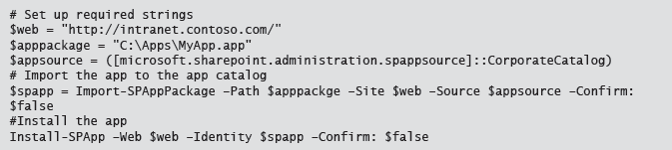
App Installation
Installation procedures
Installation permissions
Agreement to Permission Requests
Installation with PowerShell:
Notes:
20488A
11: Publishing and Distributing Apps

Slide 19
Updating an App
Upgrades are based on the version number in the app manifest
Upgrades are voluntary
Upgrades are simplified because SharePoint hosted apps and autohosted apps are self-contained
For provider hosted apps ensure that the remote web supports both old and new versions
Notes:
20488A
11: Publishing and Distributing Apps

Slide 20
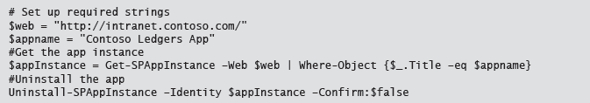
Uninstalling Apps
When you remove an app the app web is deleted
Shortcuts and the app identifier are deleted so permission no longer apply
Remote webs are not deleted
You can use PowerShell to remove apps:
Notes:
20488A
11: Publishing and Distributing Apps

Slide 21
Lab B: Installing, Updating, and Uninstalling Apps
Exercise 1: Installing an App Exercise 2: Upgrading an App Exercise 3: Removing an App
Logon Information
Virtual Machine: 20488A-LON-SP-11
Username: CONTOSO\Administrator
Password: Pa$$w0rd
Estimated Time: 30 minutes
Notes:
Exercise 1: Installing an App
In this exercise, you will install the Site Suggestions app from the app catalog. You will also verify that the app works as expected and installs the resources you expect in the SharePoint app web.
Exercise 2: Upgrading an App
The development team have completed the voting functionality for the Site Suggestions app. You want to deploy this new version for all users and enable them to upgrade from version 1.0.0.1 of the app.
Exercise 3: Removing an App
You are happy with the install and update process for the site suggestions app. In this exercise, you will remove the site suggestions app from the app catalog and remove the deployed instance of the site suggestions app.
20488A
11: Publishing and Distributing Apps

Slide 22
Lab Scenario
Before you release the Site Suggestions app, you want to ensure that the install and uninstall processes work as expected. In this lab, you will install the app on a local SharePoint site. You will then update the app and ensure that the experience for end users is seamless. Finally, you will uninstall the app and verify that it is removed cleanly.
Notes:
20488A
11: Publishing and Distributing Apps

Slide 23
Lab Review
The Site Suggestions app is a SharePoint-hosted app. When a user installs the app, where does the app create resources? When you remove an app from the app catalog, what happens to the deployed instances of that app?
Notes:
Question
The Site Suggestions app is a SharePoint-hosted app. When a user installs the app, where does the app create resources?
Answer
The app creates an app web and places all resources in that app web.
Question
When you remove an app from the app catalog, what happens to the deployed instances of that app?
Answer
Nothing. Deployed instances of the app are not removed when an app is removed from the app catalog. However, new instances of the app cannot be installed
20488A
11: Publishing and Distributing Apps

Slide 24
Module Review and Takeaways
Review Question(s) Best Practice
Notes:
Review Question(s)
Question
You have been hired by a firm of lawyers to create a specialized document management SharePoint app. The app is SharePoint hosted and enables users to track the progress of cases through multiple courts. Should you publish the app in an app catalog or the Office Store?
Answer
You should consider publishing the app in both an app catalog and the Office Store.
Question
True or False: To remove prevent any further use of an app, you can remove it from the app catalog or Office Store.
( )False
( )True
Answer
(√)False
( )True
Question
Which of the following service applications must be in place for you to publish and deploy apps from an app catalog?
( )Option 1: The Application Discovery and Load Balancer Service
( )Option 2: The Site Subscription Settings Service
( )Option 3: The Managed Metadata Service
( )Option 4: The Secure Store Service
20488A
11: Publishing and Distributing Apps
(More notes on the next slide)

