Slide 1
Module 12
Managing Taxonomy
Notes:
Throughout the module, code examples illustrate both server-side and client-side approaches to performing particular tasks. It is not possible to describe how to perform every task using every client-side object model, so the JavaScript object model is used throughout as representative of the client-side approach.
20488A
13: Managing Taxonomy

Slide 2
Module Overview
Managing Taxonomy in SharePoint 2013 Working with Content Types Working with Advanced Features of Content Types
Notes:
20488A
13: Managing Taxonomy

Slide 3
Lesson 1: Managing Taxonomy in SharePoint 2013
Understanding Taxonomy in SharePoint Creating Site Columns Declaratively Creating Site Columns Programmatically Retrieving and Editing Site Columns Working With Lookup Fields Discussion: Using Lookup Fields
Notes:
20488A
13: Managing Taxonomy

Slide 4
Understanding Taxonomy in SharePoint
A taxonomy is a system of classification
In SharePoint, taxonomy is closely associated with metadata
Building blocks:
Site columns
Content types
Term sets
Notes:
Use this topic to ensure students are familiar with the concepts of taxonomy and metadata. Emphasize that taxonomy is defined by the information architecture of the SharePoint deployment. Site columns, content types, and term sets are simply building blocks that are used to implement the information architecture.
Talk through the concepts, and relevance, of site columns, content types, and term sets. If required, remind students that columns are referred to as fields in the object model.
Note: A term set is a hierarchical set of terms that is typically maintained by one or more term set administrators. Term sets can also be open, which enables any user to add new terms by typing in a combo box.
The rest of this module covers working with site columns and content types programmatically. Manipulating managed metadata term sets programmatically is beyond the scope of this course and is covered in the sister course 20489: Advanced Solutions of Microsoft SharePoint Server 2013.
20488A
13: Managing Taxonomy

Slide 5
Creating Site Columns Declaratively
Define a Field element within an element manifest
Deploy in a web-scoped feature
Deploy using apps or solutions
<Field ID="{f02f0407-ed85-463d-bca6-61ba79b5f74e}"
Name="LeadChemist"
DisplayName="Lead Chemist"
Type="User"
UserSelectionMode="0"
Required="TRUE"
Group="Contoso Columns">
</Field>
Notes:
Briefly discuss the rationale for site columns (reusability and consistency) before describing how to create them.
Walk through the examples in the student handbook, to illustrate how different attributes and child elements apply to different field types. Encourage students to consult the schema documentation when they are creating site columns.
Emphasize that although site columns are always web-scoped, you can make a site column available across a site collection by deploying it to the root web.
Remind students that if you use an app to deploy a site column (or any other declarative component), the column will be provisioned on the app web and not on the host web.
20488A
13: Managing Taxonomy

Slide 6
Creating Site Columns Programmatically
Add new fields to a field collection
Site columns: SPWeb.Fields
List columns: SPList.Fields
From server-side code:
SPFieldCollection.Add
SPFieldCollectionAddFieldAsXml
From client-side code:
FieldCollection.AddFieldAsXml
Notes:
Talk briefly about when you might want to create site columns programmatically rather than declaratively. Subsequent slides include illustrative examples of server-side and client-side approaches.
Note: This topic includes two additional slides. The additional slides are not reproduced in the student handbook. However, the topic content in the student handbook includes all the material shown on the additional slides.
20488A
13: Managing Taxonomy

Slide 7
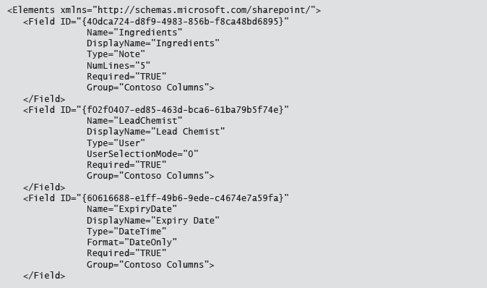
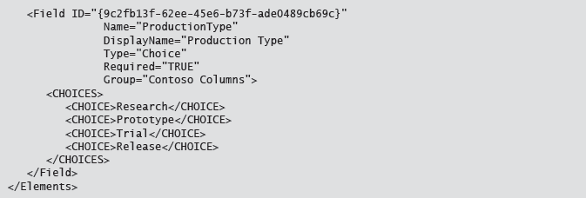
Site Colums Declarative

Slide 8
Creating Site Columns in Server-Side Code
var site = SPContext.Current.Site;
var web = site.RootWeb;
// Get the SPFieldCollection for the root web.
var fields = web.Fields;
// Add a new date field.
var fieldExpiryDate = new SPFieldDateTime(fields, SPFieldType.DateTime.ToString(), "Expiry Date");
fieldExpiryDate.StaticName = "ExpiryDate";
fieldExpiryDate.DisplayFormat = SPDateTimeFieldFormatType.DateOnly;
fieldExpiryDate.Group = "Contoso Columns";
fieldExpiryDate.Required = true;
fieldExpiryDate.Update();
fields.Add(fieldExpiryDate);
Notes:
Walk through the code example, drawing attention to the following points:
When you create a new SPField object (all derived classes), you need to specify the collection that will host the new field.
Field classes typically include two overloads: one that requires a type name (as in this example), and one that does not. You use the constructor that requires a type name when you want to create a new field, whereas you use the constructor that does not require a type name when you want to instantiate an existing field.
You must call the Update method after setting property values on the new field. Otherwise, the field will be created but the property values will not be persisted.
Even though you specified a field collection when you created the SPField object, you still need to call the SPFieldCollection.Add method to add the field to the collection.
20488A
13: Managing Taxonomy

Slide 9
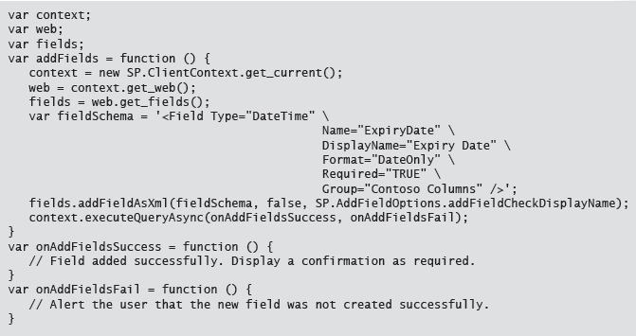
Creating Site Columns in JavaScript
Notes:
Walk through the code example. Point out that the SP.FieldCollection.addFieldAsXml method includes three parameters:
The field schema, which should be a fully-formed CAML Field element in a string.
A Boolean value, which indicates whether you want to add the field to the default view. This only applies if you were adding the field to a list, so it makes no difference in this example.
An SP.AddFieldOptions enumeration value. You can use bitwise combinations of values to specify multiple options.
20488A
13: Managing Taxonomy

Slide 10
Retrieving and Editing Site Columns
Use the following high-level process to retrieve and update site columns:
Retrieve the field from a field collection and cast to an appropriate type.
Update field properties as required.
Call the Update method to persist changes.
Notes:
Describe the high-level process, which applies to both server-side and client-side code. Subsequent slides include illustrative examples of server-side and client-side approaches.
Note: This topic includes two additional slides. The additional slides are not reproduced in the student handbook. However, the topic content in the student handbook includes all the material shown on the additional slides.
20488A
13: Managing Taxonomy

Slide 11
Retrieving and Editing Site Columns in Server-Side Code
var site = SPContext.Current.Site;
var web = site.RootWeb;
var fields = web.Fields;
var fieldProductionType = fields["Production Type"] as
SPFieldChoice;
fieldProductionType.Choices.Clear();
fieldProductionType.Choices.Add("Phase 1 Trial");
fieldProductionType.Choices.Add("Phase 2 Trial");
fieldProductionType.Choices.Add("Phase 3 Trial");
fieldProductionType.Choices.Add("Production");
fieldProductionType.Update(false);
Notes:
Walk through the code example, drawing attention to the following points:
You start by retrieving the field from a field collection (in this case, the site columns on the root web) and casting it to an appropriate type (in this case, SPFieldChoice).
When you have finished making changes, call the Update method to persist the changes to the content database.
You can include a Boolean argument when you call the Update method. If you specify true, any changes to the site column will be cascaded down to existing list columns. If you specify false, any changes to the site column will only apply to new instances of the column.
20488A
13: Managing Taxonomy

Slide 12
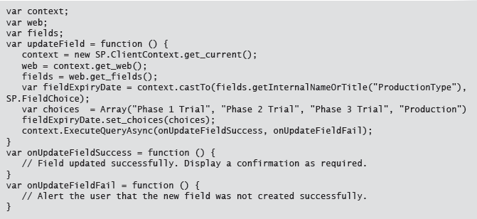
Retrieving and Editing Site Columns in Client-Side Code
Notes:
Walk through the code example, drawing attention to the following points:
The high-level process for retrieving and editing site columns in JavaScript is broadly the same as the server-side code approach.
First you retrieve the field from the collection and cast it to an appropriate type—in this case, SP.FieldChoice.
When you have finished making changes, call the update method to persist the changes to the content database. However, as with all client-side operations, the update actually takes place when you submit the operation to the server by using the ClientContext.ExecuteQueryAsync method.
20488A
13: Managing Taxonomy

Slide 13
Working With Lookup Fields
Use lookup fields to create list relationships
Conceptually similar to foreign keys in relational databases
Enables sophisticated query construction
<Field ID="{7fce20b8-9b48-4672-b4c2-011241766c0d}"
Name="ProgramsLookup"
DisplayName="Programs"
Type="Lookup"
List="Lists\Programs"
ShowField="ProgramName"
Overwrite="true"
Group="Contoso Columns">
</Field>
Notes:
Ensure students fully understand the concepts behind lookup fields, and then walk through the example. Explain the purpose of the List attribute and the ShowField attribute.
Mention that you can create a lookup field as a site column, but the list that the lookup field points to must already exist when you create the lookup field.
20488A
13: Managing Taxonomy

Slide 14
Discussion: Using Lookup Fields
In what scenarios might you use lookup fields?
Notes:
Prompt the students to suggest scenarios in which lookup fields might be appropriate. Lookup fields are generally useful when you want to reference data that already exists elsewhere in SharePoint lists, or for modeling any kind of master-detail relationship using SharePoint lists. Orders and Order Lines is the classic example.
Steer students away from using lookup fields as a dynamic alternative to choice fields. In these types of scenarios, a managed metadata term set is almost always a better approach. For example, creating a list of paint colors and then using a lookup field to surface the available colors in other lists would work, but a better approach would be to create a central term set of colors and use a managed metadata column.
20488A
13: Managing Taxonomy

Slide 15
Lesson 2: Working with Content Types
Creating Content Types Declaratively Understanding Content Type IDs Demonstration: Using the Visual Studio 2012 Content Type Designer Working with Content Types in Code Adding Content Types to Lists
Notes:
20488A
13: Managing Taxonomy

Slide 16
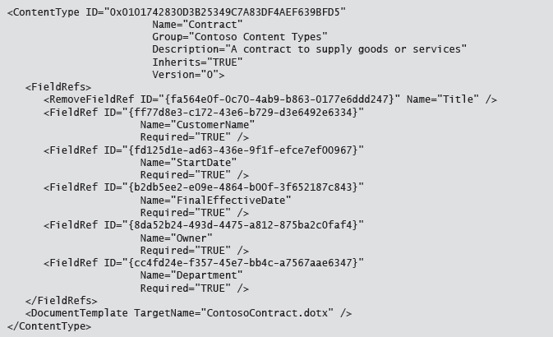
Creating Content Types Declaratively
Use the ContentType element to define:
Metadata
Document template
Custom forms
Notes:
Recap the rationale behind content types very briefly: this was covered in an earlier module.
Review the structure of the ContentType element. Draw attention to the following key points:
Mention that you will talk more about the ID attribute in the next topic.
The Inherits attribute determines whether the content type inherits fields from its parent content type.
The Version attribute should always equal 0. This attribute is reserved for future use.
Use a RemoveFieldRef child element to remove an inherited field.
Use a FieldRef child element to add a field to the content type. The field can be an existing site column, or a field defined within the same feature as the content type.
Note that the student handbook contains a more detailed example.
20488A
13: Managing Taxonomy

Slide 17
Understanding Content Type IDs
All content types inherit from a parent
Inheritance is specified through the content type ID
To create a content type ID:
Start with the ID of the parent content type
Append a double-zero
Append a GUID
0x0101
0x010100
0x0101005AF7FDFCE5FD4C359A7AE34DFB008661
Notes:
Briefly describe how content type inheritance is entirely specified through the content type ID, and then use the example on the slide to illustrate how to construct a new content type ID.
20488A
13: Managing Taxonomy

Slide 18
Demonstration: Using the Visual Studio 2012 Content Type Designer
In this demonstration, you will see how to use the Visual Studio 2012 content type designer to build a content type definition.
Notes:
Preparation Steps
You may want to start the virtual machine in advance to save time during the demonstration.
Demonstration Steps
Start the 20488A-LON-SP13 virtual machine.
Log on to the LONDON machine as CONTOSO\Administrator with password Pa$$w0rd.
On the Start screen, type Visual Studio, and then click Visual Studio 2012.
In Visual Studio, on the start page, click New Project.
In the New Project dialog box, in the navigation pane, expand Template, expand Visual C#, expand Office/SharePoint, and then click SharePoint Solutions.
In the center pane, click SharePoint 2013 - Empty Project.
In the Name box, type ContentTypeDemo.
In the Location box, type E:\Democode\, and then click OK.
In the SharePoint Customization Wizard dialog box, in the What site do you want to use for debugging box, type http://team.contoso.com.
Click Deploy as a farm solution, and then click Finish.
In Solution Explorer, right-click the ContentTypeDemo project node, point to Add, and then click New Item.
In the Add New Item - ContentTypeDemo dialog box, click Site Column.
In the Name box, type ClientName, and then click Add.
20488A
13: Managing Taxonomy
(More notes on the next slide)

Slide 19
Working with Content Types in Code
In server-side code:
Create an SPContentType object to represent the content type
Create SPFieldLink objects to represent field references
In client-side code:
Create a ContentTypeCreationInformation object to represent content type properties
Create FieldLinkCreationInformation objects to represent field reference properties
Notes:
Talk briefly about when you might want to create site columns programmatically rather than declaratively. Subsequent slides include illustrative examples of server-side and client-side approaches. Note that the student handbook includes more detailed examples than the slides.
You may want to briefly discuss when declarative approaches or programmatic approaches are preferable.
Note: This topic includes two additional slides. The additional slides are not reproduced in the student handbook. However, the topic content in the student handbook includes all the material shown on the additional slides.
20488A
13: Managing Taxonomy

Slide 20
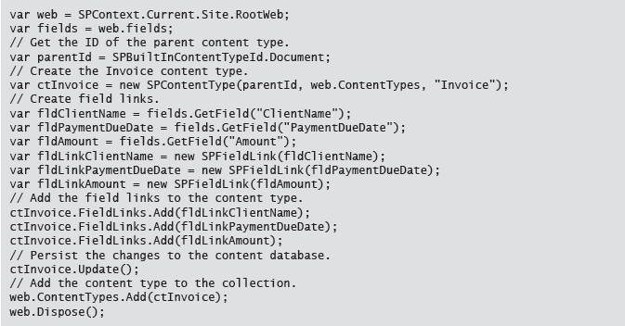
Creating Content Types in Server-Side Code
Notes:
Walk the students through the code example:
You retrieve the ID of the parent content type.
You create a new content type, specifying the parent content type ID, the target content type collection, and the name of the new content type.
You create field links and add them to the content type.
You call the Update method to persist the changes you have made to the new content type.
You add the content type to the target content type collection.
20488A
13: Managing Taxonomy

Slide 21
Creating Content Types in JavaScript
var parent = contentTypes.getById("0x0101");
var ctInfo = new SP.ContentTypeCreationInformation();
ctInfo.set_parentContentType(parent);
ctInfo.set_name("Invoice");
ctInfo.set_group("Contoso Content Types");
var ctInvoice = contentTypes.add(ctInfo);
var fieldLinks = ctInvoice.get_fieldLinks();
var fldAmt = fields.getByInternalNameOrTitle("Amount");
var linkInfo = new SP.FieldLinkCreationInformation();
linkInfo.set_field(fldAmt);
fieldLinks.add(fldLinkInfoAmount);
ctInvoice.update();
Notes:
Walk the students through the code example. Note that the code example on the slide is abridged to maintain readability; the student handbook includes a more comprehensive example. In the code example:
You retrieve the ID of the parent content type.
You create a new SP.ContentTypeCreationInformation object, and use it to specify content type properties.
You call the add method on an SP.ContentTypeCollection object, passing in the ContentTypeCreationInformation object as an argument.
You create SP.FieldLinkCreationInformation objects to represent each field link you want to add to the content type.
To add a field link, you call the add method on an SP.FieldLinkCollection object, passing in the FieldLinkCreationInformation object as an argument.
You call the update method to persist the changes you have made to the new content type.
Mention that as this is client-side code you will also need to execute the query (not shown on the slide).
20488A
13: Managing Taxonomy

Slide 22
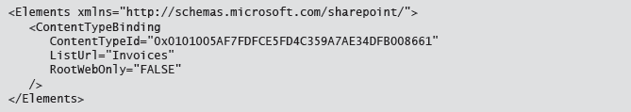
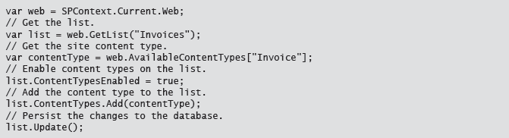
Adding Content Types to Lists
Add content type to list declaratively:
Add content type to list programmatically:
Notes:
Talk the students through the two key approaches.
Declarative approach:
Add a ContentTypeBinding element to an element manifest.
Specify the ID of the site content type and the site-relative URL of the list.
Programmatic approach:
Retrieve the content type from the site’s collection of content types.
Ensure content types are enabled on the list.
Add the content type to the list’s collection of content types.
The client-side approach follows the same approach as the server-side approach, although the code is slightly more long-winded. The student handbook includes an example that uses the JavaScript client-side object model.
Explain that when you add a site content type to a list, the list content type becomes a child of the site content type. In other words, the list content type inherits from the corresponding site content type, and the content type ID of the list content type will reflect this. This concept is important when you update site content types, as you can choose whether to cascade your changes to child content types.
20488A
13: Managing Taxonomy

Slide 23
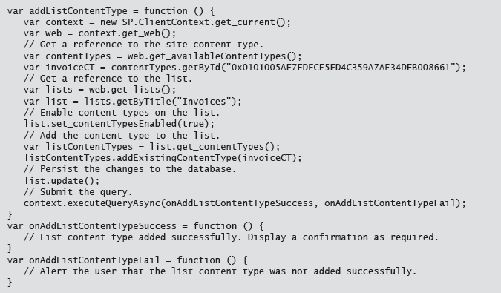
Add Content Type Client Side

Slide 24
Lab A: Working with Content Types
Exercise 1: Create a System to Capture Vacation Requests
Logon Information
Virtual Machine: 20488A-LON-SP-13
User name: CONTOSO\Administrator
Password: Pa$$w0rd
Estimated Time: 30 minutes
Notes:
Point out that you could deploy these declarative components using either a server-side solution or a client-side app. In this case, you use a solution because you want to be able to bind the content type to an event receiver assembly in the next lab.
Exercise 1: Create a System to Capture Vacation Requests
In this exercise, you will create site columns, content types, and a list in a SharePoint solution package. You will then deploy and test the solution.
20488A
13: Managing Taxonomy

Slide 25
Lab Scenario
The HR team at Contoso requires a solution for managing vacation requests. The team already uses a list named Vacation Tracker to maintain a record of the remaining vacation entitlement for each employee. They now want to enable employees to submit requests for vacations by specifying a start date and an end date. Your task is to develop site columns, content types, and a list template to implement this solution.
Notes:
20488A
13: Managing Taxonomy

Slide 26
Lesson 3: Working with Advanced Features of Content Types
Managing Document Templates Configuring Workflow Associations Associating Event Receivers with Content Types
Notes:
20488A
13: Managing Taxonomy

Slide 27

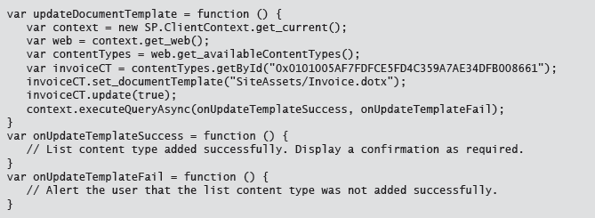
Managing Document Templates
Retrieve the content type
Set the DocumentTemplate property
Call Update(true) to cascade changes to the content type in lists
Notes:
Start by briefly talking about why document templates are useful. This is the example from the student handbook:
For example, if you are creating an invoice, you would be very unlikely to start with a blank document. Instead, you are likely to use an invoice template with formatting and boilerplate text, together with placeholders for amounts, dates, and descriptions. If you associate a template with the Invoice content type, SharePoint will launch the template every time a user creates a new Invoice item from a document library menu.
Mention that although you can specify a document template declaratively when you create a new content type, you can only set the document template for an existing content type by using code.
Walk the students through the code example. The student handbook also includes a JavaScript object model example; the approach is identical but the code is more long-winded.
Consider asking the students where they might use this code. On example might be using a feature to deploy new template documents. In this case, you could use a feature receiver to associate the template documents with content types programmatically.
20488A
13: Managing Taxonomy

Slide 28
Configuring Workflow Associations
Why associate workflows with content types?
Content types represent business content
Workflows represent business processes
Linking the two is logical
High-level process:
Retrieve the workflow template from the site
Create a workflow association for the workflow template
Retrieve the content type from the site
Add the workflow association to the content type
Cascade the changes to list content types
Notes:
Explain why associating workflows with content types, rather than lists, is a good idea. Essentially it enables you to associate a business process with a particular type of business content, regardless of where you use the content type.
Talk briefly about the high-level process for associating a workflow with a content type. Ensure students are comfortable with what you mean by a workflow template and what you mean by a workflow association. Subsequent slides provide server-side and client-side examples.
Note: This topic includes two additional slides. The additional slides are not reproduced in the student handbook. However, the topic content in the student handbook includes all the material shown on the additional slides.
20488A
13: Managing Taxonomy

Slide 29
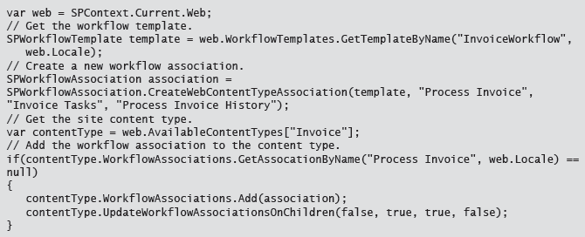
Creating Workflow Associations in Server-Side Code
Notes:
Talk the students through the code example. The student handbook includes a more verbose version of the code example.
Explain that the SPContentType.UpdateWorkflowAssociationsOnChildren method is used to apply the workflow association to list content types that are based on this site content type. The four Boolean parameters represent the following:
The first Boolean parameter specifies whether you want to mark all child content types as changed.
The second Boolean parameter specifies whether you want to update workflow associations on site content types that derive from this content type.
The third Boolean parameter specifies whether you want to update workflow associations on list content types that are based on this site content type.
The fourth Boolean parameter specifies whether you want to throw an exception if the operation encounters a content type that is sealed or read-only.
20488A
13: Managing Taxonomy

Slide 30
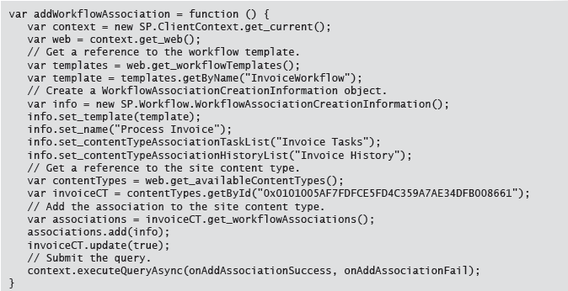
Creating Workflow Associations in Client-Side Code
Notes:
Talk the students through the code example. The code example on the slide is abridged – the student handbook contains a more verbose version, including the call to ClientContext.ExecuteQueryAsync.
20488A
13: Managing Taxonomy

Slide 31
Associating Event Receivers with Content Types
Event receiver class must inherit from SPItemEventReceiver
Add to content type declaratively or programmatically
Declaratively for new content types
Programmatically for new or existing content types
Notes:
Briefly discuss the advantages of adding event receivers to content types, rather than lists, before moving on to the implementation details.
Emphasize that there is nothing special about the event receiver class. You create it and deploy it in exactly the same way as you would for a regular list item event receiver. The difference is purely in the association, in that you add it to a content type rather than a list.
The following slides provide declarative and programmatic examples.
Note: This topic includes two additional slides. The additional slides are not reproduced in the student handbook. However, the topic content in the student handbook includes all the material shown on the additional slides.
20488A
13: Managing Taxonomy

Slide 32
Adding Event Receivers Declaratively
<ContentType ID="0x010100..."
...
<XmlDocuments>
<XmlDocument NamespaceURI="http://...">
<Receivers xmlns:spe="...">
<Receiver>
<Name>InvoiceReceiver</Name>
<Type>ItemAdding</Type>
<SequenceNumber>10050</SequenceNumber>
<Assembly>StrongName</Assembly>
<Class>FullyQualifiedClassName</Class>
<Data></Data>
<Filter></Filter>
</Receiver>
</Receivers>
</XmlDocument>
</XmlDocuments>
</ContentType>
Notes:
Talk through the code example. The student handbook includes a less abridged version.
Explain the purpose of each child element within the Receiver element:
Use the Name element to specify a name that uniquely identifies your event receiver.
Use the Type element to specify which type of event receiver you are defining (for example ItemAdding or ItemUpdated).
Use the SequenceNumber element to specify the order in which your event receivers should execute. Lower numbers are executed before higher numbers. To avoid conflicts with built-in event receivers, you should use an integer value of 10,000 or greater.
Use the Assembly element to specify the strong name of the assembly that contains your event receiver class.
Use the Class element to specify the fully-qualified name of your event receiver class.
20488A
13: Managing Taxonomy

Slide 33
Adding Event Receivers Programmatically
var invoiceCT = web.ContentTypes["Invoice"];
SPEventReceiverDefinition erd =
invoiceCT.EventReceivers.Add();
erd.Assembly = "<Assembly strong name>";
erd.Class = "<Fully-qualified class name>";
erd.Type = SPEventReceiverType.ItemAdding;
erd.Name = "ItemAdding Event Receiver";
erd.Synchronization =
SPEventReceiverSynchronization.Synchronous;
erd.SequenceNumber = 10050;
erd.Update();
invoiceCT.Update(true);
Notes:
Talk through the code example. Emphasize that you need to call the Update method on both the event receiver definition and the content type.
On the final line of code, point out that you call the Update method with an argument value of true to cascade the changes to inherited content types, including list content types.
Ask the students where they might run this code. A common approach is to create an empty site-scoped feature, add a feature receiver class, and use the feature receiver to associate the event receiver with a site content type. Using this approach, you can add the event receiver when the feature is activated and remove it when the feature is deactivated. The second lab in this module demonstrates this approach.
20488A
13: Managing Taxonomy

Slide 34
Lab B: Working with Advanced Features of Content Types
Exercise 1: Creating an Event Receiver Assembly Exercise 2: Registering an Event Receiver with a Site Content Type
Logon Information
Virtual Machine: 20488A-LON-SP-13
User name: CONTOSO\Administrator
Password: Pa$$w0rd
Estimated Time: 45 minutes
Notes:
Certain aspects of this lab may be challenging, particularly for less experienced students, and the timings do not allow much time for debugging and troubleshooting. Remind the students that, in addition to the lab answer key, the E:\Solution folder contains sample solutions for every lab.
Exercise 1: Creating an Event Receiver Assembly
In this exercise, you will create and compile an event receiver class that handles ItemAdding and ItemUpdated events.
Exercise 2: Registering an Event Receiver with a Site Content Type
In this exercise, you will associate your ItemAdding and ItemUpdated event receivers with the Vacation Request content type. To do this, you will create an empty site-scoped feature and add a feature receiver class. Within the feature receiver class, you will add the event receivers to the content type when the feature is activated, and you will remove the event receivers from the content type when the feature is deactivated.
20488A
13: Managing Taxonomy

Slide 35
Lab Scenario
The HR team at Contoso is pleased with the new Vacation Requests list. The team now wants to integrate the Vacation Requests list with the existing Vacation Tracker list:
When a user requests a new vacation booking through the Vacation Requests list, SharePoint should automatically check the Vacation Tracker list to ensure that the user has sufficient vacation days remaining.
If the user does not have sufficient vacation days remaining, SharePoint should prevent the user from submitting the request and display an informative error message.
When a line manager approves a vacation request, SharePoint should automatically update the user's remaining vacation entitlement in the Vacation Tracker list.
When the Vacation Tracker list has been updated, SharePoint should set the status of the vacation request to "Booked". In practice, this functionality might also update a third-party staff scheduling system.
Your task is to use event receivers to implement this functionality. You will use an ItemAdding event receiver to check that a user has sufficient vacation days to cover the request, and you will use an ItemUpdated event receiver to update the Vacation Tracker list when a vacation request is approved. You will then add your event receivers to the Vacation Request content type.
Notes:
20488A
13: Managing Taxonomy

Slide 36
Module Review and Takeaways
Review Question(s)
Notes:
Review Question(s)
Question
Contoso uses two lists to manage invoices. The Invoice list contains general information, such as the name of the client, the billing address, and the due date. The Invoice Items list contains more detailed information on individual invoice lines, such as the product or service and the unit costs. You want to link the two lists. How should you proceed?
Question
What are the advantages of creating a content type programmatically, rather than declaratively?
Question
You have added a workflow association to a site content type. How do you ensure that the workflow association is also applied to list content types?
20488A
13: Managing Taxonomy

