Slide 1
Module 13
Managing Custom Components and Site Lifecycles
Notes:
20488A
7: Managing Custom Components and Site Lifecycles

Slide 2
Module Overview
Component Overview Defining Custom Lists Defining Custom Sites Managing SharePoint Sites
Notes:
20488A
7: Managing Custom Components and Site Lifecycles

Slide 3
Lesson 1: Component Overview
The Component Hierarchy Site Columns Site Content Types List Columns and Content Types
Notes:
20488A
7: Managing Custom Components and Site Lifecycles

Slide 4
The Component Hierarchy
Farm
Services
Web application
Site Collection
Site
Site columns
Site content types
List/Library
List columns
List content types
List item
Field
Notes:
This topic should be a recap for the students as they should already be aware of the SharePoint hierarchy.
20488A
7: Managing Custom Components and Site Lifecycles

Slide 5
Site Columns
Definition not implementation
Scopes
Site Collection
Site
Properties
Display name
Internal name
Data type
Group
Required
Create declaratively, by using the object model, or by using the SharePoint UI
Notes:
Ensure that students understand that a site column defines a definition of a column, rather than an implementation. Ensure they understand that they can add a site column to a list to provide an implementation of that column. List columns, content types and list-scoped content types are covered later in this lesson, so you should avoid in-depth discussion of them at this point.
20488A
7: Managing Custom Components and Site Lifecycles

Slide 6
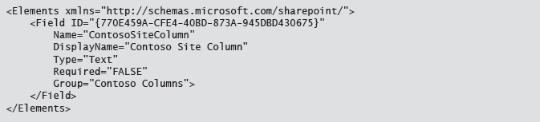
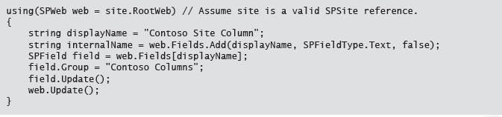
Site Columns

Slide 7
Site Content Types
Collection of columns
Definition not implementation
Scopes
Site collection
Site
Hierarchical
Item
Announcement
Document
Folder
Custom
Create declaratively, by using the object model, or by using the SharePoint UI
Notes:
Explain to students how the content type ID is used to track inheritance by using the format ParentID00ChildID, ParentID00ChildID00GrandchildID etc.
20488A
7: Managing Custom Components and Site Lifecycles

Slide 8
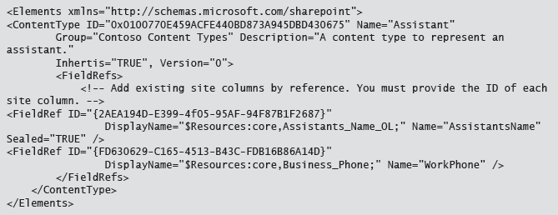
Content Types

Slide 9
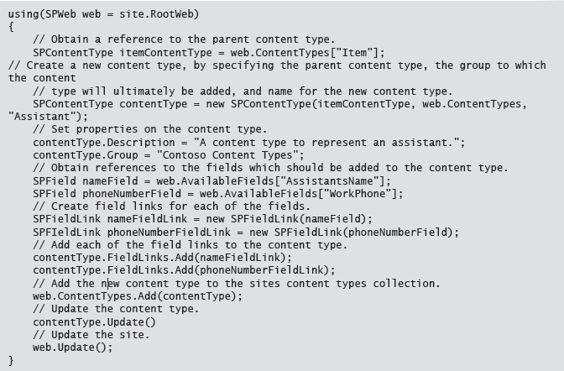
Content Types

Slide 10
List Columns and Content Types
Site
Site Column
Site Content Type
List
List Column
Copy of site column
Standalone list column
List Content Type
Inherits from Site Content Type
Notes:
The key point from this topic is that when you add a column or a content type to a list, SharePoint creates a copy of each of these rather than adding them directly. In the case of a content type, the new list-scoped content type inherits from the site-scoped content type, therefore maintaining a link which enables future updates.
20488A
7: Managing Custom Components and Site Lifecycles

Slide 11
Lesson 2: Defining Custom Lists
Introduction to List Templates Developing List Templates The Visual Studio List Designer Discussion Question Provisioning Lists
Notes:
20488A
7: Managing Custom Components and Site Lifecycles

Slide 12
Introduction to List Templates
Define list template
Content types
Fields
Views
Forms
Create list instance
Declarative (Feature)
Programmatic (SharePoint object model)
Notes:
This topic is intended only as an introduction to list templates. Do not spend too long on this topic; if students have questions on how to perform these tasks explain that the details are covered in the remaining topics in this lesson, and then take questions at the end of the lesson.
20488A
7: Managing Custom Components and Site Lifecycles

Slide 13
Developing List Templates
List template Feature
Feature.xml file (in the root of the Feature folder)
Manifest.xml file (optionally in a sub-folder, can have any name, but must be referenced in Feature.xml file)
ListName folder (determined by the value of the Name attribute of the ListTemplate element in the manifest)
Schema.xml file
Manifest.xml
<Elements>
<ListTemplate>
Schema.xml
<List>
<MetaData>
<ContentTypes>
<Fields>
<Views>
<Forms>
Notes:
This topic should introduce the process for creating a new list template. You should explain that students must use a Feature to develop a list template. Describe the folder structure, emphasizing the importance of adding the schema.xml file in a sub-folder which has the same name as the value of the Name attribute of the ListTemplate element in the element manifest file. You could ask students if they have any specific queries about developing a list template, but it is beyond the scope of this topic, and the time restrictions of the course to go into detail about each of the elements in the schema.xml file.
20488A
7: Managing Custom Components and Site Lifecycles

Slide 14
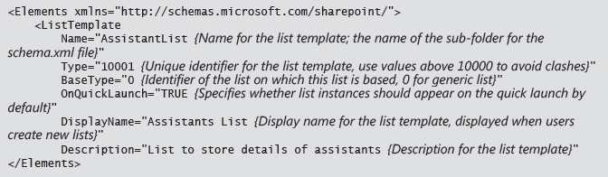
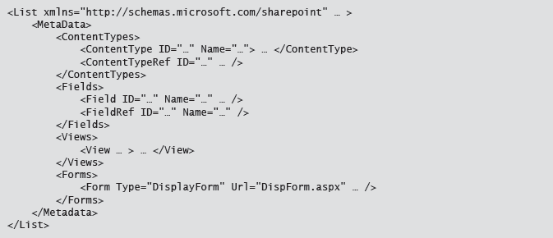
List Definitions

Slide 15
The Visual Studio List Designer
Manage
Columns
Content types
Views
Title
Url
Description
Faster (select from lists, no need to lookup GUIDs)
Easier (no need to write XML)
Reduced risk (less chance of typographical error)
Notes:
Ensure that students are aware that the list designer is the approach expected to be used by most developers most of the time. Emphasize the benefits of the list designer when compared to developing the files manually.
20488A
7: Managing Custom Components and Site Lifecycles

Slide 16
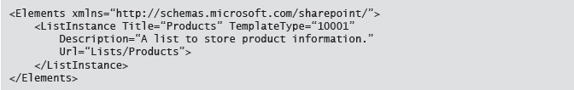
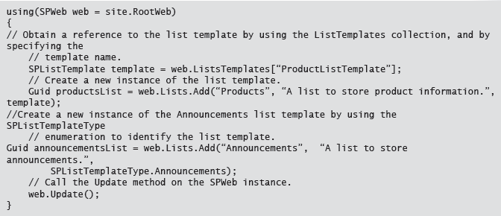
Provisioning Lists
Notes:
Explain that the process for creating a list instance by using a feature is the same for both custom and out-of-the-box templates, but the process can differ in code by using the SPListTemplateType enumeration instead of by obtaining a SPListTemplate reference by using the ListTemplates collection of the SPWeb instance.
20488A
7: Managing Custom Components and Site Lifecycles

Slide 17
Lesson 3: Defining Custom Sites
Introduction to Site Definitions and Web Templates Developing a Site Definition Declaratively Deploying Site Definitions Using Code to Provision a Custom Site Demonstration: Examining the Standard Site Definitions Feature Stapling Discussion Question
Notes:
20488A
7: Managing Custom Components and Site Lifecycles

Slide 18
Introduction to Site Definitions and Web Templates
Site definition
Deploy with a farm solution
Not dependent on any other component
Time consuming to develop
Cached by the IIS worker process for performance
Web template
Deploy with a sandboxed or farm solution
Dependent on source site definition
Fast to develop – SPWeb.SaveAsTemplate
Not cached for performance
Notes:
This topic is intended as an introduction to site definitions and web templates. Site definitions are covered in more detail later in this topic; however there is no further coverage of web templates so this may be a useful point to ask if students have any questions on web templates. Ensure that students understand that a web template is dependent on an underlying site template, and is always created from an existing site. Ensure students know that they create a web template by saving an existing site. Also explain that they can use web templates in Apps. Strongly suggest that students research web templates.
20488A
7: Managing Custom Components and Site Lifecycles

Slide 19
Developing a Site Definition Declaratively
Webtemp*.xml
15\TEMPLATES\SiteTemplates
Template and configuration definitions
Onet.xml
Site content and structure
Supporting files (pages, images, and so on)
Assemblies
Notes:
The scope of this course limits this topic to a brief introduction of the key concepts in developing a site definition. Encourage students to review the additional reading material, and to conduct research into site definitions if they are not familiar with how to develop them. Ensure that students understand the main aspects of a custom site definition; the webtemp*.xml file, and then onet.xml file. Explain the importance of the naming of the folder and how configurations in the onet.xml file must match the configurations defined in the webtemp*.xml file.
Explain that Apps are the preferred development model for SharePoint 2013, and because file system access on the SharePoint server is required, site definitions are not compatible with Apps. Ensure that students are aware that they can use a web template with an App instead.
20488A
7: Managing Custom Components and Site Lifecycles

Slide 20
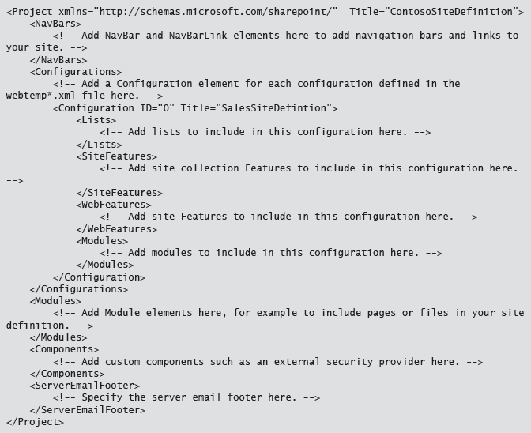
Site Template

Slide 21
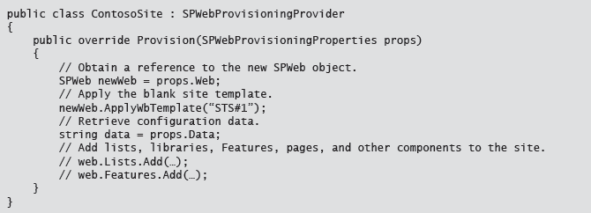
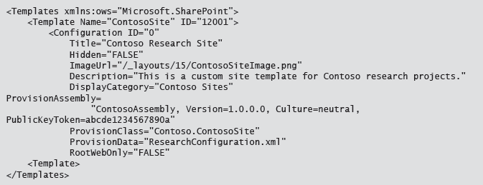
Using Code to Provision a Custom Site
Notes:
Explain to students that by default a blank site does not contain anything, and you must add pages, lists and other components to the site. Explain how you can apply the blank site template to provide a starting point for a site template.
Ensure students are aware that they must still create a webtemp*.xml file, and must specify the ProvisionAssembly and ProvisionClass attributes of the Template element, but if they provide these attributes they do no need to provide a folder in the SiteTemplates folder, or an onet.xml file.
Suggest that students use the ProvisionData attribute to store a filename which point to a file that contains further configuration data rather than including a lot of unstructured data in the webtemp*.xml file.
20488A
7: Managing Custom Components and Site Lifecycles

Slide 22
Demonstration: Examining the Standard Site Definitions
In this demonstration, you will review:
The site definitions included in SharePoint 2013
The webtemp.xml files
The onet.xml files
Notes:
The XML folder used in this demonstration uses the 1033 (en-us) locale folder. You should explain to students that if they are developing multi-lingual solutions, or not developing solutions for United States English, they should add webbtemp*.xml files to the appropriate locale folder.
Preparation Steps
Log on to 20488A-LON-SP-07 as CONTOSO\Administrator, with the password Pa$$w0rd.
Demonstration Steps
On the Start screen, click Desktop.
On the task bar, click File Explorer.
In File Explorer, browse to the C:\Program Files\Common Files\microsoft shared\Web Server Extensions\15\TEMPLATE\1033\XML folder. Explain that all of the webtemp*.xml files are stored in this folder.
Double-click WEBTEMP.xml
When prompted click Microsoft Visual Studio 2012.
In the WEBTEMP.xml file, point out the existing templates and configurations.
Point out the STS template, and the Team Site and Blank Site configurations.
Close Visual Studio.
In File Explorer, browse to the C:\Program Files\Common Files\microsoft shared\Web Server Extensions\15\TEMPLATE\SiteTemplates folder.
Point out the sts folder which corresponds with the STS template in the webtemp.xml file.
Browse to the sts folder.
Point out the aspx pages which are included in the site definition and then browse to the xml folder.
Double-click the ONET.XML file.
Point out the various aspects of the site definition, including the navigation bars, and document templates.
20488A
7: Managing Custom Components and Site Lifecycles
(More notes on the next slide)

Slide 23

Feature Stapling
Add a Feature to an existing site definition
Out-of-the-box site definitions
Custom site definitions that are in use
Stapled Feature
Stapler Feature
Notes:
Explain the benefits of Feature stapling when compared to developing a new site definition. For example, reduced development time, reduced solution complexity, and simpler upgrades.
20488A
7: Managing Custom Components and Site Lifecycles

Slide 24
Discussion Question
When would you choose to create a site definition, a web template, or use Feature stapling?
Notes:
Reasons for developing a site definition:
For highly performance solutions.
To avoid dependencies on other solutions or site definitions.
Reasons for developing a web template:
To create a template from an existing site.
To use the template with SharePoint Online.
Reasons for using a Feature stapler:
To reduce development effort by avoiding developing a new site definition.
To add a Feature to an out-of-the-box site definition, or a custom site definition this is already in use.
To avoid creating duplicate site definitions.
To reduce development complexity.
To simplify upgrade scenarios.
20488A
7: Managing Custom Components and Site Lifecycles

Slide 25
Lesson 4: Managing SharePoint Sites
Understanding the Site Hierarchy Provisioning Sites Host-named Site Collections Backing-up Site Collections Managing the Site Lifecycle Upgrading SharePoint 2010 Sites
Notes:
20488A
7: Managing Custom Components and Site Lifecycles

Slide 26
Understanding the Site Hierarchy
SPFarm.Services
SPWebService.WebApplications
SPWebApplication.Sites
SPSite.AllWebs
SPWeb
Notes:
The students should already know the basic hierarchy, so much of this topic should be a recap. Ensure students know how to navigate between layers in the hierarchy by using the relevant properties, specifically the collection classes which they will need to use in the lab for this module.
20488A
7: Managing Custom Components and Site Lifecycles

Slide 27
Provisioning Sites
SharePoint object model
SPSite site = webApplication.Sites.Add(…);
SPWeb web= site.AllWebs.Add(…);
PowerShell
New-SPSite
New-SPWeb
SharePoint user interface
Notes:
Ensure that students are aware that there are many overloads of the Add methods, and that they should choose the one most appropriate to their needs. Explain that they can specify either an out-of-the-box or a custom site definition by using the TemplateName#Configuration format (for example STS#0) with overloads of both of the Add methods.
20488A
7: Managing Custom Components and Site Lifecycles

Slide 28
Host-named Site Collections
Web Application A (port 80)
http://sales.contoso.com (site collection)
http://sales.contoso.com/sites/subsite (site)
http://sales.contoso.com/sites/subsite2 (site)
http://research.contoso.com (site collection)
http://sales.contoso.com/sites/sitecollection (site collection)
Web Application 2 (IIS host header – sharepoint.contoso.com)
http://sharepoint.contoso.com (site collection)
http://sharepoint.contoso.com/sites/sitecollection (site collection)
http://sharepoint.contoso.com/site/subsite (site)
Notes:
Use the samples on the slide to contrast the options available for hosting site collections in a web application. Ensure that students are aware that with host-named site collections they can still create site collection by using managed paths. Tell students that host-named site collections are the preferred approach for creating site collections, but explain that there are circumstances in which they are not a practical option.
20488A
7: Managing Custom Components and Site Lifecycles

Slide 29
Managing the Site Lifecycle
Lifecycle events
WebAdding
WebProvisioned
WebMoving
WebMoved
WebDeleting
WebDeleted
SiteDeleted
Identify inactive site collections
SPSite.LastContentModifiedDate
Delete sites and site collections
SPWeb.Delete()
SPSite.Delete()
Notes:
Ensure students are aware that they cannot delete the root site in a site collection; instead they must delete the site collection.
20488A
7: Managing Custom Components and Site Lifecycles

Slide 30
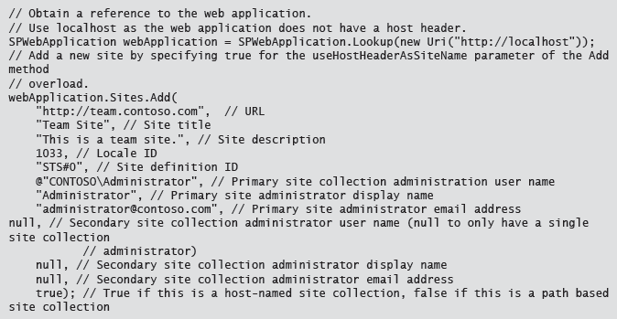
Host Header Site Collections

Slide 31
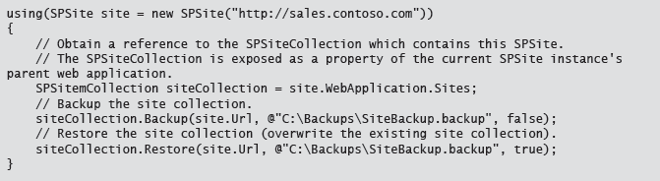
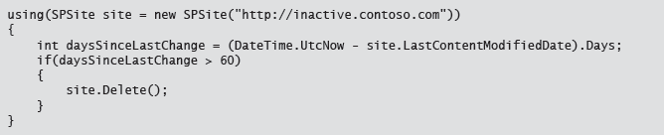
Managing Site Collections
Notes:
This topic covers how to backup and restore site collections by using the object model. Ensure students are aware that backing up site collections does not replace the need for a full farm-wide backup strategy.
20488A
7: Managing Custom Components and Site Lifecycles

Slide 32
Upgrading SharePoint 2010 Sites
Sites in SharePoint 2010 mode and 2013 mode can coexist
Delay upgrade of individual site collections based on business or technical requirements
Start upgrade
SPSite.Upgrade()
Upgrade-SPSite
Notes:
Explain to students that there are a number of reasons why you may have both new and old site collections which co-exist, for example new team projects may use the new site collections, while projects which are currently in-flight may delays until a suitable break in the project to perform the upgrade.
20488A
7: Managing Custom Components and Site Lifecycles

Slide 33
Lab: Managing Custom Components and Site Lifecycles
Exercise 1: Creating a Site Definition Exercise 2: Creating a List Definition Exercise 3: Developing an Event Receiver
Logon Information
Virtual machine: 20488A-LON-SP-07
User Name: CONTOSO\administrator
Password: Pa$$w0rd
Estimated Time: 60 minutes
Notes:
Exercise 1: Creating a Site Definition
In this exercise, you will create a site definition. First, you will create a new farm solution, and then you will add a site definition to the farm solution. You will then add two document libraries to the site definition, and add custom navigation to include links to Contoso's global sales site, and a link to Contoso's public web site.
You will then modify the home page for the site definition. You will add links in the main body to enable sales persons to easily access the document libraries, and you will add an empty web part zone. The web part zone will enable sales managers to easily add components to their sales site.
Finally, you will deploy the site definition, and create an instance of the site definition for one of Contoso's product's sales team.
Exercise 2: Creating a List Definition
In this exercise, you will create a list definition. The list definition will define a list that sales people can use to track sales leads. You will use a Feature to deploy the list definition. You will also use the Feature to deploy an instance of the new list definition.
Next, you will modify your custom site definition to include the list Feature. You will then deploy the updated site definition and test the new list functionality.
Exercise 3: Developing an Event Receiver
In this exercise, you will create an event receiver that handles the site deleting event. You will add code to the event receiver which creates a backup copy of the parent site collection, and saves the backup to disk on the SharePoint server. You will use a Feature to deploy the event receiver.
You will then create another Feature, with a Farm scope, which you will use to staple the event receiver Feature to the sales site definition that you created in the previous exercises. Finally, you will deploy the new Features to the farm. You will test the Features by creating a new instance of the sales site definition. You will verify that the event receiver Feature has been correctly stapled to the site definition and test the functionality by deleting the site.
20488A
7: Managing Custom Components and Site Lifecycles

Slide 34
Lab Scenario
Most products sold by Contoso have a dedicated sales team. Each of the sales teams requires a site to store sales documents, and to track sales leads. Sales documents fall into two categories: documents created to support a specific sales opportunity, which may contain customer specific information, and generic documents which can be used for any sales opportunity. To ensure that documents created for a specific customer are not given to another customer, generic documents must be stored in a different document library. While there are several distinct teams, the needs of the teams are consistent across the company.
You will create a site definition for a generic sales site. The site will contains two document libraries, and links to provide sales persons with easy access to Contoso sites.
You will then create a custom list definition for a list which members of the sales teams can use to store details of sales leads. You will then add an instance of the list definition to the sales site definition.
Finally, you will add an event receiver to the site which triggers if the sales site is deleting. You will add code to the event receiver which creates a backup of the parent site collection before the sales site is deleted.
Notes:
20488A
7: Managing Custom Components and Site Lifecycles

Slide 35
Module Review and Takeaways
Review Question(s)
Notes:
Review Question(s)
Question
Which of the following options accurately describes the process used by SharePoint when you add a site content type to a list instance?
( )Option 1: SharePoint adds the site content type to the list.
( )Option 2: SharePoint creates a new content type, which is a copy of the original content type, and inherits from the same parent content type as the site content type.
( )Option 3: SharePoint creates a new content type, which is a copy of the original content type, and inherits from the site content type.
( )Option 4: SharePoint creates a new list-scoped content type which inherits from the site content type and adds the new content type to the list.
( )Option 5: SharePoint creates a new, hidden, site-scoped content type which inherits from the original site content type, and adds the new content type to the list.
Answer
(√) Option 4: SharePoint creates a new list-scoped content type which inherits from the site content type and adds the new content type to the list.
Question
Which of the following items can you not include in a list schema?
( )Option 1: Fields
( )Option 2: Toolbars
( )Option 3: Content types
( )Option 4: Views
20488A
7: Managing Custom Components and Site Lifecycles
(More notes on the next slide)

