Slide 1
Module 14
Customizing User Interface Elements
Notes:
20488A
14: Customizing User Interface Elements

Slide 2
Module Overview
Working with Custom Actions Using Client-Side User Interface Components Customizing the SharePoint List User Interface
Notes:
20488A
14: Customizing User Interface Elements

Slide 3
Lesson 1: Working with Custom Actions
Introduction to Custom Actions Using the CustomAction Element Customizing the Ribbon Demonstration: Customizing the Ribbon Customizing Other SharePoint Objects Using the Custom Action Templates Deploying Custom Actions
Notes:
20488A
14: Customizing User Interface Elements

Slide 4
Introduction to Custom Actions
You can create custom actions for:
The SharePoint Ribbon
The Site settings menu
Navigational menus
List item menus
You can deploy custom actions as part of a Feature in a:
Sandbox solution
Farm solution
App for SharePoint
Notes:
This is only an introductory topic and details about all of these items will follow in the subsequent topics.
20488A
14: Customizing User Interface Elements

Slide 5
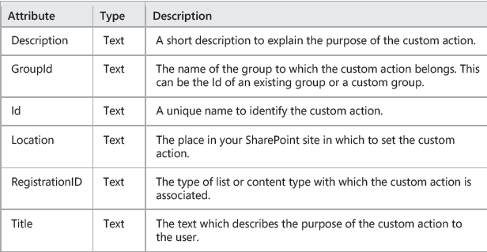
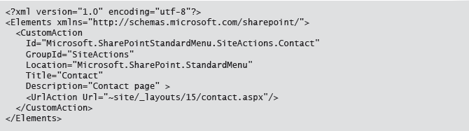
Using the CustomAction Element
Notes:
Ensure that you point out to students that creating an Elements file is only required for sandbox and farm solutions. Information about creating custom actions in an app for SharePoint is covered in the next topic.
20488A
14: Customizing User Interface Elements

Slide 6
Customizing the Ribbon
Using the CustomAction element to customize the Ribbon:
CommandUIDefinitions element
CommandUIHandlers element
Laying out the controls:
Group layouts
Scaling
Notes:
Direct the students to the image in the student notes to ensure that they are familiar with the ribbon terminology used in this topic.
You may want to open the CMDUI.xml file to show students the full range of templates and scaling markup.
20488A
14: Customizing User Interface Elements

Slide 7
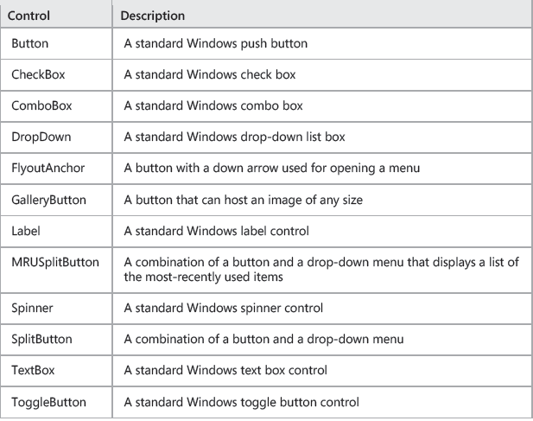
CommandUIDefinition

Slide 8
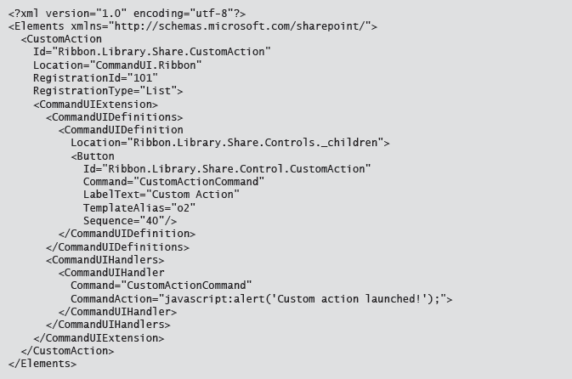
Custom Ribbon Element

Slide 9
Demonstration: Customizing the Ribbon
In this demonstration, you will see how to add a custom action Library tab with a custom group and two custom buttons to a document page.
Notes:
Preparation Steps
You may want to start the virtual machine in advance to save time during the demonstration.
Demonstration Steps
Start the 20488A-LON-SP-14 virtual machine.
Log on to the LONDON machine as CONTOSO\Administrator with password Pa$$w0rd.
On the Start screen, click Internet Explorer.
In Internet Explorer, in the address bar, type http://team.contoso.com, and then press Enter.
In the Quick Launch menu, click Documents.
On the Ribbon, click LIBRARY.
Review the groups that are present on the ribbon, and then close Internet Explorer.
On the Start screen, type Visual Studio 2012, and then click Visual Studio 2012.
On the FILE menu, point to Open, and then click Project/Solution.
In the Open Project dialog box, browse to the E:\Democode folder, click RibbonCustomActions.sln, and then click Open.
In Solution Explorer, expand Features, and then double-click ContosoCustomActionsFeature.
In the Items in the Feature list, point out the ContosoCustomActions element.
In Solution Explorer, expand ContosoCustomActions, and then double-click LibraryCustomActions.xml.
Point out the attributes for the CustomAction element.
Point out the Location for the first CommandUIDefinition.
Point out the attributes for the Group element.
20488A
14: Customizing User Interface Elements
(More notes on the next slide)

Slide 10
Customizing Other SharePoint Objects
Edit Control Block
Settings menu
Site settings page
Notes:
Compared to customizing the ribbon, customizing other items requires less markup. Talk the students through the XML code samples in the student notes, highlighting the key Location and GroupId attributes and URLAction element.
20488A
14: Customizing User Interface Elements

Slide 11
Using the Custom Action Templates
Menu item custom action:
Location attribute set to "EditControlBlock"
Set UrlAction element to required page
Ribbon custom action
Location attribute set to "CommandUI.Ribbon"
Modify CommandUIDefinitions element as required
Notes:
Ensure that you point out to students that the custom action templates are only available when you are developing an app for SharePoint.
20488A
14: Customizing User Interface Elements

Slide 12
Deploying Custom Actions
In a solution:
Deploy directly from Visual Studio to the local SharePoint site
Deploy to an alternative site by creating a SharePoint package
In an app for SharePoint
Deploy directly from Visual Studio to the local SharePoint site
Deploy to an alternative site or store by creating an app package
Notes:
Make sure that students realize that the decisions that they make when initially creating their project will influence where and how they can deploy their custom actions.
20488A
14: Customizing User Interface Elements

Slide 13
Lesson 2: Using Client-Side User Interface Components
Displaying Status Bar Messages Demonstration: Displaying Status Bar Messages Displaying Notifications Demonstration: Displaying Notifications Using SharePoint Dialog Boxes Displaying Callouts SPAnimation Library Using Focus on Content
Notes:
20488A
14: Customizing User Interface Elements

Slide 14

Displaying Status Bar Messages
Use methods of the SP.UI.Status object:
addStatus
updateStatus
setStatusPriColor
removeStatus
removeAllStatus
Notes:
Point out to students that the addStatus method returns the ID of the message which they can use to reference that message in the other methods.
20488A
14: Customizing User Interface Elements

Slide 15
Demonstration: Displaying Status Bar Messages
In this demonstration, you will see how to use the methods of the SP.UI.Status object to display and customize a message to the user.
Notes:
Demonstration Steps
Start the 20488A-LON-SP-14 virtual machine.
Log on to the LONDON machine as CONTOSO\Administrator with password Pa$$w0rd.
On the Start screen, click Visual Studio 2012.
On the FILE menu, point to Open, and then click Project/Solution.
In the Open Project dialog box, browse to E:\Democode, click StatusBarMessage.sln, and then click Open.
In Solution Explorer, double-click InformationBar.
Point out that the CommandAction attribute in the CommandUIHandler element contains Javascript code to display a status message and change its color.
On the BUILD menu, click Deploy StatusBarMessage.
On the Start screen, click Internet Explorer.
In Internet Explorer, in the address bar, type http://team.contoso.com, and then press Enter.
In the Quick Launch menu, click Documents.
On the ribbon, click Library.
On the ribbon, in the Share & Track group, click Display Status Message.
Point out the yellow information bar.
Close Internet Explorer.
Close Visual Studio.
20488A
14: Customizing User Interface Elements

Slide 16
Displaying Notifications
Use methods of the SP.UI.Notify object:
addNotification
removeNotification
Notes:
Point out to students that similarly to the status bar message functionality, the addNotification method returns the ID of the notification which they can use to reference that message in the removeNotification method.
20488A
14: Customizing User Interface Elements

Slide 17
Demonstration: Displaying Notifications
In this demonstration, you will see how to use the methods of the SP.UI.Notify object to display notifications to the user.
Notes:
Demonstration Steps
Start the 20488A-LON-SP-14 virtual machine.
Log on to the LONDON machine as CONTOSO\Administrator with password Pa$$w0rd.
On the Start screen, click Visual Studio 2012.
On the FILE menu, point to Open, and then click Project/Solution.
In the Open Project dialog box, browse to E:\Democode, click Notification.sln, and then click Open.
In Solution Explorer, double-click Notification.
Point out that the CommandAction attribute in the CommandUIHandler element contains Javascript code to display a notification.
On the BUILD menu, click Deploy Notification.
On the Start screen, click Internet Explorer.
In Internet Explorer, in the address bar, type http://team.contoso.com, and then press Enter.
In the Quick Launch menu, click Documents.
On the ribbon, click Library.
On the ribbon, in the Share & Track group, click Notification.
Point out the notification that appears.
Close Internet Explorer.
Close Visual Studio.
20488A
14: Customizing User Interface Elements

Slide 18
Using SharePoint Dialog Boxes
Displaying a modal dialog box:
var NewDialog = new SP.UI.DialogOptions();
newDialog.html = htmlElement;
SP.UI.ModalDialog.showModalDialog(newDialog)
Displaying a wait screen:
var waitDialog = SP.UI.ModalDialog.showWaitScreenWithNoClose( 'Loading page', 'Please wait…');
waitDialog.close();
Notes:
Before describing how to use model dialog boxes, ensure that students are understand what modal means. Also make sure that they understand the difference between creating your own dialog box and using the SharePoint wait screen.
20488A
14: Customizing User Interface Elements

Slide 19
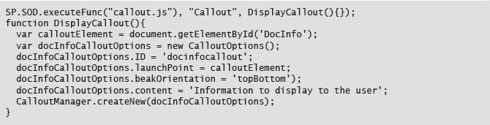

Displaying Callouts & Animations
Notes:
Check that students are familiar with SP.SOD.executeFunc and how it works before discussing the callout specific code.
20488A
14: Customizing User Interface Elements

Slide 20
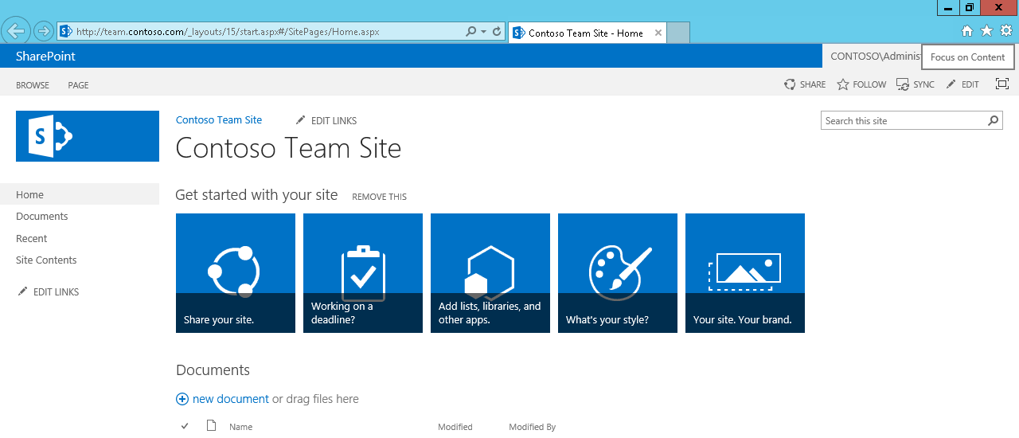
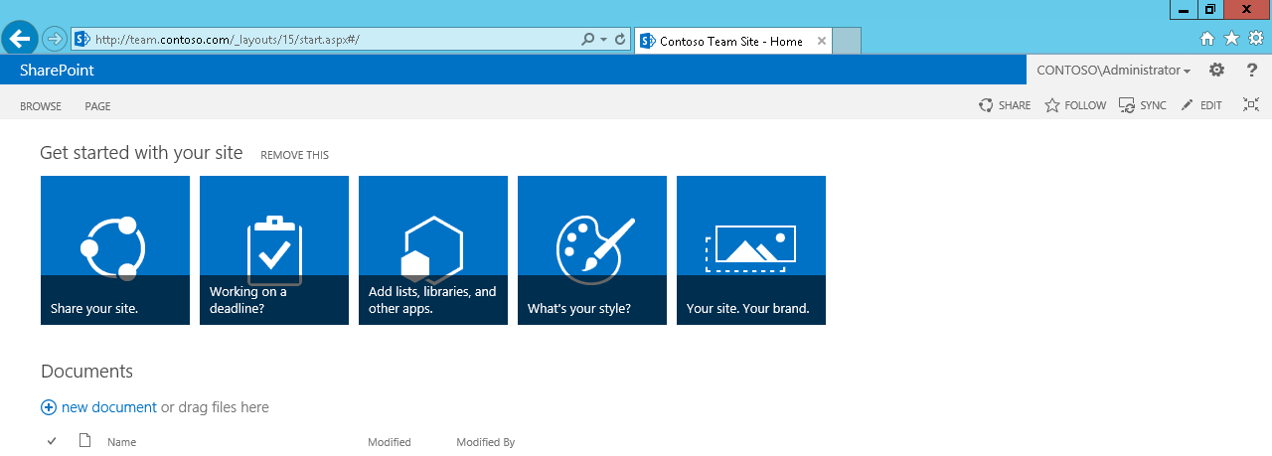
Using Focus on Content
Notes:
Either use the images on the slide or the Contoso Team Site page to show students the Focus on Content button.
20488A
14: Customizing User Interface Elements

Slide 21
Lab A: Using the Edit Control Block to Launch an App
Exercise 1: Configuring an App to Display Customer Orders Exercise 2: Use a Custom Action to Launch an App
Logon Information
Virtual Machine: 20488A-LON-SP-14
User name: CONTOSO\administrator
Password: Pa$$w0rd
Estimated Time: 30 minutes
Notes:
Exercise 1: Configuring an App to Display Customer Orders
In this exercise, you will use Visual Studio to set the permissions for app to read from the Customers and Orders lists and then write a CAML query to retrieve past orders for a given customer.
Exercise 2: Use a Custom Action to Launch an App
In this exercise, you will add a custom action to your previous code which enables users to use a menu item on the edit control block to retrieve details of a customers’ orders.
20488A
14: Customizing User Interface Elements

Slide 22
Lab Scenario
Contoso maintains a list of customers in a Contacts list. The sales team at Contoso would like to be able to view a summary of recent sales activities for each customer from the Contacts list. You plan to implement this functionality as an app for SharePoint. First, you will develop a SharePoint-hosted app that displays the order history for a selected customer. You will then develop a custom action that launches the app from the Edit Control Block for a Contacts list item. The custom action must provide the app with the URL of the selected list item. It must also display the app page as a dialog.
Notes:
20488A
14: Customizing User Interface Elements

Slide 23
Lesson 3: Customizing the SharePoint List User Interface
Introduction to Client-Side Rendering Using Client-Side Rendering to Customize the Default List View Using Client-Side Rendering to Create Custom Views Using Client-Side Rendering to Customize List Forms Using Client-Side Rendering to Apply Conditional Formatting Demonstration: Applying Conditional Formatting Using jQuery UI In Client-Side Rendering Code
Notes:
20488A
14: Customizing User Interface Elements

Slide 24
Introduction to Client-Side Rendering
Advantages of client-side rendering over using XSLT:
Performance
Flexibility
Standard development language
Two high-level tasks:
Create a JavaScript code file
Link the JavaScript code file to the list view
Notes:
This is an introductory topic and further details of the actual implementation of the two tasks follows in the next topic.
20488A
14: Customizing User Interface Elements

Slide 25
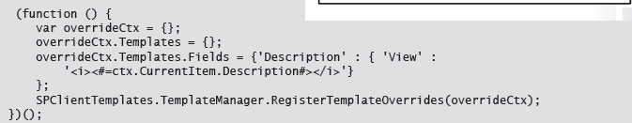
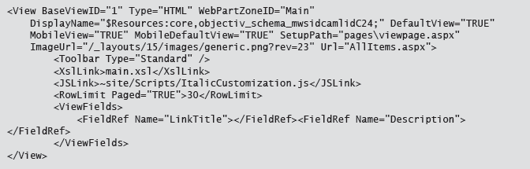
Using Client-Side Rendering to Customize the Default List View
Formatting list fields:
Linking the JavaScript code to the list view:
Notes:
Be sure to explain to students where to place the JSLink element in the Schema file.
20488A
14: Customizing User Interface Elements

Slide 26
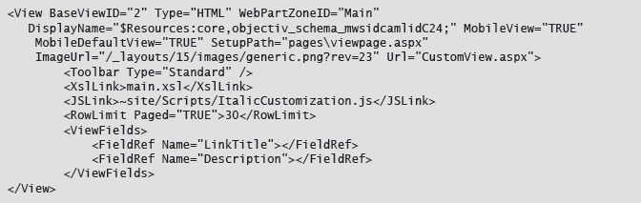
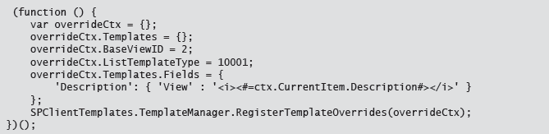
Using Client-Side Rendering to Create Custom Views
Creating the View element:
Linking the function to the new view:
Notes:
Point out that the code and XML shown on the previous slide should replace the ellipses on this slide. Full code and XML listings are shown in the student notes.
20488A
14: Customizing User Interface Elements

Slide 27
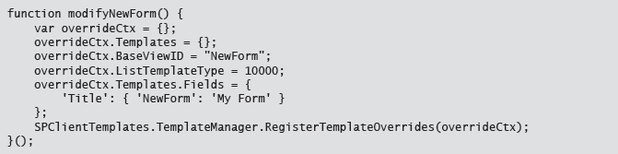
Using Client-Side Rendering to Customize List Forms
Creating the View element:
Linking the function to the new view:
Notes:
Point out to students that the steps and code that they will use to modify a list form are very similar to modify a list view.
20488A
14: Customizing User Interface Elements

Slide 28
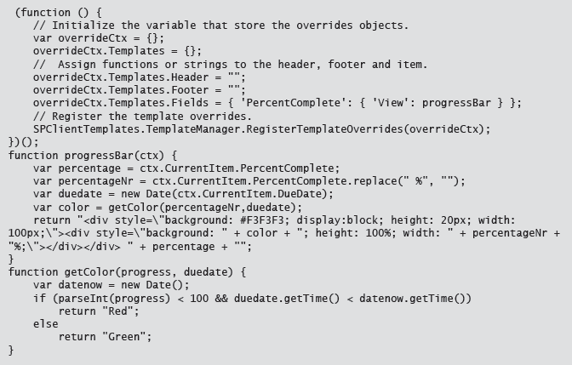
Using Client-Side Rendering to Apply Conditional Formatting
Notes:
Talk through the code sample on the slide and point out the getColor function listing in the student notes.
20488A
14: Customizing User Interface Elements

Slide 29
Demonstration: Applying Conditional Formatting
In this demonstration, you will see how to apply conditional formatting to a list view.
Notes:
Preparation Steps
You may want to start the virtual machine in advance to save time during the demonstration.
Demonstration Steps
Start the 20488A-LON-SP-14 virtual machine.
Log on to the LONDON machine as CONTOSO/Administrator with password Pa$$w0rd.
On the Start screen, click Visual Studio 2012.
On the FILE menu, point to Open, and then click Project/Solution.
In the Open Project dialog box, browse to the E:\Democode folder, click ProgressBarApp.sln, and then click Open.
In Solution Explorer, expand Custom Tasks, and then double-click Schema.xml.
Locate the View element with the BaseViewID="1" attribute and point out the JSLink child element which links the JavaScript file to the view.
In this View element, point out the contents of the ViewFields element which defines which fields to display in the view.
In Solution Explorer, expand Scripts, and then double-click CustomizeIt.js.
In the main function, point out that the PercentComplete field is calling the progressBar function.
In the progressBar function, point out that the function performs the following tasks:
Removes the percentage sign from the PercentComplete property and stores it and the DueDate property in variables.
Passes the variables to the getColor function which determines whether to display the progress bar as red or green.
In the getColor function, point out the if block which determines the color to use.
20488A
14: Customizing User Interface Elements
(More notes on the next slide)

Slide 30
Using jQuery UI In Client-Side Rendering Code
Download the jQuery UI files
Add the jQuery UI files to your project
Add the jQuery UI files to your pages
Create a JavaScript code file that uses jQuery UI
Modify the JSLink element to reference your code file
Notes:
Tell the students that they will be performing these steps in the next lab.
20488A
14: Customizing User Interface Elements

Slide 31
Lab B: Using jQuery to Customize the SharePoint List User Interface
Exercise 1: Creating a Custom List View
Logon Information
Virtual Machine: 20488A-LON-SP-14
User name: CONTOSO\administrator
Password: Pa$$w0rd
Estimated Time: 15 minutes
Notes:
Explain to students that if they need to debug their code multiple times, they may need to retract the solution before rerunning the code to avoid Internet Explorer using a cached older version.
Exercise 1: Creating a Custom List View
In this exercise, you will use Visual Studio to write custom client-side code to display the list using the accordion functionality and reference this custom code from the default list view. When this is working, you will add code to load the jQuery UI style sheet to further enhance the view.
20488A
14: Customizing User Interface Elements

Slide 32
Lab Scenario
You have a list of customers with details about each one. When this list uses the default list view, it is not easy to read the information and you can foresee that as more data is added to the list, the worse the problem will become. You decide to use the accordion functionality available in jQuery UI to display the list and use the style sheet to apply custom styling to the list.
Notes:
20488A
14: Customizing User Interface Elements

Slide 33
Module Review and Takeaways
Review Question(s)
Notes:
Review Question(s)
Question
You want to add a custom button to the ribbon in a sandboxed solution, but cannot find the Ribbon Custom Item in the Add New item dialog box. What is the problem?
Question
You want to provide the user with additional information about an element in the SharePoint user interface without interrupting their work. Which functionality should you use?
( )Option 1: Status bar message
( )Option 2: Notifications
( )Option 3: Dialog box
( )Option 4: Callouts
Answer
(√) Option 4: Callouts
Question
You can only use client-side rendering to customize list views.
( )False
( )True
Answer
(√)False
( )True
20488A
14: Customizing User Interface Elements

