Slide 1
Module 15
Working with Branding and Navigation
Notes:
20488A
15: Working with Branding and Navigation

Slide 2
Module Overview
Creating and Applying Themes Branding and Designing Publishing Sites Tailoring Content to Platforms and Devices Configuring and Customizing Navigation
Notes:
20488A
15: Working with Branding and Navigation

Slide 3
Lesson 1: Creating and Applying Themes
The SharePoint 2013 Theme Model Demonstration: Building a Composed Look Creating Custom Color Palettes Creating Custom Font Schemes Deploying Custom Themes
Notes:
20488A
15: Working with Branding and Navigation

Slide 4
The SharePoint 2013 Theme Model
New theme model in SharePoint 2013
Composed looks consist of:
A master page
A color palette (.spcolor file)
A font scheme (.spfont file)
A background image
Notes:
Emphasize that the PowerPoint-based theme model used in SharePoint 2010, based on .thmx files, has been retired. This new model applies to all SharePoint 2013 sites. Mention that the terms "composed look", "theme", and "site design" are often used interchangeably in the product documentation.
Provide a brief overview of each of the components of a composed look. Subsequent topics go into more technical detail.
20488A
15: Working with Branding and Navigation

Slide 5
Demonstration: Building a Composed Look
In this demonstration, you will see how site administrators can build a composed look interactively by selecting from available background images, color palettes, font themes, and master pages.
Notes:
Preparation Steps
You may want to start the virtual machine and load the team.contoso.com site collection in Internet Explorer in advance to save time during the demonstration.
Demonstration Steps
Start the 20488A-LON-SP-15 virtual machine.
Log on to the LONDON machine as CONTOSO\Administrator with password Pa$$w0rd.
Open Internet Explorer, and browse to http://team.contoso.com.
If you are prompted for credentials, log on as CONTOSO\Administrator with password Pa$$w0rd.
On the Settings menu, click Change the look.
On the Change the look page, scroll through the available designs. Explain that these are the built-in composed looks that ship with SharePoint 2013.
Click Nature.
Explain that the preview image is generated by the master page preview file. You can create a preview file, with a .preview file extension, for every master page you add to the master page gallery.
On the left of the page, under Start over, explain that the image is the background image for the composed look. Administrators can change the background image to an image in a library on the site, or upload a new image.
Under Colors, click the drop-down arrow. Explain that these are the color palettes that are currently available on the site.
Hover over several of the color palettes in the list, and draw attention to how the preview image is updated accordingly.
Click the second color palette from the top.
20488A
15: Working with Branding and Navigation
(More notes on the next slide)

Slide 6
Creating Custom Color Palettes
Create an XML-based .spcolor file
Define RGB or ARGB color values for various site components
<s:colorPalette isInverted="false"
previewSlot1="BackgroundOverlay"
previewSlot2="BodyText"
previewSlot3="AccentText"
xmlns:s="…">
<s:color name="BodyText" value="444444" />
<s:color name="SubtleBodyText" value="777777" />
<s:color name="StrongBodyText" value="262626" />
<s:color name="DisabledText" value="B1B1B1" />
<s:color name="SiteTitle" value="262626" />
<s:color name="WebPartHeading" value="444444" />
...
</s:colorPalette>
Notes:
Walk the students through the basic structure of an .spcolor file. Explain that you use a six-digit RGB value to specify an opaque color, or an eight-digit ARGB value to specify a color with a degree of opacity. Explain how you use the previewSlot attributes to specify which colors represent the color palette in the Colors dropdown menu when you are building a composed look.
Talk through the advantages of creating custom color palettes over creating custom CSS files:
Master pages are tightly bound to CSS files. By contrast, you can choose from multiple color palettes to customize the look of a site without editing the master page.
Color palettes are often easier to create than complete CSS files. Color palettes reduce the need for you to identity CSS element classes and to order your CSS classes appropriately.
Color palettes can be used as part of a composed look, which enables a flexible "mix and match" approach to styling a site.
In Visual Studio 2012, open the file at E:\Democode\Palette001.spcolor. This is one of the built-in color palettes that ships with SharePoint 2013. Scroll through the file to illustrate how many color elements are defined. Tell students that Microsoft provides a free utility, the SharePoint Color Palette Tool, that enables you to develop spcolor files interactively. The student handbook includes a download link for this utility.
20488A
15: Working with Branding and Navigation

Slide 7
Creating Custom Font Schemes
Create an XML-based .spfont file
Define fonts for the following types of text:
Title text
Navigation links
Small headings
Headings
Large headings
Body text
Large body text
Notes:
Explain the core concepts of an spfont file, and talk through the seven types of text for which you can define fonts.
In Visual Studio 2012, open the file at E:\Democode\fontscheme001.spfont. This is one of the built-in font schemes that ships with SharePoint 2013. Scroll through the file to illustrate the basic structure of a font file.
20488A
15: Working with Branding and Navigation

Slide 8
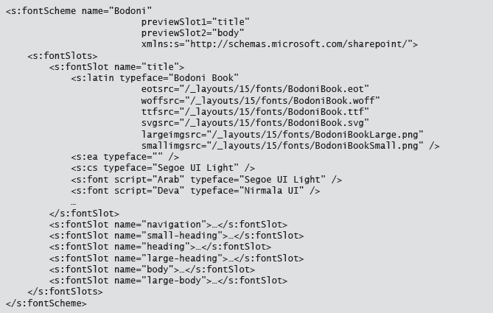
Custom Font Scheme

Slide 9
Deploying Custom Themes
Galleries:
Master page gallery (_catalog/masterpage)
Theme gallery (_catalog/theme)
Design gallery (_catalog/design)
To deploy components manually:
Upload master pages and preview files to the master page gallery
Upload spcolor files and spfont files to the 15 folder in the theme gallery
Notes:
Provide a brief overview of the three galleries that are used for theming. Explain that a gallery is just a SharePoint library or list that is exposed through the _catalog virtual directory on each site.
Mention that the design gallery is also known as the Composed Looks list. Composed looks are simply list items with fields for name, title, master page URL, color palette URL, font scheme URL, and background image URI.
The next slide illustrates the programmatic approach. The additional slide is not reproduced in the student handbook, but the code example on the slide is included in the topic content in the student handbook.
20488A
15: Working with Branding and Navigation

Slide 10
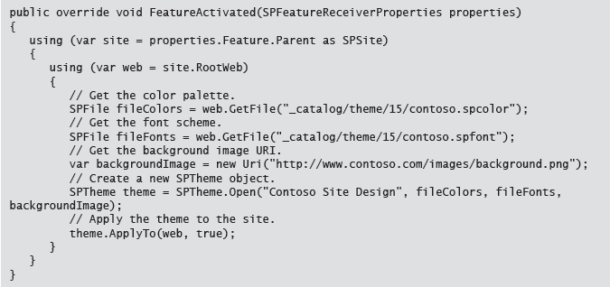
Deploying and Applying Custom Themes Programmatically
To apply a theme programmatically, use a feature receiver class
Notes:
Talk the students through the code example. You would typically include this code in the FeatureActivated method of a feature receiver class. Use the feature to deploy the color palette, the font scheme, and the background image, and then use the feature receiver to apply the theme to the site.
The student handbook includes a less abridged version of the code.
Note that production code should always include error handling, so that it fails gracefully if any of the files do not exist.
20488A
15: Working with Branding and Navigation

Slide 11
Lesson 2: Branding and Designing Publishing Sites
The Publishing Site Page Model Design Manager and the Site Design Process Creating Master Pages Demonstration: Developing Master Pages with Design Manager Creating Page Layouts Demonstration: Developing Page Layouts with Design Manager Importing and Exporting Design Packages
Notes:
20488A
15: Working with Branding and Navigation

Slide 12
The Publishing Site Page Model
Master page
Master page + page layout
Master page + page layout + page content
Content
Content
Content
Notes:
Provide an overview of how master pages, page layouts, and page content are combined when a publishing page is rendered.
Emphasize the relationship between the page layout and the corresponding content type: the content type defines the fields, and the page layout controls how the field values are rendered within placeholders in the master page.
Keep your coverage of this topic at a conceptual level, as subsequent topics provide detail on how to create master pages and page layouts.
20488A
15: Working with Branding and Navigation

Slide 13
Design Manager and the Site Design Process
Design site assets with standard web technologies:
HTML
CSS
JavaScript
Use Design Manager to:
Convert HTML designs into SharePoint master pages
Create starter HTML files for page layouts
Generate markup snippets for SharePoint controls
Notes:
Provide an overview of the new site design process for SharePoint 2013. Your emphasis should be on the following points:
The new site design process aims to provide a cleaner separation between design and development.
Designers can build master pages and other site assets using standard web technologies—HTML, CSS, and JavaScript—using any web design tools.
The Design Manager helps to automate the process of converting HTML files into fully functional SharePoint site assets.
20488A
15: Working with Branding and Navigation

Slide 14
Creating Master Pages
Use Design Manager to convert HTML files into master pages:
Upload an HTML file to the master page gallery.
Use Design Manager to convert the HTML file into a master page.
Preview the master page in Design Manager.
Use Design Manager to add snippets for SharePoint controls.
Preview the master page in Design Manager.
Edit the HTML and CSS files.
Repeat steps 5-6 until the design is complete.
Notes:
Describe the high-level process for creating a master page. Mention that you can either start with an HTML file that represents your site design, or you can get Design Manager to create a minimal master page and build your HTML around it.
Explain what happens when you use Design Manager to convert an HTML file into a master page:
Design Manager adds markup to the HTML file. The added markup represents the functionality that SharePoint requires in every master page.
Design Manager creates a parallel .master file for the .html file.
As you continue to develop the .html file, SharePoint automatically makes any required changes to the .master file.
Emphasize that site design is always an iterative process. You will typically repeat the cycle of editing HTML and previewing changes in Design Manager multiple times.
Encourage students to read the additional reading links. There are many aspects of site design and Design Manager that cannot be covered here due to time constraints.
20488A
15: Working with Branding and Navigation

Slide 15
Demonstration: Developing Master Pages with Design Manager
In this demonstration, you will see the following aspects of the master page development process:
Mapping the master page gallery as a network drive
Creating an HTML file
Converting an HTML file into a master page
Previewing the master page with Design Manager
Adding snippets to a master page
Notes:
As you work through the demonstration, provide a high-level explanation of what you are doing at each stage and why.
Preparation Steps
To save time during the demonstration, open Internet Explorer and browse to http://publishing.contoso.com in advance. This will trigger the just-in-time (JIT) compiler and ensure that the site is more responsive during the demonstration.
Demonstration Steps
Connect to the 20488A-LON-SP-15 virtual machine.
If you are not already logged on, log on to the LONDON machine as CONTOSO\Administrator with password Pa$$w0rd.
Open a File Explorer window, right-click Computer, and then click Map network drive.
In the Map Network Drive dialog box, in the Folder box, type http://publishing.contoso.com/_catalogs/masterpage, and then click Finish.
If you are prompted for credentials, log in as CONTOSO\Administrator with password Pa$$w0rd.
When the File Explorer window displays the contents of the master page gallery, close the window.
On the Start screen, type Visual Studio, and then click Visual Studio 2012.
On the FILE menu, point to New, and then click File.
In the New File dialog box, click HTML Page, and then click Open.
On the blank line after the opening body element, add the following markup:
<p>This is a very simple HTML file.</p>
On the FILE menu, click Save HTMLPage1.html As.
In the Save File As dialog box, under Computer, click masterpage.
20488A
15: Working with Branding and Navigation
(More notes on the next slide)

Slide 16
Creating Page Layouts
Create a page layout content type
Inherit from a page layout or publishing base type
Add a field for each individual piece of content
Use Design Manager to create the page layout
ASPX and HTML files are created
Edit the HTML file
ASPX file is automatically synchronized
Add style sheet links within the PlaceHolderAdditionalPageHead control
Notes:
Talk the students through the high-level process for creating a page layout. The student handbook includes more detailed guidance for each high-level step.
20488A
15: Working with Branding and Navigation

Slide 17
Demonstration: Developing Page Layouts with Design Manager
In this demonstration, you will see an example of how to use Design Manager to create a page layout.
Notes:
Preparation Steps
Ensure you complete the previous demonstration, Developing Master Pages with Design Manager. If you have completed the previous demonstration there should already be a mapped network drive for the master page gallery on publishing.contoso.com.
Demonstration Steps
Connect to the 20488A-LON-SP-15 virtual machine.
If you are not already logged on, log on to the LONDON machine as CONTOSO\Administrator with password Pa$$w0rd.
On the Start screen, click Internet Explorer, and browse to http://publishing.contoso.com.
If you are prompted for credentials, log in as CONTOSO\Administrator with password Pa$$w0rd.
On the Settings menu, click Design Manager.
On the list on the left of the page, click Edit Page Layouts.
On the Design Manager: Edit Page Layouts page, click Create a page layout.
In the Create a Page Layout dialog box, in the Name box, type FactSheet.
In the Master Page list, click seattle.
In the Content Type list, click Article Page, and then click OK.
Without closing Internet Explorer, open a File Explorer window and click masterpage.
In the File Explorer window, point out that SharePoint has created files named FactSheet.aspx and FactSheet.html.
Right-click FactSheet.html, point to Open with, and then click Microsoft Visual Studio 2012.
Briefly review the HTML content that SharePoint has generated for the page layout. Point out the commented out asp:ContentPlaceHolder elements, which represent the content placeholders in the master page. You add all markup for the page layout within these elements.
20488A
15: Working with Branding and Navigation
(More notes on the next slide)

Slide 18
Importing and Exporting Design Packages
Export design assets as a .wsp file
Contains all custom site design assets found within the site collection galleries:
Master pages
Page layouts
CSS and JavaScript files
Images and image renditions
Device channels and device channel mappings
Import and apply to other site collections
Notes:
Provide a brief overview of the high-level process for exporting and importing design packages. Explain that the design package contains all site design assets within the source site collection. For example, if the source site collection contains three custom master pages, all three custom master pages will be added to the design package.
When you import a design package, all the assets within the design package are added to the appropriate galleries in the destination site collection. Any assets that were active in the source site collection are made active in the destination site collection. For example, if the source site collection uses a master page named ContosoMaster1 for site pages, then ContosoMaster1 will be applied to site pages in the destination site collection.
20488A
15: Working with Branding and Navigation

Slide 19
Lab A: Branding and Designing Publishing Sites
Exercise 1: Creating SharePoint Master Pages Exercise 2: Building Master Page Functionality Exercise 3: Publishing and Applying Design Assets
Logon Information
Virtual Machine: 20488A-LON-SP-15
User name: CONTOSO\Administrator
Password: Pa$$w0rd
Estimated Time: 30 minutes
Notes:
It is easy to make mistakes when following instructions to edit HTML, for example by placing opening or closing tags in the wrong place. If students encounter difficulties, encourage them to compare their solutions to the sample solution file at E:\Labfiles\Solution\ContosoPrototype1.html.
Exercise 1: Creating SharePoint Master Pages
In this exercise, you will use create a new SharePoint master page. First, you will map the master page gallery as a network drive. This makes it easier to make regular changes to design assets and to preview your changes in Design Manager. Next, you will use Design Manager to create a new minimal master page. You will then use HTML and CSS to build a design around the minimal master page.
Instructor Note: If you have completed the demonstration, you can skip the first lab task as the master page gallery is already mapped as a network drive.
Exercise 2: Building Master Page Functionality
In this exercise, you will start to build the functionality of your master page by adding standard SharePoint controls. You will add the site logo, the site title, and the global navigation links. After each change, you will use Design Manager to preview the additions.
Exercise 3: Publishing and Applying Design Assets
In this exercise, you will publish the custom master page and CSS files. You will then apply the master page to the site.
20488A
15: Working with Branding and Navigation

Slide 20
Lab Scenario
The management team at Contoso wants to develop an internet-facing corporate website using SharePoint 2013. The team has asked you to lead the creation of a prototype publishing site. As a starting point in this process, you will work with web designers to develop and test a master page design for the new site.
The HTML and CSS resources provided for this lab are simple examples to help illustrate the iterative site design process. They are not intended to represent best practices for SharePoint site design.
Notes:
20488A
15: Working with Branding and Navigation

Slide 21
Lesson 3: Tailoring Content to Platforms and Devices
Understanding Device Channels Demonstration: Creating and Configuring a Device Channel Using Device Channel Panels Understanding Image Renditions Demonstration: Creating and Configuring an Image Rendition
Notes:
20488A
15: Working with Branding and Navigation

Slide 22
Understanding Device Channels
Enable you to map site assets to classes of device
Use device inclusion rules to match user-agent substrings, for example:
Windows Phone OS 7.5
Windows Phone OS
Android 4.2.2
Android
SharePoint evaluates device channels in order
Map master pages to each device channel
Notes:
Introduce device channels as a way of tailoring site designs to different devices or classes of device.
Ensure that students understand the concepts of user-agent strings. The student handbook includes some examples.
Explain that each device channel can include one or more device inclusion rules. A device inclusion rule is a user-agent substring, or part of a user-agent substring. If the request includes a user-agent substring that matches a device inclusion rule, the device channel is applied to the request. For example, a device inclusion rule of Windows Phone OS 7.5 will match Windows Phone devices running Windows 7.5, whereas a device inclusion rule of Windows Phone OS will match all Windows Phone devices.
Explain the device channels are evaluated in order. If an incoming request does not match any device inclusion rules for the device channel at the top of the list, SharePoint will move down the list of device channels until a match is found. If no matches are found, the default device channel is applied. You can reorder device channels through site settings or in Design Manager. Device channels with the most specific device inclusion rules should be at the top of the list.
You can associate a master page with each device channel on your publishing site. Because each master page can link to a unique set of CSS files, JavaScript files, and other assets, this gives you complete control over how the site is rendered for each device channel.
20488A
15: Working with Branding and Navigation

Slide 23
Demonstration: Creating and Configuring a Device Channel
In this demonstration, you will see:
How to create device channels
How to assign master pages to device channels
How to preview device channels by using query strings
Notes:
Demonstration Steps
Connect to the 20488A-LON-SP-15 virtual machine.
If you are not already logged on, log on to the LONDON machine as CONTOSO\Administrator with password Pa$$w0rd.
Open Internet Explorer and browse to http://publishing.contoso.com.
If you are prompted for credentials, log in as CONTOSO\Administrator with password Pa$$w0rd.
On the Settings menu, click Design Manager.
On the list on the left of the page, click Manage Device Channels.
On the Design Manager: Manage Device Channels page, click Create a channel.
In the Device Channels – New Item dialog box, in the Name box, type Windows Phone Devices.
In the Alias box, type WindowsPhoneGeneric.
Note: Explain that the alias is used to reference the device channel in various scenarios, such as when you create device channel panels.
In the Description box, type A device channel for all Windows Phone devices.
In the Device Inclusion Rules box, type Windows Phone OS.
Select Active, and then click Save.
On the list on the left of the page, click Publish and Apply Design.
On the Design Manager: Publish and Apply Design page, click Assign master pages to your site based on device channel.
In the Site Master Page Settings dialog box, in the Site Master Page section, in the Windows Phone Devices dropdown menu, click oslo, and then click OK.
On the top navigation menu, click Contoso Publishing to return to the site home page.
20488A
15: Working with Branding and Navigation
(More notes on the next slide)

Slide 24
Using Device Channel Panels
Display content only to specified device channels
Typically used within page layouts
Generate HTML snippet in Design Manager
Set IncludedChannels property to a comma-separated list of device channel aliases
Can include HTML elements and SharePoint components
Cannot include web parts
Notes:
Explain the concepts of device channel panels, and describe the typical uses of a device channel panel within a page layout.
Explain that you target device channels by settings the IncludedChannels property of the device channel panel to a comma-separated list of device channel aliases.
If time permits, consider briefly demonstrating how to generate an HTML snippet for a device channel panel in Design Manager.
20488A
15: Working with Branding and Navigation

Slide 25
Understanding Image Renditions
Create renditions of images at specific resolutions
Optimizes page load times
Reduces bandwidth consumption
Requires BLOB cache
To create a rendition, specify:
Name
Width
Height
Renditions generated automatically for every image on the site
Customize how renditions are generated for individual images
Notes:
Start by explain the concepts behind image renditions and the advantages of using them.
Describe how to create a rendition by specifying name, width, and height. Explain that once you have defined a rendition, SharePoint will generate renditions of every image on the site using the specified height and width. These are stored in the BLOB cache.
Explain that renditions are specified by using the RenditionID query string and specifying the ID value of the rendition you want to use. The student handbook provides a URL-based example.
Briefly explain that you can customize how renditions are generated for each image by using cropping tools, but you always end up with an image with dimensions as specified by the rendition. The next topic demonstrates how to do this.
20488A
15: Working with Branding and Navigation

Slide 26
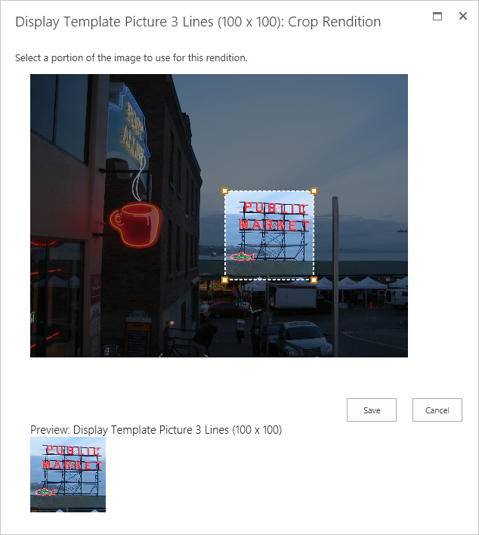
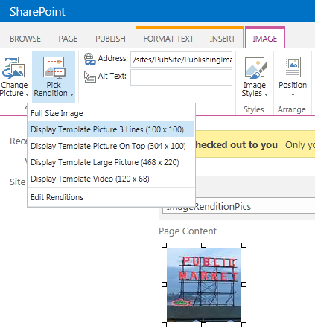
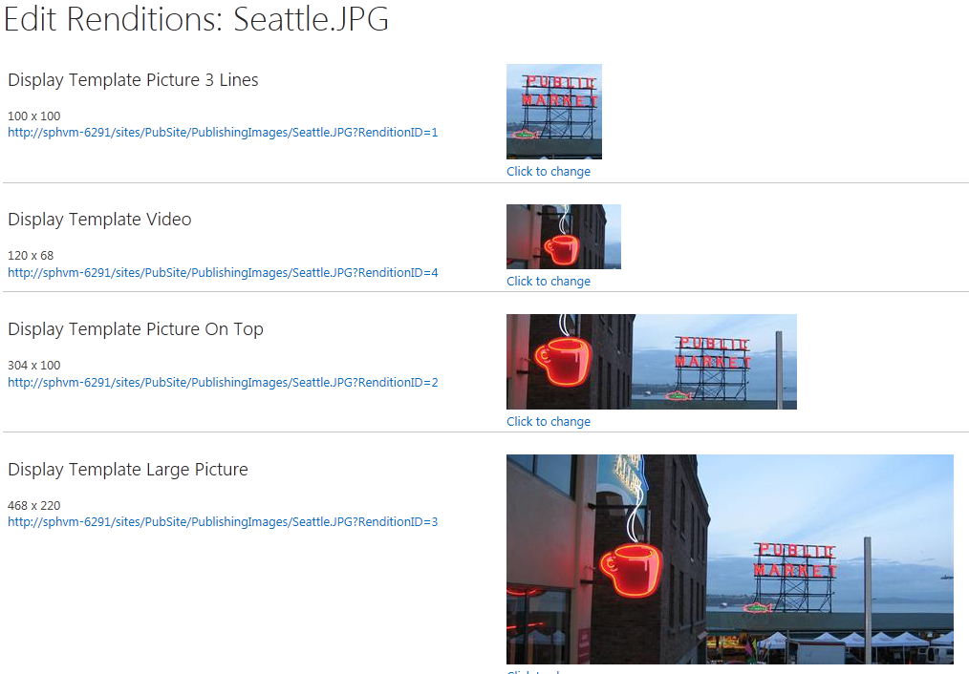
Image Renditions

Slide 27
Demonstration: Creating and Configuring an Image Rendition
In this demonstration, you will see:
How to enable the BLOB cache in a development environment
How to define an image rendition
How to customize how individual images are presented in a particular rendition
Notes:
Demonstration Steps
Connect to the 20488A-LON-SP-15 virtual machine.
If you are not already logged on, log on to the LONDON machine as CONTOSO\Administrator with password Pa$$w0rd.
Open a File Explorer window and browse to C:\inetpub\wwwroot\wss\VirtualDirectories\80.
Right-click web.config, point to Open with, and then click Microsoft Visual Studio 2012.
In the web.config file, locate the BlobCache element.
Provide a brief explanation of the BlobCache element attributes:
The location attribute specifies the file system location where files will be cached.
The path attribute specifies the file types that should be cached, in the form of a regular expression.
The maxSize attribute specifies the maximum size of the cache in gigabytes (GB).
Change the value of the enabled attribute to true.
Save the file and then close Visual Studio.
Open Internet Explorer and browse to http://publishing.contoso.com.
If you are prompted for credentials, log in as CONTOSO\Administrator with password Pa$$w0rd.
On the Settings menu, click Site settings.
On the Site Settings page, under Look and Feel, click Image Renditions.
On the Image Renditions page, click Add new item.
On the New Image Rendition page, in the Name box, type Landscape Large.
In the Width box, type 500.
In the Height box, type 400, and then click Save.
20488A
15: Working with Branding and Navigation
(More notes on the next slide)

Slide 28
Lesson 4: Configuring and Customizing Navigation
Navigation in SharePoint Server 2013 Understanding the SharePoint Navigation Architecture SharePoint 2013 Site Map Providers Understanding Managed Navigation Configuring Navigation Programmatically Customizing the Navigation Experience
Notes:
20488A
15: Working with Branding and Navigation

Slide 29
Navigation in SharePoint Server 2013
Navigation in SharePoint:
Global navigation
Current navigation
Breadcrumb trails
Metadata navigation
Security trimming
Types of navigation:
Structural
Managed
Notes:
Provides a brief overview of the four major categories of navigation in SharePoint: global navigation, current navigation, breadcrumb trails, and metadata navigation.
Provide a high-level introduction to/overview of security trimming, and explain that security trimming is common to all SharePoint navigation.
Provide a brief overview of structural navigation and managed navigation. As an aside, mention that managed navigation is now the default for global and current navigation in publishing sites.
20488A
15: Working with Branding and Navigation

Slide 30
Understanding the SharePoint Navigation Architecture
Site map providers
Also known as navigation providers
Provide a collection of site map nodes
Perform security trimming
Navigation controls
Render site map nodes in various ways
AspMenu
SPTreeView
ListSiteMapPath
SiteMapDataSource controls
Act as an intermediary between providers and controls
Configure starting node, maximum node depth, and more
Notes:
Describe the core concepts of site map providers. Explain that SharePoint site map providers derive from ASP.NET site map providers. Most notably, SharePoint site map providers add security trimming functionality.
Briefly review the navigation controls most commonly used in SharePoint sites, such as AspMenu, SPTreeView, SiteMapPath, and ListSiteMapPath.
Explain the role that SiteMapDataSource plays as an intermediary between the site map provider and the navigation control.
20488A
15: Working with Branding and Navigation

Slide 31
SharePoint 2013 Site Map Providers
SPSiteMapProvider
SPContentMapProvider
SPXmlContentMapProvider
SPNavigationProvider
PortalSiteMapProvider
TaxonomySiteMapProvider
Notes:
Provide a brief overview of the functionality of each of the core site map providers named on the slide. The student handbook includes a table summarizing the key aspects of each provider.
Consider opening a SharePoint web.config file on a virtual machine (for example C:\inetpub\wwwroot\wss\VirtualDirectories\80\web.config) to show how providers are registered within the siteMap/providers element.
20488A
15: Working with Branding and Navigation

Slide 32
Understanding Managed Navigation
Relies on TaxonomySiteMapProvider
Uses a navigation term set to generate site map nodes
Friendly URLs
URL based on navigation term
Each term is associated with a physical URL
Decouples term set structure from physical site structure
Search-driven content
Associate multiple terms with the same physical page
Use Content Search Web Part to display content from search index based on navigation terms
Notes:
Use this topic to explain how managed navigation works at a conceptual level.
20488A
15: Working with Branding and Navigation

Slide 33
Configuring Navigation Programmatically
Configuring structural navigation:
PublishingWeb class
PortalNavigation class
Server-side object model only
Configuring managed navigation:
WebNavigationSettings class
TaxonomyNavigation class
Server-side or client-side
Notes:
Provide a brief overview of the major navigation classes. The additional slide provides an example of how to configure a site to use structural or managed navigation.
20488A
15: Working with Branding and Navigation

Slide 34
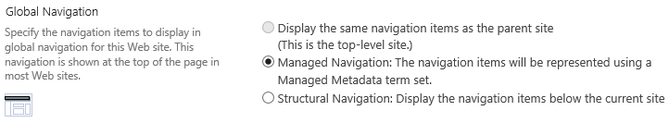
Configuring a Site to Use Structural or Managed Navigation
var web = SPContext.Current.Web;
var settings = new WebNavigationSettings(web);
// Use inherited navigation:
settings.GlobalNavigation.Source =
StandardNavigationSource.InheritFromParentWeb;
// Use managed navigation:
settings.GlobalNavigation.Source =
StandardNavigationSource.TaxonomyProvider;
// Use structural navigation:
settings.GlobalNavigation.Source =
StandardNavigationSource.PortalProvider;
Notes:
The image on the slide shows a screen capture of the global navigation settings for a publishing site. The code example below the image shows how to apply each of these options programmatically, by using the WebNavigationSettings class.
Note: This slide is not replicated in the student handbook. The topic in the student handbook shows a more verbose example of how to configure managed navigation using the WebNavigationSettings class.
20488A
15: Working with Branding and Navigation

Slide 35
Customizing the Navigation Experience
Scenario | Possible Approaches
You want to change the way navigation nodes are presented | Configure the navigation control Use a different navigation control
You want to customize which nodes are displayed | Configure the SiteMapDataSource control Configure the navigation control Edit the node collections programmatically
You want to display site map nodes from an alternative data source | Leverage an alternative site map provider Create a custom site map provider
Notes:
Briefly discuss the different ways in which you might want to customize navigation, and the approaches that are available to you for each scenario.
20488A
15: Working with Branding and Navigation

Slide 36
Lab B: Configuring Farm-Wide Navigation
Exercise 1: Creating a Custom Site Map Provider Exercise 2: Adding Custom Navigation Controls to a Master Page
Logon Information
Virtual Machine: 20488A-LON-SP-15
User name: CONTOSO\Administrator
Password: Pa$$w0rd
Estimated Time: 15 minutes
Notes:
Exercise 1: Creating a Custom Site Map Provider
In this exercise, you will create a SharePoint solution that deploys a custom XML-based sitemap file to the _layouts virtual directory. You will also use a feature receiver class to register a new instance of the SPXmlSiteMapProvider class in the web.config file for the publishing site. This site map provider will consume navigation data from your custom sitemap file.
Instructor Note: In the third task, using the SPWebConfigModification class may be challenging for less experienced students. Remind students that they can refer to the lab answer key, or view the sample solution in the E:\Solution folder, for guidance on how to complete the task.
Exercise 2: Adding Custom Navigation Controls to a Master Page
In this exercise, you will modify the prototype master page that you created in the previous lab. Within the master page footer, you will configure a SiteMapDataSource instance to consume data from your custom site map provider. You will then configure an AspMenu control to display navigation links from the data source.
To preserve the relationship between the master page .html file and the .master file, you will use Design Manager to convert your ASP.NET markup into HTML snippets that you can add to the master page.
Instructor Note: If students needs to troubleshoot master page modifications—for example, if the preview page is displaying an error—you may want to suggest that they edit the web.config file as follows:
Open the file at C:\inetpub\wwwroot\wss\VirtualDirectories\80\web.config.
Locate the customErrors element and change the value of the mode attribute to RemoteOnly.
Locate the SafeMode element and change the value of the CallStack attribute to true.
This will ensure that the page displays an informative error message instead of a generic error page.
20488A
15: Working with Branding and Navigation

Slide 37
Lab Scenario
Contoso consists of four geographical divisions. The marketing team at Contoso wants to create a publishing site collection for each division. The team also wants users to be able to navigate quickly between these divisional site collections, and your task is to implement this navigation. Because the default SharePoint navigation providers do not support navigation across site collection boundaries, you must create a custom navigation provider. You will then add custom navigation controls that display these divisional links to the footer of your prototype master page.
Notes:
20488A
15: Working with Branding and Navigation

Slide 38
Module Review and Takeaways
Review Question(s)
Notes:
Review Question(s)
Question
Which of the following items do you not deploy in a composed look?
( )Option 1: A master page.
( )Option 2: A color palette.
( )Option 3: A font scheme.
( )Option 4: A background image.
( )Option 5: A CSS file.
Answer
(√) Option 5: A CSS file.
Question
You want to create a new page layout. What should you do first?
( )Option 1: Create a new master page in Design Manager.
( )Option 2: Create or identify a page layout content type.
( )Option 3: Create custom field controls.
( )Option 4: Create a new page layout in Design Manager.
( )Option 5: Create a new page layout in HTML.
Answer
(√) Option 2: Create or identify a page layout content type.
Question
20488A
15: Working with Branding and Navigation
(More notes on the next slide)

Slide 39



Course Evaluation
Notes:
Remind students to complete the course evaluation.

