Slide 1
Catalogues generation

Slide 2
SOP of Catalogue generation
1.
按順序製作演算法所需資料(紅色框)，藍色框為使用之演算法。
2.
3.

Slide 3
Onboard Star Catalogue generation (1)
Matlab code: catalog_gen.m
Input
real_catalogue_without_doublestar.txt: Real Catalogue without double stars
Output
Onboard Star Catalogue 1 (normal mode)
guide_catalogue_1.txt : Feature Sequence
guide_catalogue_ID_1.txt : Nearby Stars ID
Onboard Star Catalogue 2 (miss partner star mode)
guide_catalogue_2.txt : Feature Sequence
guide_catalogue_ID_2.txt : Nearby Stars ID

Slide 4
Mapping table generation (2)
Matlab code: mapping_table_gen.m
Input
guide_catalogue_1.txt : Feature Sequence
guide_catalogue_2.txt : Feature Sequence (miss partner mode)
Output
mapping_talbe_1.txt: LIS mapping table
mapping_talbe_2.txt: LIS mapping table (miss partner mode)

Slide 5
star index catalogue generation (3)
Matlab code: catalogue_TRK_gen.m
Input
guide_catalogue_ID_1.txt : Nearby Stars ID
guide_catalogue_ID_2.txt : Nearby Stars ID (miss partner mode)
Output
catalogue_TRK_1.txt: star index catalogue
catalogue_TRK_2.txt: star index catalogue (miss partner mode)

Slide 6
Algorithm

Slide 7
LIS mode
LIS mode 所使用之演算法(Geometric Pattern Voting Algorithm):
1. LIS_matching.m: 演算法主體。
2. LIS_matching_oneshot.m: 隨機挑選天球中任意點做為FOV中心點，測試演算法在該點結果。
3. LIS_coverage_circumcenter.m: 將天球分為131,072個測試點，測試FOV中心點在該處的演算結果。

Slide 8
LIS mode matching
Matlab code: LIS_matching.m (function)
Input
X
Output
X

Slide 9
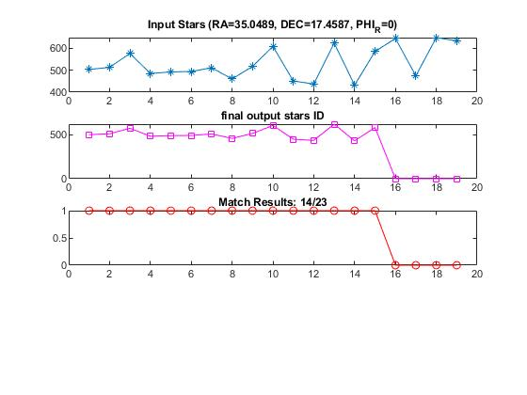
LIS mode matching
Matlab code: LIS_matching_oneshot.m
Input
real_catalogue.txt: all stars catalogue
guide_catalogue_1.txt : Feature Sequence
guide_catalogue_ID_1.txt : Nearby Stars ID
mapping_talbe_1.txt: LIS mapping table
Miss partner star mode
guide_catalogue_2.txt : Feature Sequence
guide_catalogue_ID_2.txt : Nearby Stars ID
mapping_talbe_2.txt: LIS mapping table
Output
Figure(1) :
Final output stars ID: ID of Matched Stars
GVA Match Results: 0 -> NG match , 1 -> match OK ,
2 -> mismatch
(1)

Slide 10
LIS mode matching
Matlab code: LIS_coverage_circumcenter.m
Input
real_catalogue.txt: all stars catalogue
qtm_triangle_circumcenter.txt: 131,072 test points
guide_catalogue_1.txt : Feature Sequence
guide_catalogue_ID_1.txt : Nearby Stars ID
mapping_talbe_1.txt: LIS mapping table
Miss partner star mode
guide_catalogue_2.txt : Feature Sequence
guide_catalogue_ID_2.txt : Nearby Stars ID
mapping_talbe_2.txt: LIS mapping table
Output
gva_coverage_result.txt: result of Algorithm
gva_coverage_NG_result.txt: NG test pioints

Slide 11
TRK mode
TRK mode 所使用之演算法(Geometric Pattern Voting Algorithm):
1. TRK_matching.m: 演算法主體。
2. TRK_matching_oneshot.m: 隨機挑選天求任意點做為FOV中心點，測試演算法在該點結果。

Slide 12
TRK mode matching
Matlab code: TRK_matching.m (function)
Input
X
Output
X

Slide 13
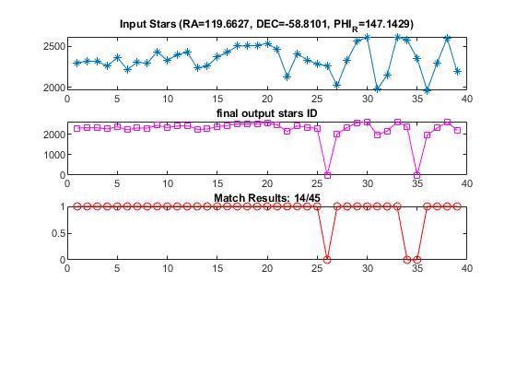
TRK mode matching
Matlab code: gva_TRK_oneshot.m
Input
real_catalogue.txt: all stars catalogue
guide_catalogue_1.txt : Feature Sequence
guide_catalogue_ID_1.txt : Nearby Stars ID
catalogue_TRK_1.txt: star index catalogue
Miss partner star mode
guide_catalogue_2.txt : Feature Sequence
guide_catalogue_ID_2.txt : Nearby Stars ID
catalogue_TRK_2.txt: star index catalogue
Output
Figure(2) :
Final output stars ID : ID of Matched Stars
GVA Match Results: 0 -> NG match , 1 -> match OK ,
2 -> mismatch
(2)

Slide 14
CCS Catalogue Generation

Slide 15
CCS Catalogue generation (1)
Matlab code: catalogue_to_C.m
Input
real_catalogue.txt: all sky-stars catalogue
Onboard Star Catalogue 1 (normal mode)
guide_catalogue_1.txt : Feature Sequence
guide_catalogue_ID_1.txt : Nearby Stars ID
catalogue_TRK_1.txt: star index catalogue
mapping_talbe_1.txt: LIS mapping table
Onboard Star Catalogue 2 (miss partner star mode)
guide_catalogue_2.txt : Feature Sequence
guide_catalogue_ID_2.txt : Nearby Stars ID
catalogue_TRK_2.txt: star index catalogue
mapping_talbe_2.txt: LIS mapping table

Slide 16
CCS Catalogue generation (2)
Output
real_catalogue.txt: all sky-stars catalogue
Onboard Star Catalogue 1 (normal mode)
Guide_Catalog_1.txt : Star Catalogue
Searching_List_1.txt : Feature List
Mapping_Talbe_1_C.txt: LIS mapping table
Onboard Star Catalogue 2 (miss partner star mode)
Guide_Catalog_1.txt : Star Catalogue
Searching_List_1.txt : Feature List
Mapping_Talbe_1_C.txt: LIS mapping table

Slide 17
Thanks
謝謝各位聆聽
部门：设计部

