Slide 1
Chapter 12 Exception Handling and Text IO
Part-2

Slide 2
The File Class
The File class contains the methods for obtaining the properties of a file/directory and for renaming and deleting a file/directory

Slide 3
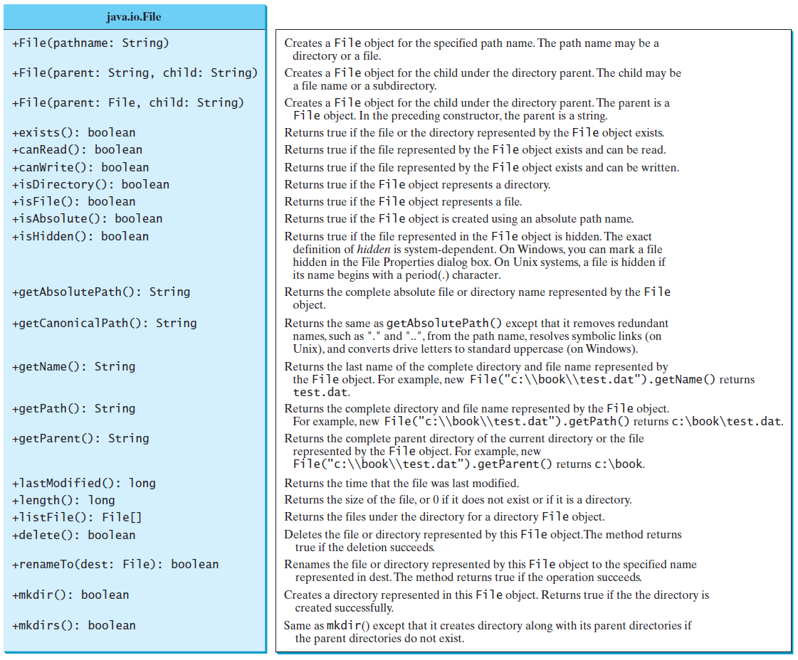
Obtaining file properties and manipulating file

Slide 4
Problem: Explore File Properties
TestFileClass

Slide 5
Text I/O
A File object encapsulates the properties of a file or a path, but does not contain the methods for creating a file or for reading/writing data from/to a file.
In order to perform I/O, you need to create objects using appropriate Java I/O classes. The objects contain the methods for reading/writing data from/to a file.
To read/write strings and numeric values from/to a text file, the Scanner and PrintWriter classes are used.

Slide 6

Writing Data Using PrintWriter
WriteData

Slide 7
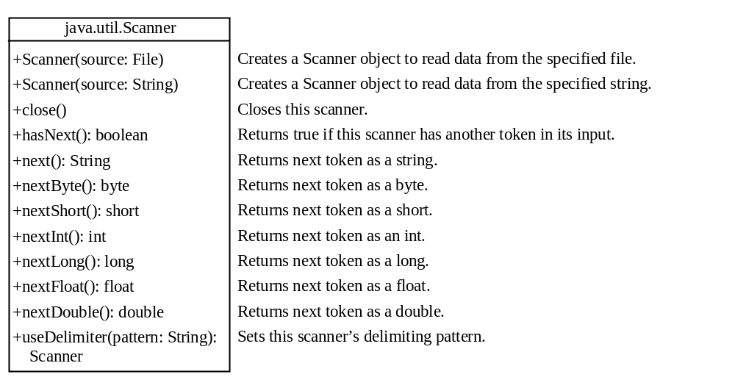
Reading Data Using Scanner
ReadData
Run

Slide 8
Extra Slides

Slide 9
Try-with-resources
Programmers often forget to close the file. JDK 7 provides the followings new try-with-resources syntax that automatically closes the files.
try (declare and create resources) {
Use the resource to process the file;
}
WriteDataWithAutoClose
Run

Slide 10
Problem: Replacing Text
Write a class named ReplaceText that replaces a string in a text file with a new string. The filename and strings are passed as command-line arguments as follows:
  java ReplaceText sourceFile targetFile oldString newString
For example, invoking
  java ReplaceText FormatString.java t.txt StringBuilder StringBuffer
replaces all the occurrences of StringBuilder by StringBuffer in FormatString.java and saves the new file in t.txt.
ReplaceText
Run

Slide 11
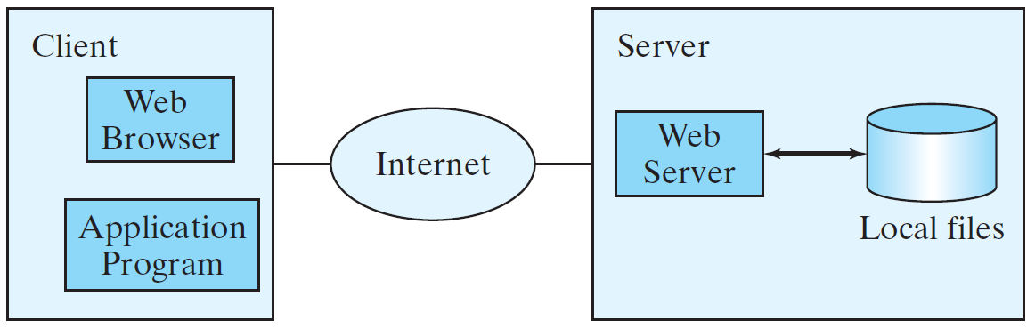
Reading Data from the Web
Just like you can read data from a file on your computer, you can read data from a file on the Web.

Slide 12
Reading Data from the Web
URL url = new URL("www.google.com/index.html");
After a URL object is created, you can use the openStream() method defined in the URL class to open an input stream and use this stream to create a Scanner object as follows:
Scanner input = new Scanner(url.openStream());
ReadFileFromURL
Run

Slide 13
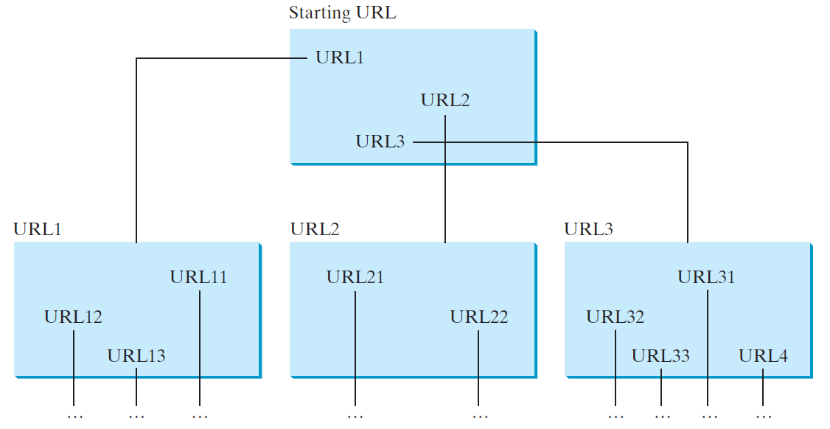
Case Study: Web Crawler
This case study develops a program that travels the Web by following hyperlinks.

Slide 14
Case Study: Web Crawler
The program follows the URLs to traverse the Web. To avoid that each URL is traversed only once, the program maintains two lists of URLs. One list stores the URLs pending for traversing and the other stores the URLs that have already been traversed. The algorithm for this program can be described as follows:

Slide 15
Case Study: Web Crawler
Add the starting URL to a list named listOfPendingURLs;
while listOfPendingURLs is not empty {
Remove a URL from listOfPendingURLs;
if this URL is not in listOfTraversedURLs {
Add it to listOfTraversedURLs;
Display this URL;
Exit the while loop when the size of S is equal to 100.
Read the page from this URL and for each URL contained in the page {
Add it to listOfPendingURLs if it is not is listOfTraversedURLs;
}
}
}
WebCrawler
Run

