Slide 1
DBSCAN vs. K-Means for focal sample selection
A controlled comparison for diabetes prediction
Amber Ramey, Nairuti Vora, Jonus Ronquillo

Slide 2
Problem & Motivation
The Problem
Our intended Research
Diabetes Prediction-Binary Classification Problem
Datasets can contain more nondiabetic than diabetic cases
This paper used Focal Active learning with K means clustering for sampling
Replace K-Means with DBSCAN within the Focal Active Learning framework.
Compare DBSCAN against K-Means for diabetes prediction.
Evaluate whether DBSCAN improves prediction accuracy, particularly for the minority diabetic class.
K-Means is the clustering method used in the existing approach, but its suitability compared with alternative clustering methods has not been established.
How can we improve diabetes prediction when the data is imbalanced, particularly by investigating whether a different clustering method can help the model identify diabetic cases more accurately?

Slide 3
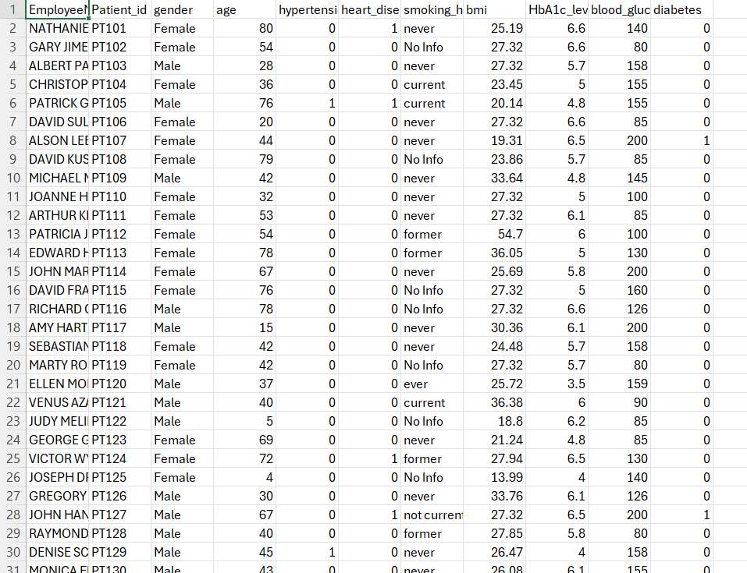
Datasets
Diabetes Prediction Dataset
Source: GitHub — AbiDanalyst/Diabetes-Prediction-Analysis
Task: test K-Means vs. DBSCAN within Focal Active Learning
Features include: Age, gender, BMI, hypertension, heart disease, smoking history, HbA1c and blood glucose
Target: Diabetes status (positive / negative)
Evidence of Dataset Access
Diabetes_prediction.csv
Dataset downloaded and available for analysis
10,000 patient records with medical and demographic information​

Slide 4
ML formulation
Task
Binary classification with an unsupervised sample-selection step
Training pool
Clustering
Representative foci
Fixed classifier
Prediction
Clean and standardize
K-means or DBSCAN (Only the focal clustering method changes)
Select informative points
Same model and settings
Diabetes: 0 or 1
Baseline
K-Means provides centroids that naturally serve as focal points
Proposed Method
DBSCAN forms density-based clusters. We will use a medoid as each cluster's focus and document how noise points are handled.
Hypothesis
DBSCAN selected foci will improve diabetic-class recall and F1 because density-based clusters can handle noise and non-spherical structure.

Slide 5
Experiment Design
Change ONE factor (isolate the effect of the clustering method)
K-Means focal selection vs. DBSCAN focal selection
Same cleaned and standardized data
Same classifier and hyperparameter search
Same label budget, stopping rule, and random seeds
Same test set, untouched until final evaluation
Evaluation
Primary metrics
Recall and F1 score
Secondary: precision, accuracy, runtime, cluster count, and DBSCAN noise rate
Hypothesis
DBSCAN selected foci will improve diabetic-class recall and F1 because density-based clusters can handle noise and non-spherical structure.
Null hypothesis: replacing K-Means with DBSCAN produces no meaningful improvement in downstream classification

Slide 6
Originality and contribution
What the paper established
Its focal active-learning pipeline uses K-Means to choose initial representative samples
The authors identify K-Means' spherical-cluster assumption and outlier sensitivity as limitations
Their future work explicitly proposes DBSCAN and GMM as alternatives
Gap we will fill
A controlled K-Means vs. DBSCAN comparison inside the same focal selection pipeline remains untested regarding the paper and its model.
Why the comparison is nontrivial
DBSCAN requires epsilon and minimum-samples tuning
It labels noise and lacks centroids, so scaling, feature encoding, and representative-point rules affect the result.
Research question
Does replacing K-Means with DBSCAN for focal sample selection improve recall and F1-score in diabetes prediction?

