Slide 1
24 Game Explanation
By Aram Antonyan

Slide 2
Description
You have 4 cards each containing a number from 1 to 9. You need to judge whether they could operated through *, /, +, -, (, ) to get the value of 24.
Example 1:
Input: [4, 1, 8, 7]
Output: True because (8-4) * (7-1) = 24
Example 2:
Input: [1, 2, 1, 2]
Output: False because it is impossible to get 24 from digits above.

Slide 3
Algorithm
First, we need to mention that we do not need to consider parentheses, it just a to calculate two elements first. This problem just like you pick two elements from these four numbers and then you do some calculation to make three numbers from four. Then, you need to pick next two items do some arithmetic calculation to make two numbers from three and so far. In the last we will only have one element and we need to check is it 24 or not.

Slide 4
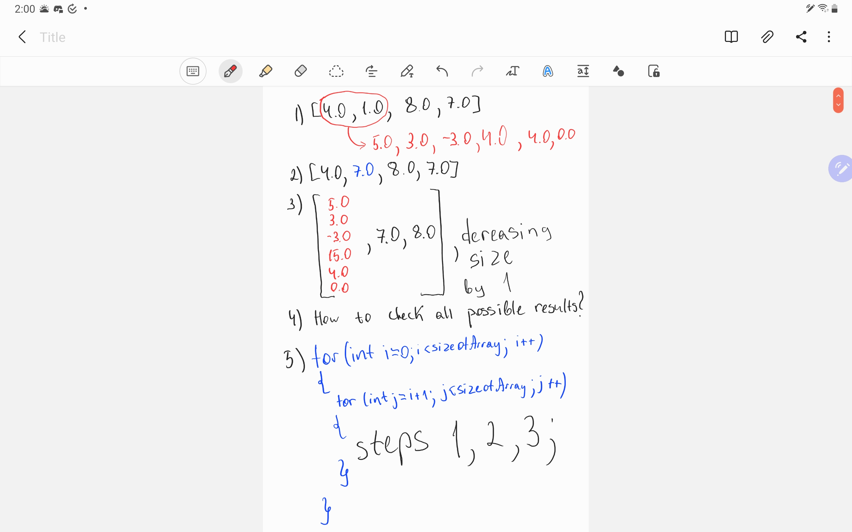
Algorithm Visualization

Slide 5
Get All Possible Solutions for Two Cards
vector<double> getAllExpressions(
double a, double b) // method to get all possible solution by using
two cards
{
return {a + b, a - b, b - a, a * b, a / b, b / a};
}

Slide 6
Solve helper function
bool solve(vector<double> &numbers,
int s) // helper function with vector of doubles and size of vector
{
if (s == 1) // if one item left
return abs(numbers[0] - 24) < checker; // return true or false, checker is 0.0001
for (int i = 0; i < s; i++) // from 0 to size of Array
{
for (int j = i + 1; j < s; j++) // from 1 to size of Array
{
double index1 = numbers[i]; // taking 1 element
double index2 = numbers[j]; // taking 2 element
numbers[j] = numbers[s - 1]; // second number becomes last one
for (double x : getAllExpressions(index1, index2)) // for 6 results
{
numbers[i] = x; // we put each result on first place
if (solve(numbers, s - 1)) // and try solve it again
return true;
}
numbers[i] = index1; // if not solved we put index1 to its place
numbers[j] = index2; // if not solved we put index2 to its place
}
}
return false;
}

Slide 7
JudgePoint24
bool judgePoint24(vector<int> &nums) {
vector<double> numsDouble(nums.begin(), nums.end()); // changing int to double
int sizeofArray = numsDouble.size();
return solve(numsDouble, sizeofArray);
}

Slide 8
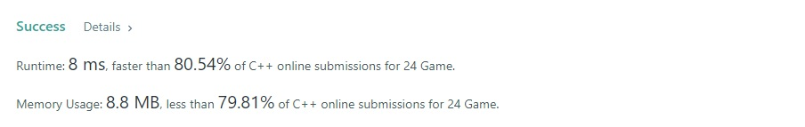
Time and Space Complexity
Thus, we have only 4 cards and 4 operations, let’s see how many possibilities we have to express those. We choose two numbers in 12 (4*3) ways and perform one of 4 operations (12*4), then 3 remaining and we do the same thing, but we already have 6 ways – (6 * 4), then 2 remaining and 2 ways to express – (2 * 4).
So, 12 * 6 * 2 * 4 * 4 * 4 = 9216 ways to calculate 4 cards with 4 operation by using parentheses.
For solving this problem, I used two helper functions.

Slide 9
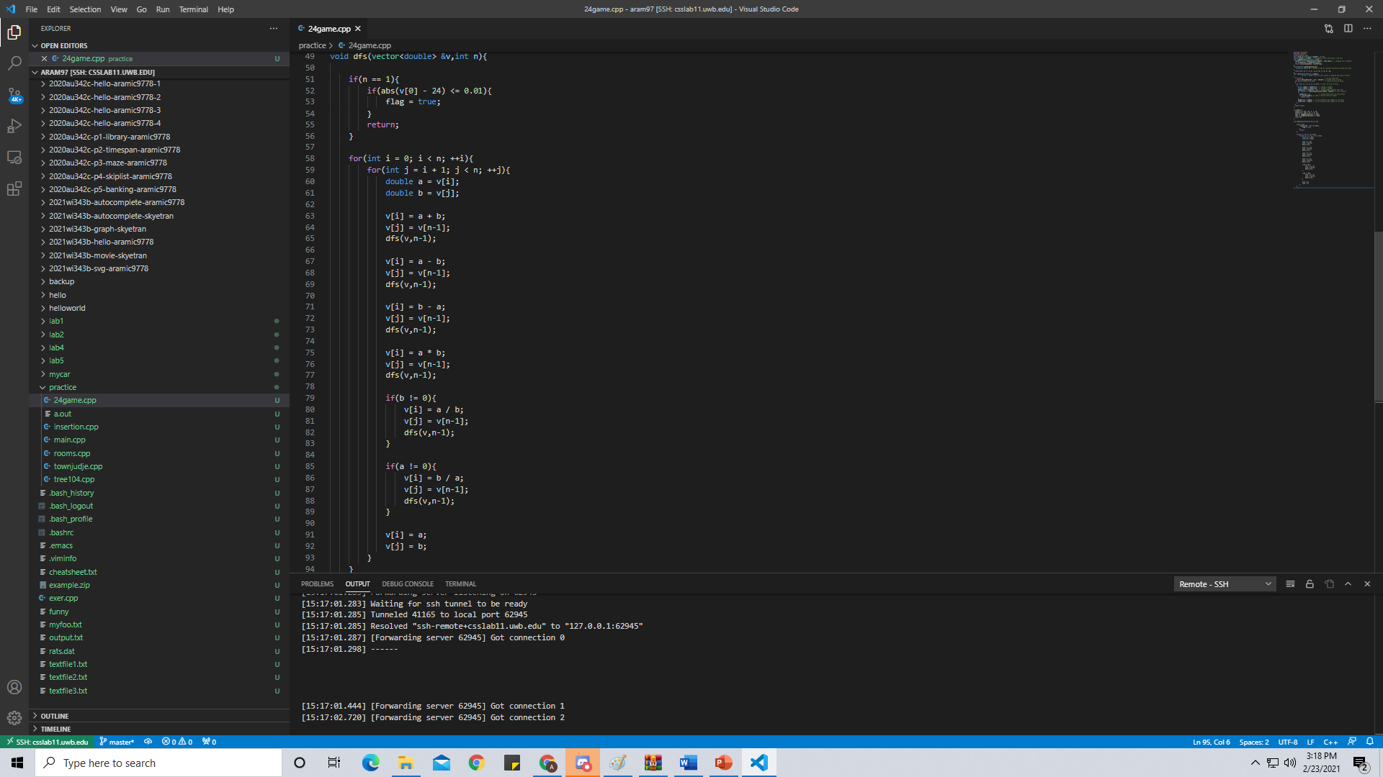
Better Solution for Time Complexity
One helper function instead of two
Two for loops instead of three

Slide 10
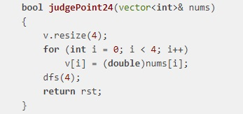
Better Solution for Space Complexity
Best space complexity was 7.2 MB or 7200 KB and main difference between mine and this solution was that we could avoid creating a new vector for double type of variable and also, we can avoid using getAllExpression() method and do everything manually in solve() function.

Slide 11
Thank you for your attention!

