Slide 1

COMATEQ
Made by:
Aramis E. Matos Nieves
Lenier Gerena Meléndez

Slide 2

Models for the Database

Slide 3
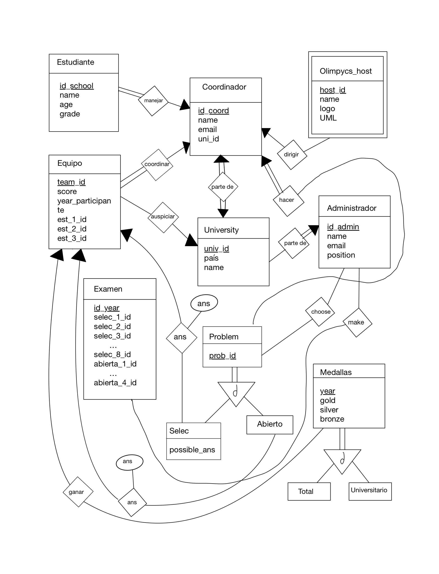
ER Model

Slide 4












MR Model

Slide 5
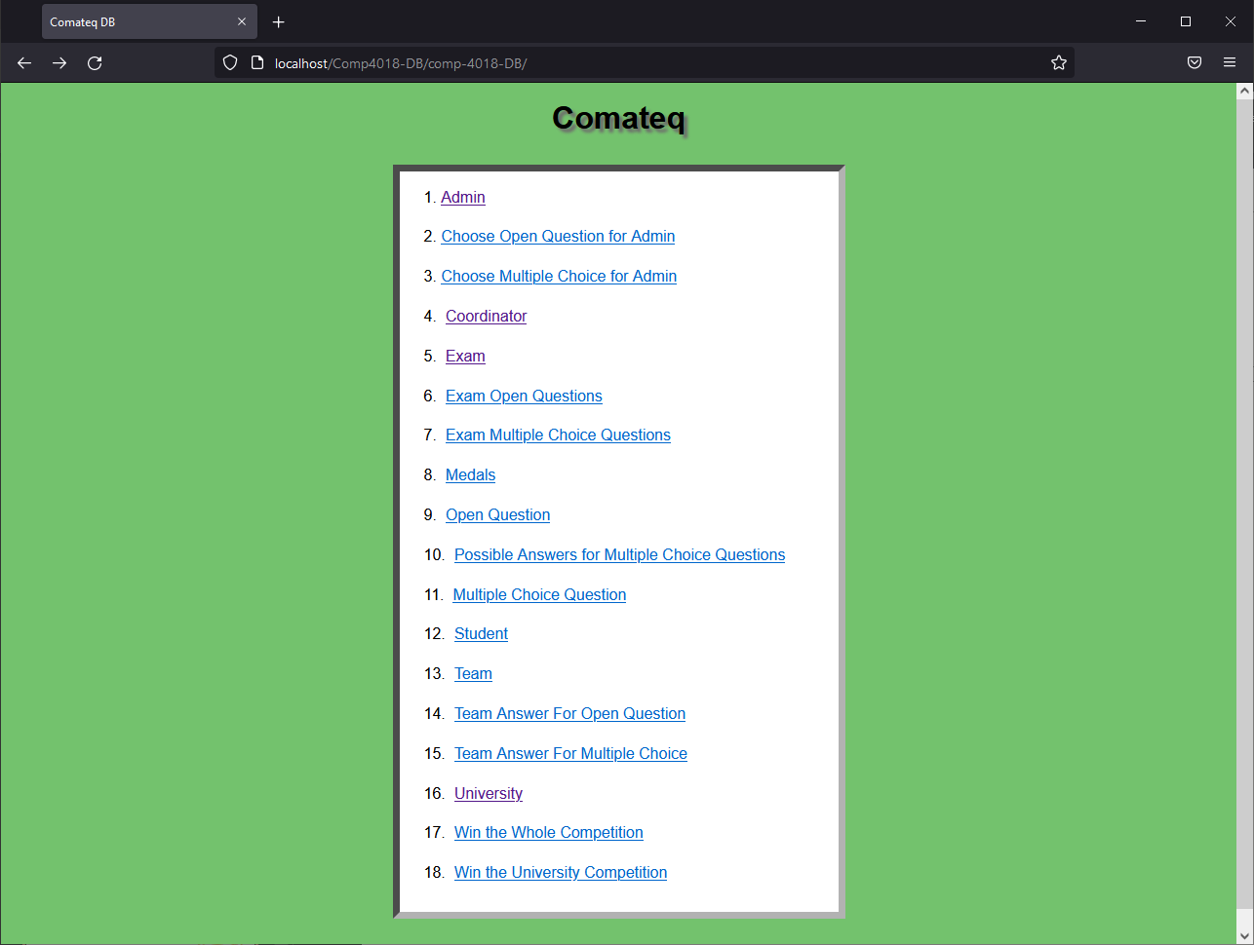
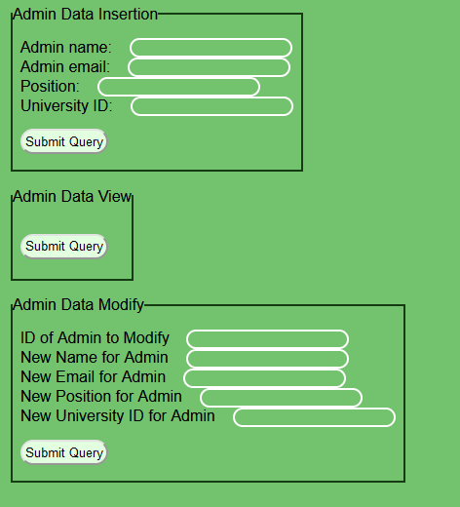
Interface

Slide 6
Interface
Composed of links that lead to different forms to fill out.
These forms will either insert, view, or modify the database tuples.
Viewing is a special case, since its only returning all of the information present within the data base.
These are performed simply by checking which button was pressed and send back via the POST method and sent as an array of inputs that check if the information is correct.

Slide 7
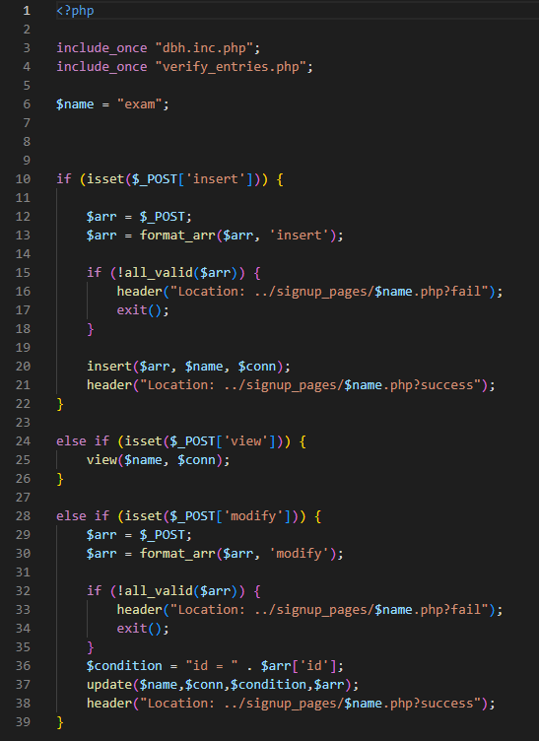
Example: Exam check

Slide 8
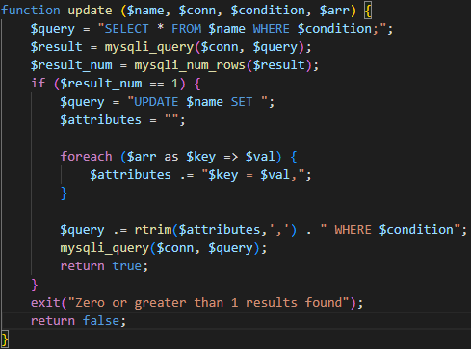
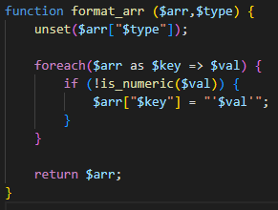
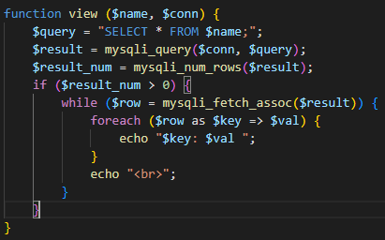
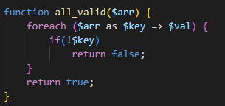
Checks

Slide 9
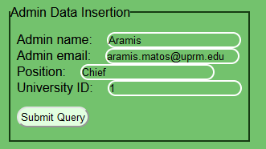

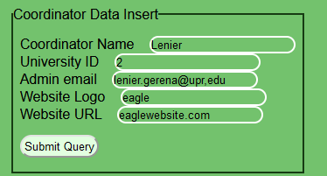

Insertion/View:
Info Inserted:
View Output:

Slide 10
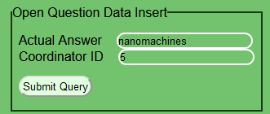

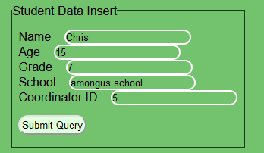

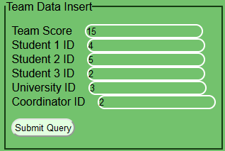

Slide 11
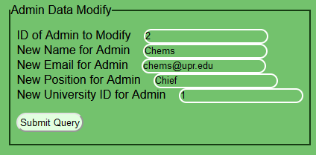

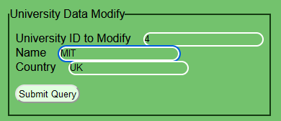

Modify/View:

Slide 12
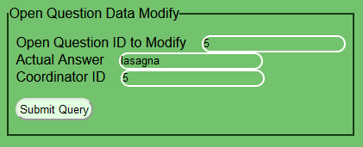

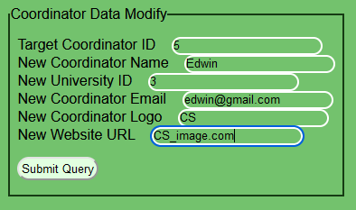


Slide 13

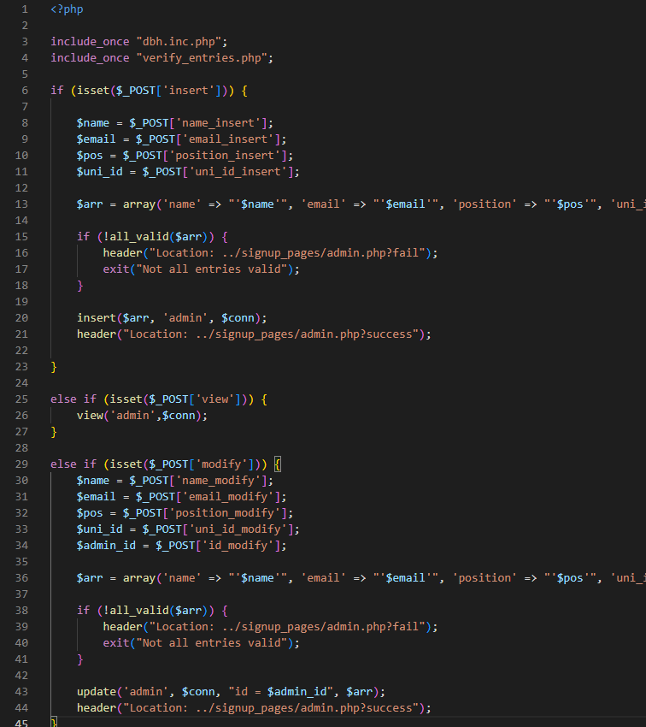
Github site:
https://github.com/aramis-matos/comp-4018-DB

