Slide 1
Inheritance
Chapter 5
Abid Farhan - Technical Consultant

Slide 2
Agenda
1
Model Inheritance
2
View Inheritance

Slide 3
Model Inheritance
1

Slide 4
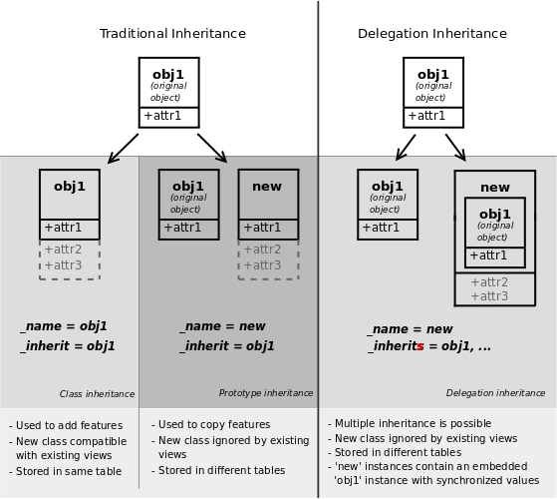
Overview

Slide 5
Types
Models have two fields used for handling inheritance
_inherit
_inherits
We recognise three types of inheritance
Prototype Inheritance
Class Inheritance
Delegation Inheritance

Slide 6
Class Inheritance
Achieved by setting _inherit only
Overrides the parent
No new models are created

Slide 7
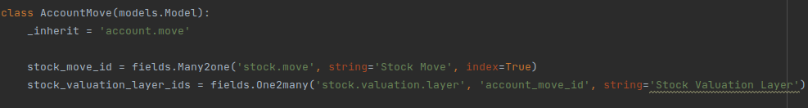
Example
We inherit the account.move model in order to add features to it
All fields added to this class will be added to the inherited/parent class

Slide 8
Prototype Inheritance
Achieved by setting both _name and _inherit fields which are the names of the new model and the parent model respectively
Creates a new model while using the inherited model as a blueprint
Similar to Python inheritance
You could use multiple inheritance by passing an array of strings to _inherit

Slide 9
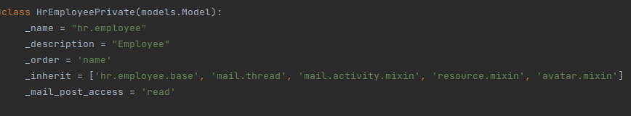
Example
hr.employee model inherits hr.employee.base model via prototype inheritance
All fields and methods of hr.employee.base model are available in hr.employee
Creating a new hr.employee record will not create a new hr.employee.base record

Slide 10
Delegation Inheritance
Achieved by setting _name and _inherits
_inherits takes a dict where keys are parent model names and values are reference field names
Does not inherit methods
Example: product.template and product.product

Slide 11
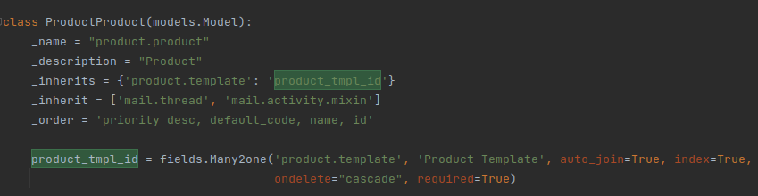
Example
product.product model inherits product.template model
All fields of product.template are available in product.product
Whenever a new product.product record is created, a new product.template record is also created and stored in product_tmpl_id field
Methods defined in product.template are not available in product.product

Slide 12
View Inheritance
2

Slide 13
Extending Views
Views in Odoo are extensible
To define an inheriting view, you need to add the following field to the view definition: <field name=”inherit_id” ref=”parent_view_xml_id”/>
We recognise two different extension modes
Primary: create a new view and leave the original untouched
Extension (default): apply modifications on the original view itself
We cannot write a normal architecture so instead, we use XPathing to insert changes
<xpath expr="" position="">
[changes]
</xpath>

Slide 14
XPathing - expr
An expr is used to locate the node that you wish to modify
//tag find the first tag anywhere
//field find the first field you find
//group//field find the first field that is directly or indirectly under the first group
/tag find a tag which is a direct child
Here are some examples
<xpath expr="/div"
<xpath expr="//group/button"
<xpath expr="//sheet/group//div/field”

Slide 15
XPathing - expr
Nodes could use predicates to get more specific e.g. //tag[predicate]
Pass a number to choose which node to match (index starts from 1)
//field[2] find the second field
//group[2]/field find the first field that is directly under the second found group
You could pass last() - n to match the nth last found tag
Pass hasclass(name<string>) to match a node that has the class name
Use @attr='' to check an attribute e.g. //field[@name=’age’]
Use * as a wild card e.g. //div/*[5]
Here are some examples
<xpath expr=”//group/div[3]//field[@name=’order_id’]”
<xpath expr=”//div[hasclass(‘oe_box_button’)]”

Slide 16
XPathing - position
before: Insert changes before the matched node
after: Insert changes after the matched node
replace: Replace the matched node with the changes
inside: Add the changes after the last child of the root of the matched node
move: Move the matched node to another node location
attributes: Modify attributes of the matched node

Slide 17
Position Move
Used to move the matched node
<xpath expr='some_expr' position='after'>
<xpath expr="//field[@name='age']" position="move"/>
</xpath>
Must move and replace with care
Removal of a node could potentially break if some XPaths are trying to find the node

Slide 18
Position Attributes
Used to add or modify attributes
<xpath expr='some_expr' position='attributes'>
<attribute name='invisible'>0</attribute>
</xpath>
This would fully overwrite an attribute
If you are changing something like domain, you might want to copy the entire old domain and insert your changes within it

Slide 19
Notes
For very simple changes, you can refer to the field instead of writing a full XPath expression
<field name="parent_res_name" position="attributes">
<attribute name="string">Helpdesk Team</attribute>
</field>
For embedded views, you need to specify the original field within the expression
<xpath expr=”//field[@name=’o2m_id’]/tree/field[@name=’target’] position=’before’>
<field name=’my_field’/>
</field>

Slide 20
Sally’s Flower Shop - Part 2
EXERCISE
SOLUTION
CODE

Slide 21
Thank You
💭
Abid Farhan - Technical Consultant

