Slide 1

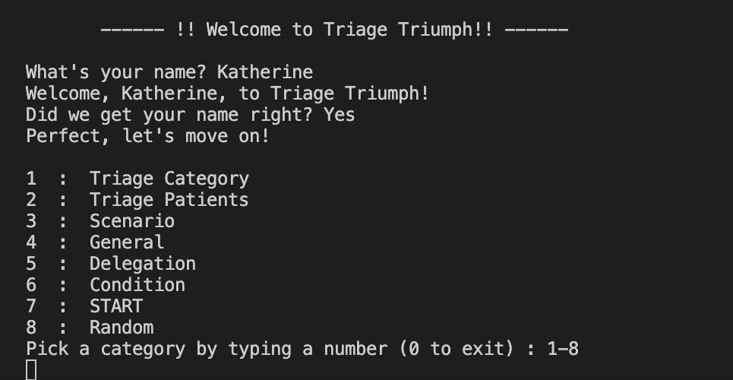
TRIAGE TRIUMPH
A trivia game designed to help future nurses study triage scenarios and prepare for the NCLEX-RN exam
Coded By: Katherine Chadwick and Ashleen Randhawa
Repository URL: https://github.com/ksu-hmi/triage_triumph
Original Code: https://github.com/ksu-hmi/Anatomy-Game

