Slide 1
Pandemic tweet classification
Ishaan Patel

Slide 2
The problem
Sentiment classification of tweets
5 class labels (Extremely Negative to Extremely Positive)
Tweets are about COVID-19 Pandemic
Training dataset: ~ 40,000 tweets
Test dataset: ~ 3800 tweets
https://www.kaggle.com/c/pandemic-tweet-challenge/overview

Slide 3
History of Sentiment Classification
1997: McKeown & Hatzivassiloglou predict the semantic orientation of adjectives
No machine learning used
2004: Pang and Lee apply machine learning to sentiment analysis
Pick out subjective sentences
Naïve Bayes & SVM used -> 86.4% accuracy
2014: Cambridge Analytica makes psychographic profiles of people
Sentiment analysis captured consumer opinions & interests
Allegedly used to influence voter opinion
Notes:
1997 – corpus based approach
2014: mention that they were given a crap ton of facebook data

Slide 4
The approach
Goal: Compare different approaches to sentiment classification
Solve the problem with
Basic RNN
Bidirectional RNN
1D CNN
Compare accuracy, efficiency, advantages of different techniques

Slide 5
The design
Data: Training & test data from Kaggle
Imported libraries: TensorFlow/keras, Pandas, NumPy, Sklearn, NLTK
Overall steps
Preprocess data
Obtain word embeddings
Build neural networks
Train networks
Evaluation: F1 score (precision & recall)

Slide 6
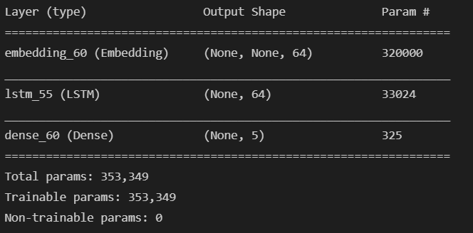
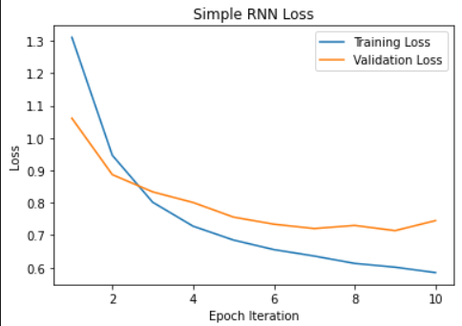
The simple rnn
Used dropout to improve accuracy
+ Can remember information through time (LSTM)
+ Quick enough to train
Vanishing/exploding gradient problem
Not really an issue here
F1 Score: 0.8094

Slide 7
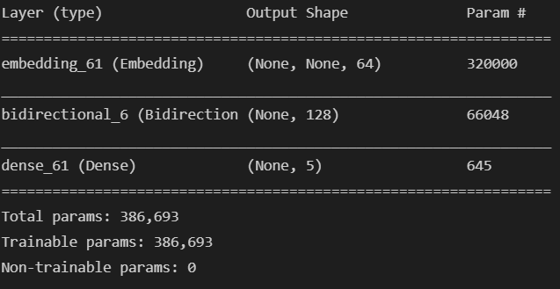
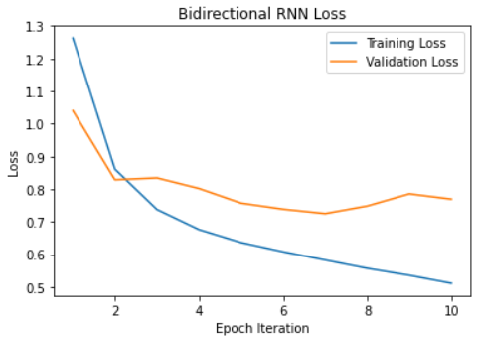
The bidirectional rnn
Used dropout to improve accuracy
Longer training time
+ LSTM for remembering information through time
+ Theoretically more accurate than simple RNN
+ Forward & Backward RNN
F1 Score: 0.80106

Slide 8
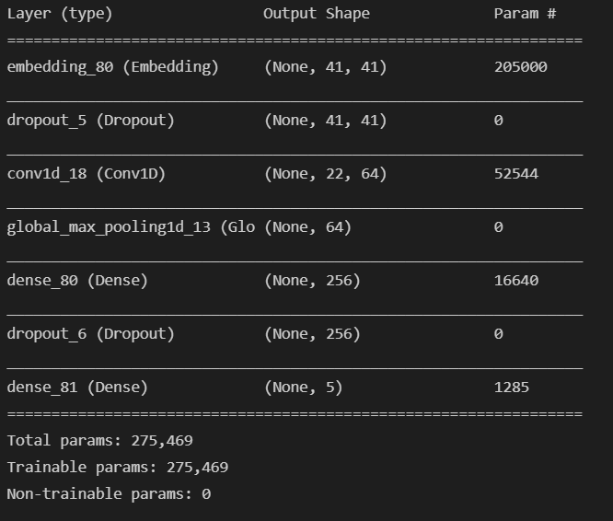
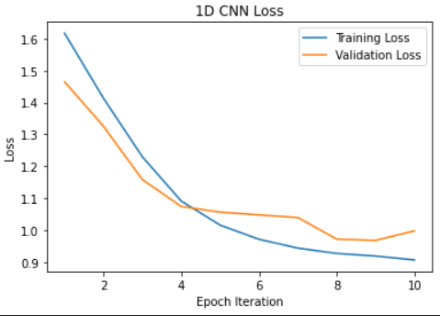
The 1D Cnn
+ Very fast training time
- Not as accurate as RNN
Overfits quite easily
Regularization required
Used dropout for accuracy improvement
F1 Score: 0.78292

Slide 9
Analysis of Results
Neural Network | Training loss | Validation Loss | Training Accuracy | Validation Accuracy | F1 Score
Simple RNN | 0.5844 | 0.7449 | 0.8047 | 0.7504 | 0.8094
Bidirectional RNN | 0.5115 | 0.7694 | 0.8281 | 0.7463 | 0.80106
1D CNN | 0.9073 | 0.9982 | 0.7403 | 0.7209 | 0.78292

Slide 10
More Analysis of Results
Neural Network | Extremely Negative | Negative | Neutral | Positive | Extremely Positive
Simple RNN | 523 | 1006 | 616 | 1029 | 624
Bidirectional RNN | 504 | 1018 | 631 | 1084 | 561
1D CNN | 397 | 1152 | 712 | 1067 | 470

Slide 11
Some remarks
More data may have been needed to see differences in models
Could have reduced overfitting a bit more to improve accuracy
Additional layers to improve accuracy
Kaggle only gave F1 score for evaluation

