Slide 1
Chessy — RandomForest Chess Engine with GUI
Lightweight chess engine + Tkinter GUI | Team: [Your Name] (Maker) | Guide: [Advisor Name]
Demo + Source: c:\\Users\\91738\\OneDrive\\Desktop\\coding\\Chessy

Slide 2
Problem Statement & Objective
Problem: Casual players lack an interpretable, fast local engine
Objective: RF-based move prediction + minimax with custom eval
Constraint: Runs locally, minimal deps, responsive GUI

Slide 3
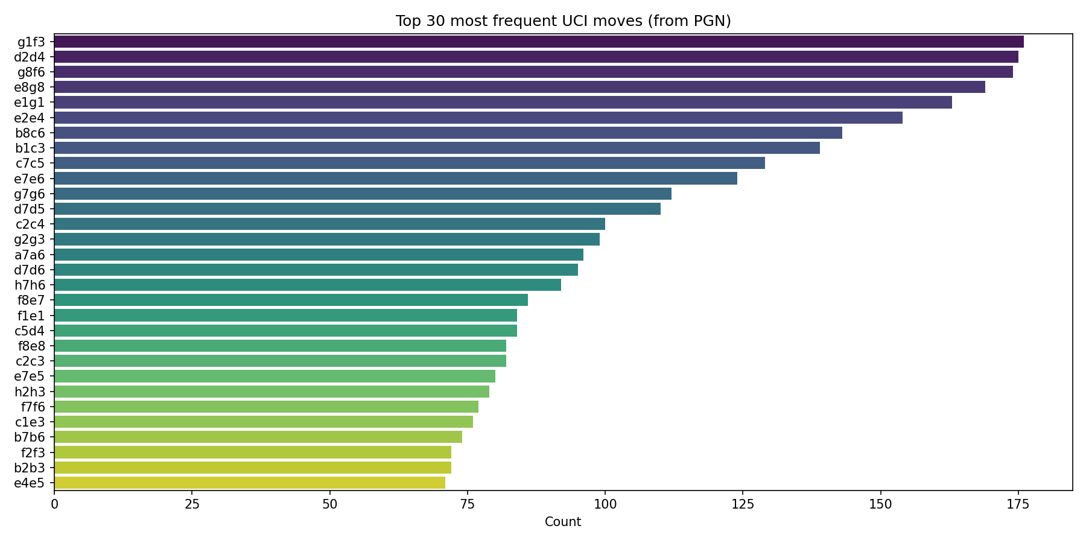
Dataset Description
Source: PGN historical games (data/sample.pgn)
Granularity: positions -> moves (UCI strings)
Features: board encoding + engineered features
Target: next move index (data/vocab.json)

Slide 4
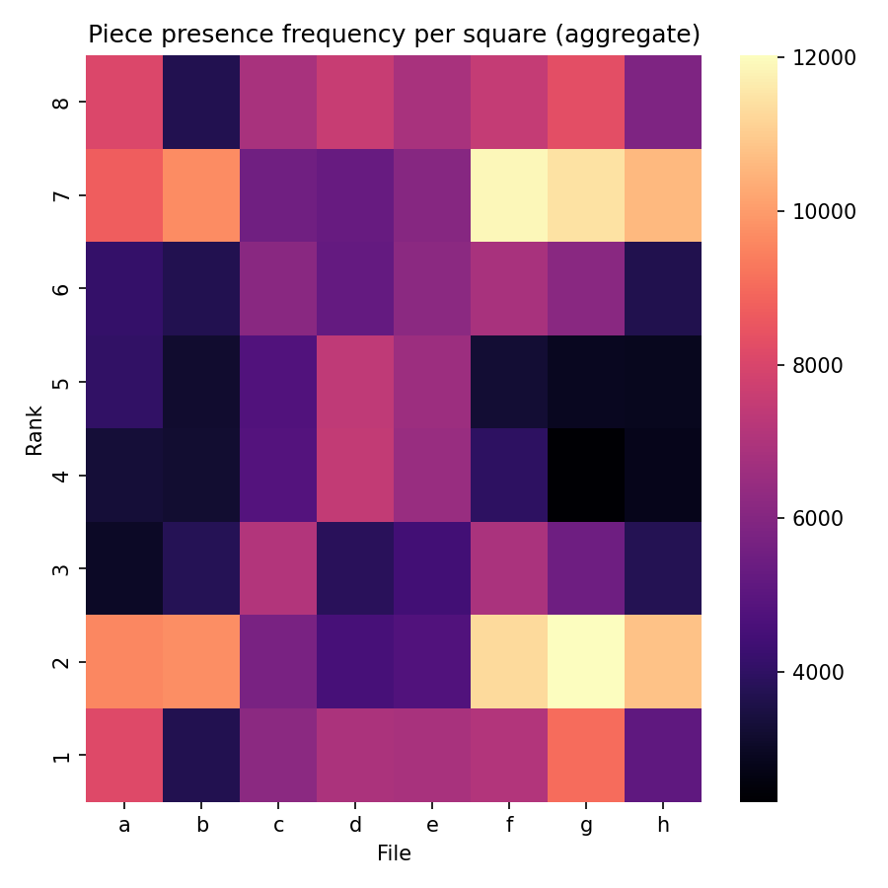
Data Cleaning & EDA
Parse PGN -> positions; build vocab (vocab.py)
Encode board; compute features (train.extract_features)
Saved dataset as NPZ (preprocess.py)

Slide 5
Model Selection & Justification
Key numbers (short bullet set):
  Training positions saved: 100,000
  Eval sample used: 2,000 (sampled)
  Distinct move classes observed in eval: 810
  Inference speed (CPU): ~0.184 ms per sample (≈0.37 s for 2k samples) — excellent for responsive GUI
  Raw top-1 accuracy (all classes): 0.1% — reflects large multi-class space and heavy-tail distribution
  Raw top-3 accuracy: 0.2%; raw top-5: 0.25%
  Observation: top-k over legal moves (legal-aware metric) recommended — this will be our next evaluation step
Short justification paragraph (for speaker notes)
  "We chose Random Forest for the initial engine prior because it is CPU-friendly, fast at inference, easy to interpret (feature importances and tree inspection), and quick to train with scikit-learn. This makes it ideal for a local demo where we want to combine a lightweight ML prior with a deterministic minimax search. While the RF baseline has low raw top-k accuracy across the full UCI move space, this is expected given the extremely large, imbalanced label set; we plan to improve effective gameplay by masking to legal moves and adopting a hierarchical or candidate-scoring approach."

Slide 6
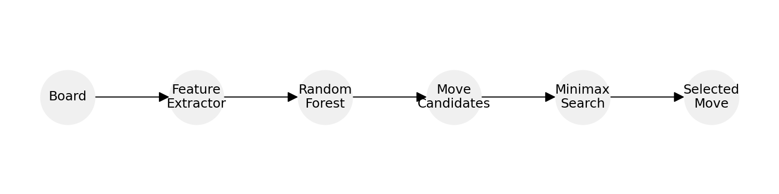
Hyperparameter Tuning & Evaluation
Tuning: manual/grid-like (max_depth, min_samples_leaf, n_estimators)
Example: max_depth=12, min_samples_leaf=10, n_estimators=30
Report: test accuracy / qualitative gameplay

Slide 7
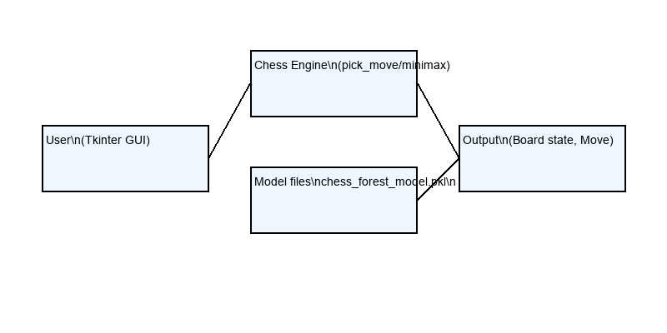
Deployment & Architecture
Local desktop app: Python + Tkinter GUI
Core files: vocab.py, preprocess.py, train.py, play.py, chess_gui.py

Slide 8
GUI Demo / Screenshot
Drag & drop moves; text-entry; SAN move history
Bot thinking indicator and status bar

Slide 9
Results & Performance Metrics
Training time, test accuracy (~X%)
Average bot move time by phase (e.g., depth=3 -> ~1-3s)

Slide 10
Conclusion & Future Scope
Achievements: local engine + GUI
Future: PGN export, time controls, stronger eval, headless tests

