Slide 1
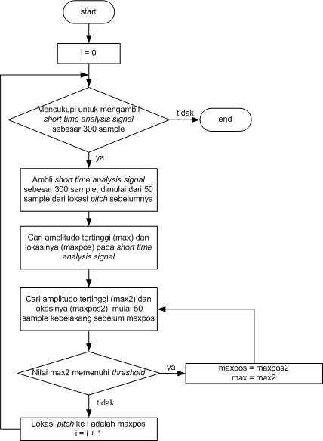
Flowchart proses pencarian lokasi pitch

Slide 2
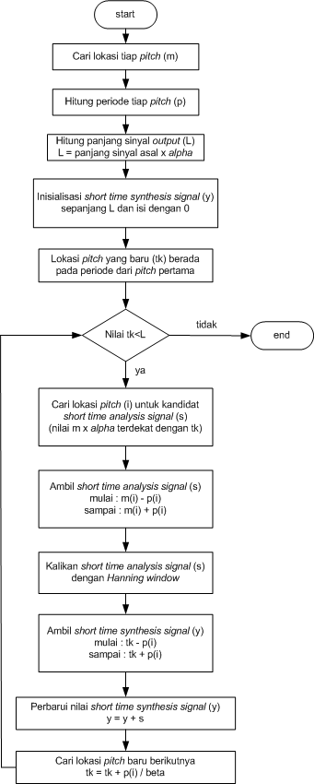
Flowchart algoritma TD-PSOLA

