Slide 1
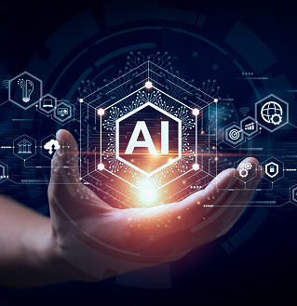
Machine learning Workshop
Arang

Slide 2
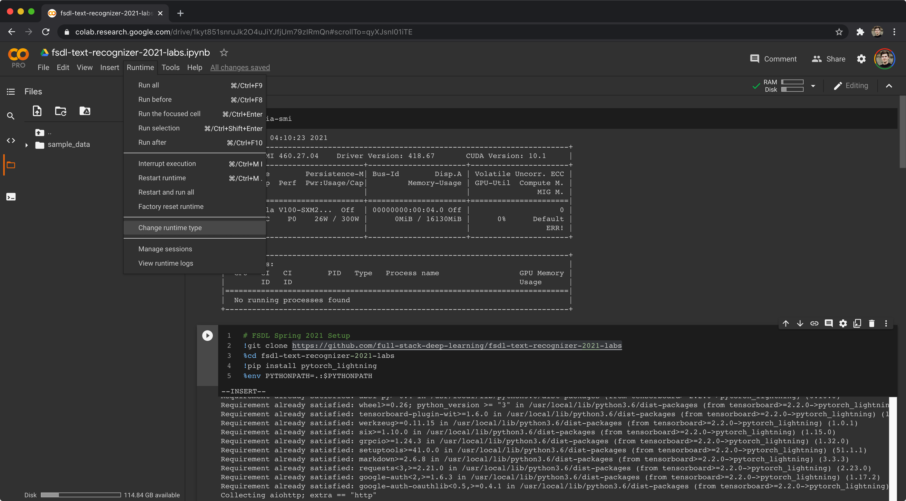
colab

Slide 3
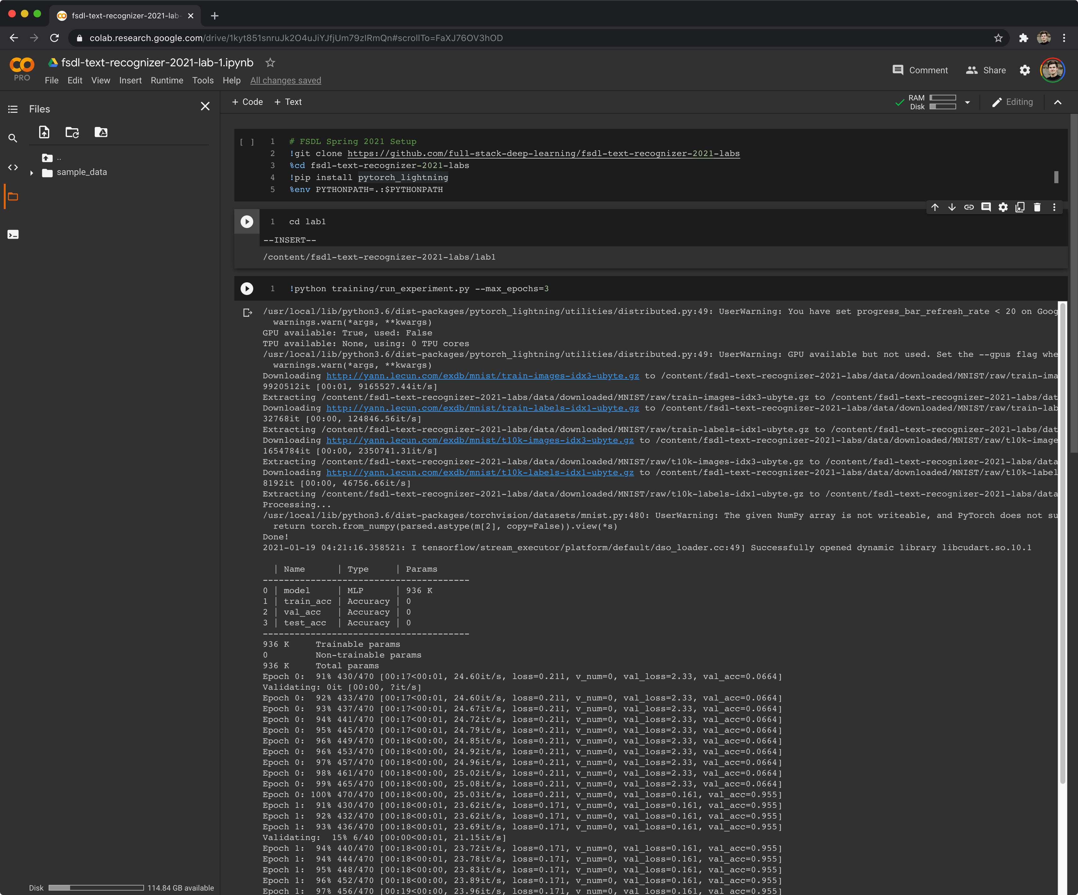
colab

Slide 4
Thank You!

